Slide 1
Smart Contract
Upgradable Smart Contract Pattern
Welcome to the presentation!
By Van Cuong Bui
1

Slide 2
Outline
Abstract
Relating Works
Our approach
Conclusion
Suggestion for next researching areas
Demonstration
References
2

Slide 3
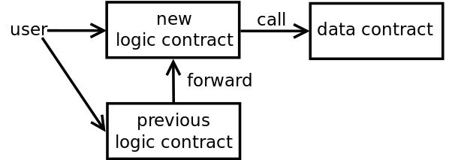
Relating Works
B. Data Segregation Contract Pattern
The contract will be separating into:
logical contract
data contract
https://blog.trailofbits.com/2018/09/05/contract-upgrade-anti-patterns/
3

Slide 4
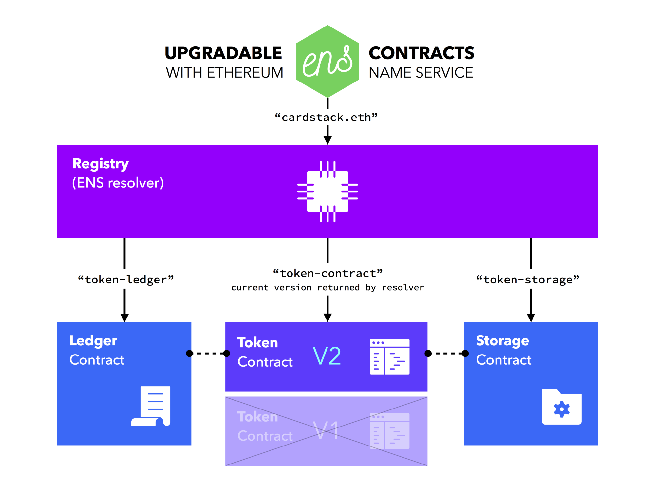
Relating Works
A. Register Contract Pattern
The registry contract performs the bookkeeping necessary to keep track of the shared contract state
4

Slide 5
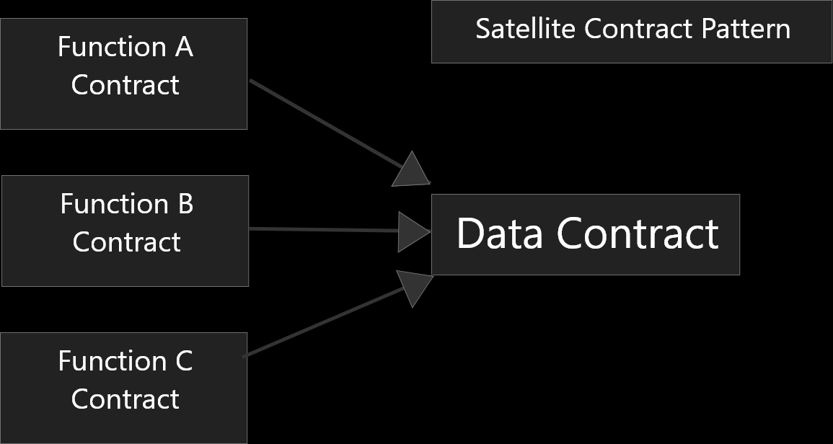
Relating Works
C. Satellite Contract Pattern
Separating the contract into:
base contract,
Functions of this contract into other namely satellite contracts.
5

Slide 6
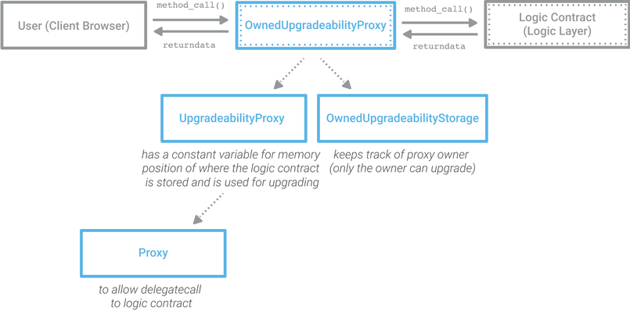
Relating Works
D. Delegate-call-based proxy pattern
6

Slide 7
Problem Statement
It is not scalable for current approach
Re-entry attacks would be a big issue
DoS attacks would be another issue
7

Slide 8
Research questions
How effective the Middleware Contract Pattern in terms of Security
How scalable the Middleware Contract compare to current approaches.
8

Slide 9
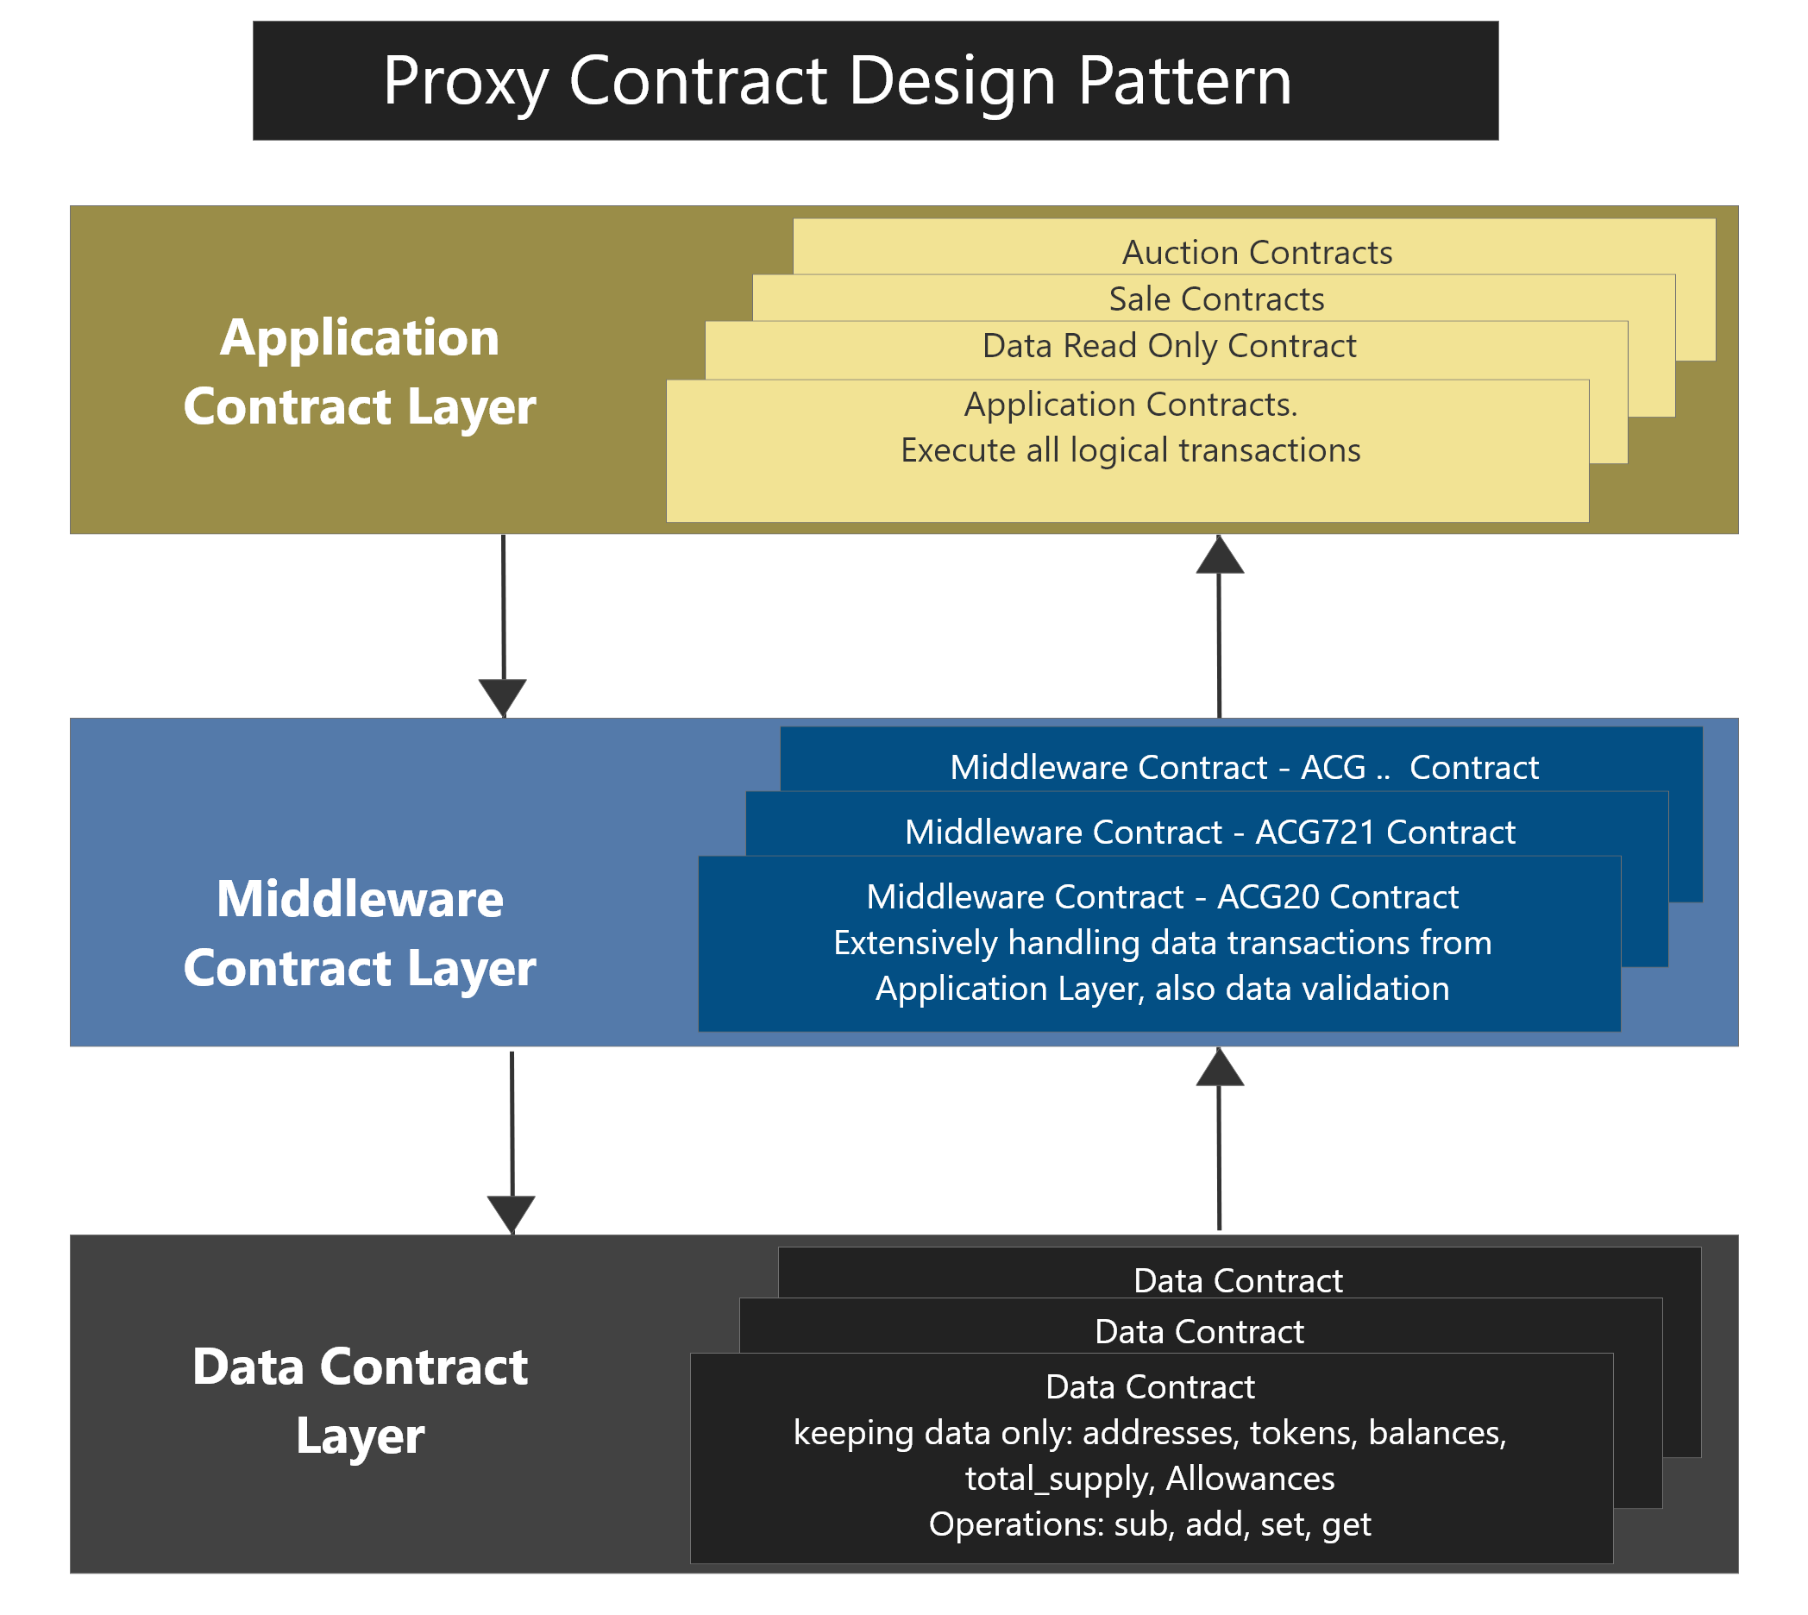
Aim of the research
Middleware Contract Pattern Approach:
Upgradability
Scalability
Security
9

Slide 10
Upgradable Ability
Data contract
Permanent data states
Temporary changes on data states
Middleware contracts
do not hold any data states
Data validate
Authorization
Token-based operations
Application contracts:
All logical operation
openly
10

Slide 11
Aim of the research
Scalable problems
Problems with current approach:
Block size limit: 4Mb
EVM Node resources limit: Storage, CPU, RAM
Single Chain Limitation
Gas Limit.
TPS limitation
https://energyweb.org/2018/05/10/when-it-comes-to-throughput-transactions-per-second-is-the-wrong-blockchain-metric/
11

Slide 12
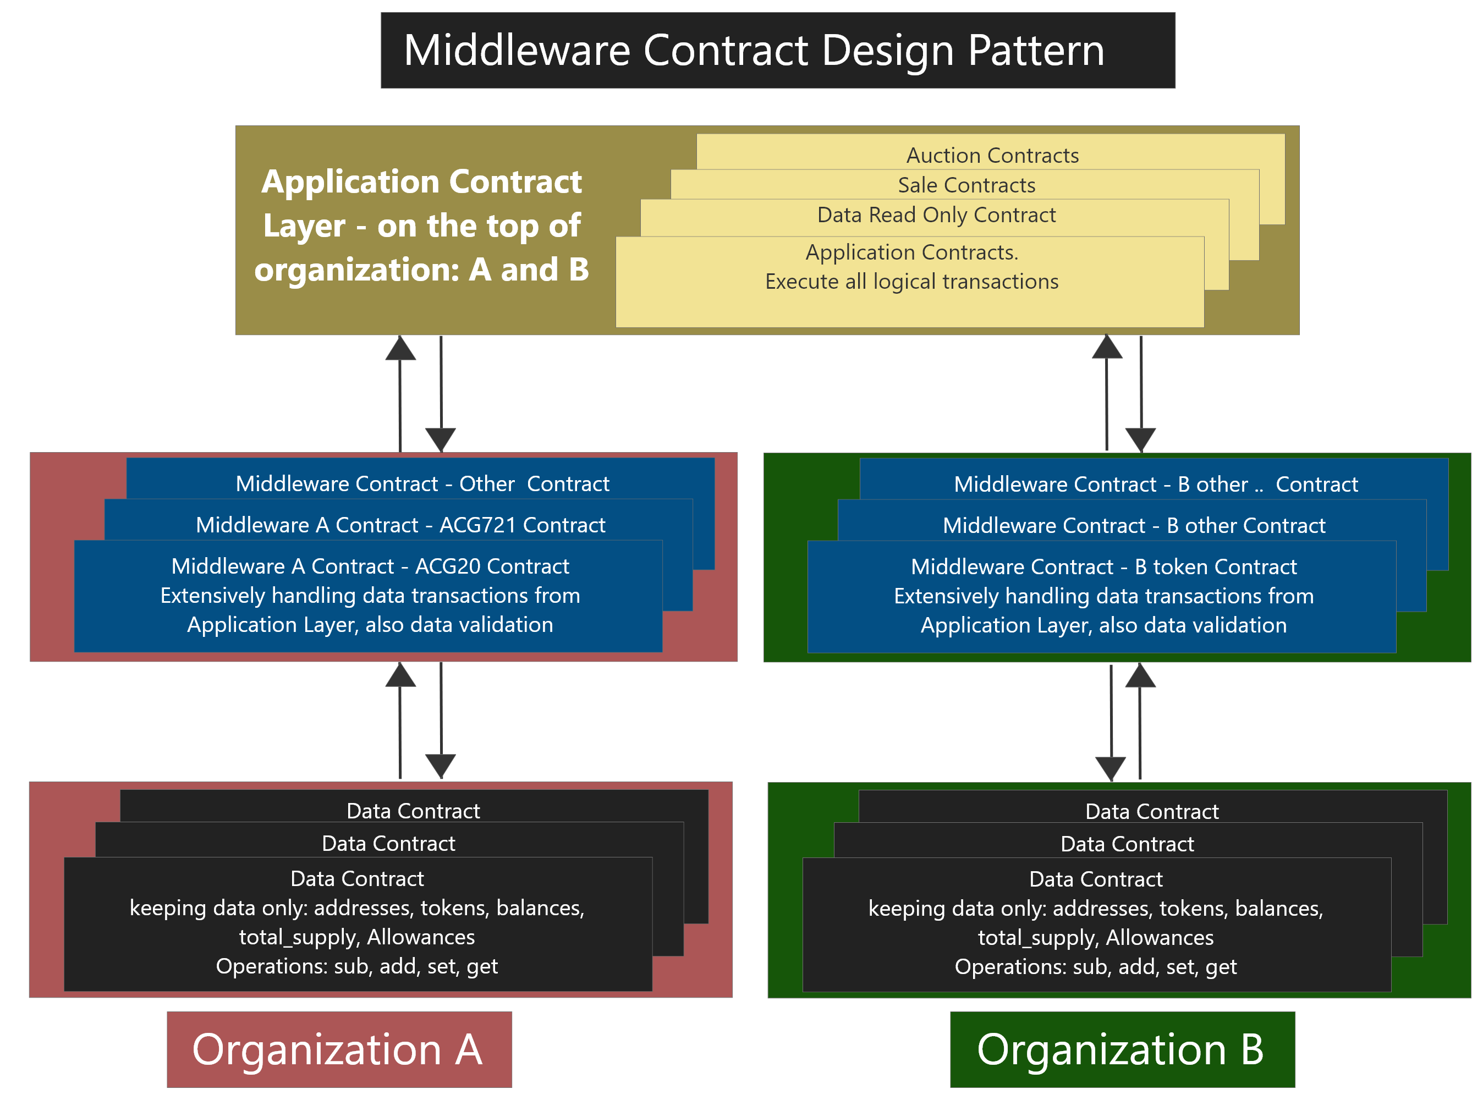
Aim of the research
Scalable by implementing:
para-data Contract
https://energyweb.org/2018/05/10/when-it-comes-to-throughput-transactions-per-second-is-the-wrong-blockchain-metric/
https://polkadot.network/#howitworks
12

Slide 13
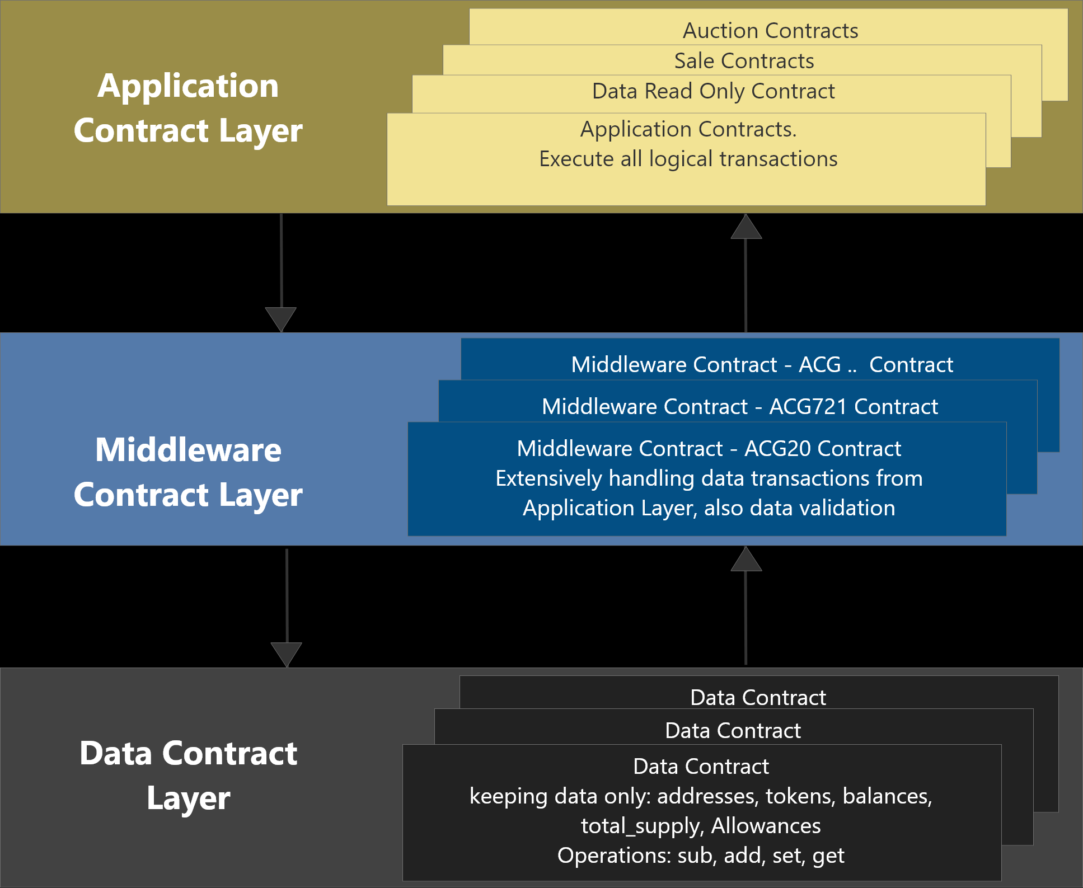
Aim of the research
Scalability achieving by flexibility on:
Application Layer: open for everyone to write and deploy
Middleware layer: authorized.
13

Slide 14
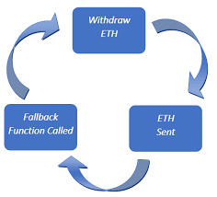
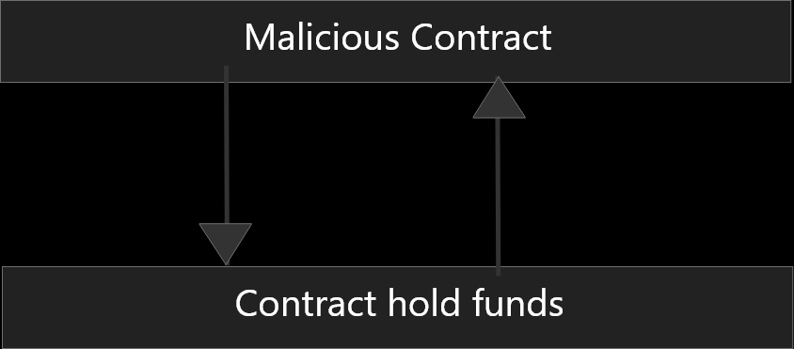
Aim of the research - Security
Re-entrance attacks
Reference: https://hackernoon.com/smart-contract-attacks-part-1-3-attacks-we-should-all-learn-from-the-dao-909ae4483f0a
14

Slide 15
Aim of the research - Security
Re-entrance attacks - example
mapping (address => uint) private userBalances;
function withdrawBalance() public {
uint amountToWithdraw = userBalances[msg.sender];
require(msg.sender.call.value(amountToWithdraw)());
// At this point, the caller's code is executed,
//and can call withdrawBalance again
userBalances[msg.sender] = 0;
}
Reference: https://consensys.github.io/smart-contract-best-practices/known_attacks/
15

Slide 16
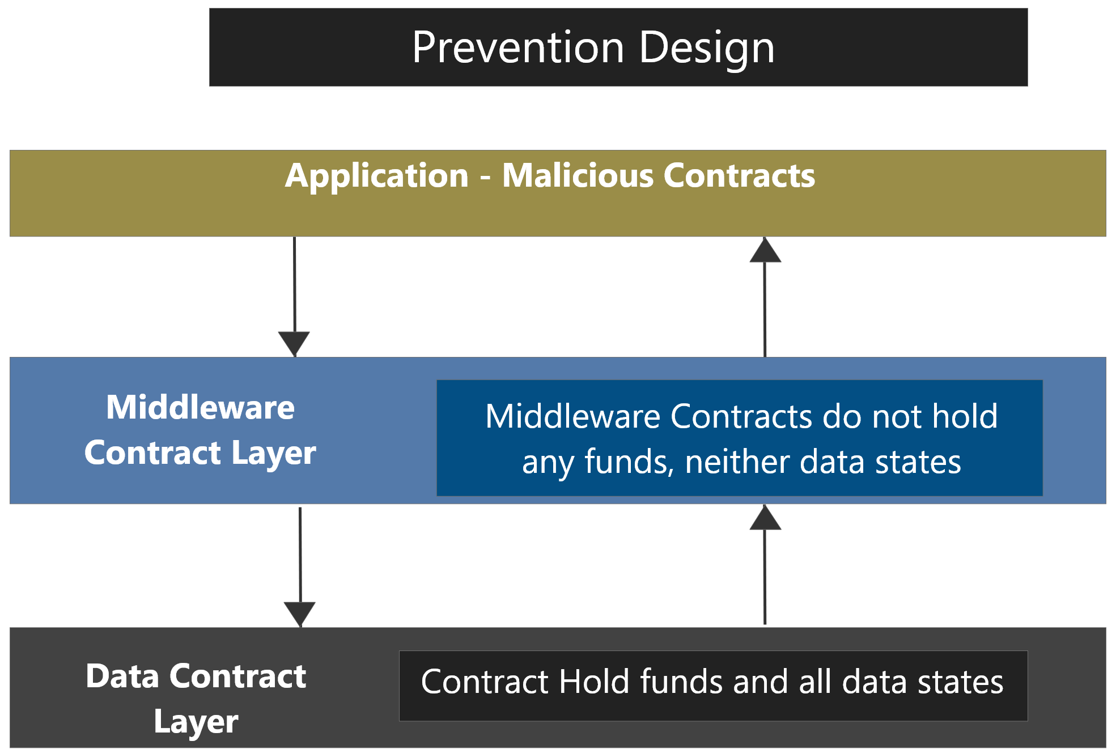
Aim of the research - Security
How our design can solve re-entrance attacks:
- No funds, data on middleware contract layers
16

Slide 17
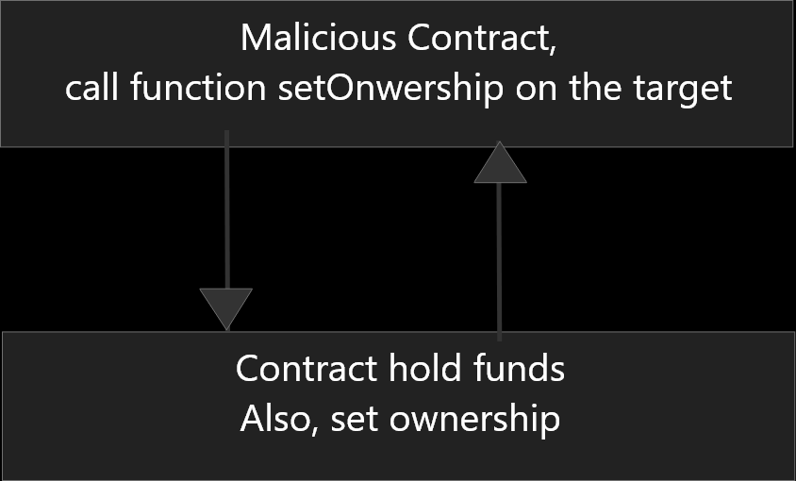
Aim of the research - Security
Risk of exploiting bugs on contract
A bug in the contract allow other contracts to
set the ownership of original contract
executing any functions of the contract
https://blog.zeppelin.solutions/on-the-parity-wallet-multisig-hack-405a8c12e8f7
17

Slide 18
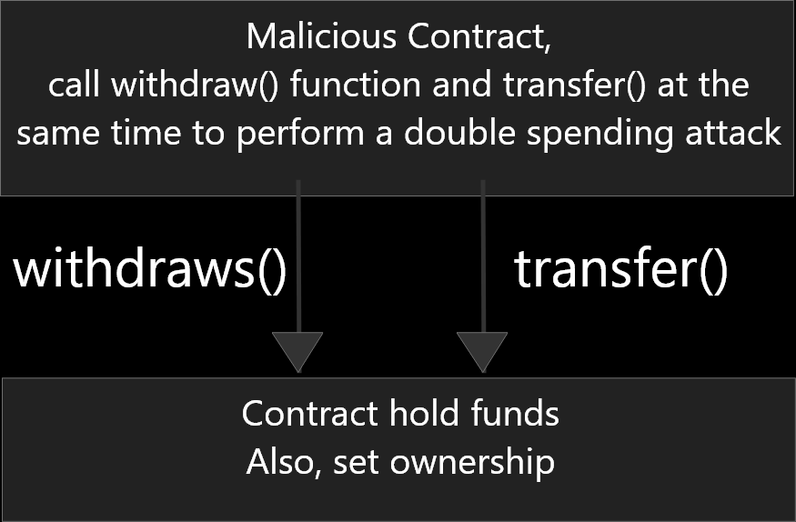
Aim of the research - Security
Cross-function race condition attacks
Not properly validating data, allow attacker perform double spending:
Withdraw funds
Transfer funds
18

Slide 19
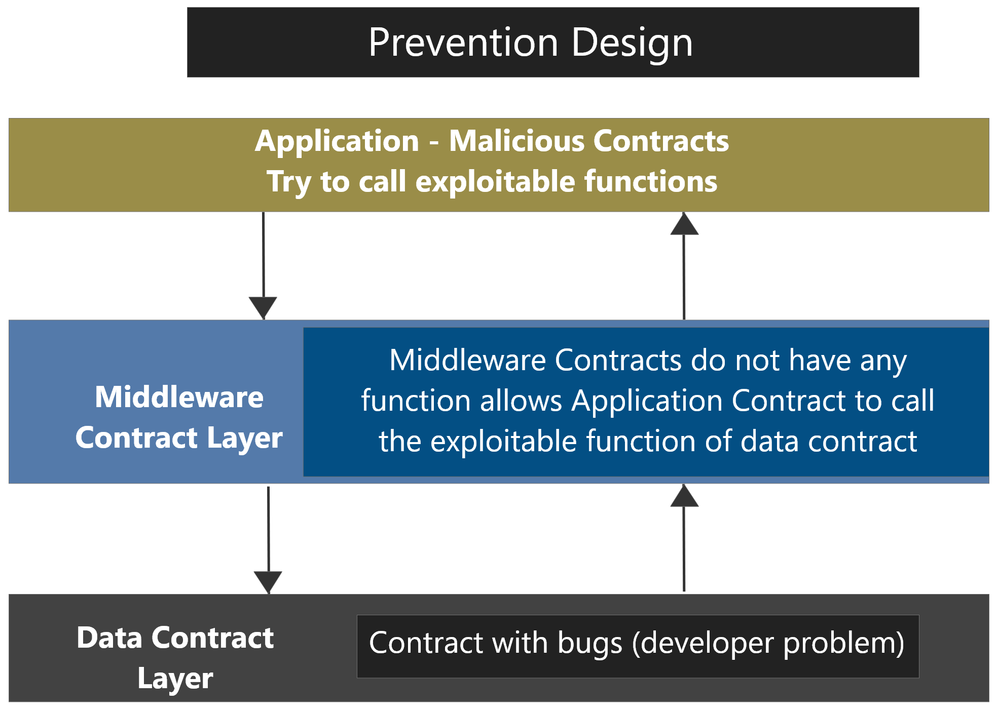
Aim of the research - Security
How our design reduce the risk of this attack:
Any call() to data contract will create a new call from middleware to data layer.
The call() from middleware to data contracts will be validate each time.
19

Slide 20
Aim of the research - Performance
To assess the performance of the new approach based on TPS, CPU and RAM consumption
20

Slide 21
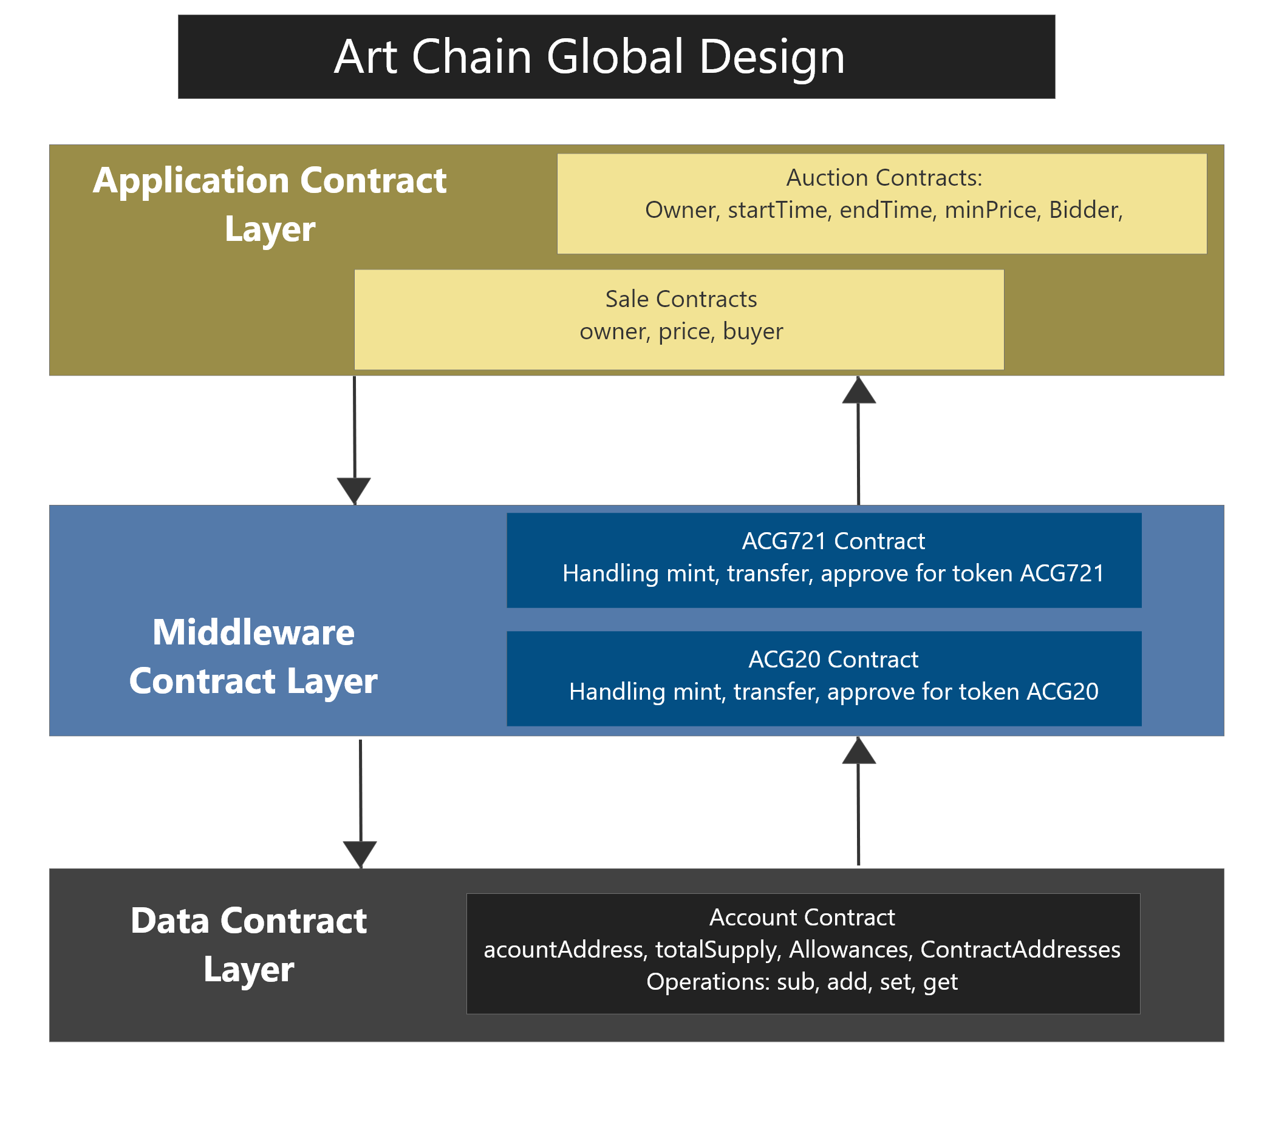
Experiment Design
Contract design
Account Contract
ACG20 Contract
ACG721 Contract
Sale Contract
Auction Contract
21

Slide 22
Implementation Design
AWS Ubuntu servers
Ali Ubuntu servers
4 super nodes
Data contract on 1 super node
Middleware contracts on 2 super node
Application on 1 other node
22

Slide 23
Conduct the experiment
Pretest
Treatment
Post Test
Result Evaluation
23

Slide 24
How data being collect and analyse
Validate data:
Transaction type
Time
Collect data:
TPS
Percentage of using resources
Data Analysing:
Comparing with baseline, other approaches.
24

Slide 25
Conclusion
Problem statement
Aim of the research
Research Questions
Presenter Qiao Yang
25

Slide 26
Q & A
Thank you for attending
http://www.mdpi.com/1999-5903/10/3/23/htm
26

Slide 27
REFERENCES
https://blog.trailofbits.com/2018/09/05/contract-upgrade-anti-patterns
https://blog.zeppelinos.org/proxy-patterns/
27

