Slide 1
Cyclistics User Conversion From Casual Riders to Subribers
Prepared by Dac-Thanh Van
Date: Oct 19th, 2022

Slide 2
Outline
Business task
Data Description
Data Manipulation
Analysis Summary
Key findings
Recommendations

Slide 3
1. Business Task
Using data from Cyclistics, finding important insights between casual riders and subscribers in order to assist conversion.

Slide 4
2. Data description
Trip Data from September 2021 to September 2022 were selected for this analysis.
The data was downloaded from https://divvy-tripdata.s3.amazonaws.com/index.html
Personal information of users was removed to ensure confidentiality agreement.

Slide 5
3. Data Manipulation
For data processing in this step, python was used to combine the csv into one file for ease of processing.
Time from started_at and ended_at columns were converted to calculate duration.
Distance between start and end was calculated.
All calculations are stored in data_processing.py

Slide 6
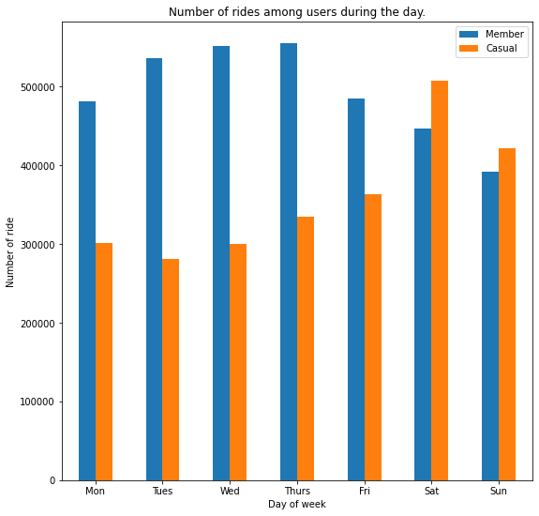
4. Analyze
During weekday, member rides are more frequent compared to casual riders.
Weekends shows a significant rise of casual users.
Figure 1. Rides throughout the week for the past 13 months (9-2021 to 9-2022)

Slide 7
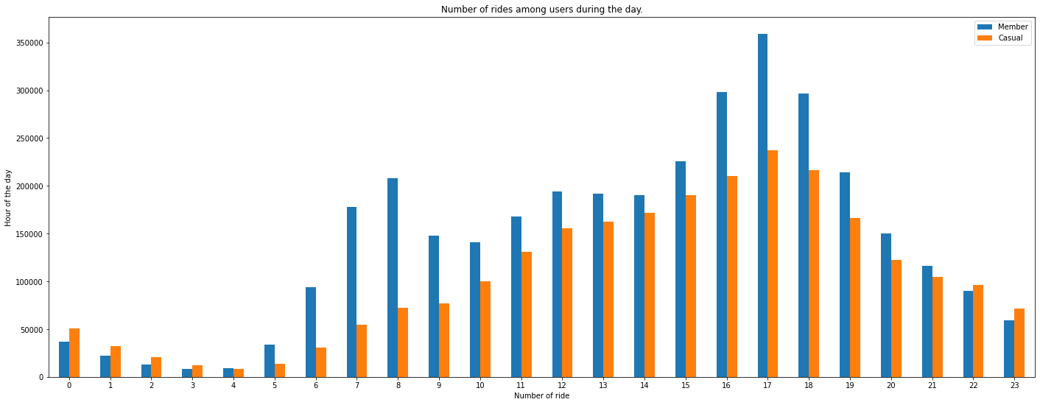
4. Analyze (cont)
Figure 2. Ride frequency throughout the day from 9/2021 to 9/2022.
From 6AM, rides increase to 6PM and gradually falls to 12PM.
Member ride spikes up at 6 -8AM and from 4-6PM as time to work and off work. While casual rides follow a gradual increase and fall patterns.

Slide 8
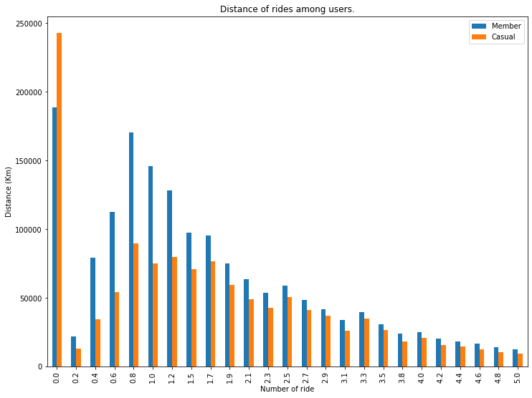
4. Analyze (cont)
A significant number of users takes short trip of less than 200 meters.
Number of users increases from 0.2 Km and reaches highest at 0.8-1 km

Slide 9
Recommendations
Deploying a discount program that converts casual to member riders using 3 conditions can improve the number of Cyclistics’ membership quantity:
Discount to member users during weekend to attract more casual conversion.
Discount to member users from 4PM to 7PM to take advantage of highest number of casual users.
Discount to member users for ride less than 300 meters.

Slide 10
Questions and Answers

