Slide 1
Multiparticle Quantum Random Walk Simulator
B.Tech Mini Project
202001023 – Vandan Patel
Guided by
Prof. Gautam Dutta

Slide 2
Motivation
Inherent Curiosity in Quantum Systems
Counterintuitive Behaviors in Quantum Mechanics
Potential for Developing Novel Quantum Algorithms
Bridging the Gap Between Theory and Practice
Addressing the Motivational Gap
Continuous Exploration of Quantum Phenomena
Inspiration for Future Research

Slide 3
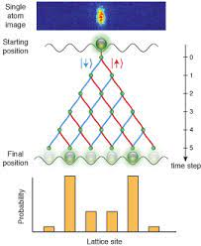
Objectives
Objective 1: Implementation of Quantum Random Walk Simulator
Objective 2: Exploration of Entanglement in Quantum Walks
Objective 3: Parameter Analysis for Quantum Walks

Slide 4
Tools & Technology
Language: Python
Library: Qiskit
Quantum Computing Hardware

Slide 5
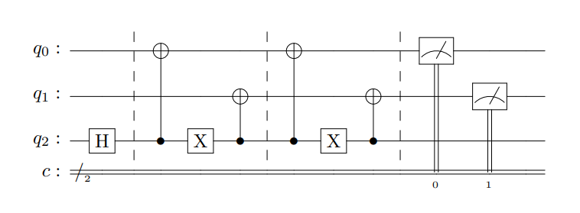
1 particle DTQRW for 2D cube
Qubits q0 and q1 represents position space of the particle
Qubit q2 represents the coin space of the particle
The Quantum Circuit for 1 particle DTQRW on 2D cube

Slide 6

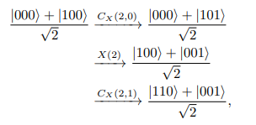
1 particle DTQRW for 2D cube
The system is initialized to (H ⊗ I ⊗ I) |000⟩, where I is the identity operator. Since,
the system is thus initialized to |D⟩ |00⟩.
The application of U to this initial state evolves the system to the quantum state ( |110⟩+|001⟩ ) / √2 as shown below.

Slide 7
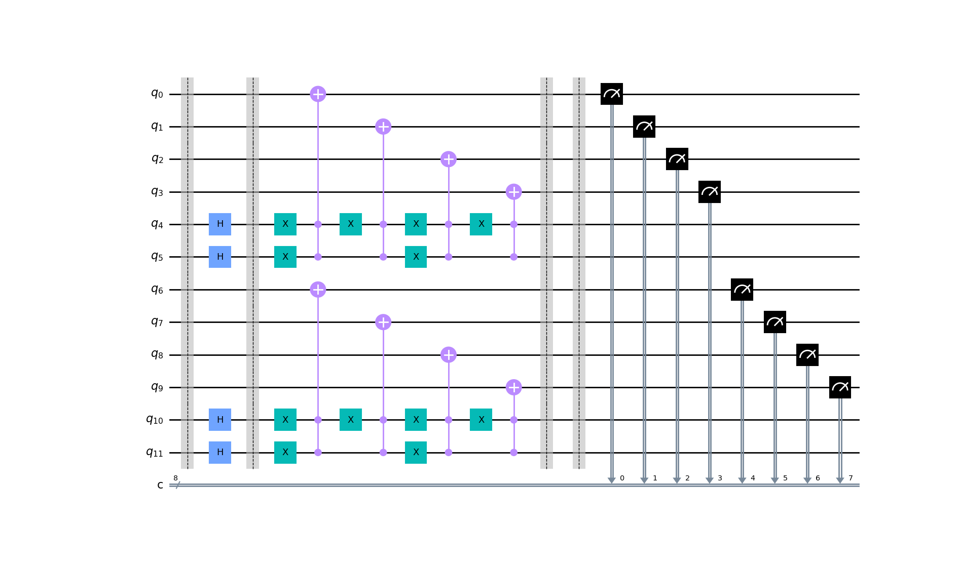
Qiskit Circuit for 2 particle DTQRW on 4D hypercube with Hadamard coin operator for 1st step

Slide 8
Simulator design
Parameters
Number of particles
Number of steps
Initial Coin Space
Initial Position Space
Coin Operator
Outputs
Histogram plot
Joint Probability Distribution graph
Average distance graph between 2 particles (Specifically for 2 particles)

Slide 9
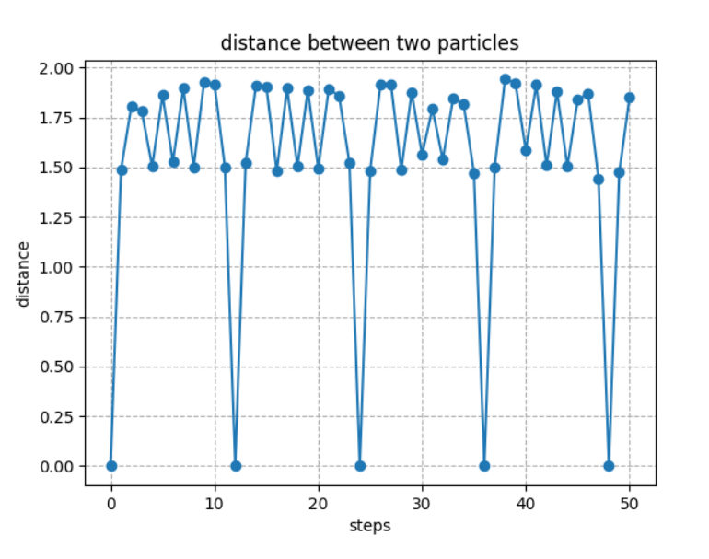
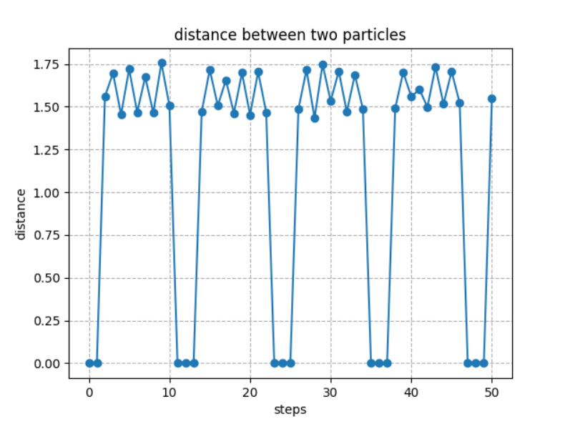
Graph depicting the average distance between two particles on a 4D hypercube with the Grover coin operator
The entangled Case
The unentangled Case

Slide 10
Project phases
August
Literature Review and Initial Research
September
Development of Simulator
Parameter Analysis Setup and Debugging
November
Visualization techniques Exploration and Data Analysis
October

Slide 11
Challanges
Quantum Noise and Errors
Optimizing Quantum Circuits
Integration with Qiskit Features
Visualization of Evolution of Multiple Particles

Slide 12
Future Scope
Extension to Higher-Dimensional Spaces
Exploration of Advanced Quantum Walk Applications
Integration with Quantum Machine Learning
Quantum Error Correction in Simulatio
Optimization of Quantum Circuits
Collaboration with Experimental Quantum Platforms

Slide 13
Thank you!

