Slide 1
INDIAN BUSINESS SALES
Executive Analytics Report | W11D2
Executive reporting with Plotly and python-pptx
Analysis covers 128,975 dataset rows
Focus: category performance, order status, monthly patterns and geography
Prepared as a descriptive business analysis

Slide 2
Executive Overview
Key metrics from the available dataset
Recorded Amount total: INR 78,592,678.30
Valid Amount coverage: 93.96%
Mean / median recorded Amount: INR 648.56 / INR 605.00
Cancelled rows: 18,332 (14.21%)
Duplicate rows: 0

Slide 3
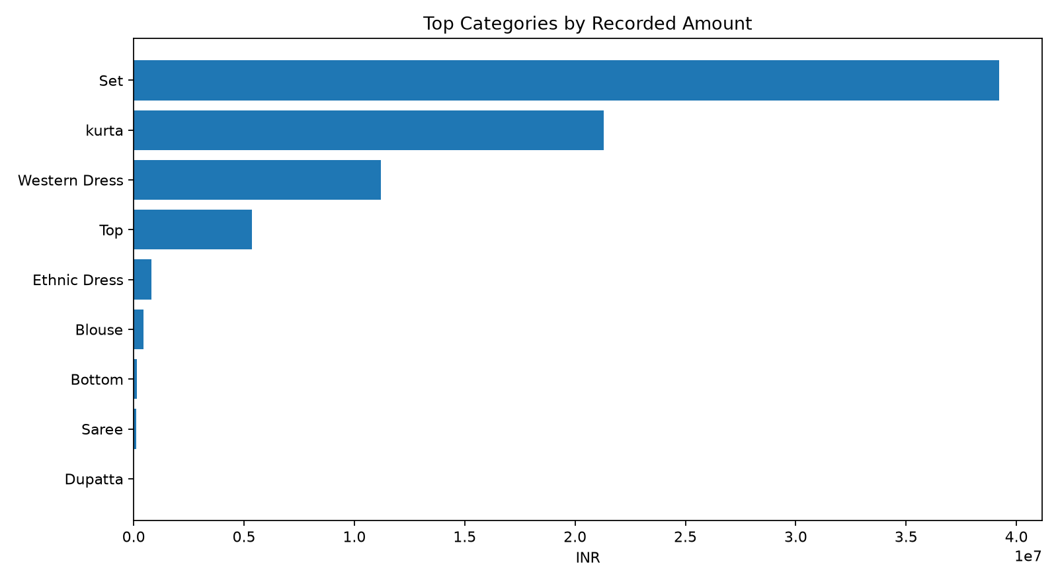
Category Performance
Set leads with 49.88% of valid recorded Amount.

Slide 4
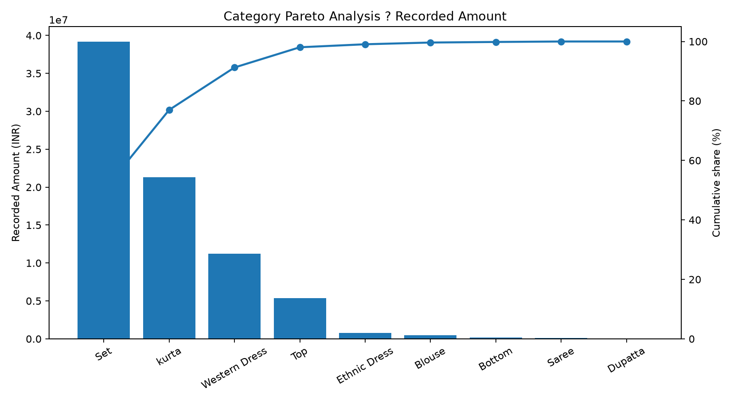
Category Concentration ? Pareto
Top two categories account for 76.98% of valid recorded Amount; confirm the meaning of Set.

Slide 5
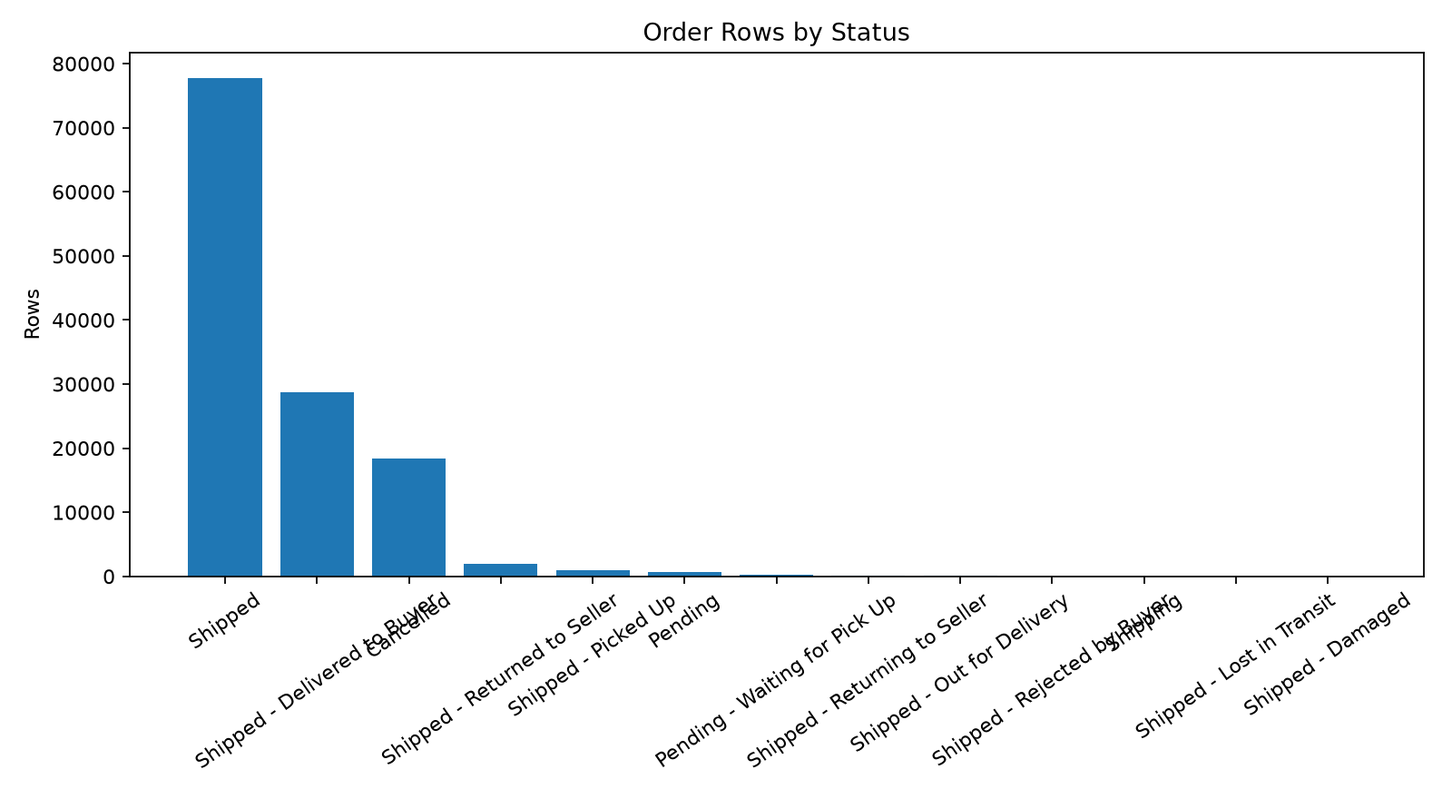
Order Status
Status counts describe dataset rows, not unique orders.

Slide 6
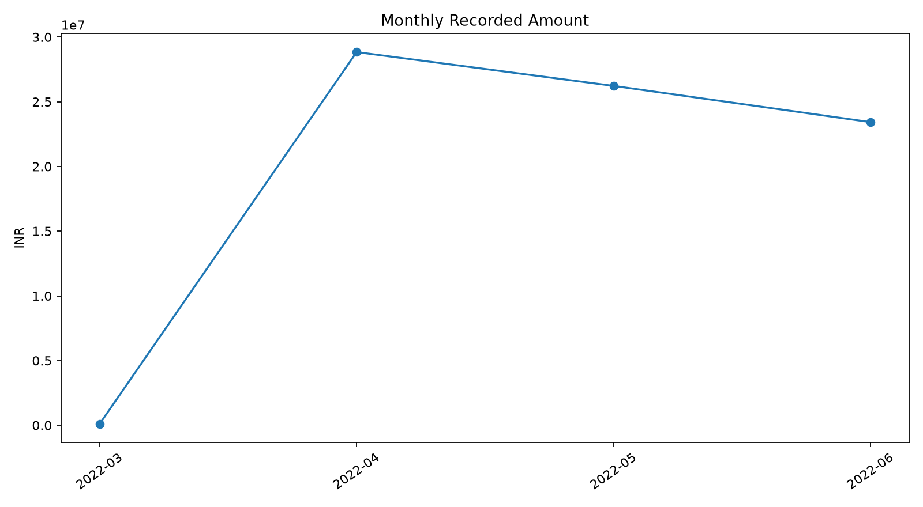
Monthly Performance
Monthly totals include rows with valid dates and recorded Amount.

Slide 7
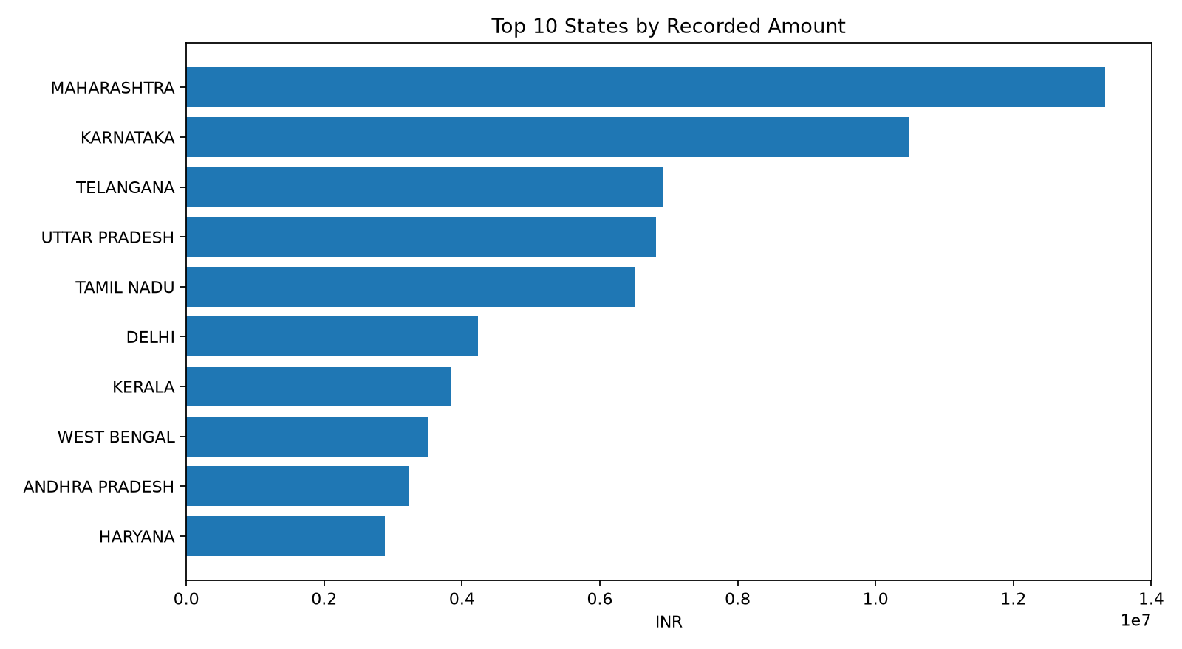
State Performance
Top states ranked by valid recorded Amount.

Slide 8
Recommendations & Reporting Caveats
Monitor concentration: the top two categories represent 76.98% of valid recorded Amount.
Confirm the business definition of the Set category before assigning product meaning.
Investigate category demand, availability and fulfilment together.
Review cancellation patterns by category, state and date.
Improve completeness checks for the Amount field.
Track monthly and state-level recorded Amount over time.
Recorded Amount is not confirmed net revenue or profit; findings are descriptive.

