Slide 1
Indian E-commerce Sales EDA
Set leads recorded category amount with INR 392.04 lakh.
Shipped is the most frequent order status. The most frequent shipping state is MAHARASHTRA.
Dataset: 128,975 records | 31 Mar 2022 to 29 Jun 2022
Note: Recorded amounts are not equivalent to net realized revenue.
Source: Amazon Sale Report CSV supplied for this project

Slide 2
Dataset Overview and Data Quality
Dataset size: 128,975 rows and 24 columns.
Date coverage: 31 Mar 2022 to 29 Jun 2022.
Duplicate rows: 0.
Missing Amount values: 7,795.
Missing shipping city values: 33.
Invalid or missing dates: 0.
No source rows were automatically deleted or imputed.
Undocumented Unnamed: 22 was excluded from analysis.

Slide 3
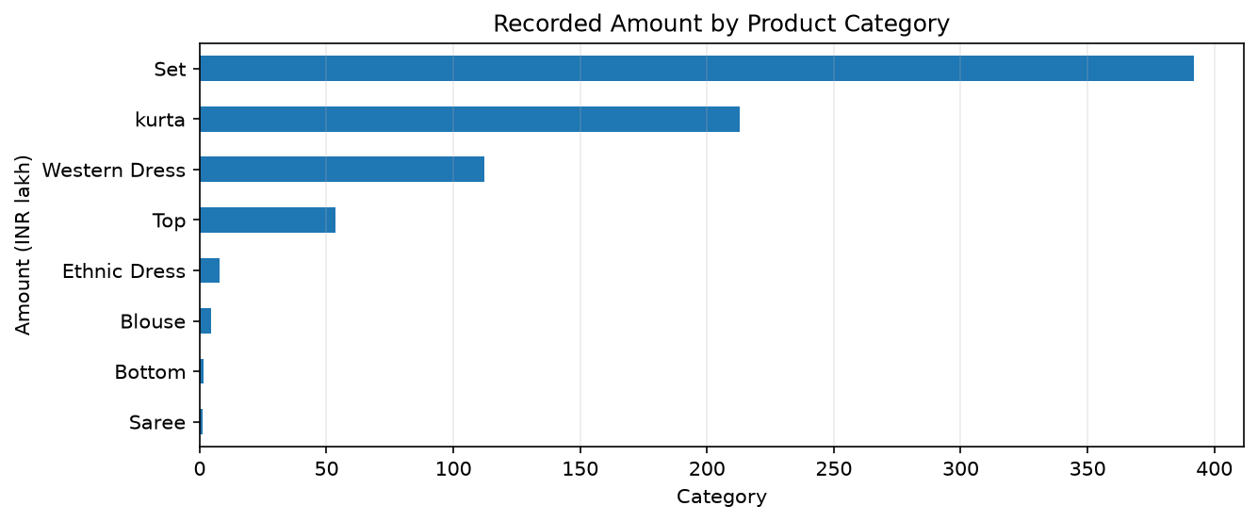
Product Category Analysis
Set has the highest recorded amount. Amounts include all order statuses.

Slide 4
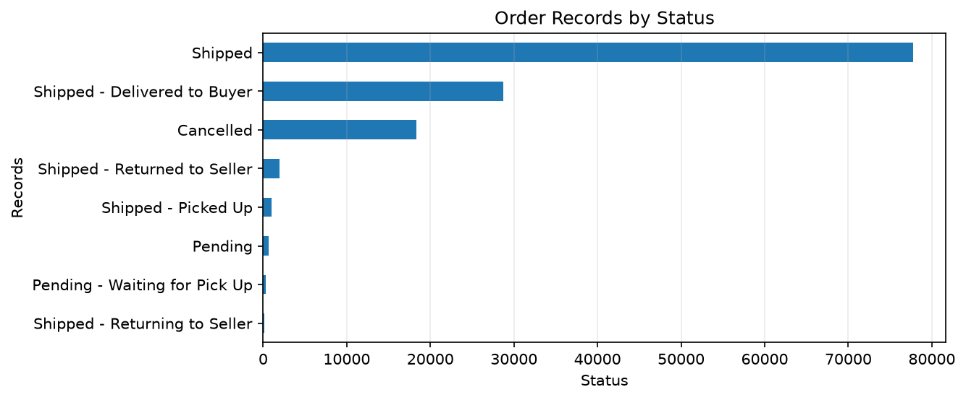
Order Status Analysis
Cancelled, pending, shipped and returned records are shown separately.

Slide 5
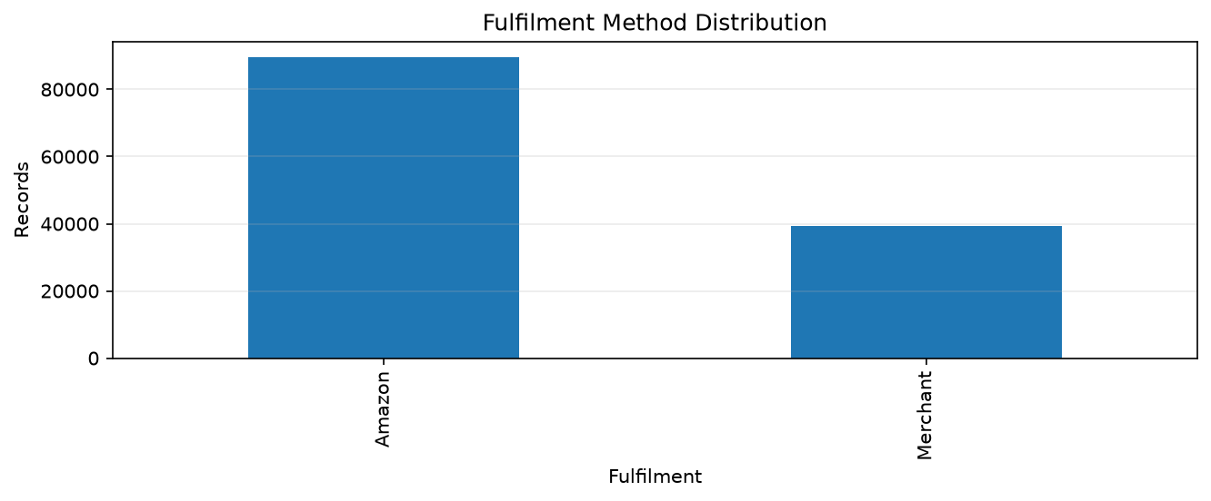
Fulfilment Analysis
Compare Amazon and merchant fulfilment volumes when planning operations.

Slide 6
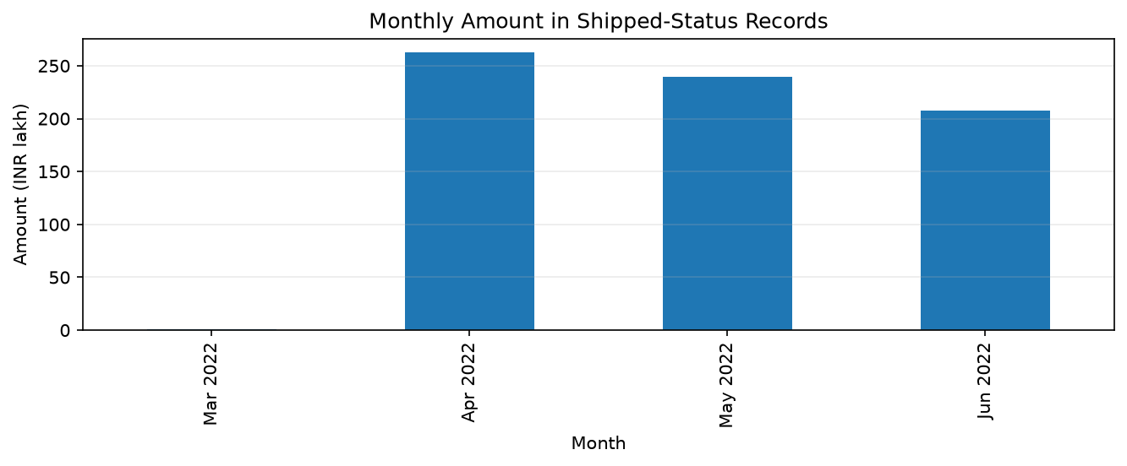
Monthly Shipped-Status Amount Trend
Includes statuses beginning with Shipped; this is not net realized revenue.

Slide 7
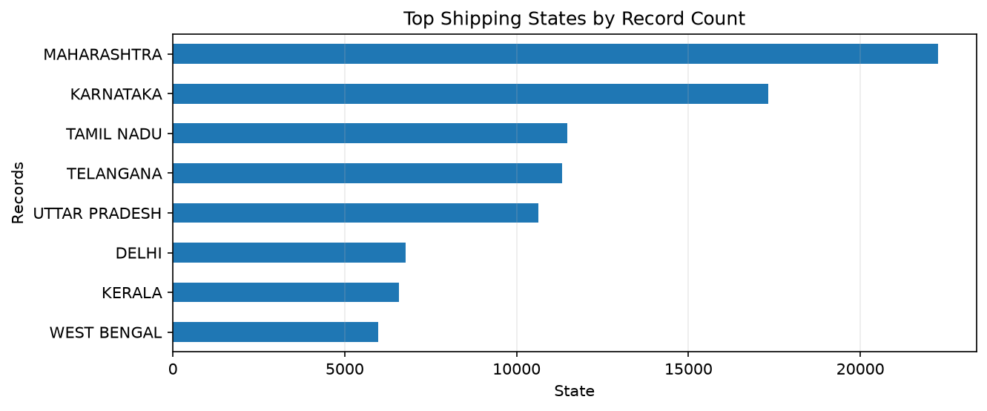
Shipping Geography
These are the most frequent shipping states by order-record count.

Slide 8
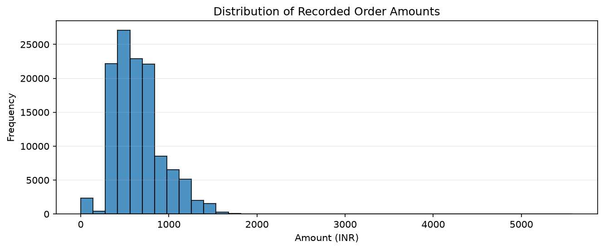
Order Amount Distribution
Skewness: 0.89 | Potential IQR outliers: 3,600. Outliers are flagged, not removed.

Slide 9
Business Insights and Recommendations
Set leads recorded category amount; review its inventory and demand patterns.
Shipped is the most frequent status; monitor fulfilment and delivery performance.
MAHARASHTRA has the most shipping records; review regional logistics capacity.
Analyze cancellations and returns separately before estimating net sales.
Investigate missing Amount and shipping-location data to improve reporting completeness.
Review potential high-value outliers individually before making business decisions.

