Slide 1

SMART BRIDGE 2025 TITLE PAGE
PROJECT NAME: HealthAI :Intelligent Healthcare Assistant
Using IBM Granite
Subtitle: AI Assistant for Better Health
team members: CHIKKAVARAPU NAGA VANDANA
College Name: RAMACHANDRA COLLEGE OF ENGINEERING

Slide 2
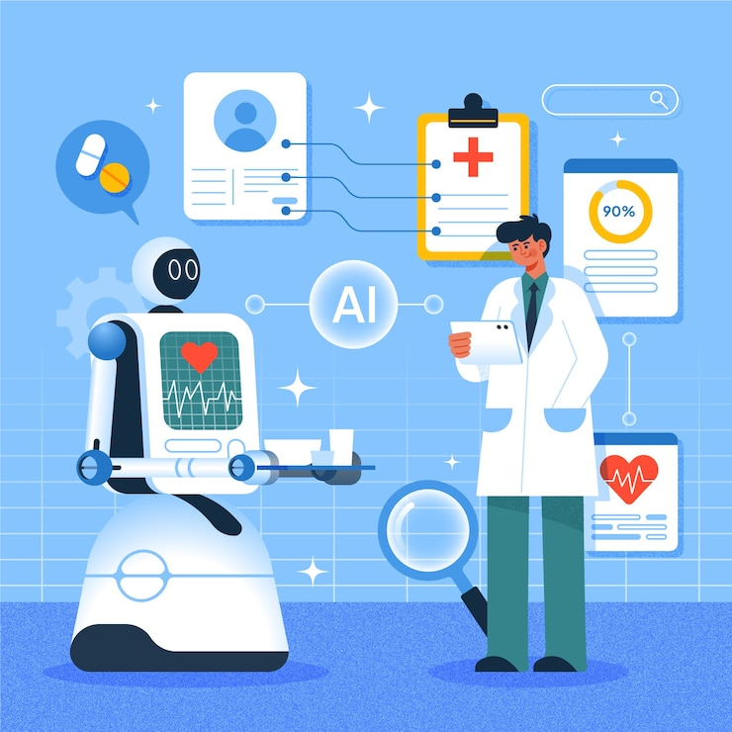

Slide 3
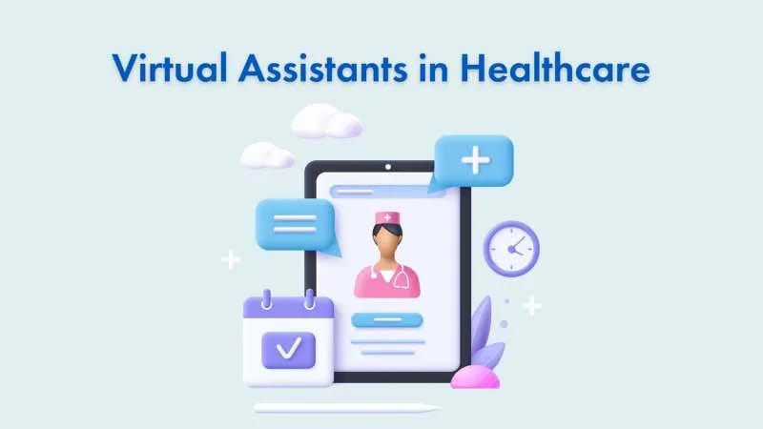
Introduction
HealthAI is an AI-based healthcare assistant that helps people get basic medical information.
It uses IBM Granite, a powerful AI model, to understand health-related questions and give helpful suggestions.
The main goal is to make healthcare advice easy, fast, and available to everyone.

Slide 5
Problem Statement
Access to basic healthcare advice is limited for many people. Hospitals are often crowded, and doctors may not be available immediately. Patients may struggle to understand if their symptoms are serious or not.
There is a need for a smart assistant that can provide quick and reliable health suggestions.

Slide 6
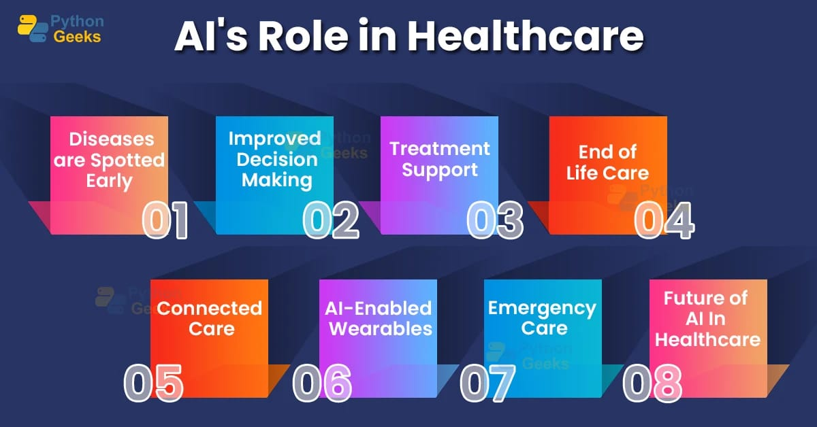

Slide 7
Technologies Used
IBM Granite – for AI and understanding health questions
Python – to build the backend
React / Flutter – to create the app or website
IBM Cloud – to run and host the project
MongoDB – to save user data

Slide 8
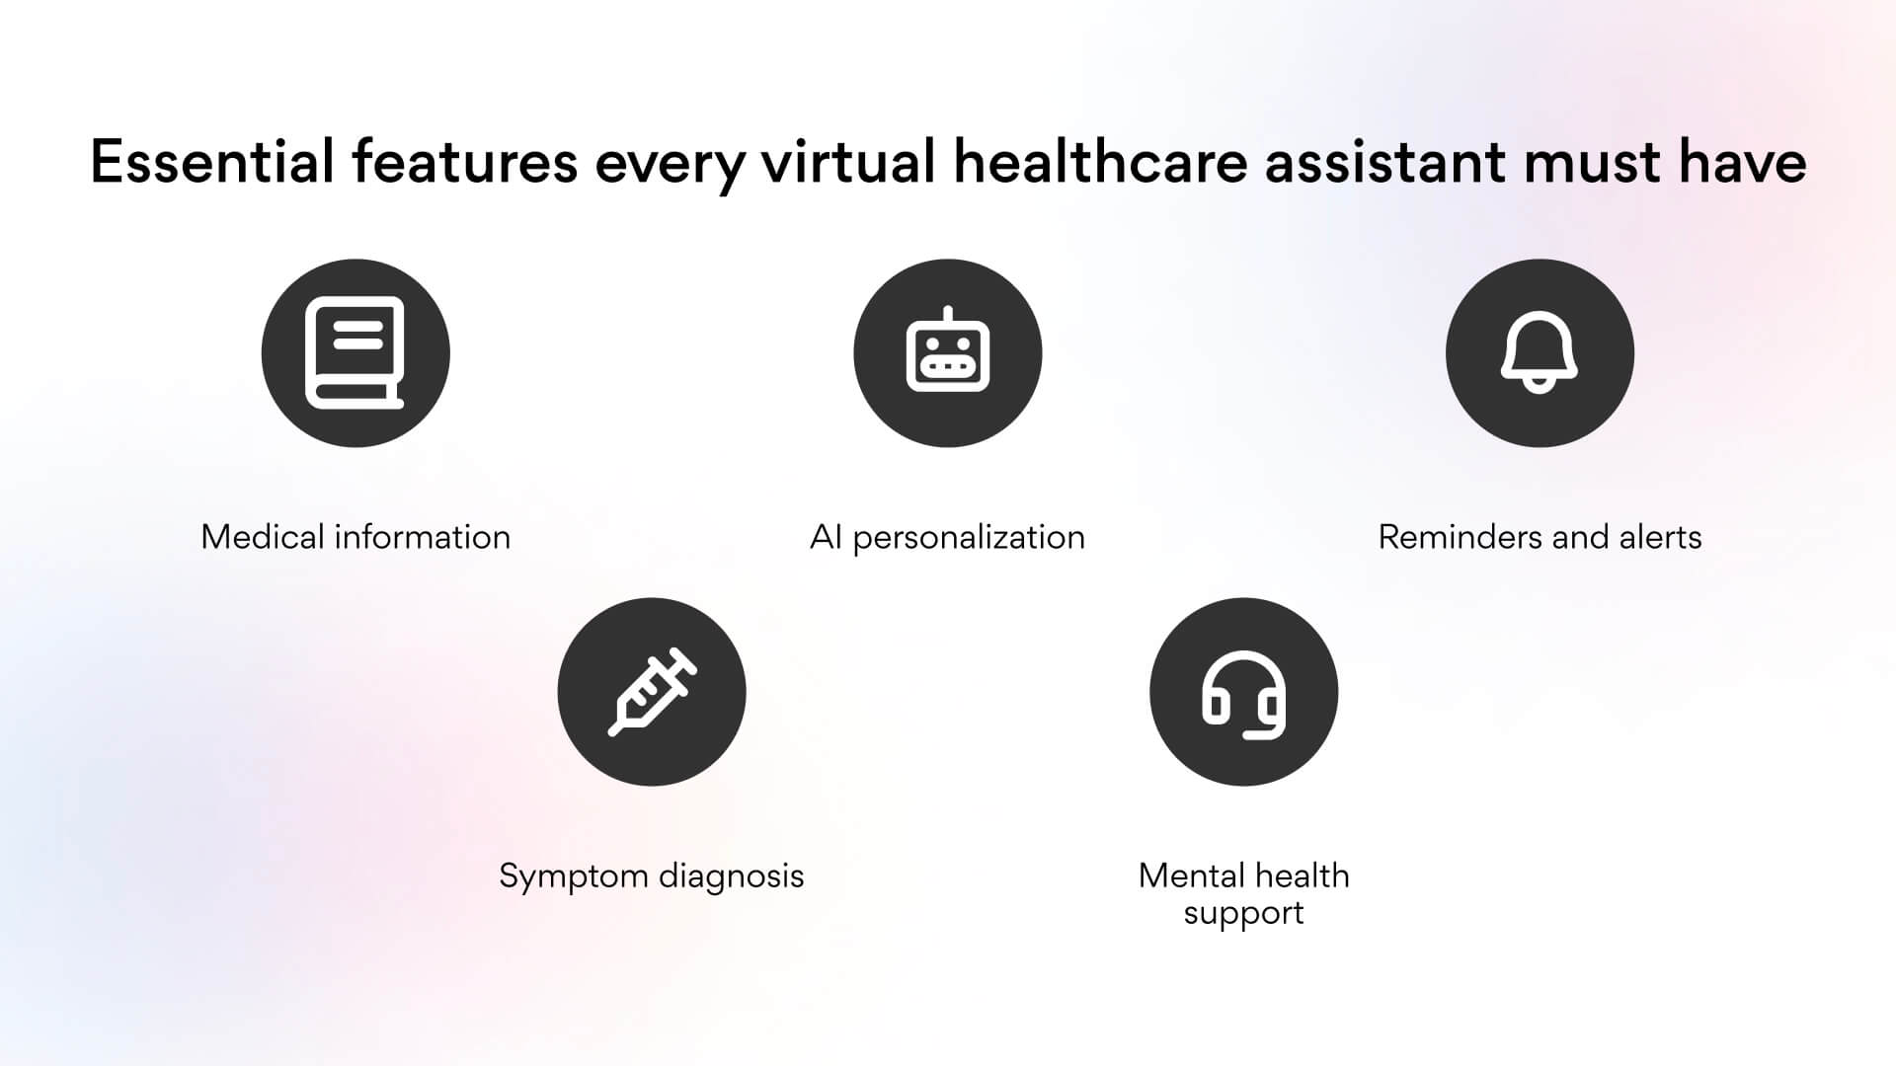

Slide 9
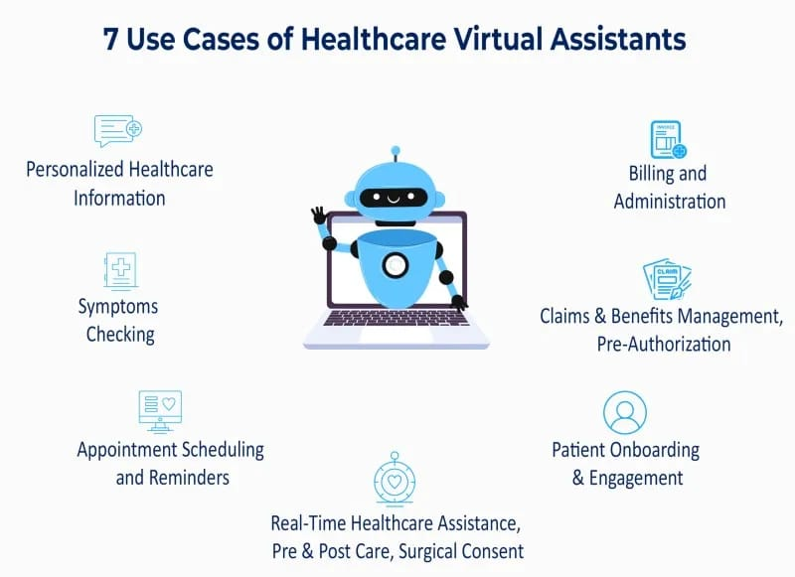

Slide 10
System Architecture
User Interface (App or Website)
User asks a health-related question.
Backend Server (Python)
Sends the question to IBM Granite AI.
Processes the response.
IBM Granite Model (AI)
Understands the question.
Gives a smart answer.
Database (MongoDB)
Stores user input and health data (if needed).
Response to User
The answer is shown in the app or website.

Slide 11
SDLC (Software Development Life Cycle)
Requirement Analysis
Understand the need for a healthcare assistant.
Planning
Choose technologies like IBM Granite, Python, etc.
Design
Create system architecture and UI layout.
Development
Build frontend and backend, integrate IBM Granite.
Testing
Check responses, fix bugs, and improve accuracy.
Deployment
Host the app using IBM Cloud or other services.
Maintenance
Update AI responses, improve features based on feedback.

Slide 12
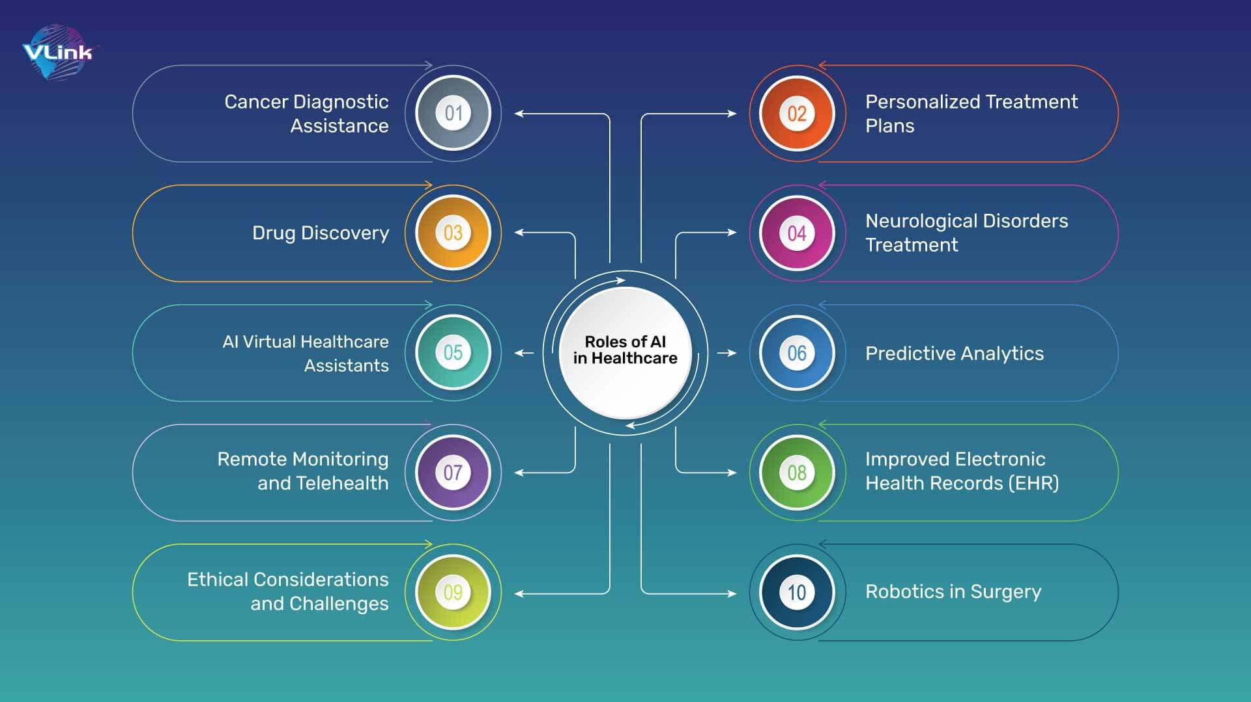

Slide 13
Key Features
Chat with the AI for health help
Understands symptoms and gives advice
Works anytime (24/7)
Easy to use app or website
Keeps your data safe
https://vandana-chikkavarapu.github.io/health-care/

Slide 14
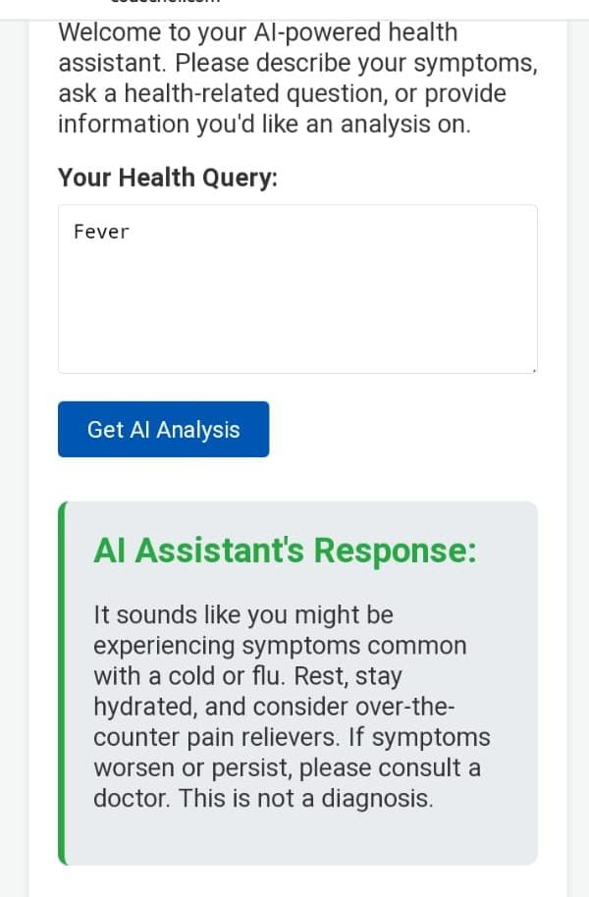

Slide 15
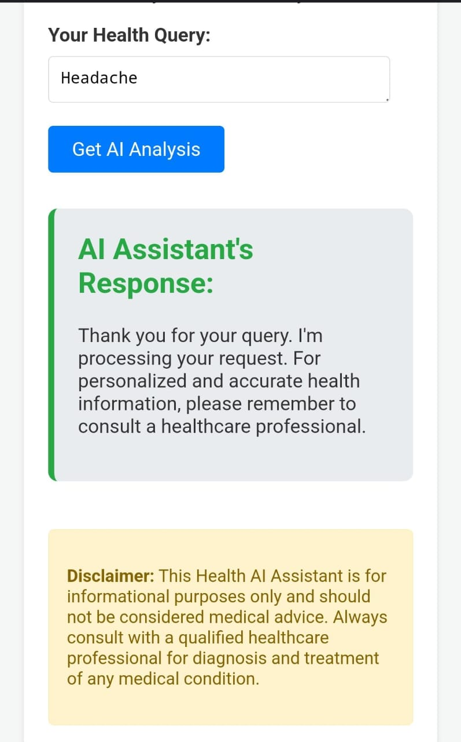

Slide 16
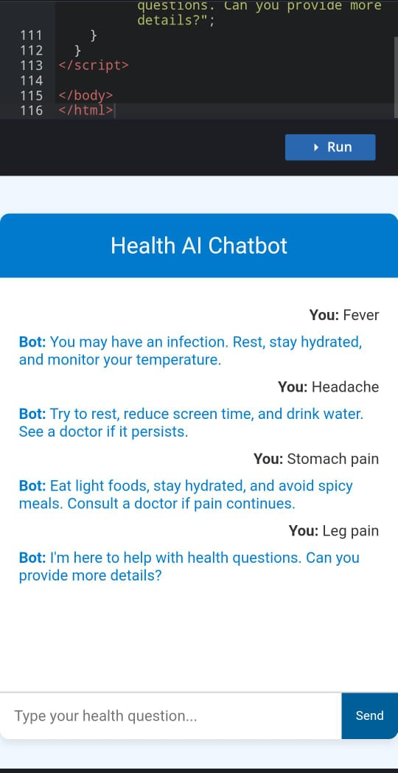

Slide 17
Advantages
Gives quick health advice
Available 24/7
Easy to use from phone or computer
Reduces hospital crowd for small issues
Uses AI for smart suggestions

Slide 18
Limitations
Not a replacement for a real doctor
May not understand all medical cases
Needs internet to work
Can sometimes give wrong or unclear answers

Slide 19
Future Scope
Add support for local languages (like Telugu, Hindi, etc.)
Connect with doctors for live chat or video calls
Use wearable devices (like smartwatches) for health tracking
Improve AI with more medical training
Make it work offline for rural areas

Slide 20


