Slide 1
Domain: Android
Technology: Kotlin
Food ordering system

Slide 2
Block Diagram
Login
View Cafeteria
View Food items
Place order
View status
Logout
Register
user
Login
Add Food items
View Food items
View order
Logout
Login
Database
Cafeteria
Admin
Login
Add Cafeteria
View Cafeteria
Logout

Slide 3
Class Diagram

Slide 4

UML diagrams use case

Slide 5
UML diagrams Sequence

Slide 6
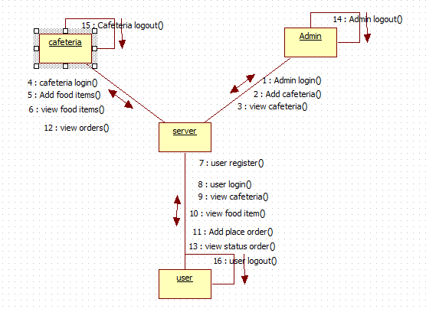
UML diagrams Collaboration

Slide 7
UML diagrams activity

Slide 8
UML diagrams Component

Slide 9
UML diagrams Deployment

Slide 10
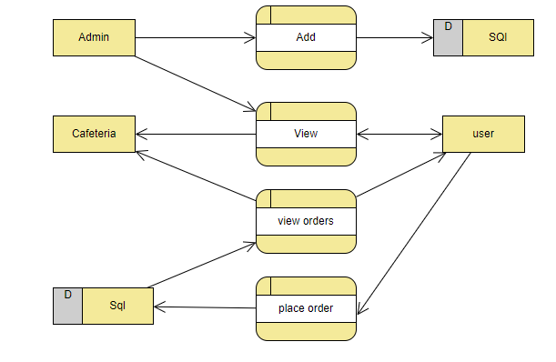
UML diagrams DFD

Slide 11
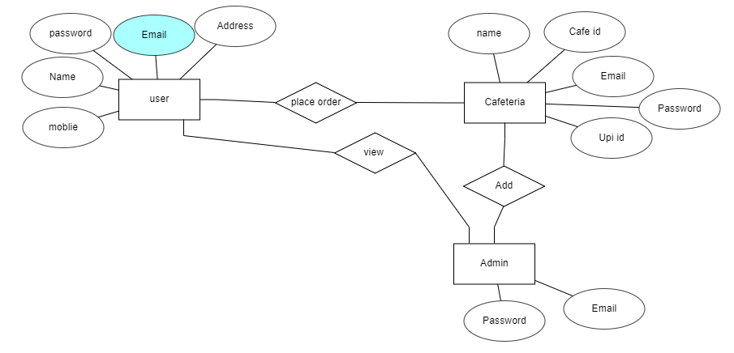
UML diagrams ER Diagram

