Slide 1


Shamir’s Secret Sharing for Authentication without Reconstructing Password
.

Slide 2
Team Members
Sai Trinadh Kumar Pulivarthi (R11800471)
Vamsi Krishna Muppala (R11770853)
Vandana Priya Muppala (R11751885)
Mahitha Pammi (R11800440)
Lavanya Thota (R11801643)
Kavya Gaddipati (R11800877)
Dheeraj Chowdary Yalamanchili (R11799764)
Sowmya Shetty (R11770733)

Slide 3
Abstract
Shamir's Secret Sharing is a quantum attack resistant method that is widely used for secret sharing. However, it can also be used to replace hashing in authentication protocols.
Here, we present an authentication protocol which will use Shamir’s secret sharing method to authenticate with server.
Hashing is not much effective at hiding the data in post quantum era. So, in post quantum era, if any data server get exposed, user's credentials can be also compromised as they were hidden by using hashing as a one-way encryption.
Our protocol will be able to solve this problem in a way that complete data exposure from server will not reveal the actual password provided by the user. So, even if the user uses same password for other online services/systems, these services and systems will not be affected.

Slide 4
Introduction
Numerous individuals use powerless or customary passwords. Software engineers are always driving the client to make complex and lengthy pass key. So, clients are inclined to use just complex and lengthy pass key for all the digital services.
As example, in figure 1 we can see, clients utilize similar passwords to get to two totally detached systems A and B.
Here, the next section provides a general idea of the current state of password protocols. In the following section, we provide our methodology. After that, in the sixth section, we will analyze the effectiveness of our proposed protocol with the conclusion section, which will summarize and recommend some future works.

Slide 5
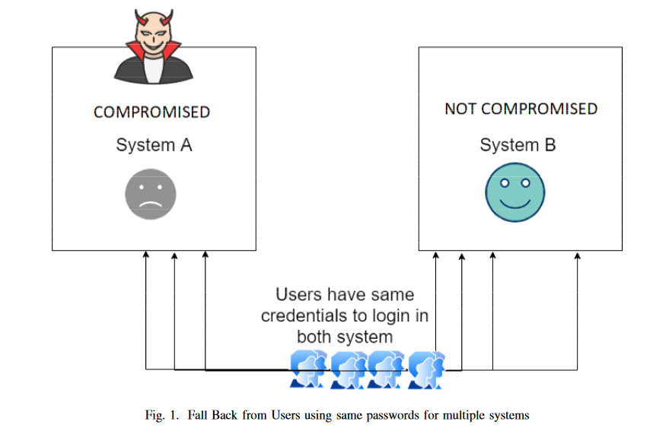

Slide 6

How does Shamir's secret sharing work?
.
.
Secret sharing works by splitting private information into smaller pieces — or shares — and then distributing those shares amongst a group or network.
Each individual share is useless on its own but when all the shares are together, they reconstruct an original secret.

Slide 7
In this part, we will talk about how different techniques are attempting to determine the issue, we examined in the past area.
Security experts are using different procedures, for example, using system unequivocal "salt" to make pass keys stand-out to each system or client unequivocal salt characteristics to make each mystery expression remarkable. This approach relies upon strength of hashing strength.
Nowadays, biometric confirmations are inducing anyway it has a nonappearance of accommodation, and it is over the top to execute. As clients are wrapping up progressively more insurance careful, standard housing need to keep away from biometric apperception.
Two-factor or multifaceted verifications are also plagued by the problem of using the same secret phrase and executions for all use cases. Only secret phrase-based confirmation remains the most simple and advantageous method for both the user and the convenience provider.
By utilizing a strong authentication scheme, our method adds enhanced security against cryptocurrency attacks and advanced malware.
Industry standard "Kerberos" is presently most broadly utilized convention for authentication yet at the same time it has dependency on encryption which are not quantum assault evidence.
When compared to other strategies (other secret sharing techniques for validation), the main differences are that we don't have to recreate the secret phrase and we use Shamir's secret sharing key, which is quantum-safe. We can see that most advanced hashing algorithms are powerless in the face of the coming quantum PC era. Another important point is that we don't have a single point of failure because we don't have any data on the server that an aggressor could use.

Slide 8
BACKGROUND
To resolve the issues with previous authentication techniques and protect the password from being exposed we used Shamir’s secret sharing methodology.
For user authentication generally 3 types of methodologies are being used i.e., Something the user knows, Something the user has, something the user is.
The secret sharing methodology mainly uses the concept of Password-based Authentication.

Slide 9
Password-Based Authentication(PAP)
Password Based Authentication is a process where a user gain’s access to the resource with the help of user credentials which contains usernames and passwords that are stored in the server/system.
Password Based Authentication is known for its simplicity and cost effectiveness.
Password Based Authentication is commonly used because the bio metric authentications are not practical all the time and two-way authentications takes up time to process.

Slide 10
Password-Based Authentication(PAP)
The passwords created by the users are securely stored in a hash format in the server.
It helps to secure the data without exploiting it whenever there is an attack.
In Password Based Authentication the users get access only when the authenticity is checked.
To guarantee a strong and protected user access, password checks are dependent on cryptographic hashes.

Slide 11
Password-Based Authentication(PAP)
While storing the passwords if all the passwords are stored in the server without encrypting then there is high change of security breach.
To overcome the above issue, we can just store the hash digest for every password.
The hash digest is used to check the authenticity of the users.
When a user provides the password while using the system the password is hashed and is compared with the already stored hash digest.

Slide 12
Password-Based Authentication(PAP)
To perform hashing on the given passwords a password reset method is used which uses a random, non secret salt value stored with the hash value.
Recalculating the authentic password from already stored hash digest value is not possible.
The result of hashing can be used to determine the secret keys.

Slide 13

Hashing
Hash-functions are functions that can map any list of values to a smaller list of fixed size Keys.
Different salt is used in hash functions to avoid a brute-force attack
When two key-value has the same hash digest after hashing conversion, that known as hash collision.
They are vulnerable, to advanced attacks like Dictionary Attack, Reverse lookup tables, Birthday attack, Hybrid password attack, etc

Slide 14
Shamir’s secret sharing
It is one of the precise and classical cryptography calculations for sending a secret over several parts.
It states that "split a secret S into n parts such that with any k-out-of-n pieces you can reconstruct the original secret S, but with any k-1 pieces, no information is exposed about S.
This algorithm is a quantum-proof algorithm, which suggests even in a quantum computer can not retrieve the secret if it has less than the threshold numbers of the key.

Slide 15
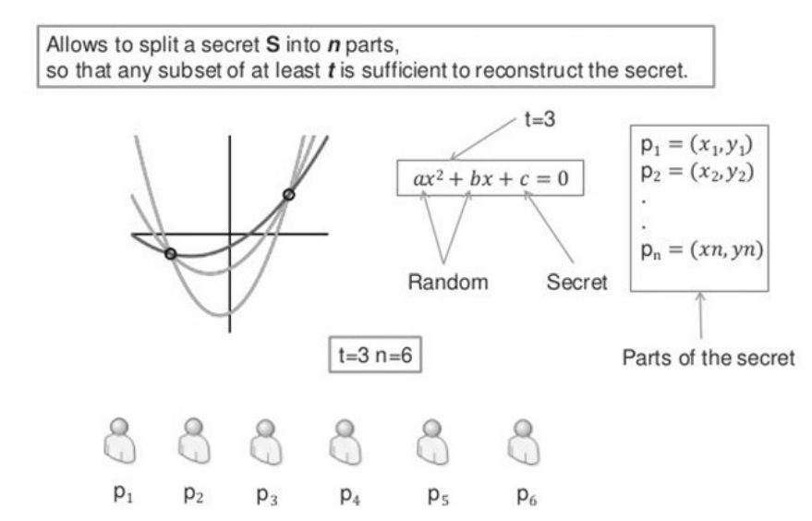

Slide 16
Problem formulation
We need to design function F=f(p) which will convert the user’s password P to Pu and will store it in a server S it is designed in such a way that Function F can’t be reversible to P from Pu. It also contains below properties:
Different P will not have the same Pu.
For a user registration and sign in time valid P will create same Pu.
From the Pu, P reconstruction will not be possible.

Slide 17
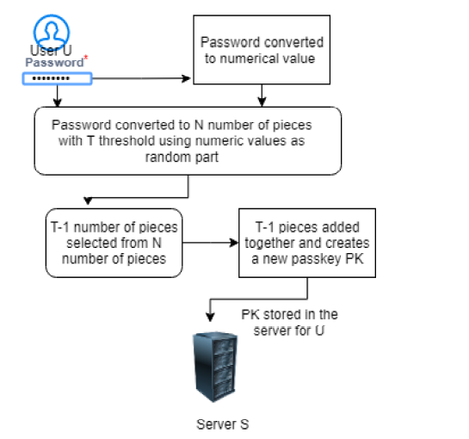
Methodology
It functions as a one-way function like hash algorithm.
Same key will be generated for both registration and sign in time. By providing the same random part for every user.

Slide 18
Registration algorithm
Step1: Pw ← plaintext Password, Uid ← User-id, Ss ← Server Salt
Step2: Create 512-bit hash TH from Pw + Uid + Ss,
Step3: Split TH into T(H1) and T(H2)
Step4: Generate values x1, x2, x3....xn from T(H1) by taking the ASCII values from T(H1)
Step5: We need to pass the generated values into shamir’s secret key algorithm S ← T(H1)
Step6: Using Xi as X-coordinates to generate Shamir’s secret keys k1, k2, k3....kn, if threshold number is T , Pick k1, k2, k3....k(T − 1) keys and send them to server.
Step7: Server will store the keys as single string Pss = k1 + k2 + k3....k(T − 1)
Step8: server will store the Uid and Pss

Slide 19
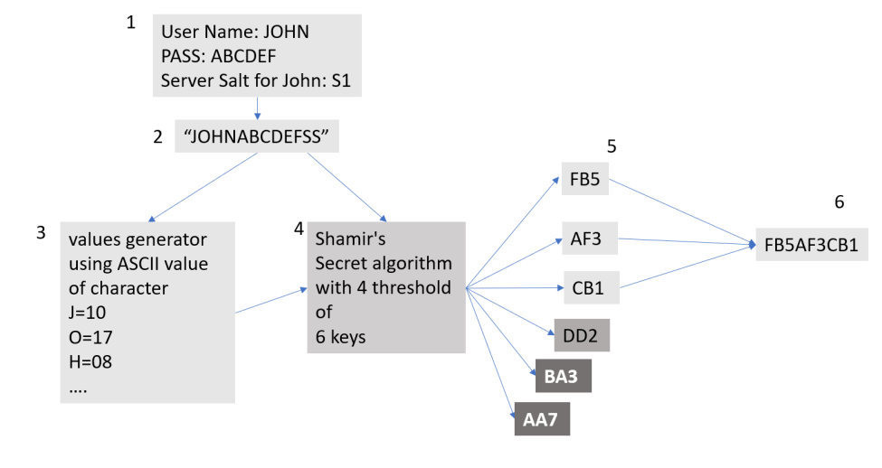
Implementation example

Slide 20
As from the figure we could see, username JOHN, password ABCDEF, and salt S1. We merged it and got a single string "JOHNABCDEFS1“.
First, we generated some numerical values from "JOHNABCDEFS1" by simple converting each of character to their corresponding ASCII values.
Then we send the string "JOHNABCDEFS1" and the numerical values to Shamir’s secret key generator, which will generate six keys with four thresholds.
We will pick the first 4-1=3 keys and merged them and send them to the server.
Now in case of server exposure, as these keys only have three parts, it will not be able to reconvert to the password as that requires at least 4part of keys. But it is unique enough as a password.

Slide 21

Key Collision probability
Pc: Probability of one collision
C : Number of keys
M : Number of user in the system
K : Length of Keys
N : Total representation number(eg: all possible symbol in password)
> If we increase the number or length of keys ,probability of collision will get decrease.
> But with combination of representation number and adding uniqueness to password from server side can reduce the probability of collision

Slide 22

Advantages
It is not vulnerable to quantum attack.
Even though the system server exposes to vulnerabilities , the password is not recoverable.
It is flexible and extensible which means that the secret owner could add, amend or remove shares at anytime if they wanted to, without modifying the original secret.

Slide 23
Limitations
Collision rate is higher than the hashing methods.
Each share of the secret must be at least as large as the secret itself.
To ensure that shareholders are not submitting fake shares is one of the problem in Shamir secret algorithm.

Slide 24
Conclusion& Future work
Using distinct passwords for each different online service is inconvenient for users. Users frequently reuse the same passwords across various services. Any service server exposure puts the user's other online services at risk. Hash functions, as we can see, are ineffective against quantum computers.
Using the strength of Shamir's secret sharing method, our proposed protocols can solve this challenge.
We will improve these methods in the future by using threshold cryptography.
The collision rate of this method is larger than that of hashing methods, which is its restriction. However, we may get around this difficulty by increasing the length of the keys. We can also overcome the problem by introducing another way to provide more uniqueness. We'll work on it in the future.

Slide 25
Thank you ☺

