Slide 1


CMR TECHNICAL CAMPUS UGC (Autonomous) Kandlakoya, Medchal Road, Hyd-501 401 Department of Computer Science and Engineering
Mini Project Review
SEMANTICS OF DATA MINING SERVICES IN CLOUD COMPUTING
BATCH .NO-01
Project Guide:
Dr. K. Srujan Raju
Professor, CSE Department
Project Coordinator:
Dr. J. Narasimha Rao
Associate Professor, CSE Department
Presented by:
217R1A05N7 : Koppula Vandana
217R1A05Q7 : Shaik Anjum
217R1A05N9 : Lingala Nithin Chandra

Slide 2
ABSTRACT
This project aims to create a simple, standardized way to define Data Mining services for use in Cloud Computing.
Right now, different cloud providers use different formats, making it hard to move data mining workflows between them.
The goal is to design one easy-to-use service definition that allows data mining tasks to be easily transferred, shared, and deployed on different platforms or even sold in a marketplace.
This would make using data mining services more flexible and compatible across providers.

Slide 3
EXISTING SYSTEM
Integrated System:
Combines cloud storage, data lakes, and warehouses for managing data.
Semantic Technologies:
Uses tools like ontologies, RDF, and OWL to structure and interpret data.
Machine Learning:
Employs AI tools to analyze data and find patterns.
Service-Oriented Architecture:
Uses RESTful APIs and microservices for app interaction.
Focus on Security and Performance:
Ensures data privacy, compliance, scalability, and monitoring for efficient handling.

Slide 4
Disadvantages of Existing System
Limited accuracy.
Low Efficiency.
High Costs
Complexity and Management

Slide 5
PROPOSED SYSTEM
Focus on Standardization:
Aims to make Data Mining services more uniform and industry-friendly.
Provider Insights:
Includes information from various Data Mining service providers to support the system.
User-Friendly:
Designed to make it easier for users to understand and use Data Mining services.
Practical Application:
Provides a hands-on example to show how the system works in real life.
Improved Access:
Helps users find and utilize Data Mining services more effectively.

Slide 6
Advantages of Proposed System
1. Robust Security and Privacy
2. Optimized Data Access
3. Efficient Data Management
4. Improved generalization.
5. Increased Flexibility.
6. Faster processing.

Slide 7
HARDWARE REQUIREMENTS
System : i5 or Above
RAM : 8 GB
Hard Disk : 256 GB
SOFTWARE REQUIREMENTS
Operating System : Windows 8 or Above
Technologies : Cloud Server
Coding Language : Python 3.7.0 Version

Slide 8
Novelty of Project
This system uses cloud technology to make it easier to analyze data and discover patterns.
It can gather data from multiple sources while keeping it private and secure. By using machine learning and AI, it automatically provides helpful insights.
With Data Mining as a Service, you can access powerful tools without needing special equipment.
It also supports real-time analysis, helping teams collaborate and get insights quickly.

Slide 9
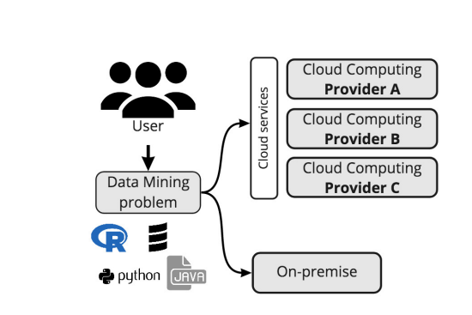
Architecture

Slide 10
Modules
Upload Diabetes Dataset
Preprocess Dataset
Train Random Forest Algorithm
Start Cloud Server & Publish CCMD Service

Slide 11
Upload Diabetes Dataset: Select and upload the diabetes dataset for analysis and processing. Preprocess Dataset: Clean and prepare the dataset for further analysis by handling missing data, normalization, etc. Train Random Forest Algorithm: Train a machine learning model using the Random Forest algorithm to classify or predict outcomes based on the dataset. Start Cloud Server & Publish CCMD Service: Deploy a cloud-based server and make the CCMD (Cloud Computing for Medical Data) service accessible for real-time predictions.

Slide 12
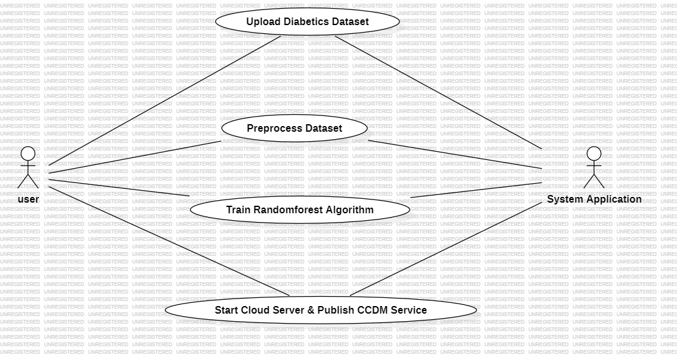
Use case Diagram

Slide 13
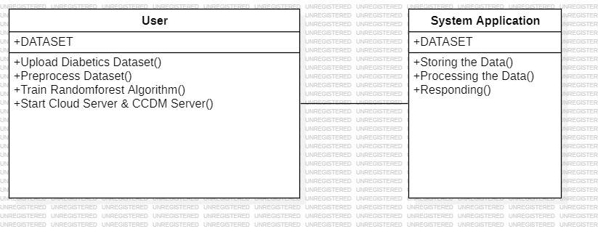
Class Diagram

Slide 14
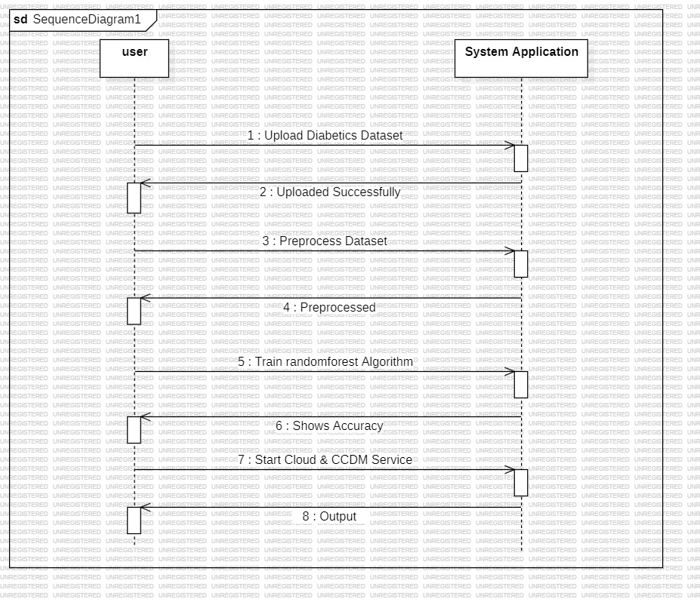
Sequence Diagram

Slide 15
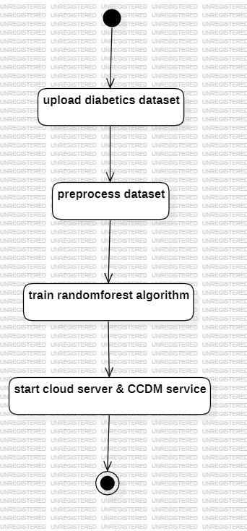
Activity Diagram

Slide 16
Future scope
Technological Advancements
Flexibility and Interoperability
User Experience
Scalable and Distributed Data Mining
Key Benefits

Slide 17
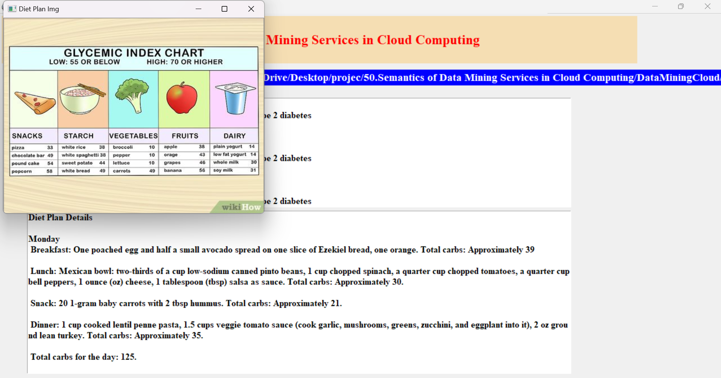
Result:

Slide 18
CONCLUSION
The system we proposed improves data mining in cloud computing by using a combination of different cloud types, better resource management, and stronger security.
It optimizes how resources are used through machine learning, making tasks more efficient and cheaper.
At the same time, it uses strong encryption to protect sensitive data.
This system not only improves existing cloud services but also offers a more secure, adaptable, and cost-effective solution for data mining.

Slide 19
THANK YOU

