Slide 1
Insights to the Marketing Team in Food & Beverage Industry

Slide 2
Challenge Overview
CodeX is a German beverage company that is aiming to make its mark in the Indian market. A few months ago, they launched their energy drink in 10 cities in India.
Their Marketing team is responsible for increasing brand awareness, market share, and product development. They conducted a survey in those 10 cities and received results from 10k respondents.
As a Marketing Data Analyst, my role is to transform raw survey data into actionable insights that help the team make informed marketing decisions and drive strategic actions across channels.

Slide 3



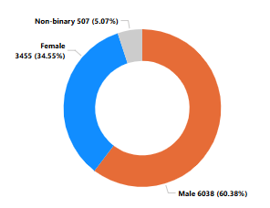

Who prefers energy drink more?
60%
34%
5%
Males are the dominant consumer segment for energy drinks, making up over 60% of the total respondents

Slide 4
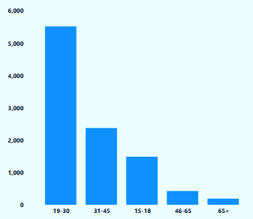
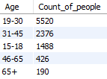
Which age group prefers energy drinks more?
Young adults (19–30) dominate energy drink consumption, accounting for over half (55%) of the total users.
Teenagers (15–18) also form a significant 15% share, suggesting early adoption trends. Usage declines sharply beyond age 45.

Slide 5
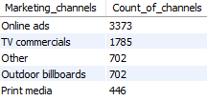
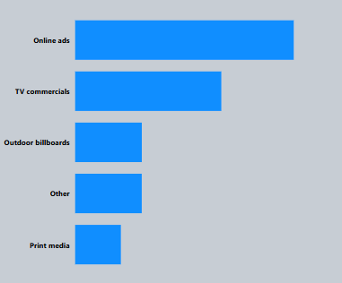
Which type of marketing reaches the most Youth (15-30)?
Online ads are the leading source of awareness for energy drinks, influencing over one-third of consumers
Traditional media like TV and print have lower impact.
Focus on digital marketing, reduce print spend, and explore new channels like influencers.

Slide 6

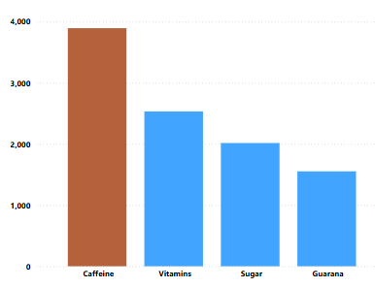
What are the preferred ingredients of energy drinks among respondents?
The top preferences (caffeine, vitamins) suggest that users seek functional energy and health support, not just flavour or sugar rush.
Sugar ranks below vitamins -indicating a shift toward health-conscious consumption, especially among younger users. Clearly listing caffeine content and vitamin benefits on packaging may increase consumer trust and visibility at point of sale.
Guarana is less favored, likely due to low awareness - Educate consumers about its benefits to drive interest.

Slide 7
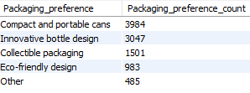
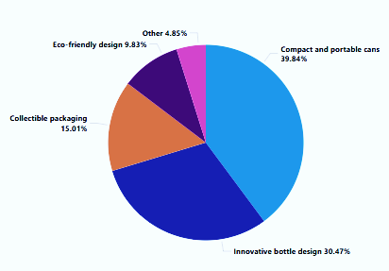
What packaging preferences do respondents have for energy drinks?
The strong preference for compact and portable cans shows that on-the-go consumption is key -especially among busy, urban consumers.
Consumers prioritize aesthetic and functional design over eco-friendly options
The low response for eco-friendly design is an opportunity to lead with sustainable innovation and build brand values over time.
With nearly 85% favouring unique or functional designs, packaging can be used not just for utility but also as a key visual branding asset.

Slide 8
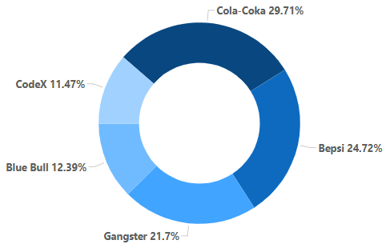
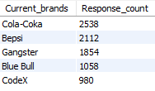
Who are the current market leaders?
While CodeX currently ranks 5th, it commands a solid base of nearly 10% market share - offering a strong foundation to build on.
CodeX can stand out through unique flavours, clean energy, or sustainable packaging.
With online being the top awareness channel, CodeX can grow fast by doubling down on digital storytelling, influencer collabs, and community-driven brand content.

Slide 9
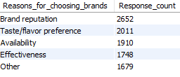
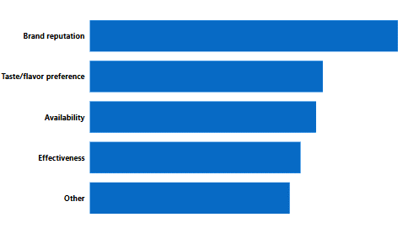
What are the primary reasons consumers prefer those brands over ours?
Reasons for preferring other brands
26.5%
Since brand reputation is the top reason others are chosen, CodeX should amplify its credibility through collaborations with trusted influencers or athletes, highlighting customer reviews.
It can also stand out through limited-edition flavors or health-forward options.
20.2%
19%
17.4%
16.7%%

Slide 10
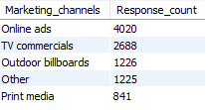
Which marketing channel can be used to reach more customers?
TV Commercials
Online Ads
hi
Outdoor billboards
Other
hi
Print Media
Online ads reach the largest audience — more than any other channel. This indicates that young, tech-savvy consumers are highly responsive to digital outreach.
Focus on interactive online campaigns (e.g., ads, polls etc.) across various social media platforms.
CodeX can increase visibility through youth-focused outdoor ads (college fests, gyms, cafes) and “other” channels like influencer collabs or experiential sampling

Slide 11





How effective are different marketing strategies and channels in reaching our customers?
TV Commercials have effectively built brand awareness (46.7%) but show lower conversion to trial (35.75%), indicating a need for stronger call-to-action or product sampling integration within ads.
Online Ads, with a reach of 44.9%, remain the most effective channel for both awareness and conversion-over 50% of exposed users have tried the product. CodeX should prioritize targeted digital campaigns across social media and streaming platforms to engage younger, tech-savvy audiences and drive rapid growth.
Print Media, despite having the lowest reach at 44.1%, shows a strong influence with 53.5% of exposed users trying the product. This channel can be used for placements in fitness magazines, gyms, or cafes where high-intent audiences are more likely to convert.
Outdoor Billboards have a moderate reach of 42.7% but a high conversion rate of 52.2%, indicating strong visual impact. CodeX can leverage this by placing bold, eye-catching creatives in high-traffic youth zones like college areas, gyms, and urban hotspots
Other channels show the highest influence at 61.7% despite lower reach (40%), highlighting the power of experiential and word-of-mouth marketing. CodeX should tap into this by running influencer collaborations, campus activations etc.

Slide 12
What do people think about our brand? (overall rating)
10000
4447
2026
Total customers responded
Avg. Rating
44% of the customers have heard of the brand before
45% of customers who are aware of the brand have gone on to try it, indicating a healthy conversion from awareness to trial
With only 20% of customers giving a positive response after trying the drink, CodeX should focus on improving taste, packaging, and customer engagement strategies to boost satisfaction and brand loyalty.

Slide 13
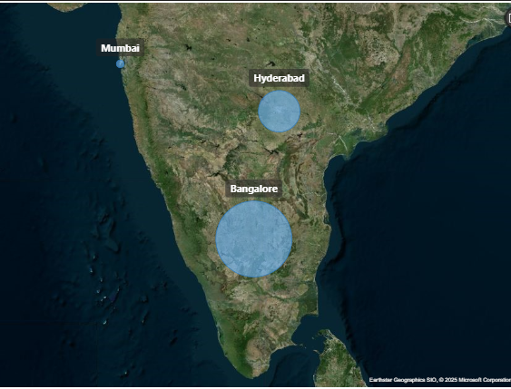
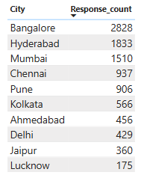
Which cities do we need to focus more on?
Bangalore leads significantly in customer count, indicating strong brand presence or higher engagement in the region. Other major metros like Mumbai, Hyderabad, and Chennai show potential for growth with targeted regional campaigns.

Slide 14
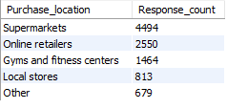
Where do respondents prefer to purchase energy drinks?
44.9%
25.5%
14.6%
Most customers buy from supermarkets, showing they prefer shopping in stores.
Online shopping and gyms are growing options, so promoting the drink on health websites or gym tie-ups can help reach more people.
8.1%
6.7%

Slide 15
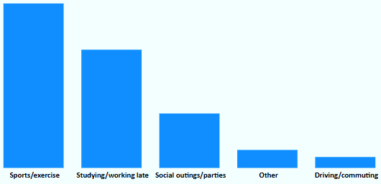
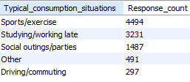
What are the typical consumption situations for energy drinks among respondents?
Energy drinks are strongly associated with active lifestyles, with the highest consumption during sports and workouts.
Their use for late-night studying or work suggests a growing demand among students and professionals.
Lower consumption during commuting and social events indicates potential for market expansion through lifestyle positioning and convenience-based packaging

Slide 16
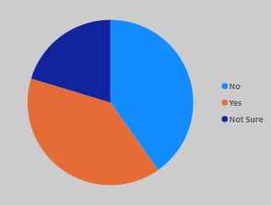
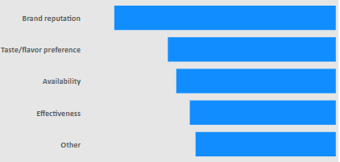
What factors influence respondents' purchase decisions, such as price range and limited edition packaging?
Nearly 49% of respondents showed interest in limited edition packaging, while 21% are uncertain - indicating curiosity that can be influenced through branding.
Only 30% clearly rejected the idea, highlighting a strong opportunity to leverage limited edition that could attract a majority of the market.
Brand reputation influences the highest number of choices, showing that trust plays a major role in consumer decisions.
The relatively close numbers for taste, availability, and effectiveness suggest that improving product performance and reach, along with branding, can maximize market appeal.

Slide 17
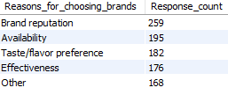
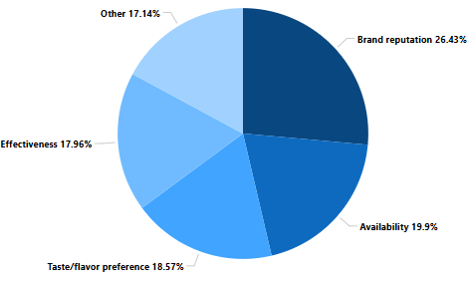
Which area of business should we focus more on our product development? (Branding/taste/availability)
Brand reputation remains the top reason for choosing a brand, emphasizing the need to build trust and visibility.
The small gap between other factors like availability, taste, and effectiveness suggests that consumers consider multiple aspects when deciding.
A balanced focus on quality, accessibility, and proven results can strengthen overall brand preference.

Slide 18
What immediate improvements can we bring to the product?
Strengthen Brand Visibility & Trust
Enhance Taste Profiles
Improve Availability & Distribution
Health Concerns

Slide 19

What immediate improvements can we bring to the product?
Strengthen Brand Visibility & Trust
Partner with popular fitness influencers or athletes to promote CodeX on social media and at events - this builds credibility and reaches active, engaged audiences.
Share customer stories and reviews through ads and online platforms to create a sense of community and trust around the brand.
Maintain consistent, high-quality branding across all touchpoints - packaging, website, ads - to reinforce professionalism and recognition.
9.7%

Slide 20
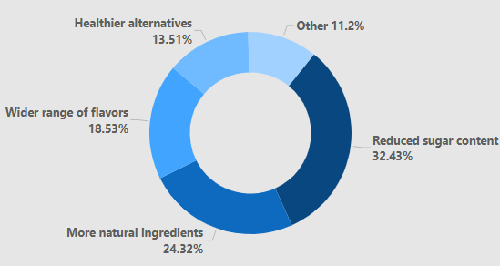
What immediate improvements can we bring to the product?
Enhance Taste Profiles
Launch limited-edition or seasonal flavours to create excitement and attract new customers.
Conduct taste-testing campaigns in gyms, colleges, and supermarkets to gather feedback and refine existing flavours.
Introduce a sugar-free or low-calorie variant to cater to health-conscious consumers without compromising on taste.
Collaborate with flavour experts to develop unique blends that stand out from competitors.

Slide 21
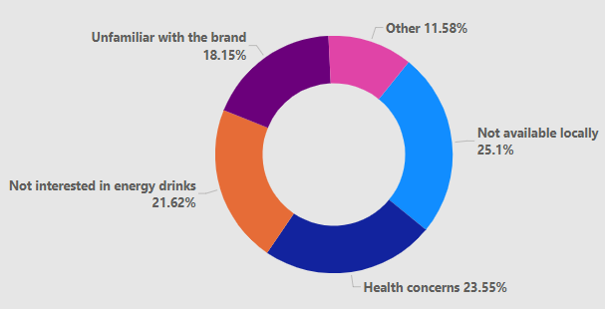
What immediate improvements can we bring to the product?
Improve Availability & Distribution
Out of the customers who have heard of the brand, 54% of them did not tried the same because of the absence of availability of the brand.
Expand presence in supermarkets, gyms, and convenience stores, especially in top-performing cities like Bangalore and Hyderabad.
Strengthen partnerships with major online retailers (e.g., Amazon, Flipkart) and ensure faster delivery options.
Introduce small display units in local and neighbourhood stores to increase visibility and impulse purchases.

Slide 22
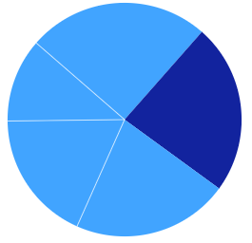
What immediate improvements can we bring to the product?
Health Concerns
Approximately 23% of customers who were aware of the brand chose not to try it due to health-related concerns, highlighting the need for improved transparency in ingredients and communication around health benefit
Introduce a version with low calorie, natural ingredients, reduced sugar, and no artificial additives to appeal to health-conscious consumers.
Clearly communicate health benefits and certifications on packaging and in marketing (e.g., “No added sugar,” “With essential vitamins,” “Approved by nutrition experts”)
Health Concerns 23.5%

Slide 23

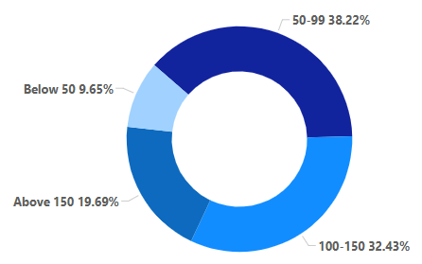
What should be the ideal price of our product?
Suggested Deal Price: ₹109
Why it works ? Within the ₹100–₹150 preference bracket (3142 customers), while also appealing to those just above the ₹50–₹99 segment.
Offer small trial packs (₹50–₹60) for first-time buyers.
Reserve premium variants (like limited-edition) for the ₹120–₹140 range to tap into niche segments.
Partner with modern trade outlets and online stores to distribute combo packs with discounts or pairing it with other products.
Flexible for promotions:
Intro offer at ₹99
Combo: 2 for ₹199

Slide 24
What kind of marketing campaigns, offers, and discounts we can run?
Try & Buy
Bundle & Save
Refer & Earn
Flash Sale Fridays
Fuel Your Game
1. Try & Buy - Offer small trial packs at ₹49–₹59 to encourage first-time users to taste without a high commitment so that conversion to repeat buyers improves.
2. Bundle & Save - Create value packs (like 2 for ₹199 or 4 for ₹389) to boost volume and repeat purchase.
3. Refer & Earn - Reward existing customers for referring friends with cashback, free cans, or discount codes.
4. Flash Sale Fridays - Run limited-time discounts (e.g., 20% off) every Friday to create urgency and boost weekly sales.
5. Fuel Your Game - Collaborate with esports, fitness influencers, or colleges for themed campaigns that associate CodeX with energy and performance.

Slide 25
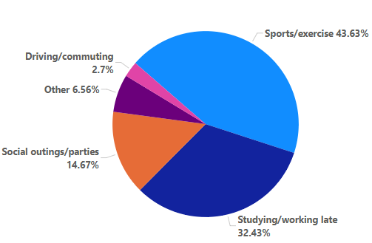
Who should be our target audience, and why?
With over 75% of CodeX users aged between 15–30, the brand needs a youthful and energetic face to connect with its core audience.
A popular fitness influencer, gamer, or youth icon (aged 20–30) can effectively represent the lifestyle CodeX promotes - active, driven, and social.
Their strong presence on platforms like Instagram, YouTube, and esports streams will boost visibility and engagement.
Benefits - This strategy enhances brand relatability, trust, and loyalty among young, impressionable consumers.

Slide 26
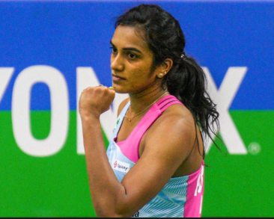
Who can be a brand ambassador, and why?
PV Sindhu is one of India’s most celebrated athletes, symbolizing strength, stamina, and consistent high performance-qualities that align perfectly with an energy drink like CodeX.
With a massive fan following, especially among the 15–30 age group, she commands trust and admiration from both young men and women.
Her disciplined lifestyle and success on global platforms make her a credible and aspirational figure for health-conscious, performance-driven consumers.
As a youth icon, her presence can enhance brand visibility and trust, especially in fitness, sports, and academic circles.
PV Sindhu also brings a national pride factor, making her ideal for campaigns targeting a wide Indian audience.
Gender – Female
Age - 28
Sport - Badminton

Slide 27
Thank You

