Slide 1
ClimaFlu-GNN
BIG DATA ANALYTICS (23AID302) · FINAL PROJECT REVIEW
Climate-aware influenza forecasting on a Hadoop + Spark pipeline
HDFS · MapReduce on YARN · Spark (Scala, DataFrame API) · Spark MLlib · Structured Streaming · Graph Neural Network
Group 04
Madhu Hasini — CB.AI.U4AID24060
Saanvika — CB.AI.U4AID24047
Dharshini — CB.AI.U4AID24013
Faculty
SREEJA B P
Amrita Vishwa Vidyapeetham
Notes:
Introduce the team and the title. One line: we forecast weekly flu activity for 50 US states using 26 years of climate data, processed on Hadoop and Spark.

Slide 2
Problem statement, objectives and why Big Data
Problem
Why Big Data?
Flu (influenza-like illness, ILI) rises in each US state at a different time and strength
Health agencies need forecasts per state, 1–4 weeks ahead
Cold, dry weather is linked to flu, but climate data is huge and messy
26 years of daily weather: 34.6 GB, 968.9 million records
Plain pandas ran out of memory already at 1 year of data
Needs distributed storage (HDFS) and parallel processing (MapReduce, Spark)
Objectives
1
Store and process ≥ 25 GB on Hadoop (HDFS + YARN)
2
Clean and join climate + flu data with Scala Spark
3
Forecast weekly ILI for 50 states (Spark MLlib vs GNN)
4
Stream live climate data and show it on a dashboard
Notes:
Problem: flu timing differs by state and agencies need 1-4 week forecasts. Why big data: 34.6 GB, 968.9 million weather records; pandas could not hold even one year in a 4 GB memory cap. Objectives: Hadoop storage, Scala Spark processing, forecasting with Spark MLlib and a GNN, live streaming and a dashboard.

Slide 3
Dataset: source, size and the 4 V's
Dataset | Source | Size | Used for
GHCN-Daily climate | NOAA NCEI | 34.6 GB, 26 yearly CSVs (2000–2025), 968.9 M records | daily TMAX, TMIN, PRCP
GHCN stations | NOAA NCEI | fixed-width text, 78,567 US stations | station → state
ILINet | CDC FluView | 44,808 state-week rows | target: ILI %
NREVSS (3 tables) | CDC FluView | clinical and public-health lab results | lab context
Final table | our Spark ETL | 40,408 state-weeks, 50 states, 2010–2025 | every model
Volume: 34.6 GB in HDFS, 3 DataNodes, replication 2
Velocity: live feed of 60 daily files, 38.1 k rows/s processed
Variety: CSV, fixed-width text, CSV with title line → Parquet
Veracity: 1.06 M quality-flagged values removed; NY + NYC merged
Key attributes: GHCN: station ID, date, element, value, quality flag · ILINet: state, year, week, ILI total, total patients, unweighted ILI %
Notes:
Main dataset: NOAA GHCN-Daily, 26 yearly CSV files, 34.6 GB, 968.9 million records; the station file is fixed-width text. The target comes from CDC ILINet. Veracity: 1,060,351 quality-flagged values removed; weighted ILI is 99.85% missing at state level so we use unweighted ILI; New York and New York City are merged by summing counts.

Slide 4
System architecture
Data sources
NOAA climate 34.6 GB, CDC FluView
HDFS
NameNode + 3 DataNodes
MapReduce
on YARN, 2 Python jobs
Spark + Scala
clean, join, features (DataFrame)
Spark MLlib
Linear Reg., Random Forest, GBT
Output
dashboard, results back in HDFS
Spark Streaming
live climate feed, 5 s batches
Evaluation
2023–2025 test, statistical tests
ClimaFlu-GNN
PyTorch Geometric, climate graph
Blue: Big Data layer (Hadoop, Spark, Scala) · Orange: machine-learning layer
Everything runs in Docker containers (Hadoop cluster, Spark, PyTorch, dashboard)
One command runs every stage: .\run_pipeline.ps1 <stage>
Notes:
Data goes into HDFS. MapReduce on YARN computes totals; Spark with Scala cleans and joins the data and builds features. Spark MLlib models and our graph neural network forecast flu; Spark Structured Streaming processes a live climate feed; results go to a dashboard and back into HDFS.

Slide 5
Spark workflow: DataFrame, DAG, partitioning, caching
One API: all Spark code uses DataFrames (optimised by Catalyst); no RDD
Operations: read CSV / text, filter, withColumn, broadcast join, groupBy + agg, pivot, write Parquet
DAG: a new stage starts at every shuffle; broadcasting 78 k stations avoids shuffling 303.6 M rows
Partitioning: tested 8 / 24 / 96 / 384; Spark defaults with AQE were fastest (285 s)
Caching: persist(MEMORY_AND_DISK) was slower under a 3 GB heap (702–1,397 s; out of memory at 24), so we recompute
Notes:
All Spark code uses the DataFrame API. The DAG breaks into stages at shuffles; we broadcast the small stations table so the 303.6 million weather rows are not shuffled for the join. Tuning: 8, 24, 96 and 384 partitions with and without caching; Adaptive Query Execution with default settings was fastest at 285 s. Caching was slower because the 3 GB heap forced spills, and at 24 partitions it ran out of memory (no bar).

Slide 6
Scala implementation: key code
Cleaning 968.9 M climate records (WeatherPreprocess.scala)
What it does
val raw = spark.read.schema(weatherSchema)
.csv(s"$rawDir/*.csv") // 26 CSVs in HDFS
val cleaned = raw
.filter(c("id").startsWith("US"))
.filter(c("element").isin("TMAX","TMIN","PRCP"))
.filter(c("qflag").isNull || c("qflag") === "")
.withColumn("obs_date", to_date(c("date"), "yyyyMMdd"))
.withColumn("value_scaled", c("value") / 10.0)
.persist(StorageLevel.DISK_ONLY)
cleaned.write.mode("overwrite")
.partitionBy("element")
.parquet(s"$processedDir/weather_cleaned")
Reads all 26 yearly CSVs from HDFS with a fixed schema
Keeps US stations, TMAX / TMIN / PRCP and values without a quality flag
Converts dates and scales values (tenths → units)
Writes 303.6 M rows as Parquet, partitioned by element
Same filter as MapReduce → identical SHA-256 result
Notes:
Real code from WeatherPreprocess.scala (c is an alias for col). Every step is a DataFrame transformation; nothing runs until count or write (lazy evaluation). DISK_ONLY persistence avoids recomputing the 968.9 million-row read. The same filter in Hadoop MapReduce and in pandas gives exactly the same SHA-256 checksum.

Slide 7
Scala Spark jobs and project structure
Scala Spark jobs (DataFrame API)
Project structure
ETL: Preprocess (stations + CDC files), WeatherPreprocess, BuildModelingTable, GraphConstruction, LagAwareFeaturesV3
Spark ML: BaselineGBT, MLlibComparison
Streaming: StreamingV2 (Structured Streaming)
Tuning: BenchmarkWorkload, TuningExperiment
Checks: DataChecks, DataFrameConsistency, PublishResultsToHdfs
run_pipeline.ps1: one entry point for every stage
docker-compose.yml: Hadoop cluster (HDFS + YARN), Spark, PyTorch, dashboard
bigdata_pipeline/: MapReduce (Python), Scala Spark jobs, dashboard
src/: GNN models, evaluation, reports
results/, docs/: results, graphs, project guide
Run everything: .\run_pipeline.ps1 all · one Spark job: .\run_pipeline.ps1 job Preprocess
Notes:
The Scala jobs are grouped by stage: ETL, Spark ML, streaming, tuning and checks. One entry point, run_pipeline.ps1, runs any stage or a single Spark job by name. Big-data code is in bigdata_pipeline, the Python machine-learning code in src.

Slide 8
Spark ML and deep learning pipeline
Spark ML (MLlib)
Deep learning: ClimaFlu-GNN
Features: ILI of the last 4 weeks + trend; weekly TMAX, TMIN, PRCP, day–night range
Algorithms: Linear Regression, Random Forest, GBT (VectorAssembler → regressor)
Tuning: ParamGridBuilder grids, best setting chosen on the 2022 validation year (RMSE)
Graph: rebuilt every week, linking states with similar climate (8 nearest)
Model: graph convolution over climate + MLP over ILI history → forecast
Checks: 10 seeds per model; compared with no graph, random, static and map-based graphs
Fair evaluation (same rules for every model)
Train ≤ 2022 · test 2023–2025 (7,691 state-weeks) · forecasts 1, 2, 3 and 4 weeks ahead
Diebold–Mariano test with Holm correction · plan fixed before the runs
Notes:
Spark ML: features are the last four weeks of ILI plus trend and weekly climate. Three MLlib regressors in a Pipeline with VectorAssembler; the grid is tuned on 2022 only, never on the test years. The GNN builds a new climate-similarity graph every week. Every model is tested on the same 2023-2025 rows; differences are checked with the Diebold-Mariano test, Holm-corrected.

Slide 9
Results: model comparison (test 2023–2025)
Test RMSE (ILI %) | 1 week | 3 weeks
Persistence (last week) | 1.038 | 1.479
Spark Linear Regression | 0.992 | 1.378
Spark Random Forest | 0.924 | 1.267
Spark GBT (tuned) | 0.929 | 1.267
ClimaFlu-GNN (10 seeds) | 0.924 | 1.251
GNN and tree models cut error 11–17 % vs persistence
GNN beats the fixed-setting Spark GBT at 3 weeks (p = 0.017); vs tuned MLlib: no significant gap
Insight: states can plan staff and vaccines 3–4 weeks ahead
Notes:
RMSE is in ILI percentage points; lower is better. The GNN has the lowest error at 3 and 4 weeks and ties Random Forest at 1 week. Against persistence the error drops 11% at 1 week and 17% at 4 weeks. The GNN beats the fixed-setting Spark GBT at 3 weeks (Holm-adjusted p = 0.017); against the tuned Random Forest and GBT the difference is not significant. Climate features lowered Random Forest error at every horizon.

Slide 10
Results: speed, streaming and consistency
18×
Spark faster than pandas on all 26 years (90.1 s vs 1,619 s)
38.1 k
rows/s processed by the stream (15.3 k/s arriving)
4.7 s
median streaming latency, each file processed exactly once
100 %
MapReduce = Spark = pandas: identical SHA-256
Notes:
Benchmark: identical workload and identical result checksum in Spark and pandas, each in a fresh container with the same 4 GB memory cap. On all 26 years Spark takes 90.1 s and chunked pandas 1,619 s, 18 times slower; in-memory pandas ran out of memory at 1 year. Streaming: 60 daily files, 5.97 million rows, 38.1 thousand rows per second against 15.3 thousand arriving, median 4.7 s from arrival to output.

Slide 11
Challenges, limitations, conclusion and future work
Challenges
Limitations
Hadoop + Spark on one 8 GB Docker VM: memory limits (3 GB Spark driver)
Messy CDC files: title lines, NY + NYC duplicates, 99.85 % missing weighted ILI
Cluster runs on a single machine (all DataNodes on one host)
The climate graph was not significantly better than a no-graph model
Conclusion
Future work
Full pipeline: HDFS → MapReduce → Spark → MLlib → Streaming → dashboard
34.6 GB processed; Spark 18× faster than pandas
Forecast error 11–17 % below persistence, 1–4 weeks ahead
Multi-node cluster, Spark on YARN
Add humidity, vaccination and mobility data
Live weekly CDC feed with forecast intervals
Notes:
Challenges were mostly resources (one 8 GB Docker VM for the whole cluster) and messy public-health data. Honest limitation: the climate-similarity graph did not beat a model without a graph by a statistically significant margin. Conclusion: a complete, reproducible big-data pipeline whose forecasts beat the naive baseline by 11 to 17 percent.

Slide 12
References and GitHub
Y. Zhao et al., "A new two-way ensemble prediction for infectious diseases," IEEE Trans. Computational Social Systems, 2026 (base paper).
M. J. Menne et al., "An overview of the Global Historical Climatology Network-Daily database," J. Atmos. Oceanic Technol., 2012.
CDC, FluView Interactive: ILINet and NREVSS surveillance data.
J. Shaman, M. Kohn, "Absolute humidity modulates influenza survival, transmission, and seasonality," PNAS, 2009.
T. N. Kipf, M. Welling, "Semi-supervised classification with graph convolutional networks," ICLR, 2017.
M. Zaharia et al., "Apache Spark: a unified engine for big data processing," Commun. ACM, 2016.
J. Dean, S. Ghemawat, "MapReduce: simplified data processing on large clusters," OSDI, 2004.
F. X. Diebold, R. S. Mariano, "Comparing predictive accuracy," J. Business & Economic Statistics, 1995.
GitHub: https://github.com/vandanapumadhuhasini-ctrl/climate-adaptive-flu-forecasting
Notes:
Base paper: Zhao et al. 2026, IEEE TCSS. The repository holds all code, results, the PPT and the report.

Slide 13
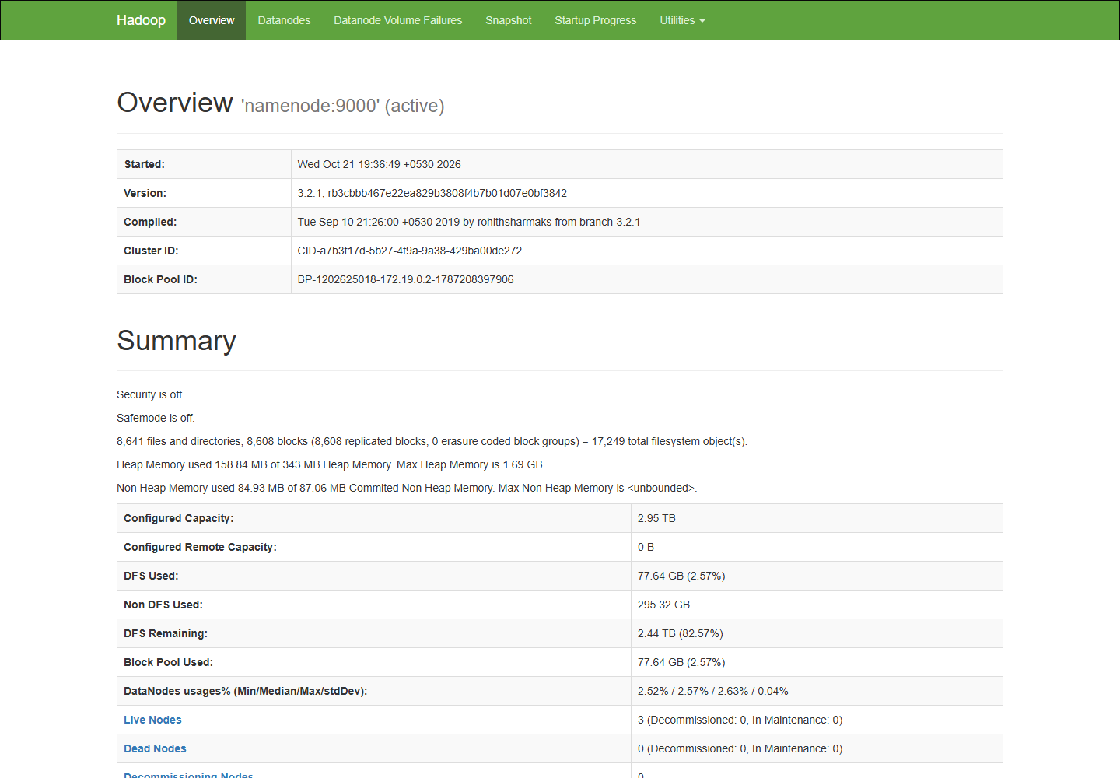
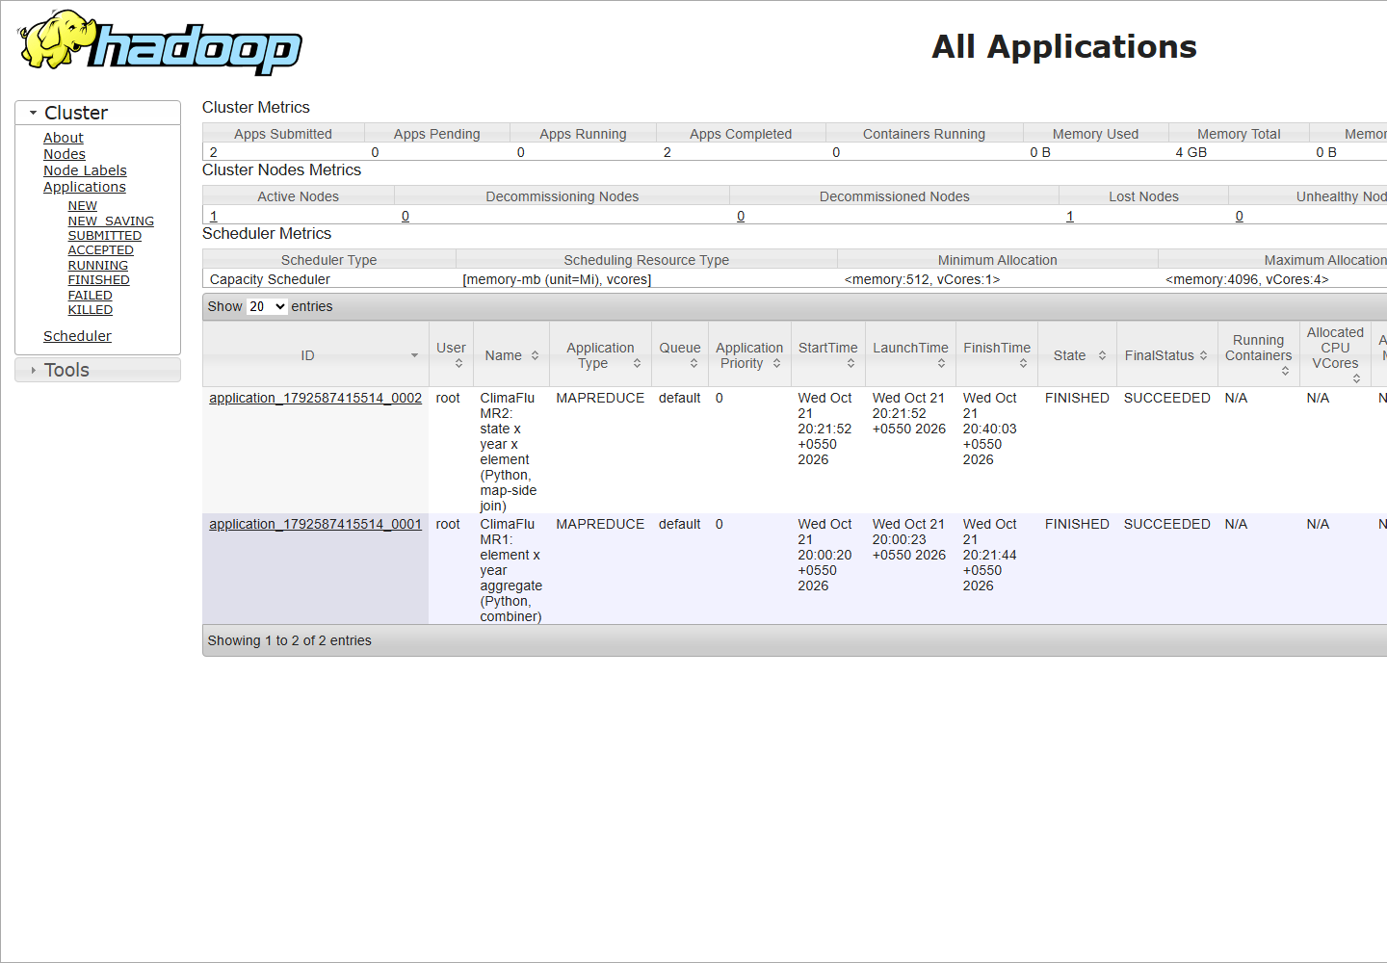
Backup: Hadoop evidence (HDFS and YARN web UIs)
HDFS NameNode (localhost:9870): 3 live DataNodes, safe mode off
YARN (localhost:8088): both Python MapReduce jobs SUCCEEDED
Notes:
Backup for questions about the cluster: NameNode page with live DataNodes; YARN page with the MapReduce applications.

Slide 14
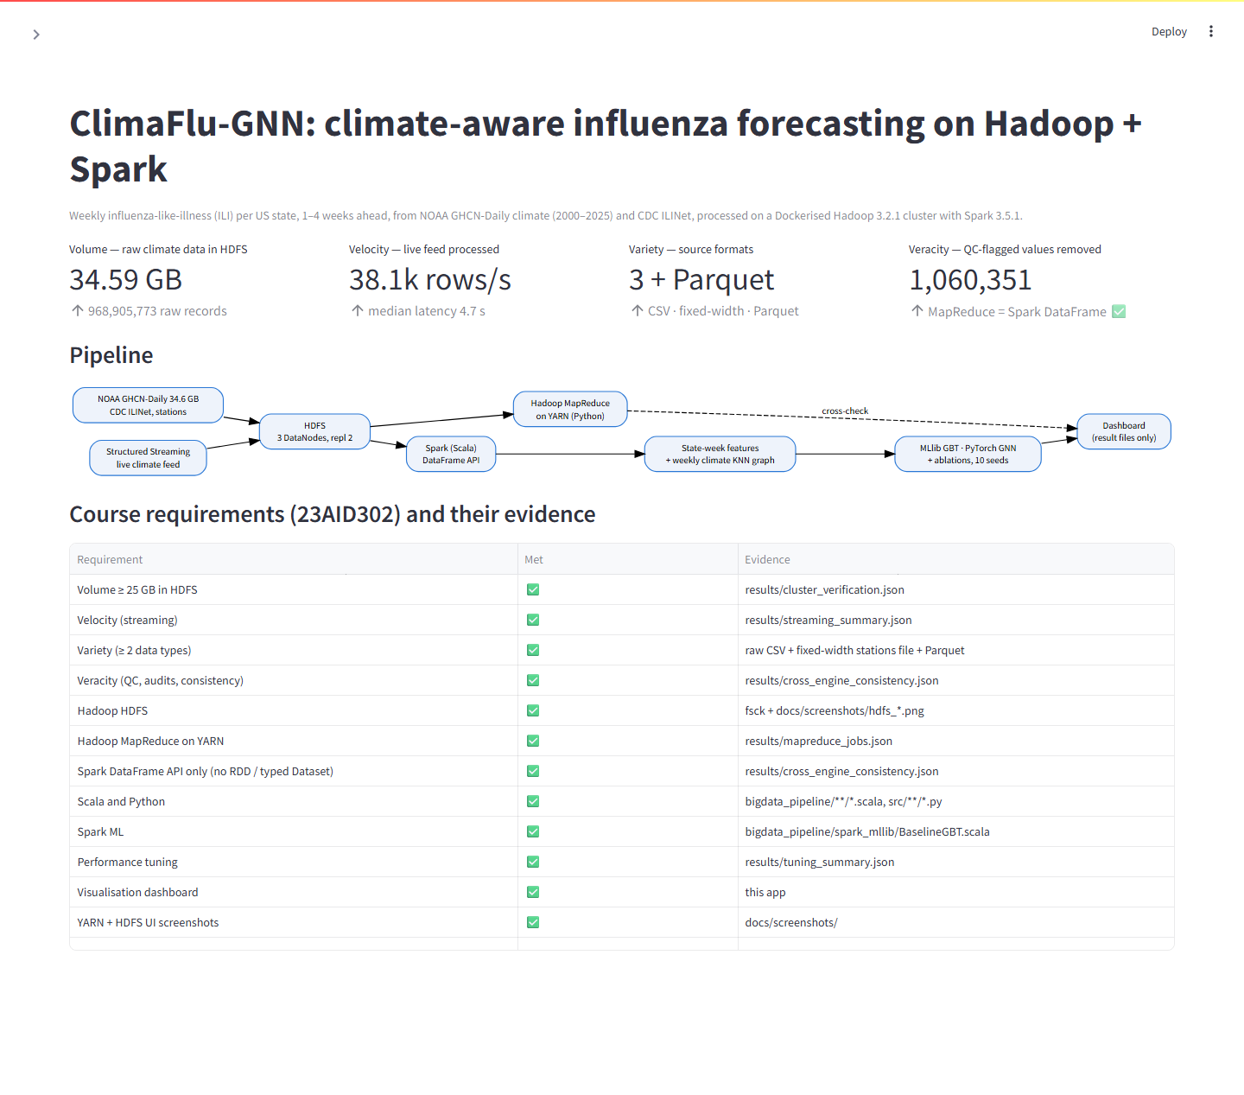
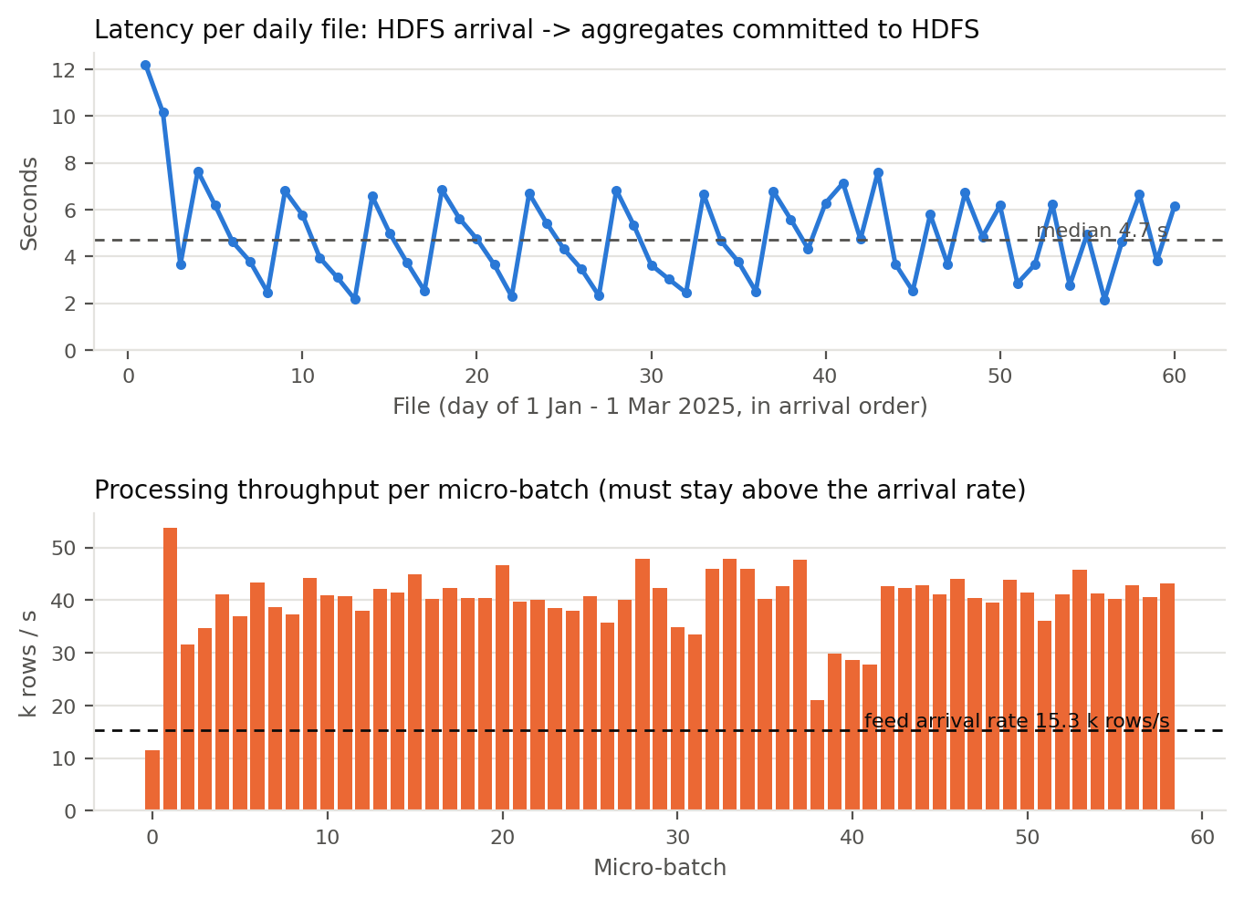
Backup: dashboard and live streaming
Streamlit dashboard (localhost:8501): 4 V's, cluster, forecasts, graph
Structured Streaming: 5.97 M rows, median latency 4.7 s
Notes:
Backup: the dashboard reads only result files; the streaming chart shows arrival-to-output latency per micro-batch.

