Slide 1
INFO5100
VANDANA RANGASWAMY
DHAANUSH AMRUTHUR SATISH
ANIRUDH RAJ
APPLICATION ENGINEERING AND DEVELOPMENT
EDUAID

Slide 2
EduAid
A student support system for the underprivileged, the underrepresented, the underserved — empowering them to overcome challenges and achieve their academic and personal goals.

Slide 3

EduAid is a dedicated platform with a mission to empower underprivileged college students.
Our goal is to break down barriers and ensure that every underprivileged college student has equal access to essential services, paving the way for their success.
Our platform is dedicated to offering a comprehensive support system for students facing economic challenges throughout their academic journey.

Slide 4
Access to essential services is a fundamental right. Yet, many underprivileged college students face obstacles that hinder their access to healthcare, housing, part-time jobs, and education.
The Importance of Support
By addressing these challenges, we aim to create an environment where students can focus on their studies without the burden of unmet needs

Slide 5
Limited Access to Healthcare:
27% of underprivileged college students face challenges in accessing affordable healthcare.
27%
Lack of healthcare resources contributes to health disparities, affecting both physical and mental well-being.

Slide 6
Inadequate Housing:
22% of underprivileged college students experience housing insecurity or homelessness.
22%
Unstable housing situations negatively impact students' ability to focus on academics and hinder overall stability.

Slide 7
Unemployment and Job Scarcity:
57% of underprivileged college students struggle to secure part-time employment.
Limited job opportunities lead to financial stress and may force students to prioritize work over studies.
57%

Slide 8
Medical Assistance
A student can consult with the on-site doctors.
The doctor can then access the student’s file and review past treatments
Key Features
The doctor can also include detailed diagnosis notes for future reference.

Slide 9
Job Opportunities
Job portal connects the students with local part-time job opportunities.
This helps in Skill-building resources to enhance employability and reduce the financial stress on them.
Key Features
The students can also find full-time jobs later on.

Slide 10
A student can request for an off- campus housing.
HOUSING SUPPORT
A list of affordable housing options near college campuses is presented and assigned to the student.
Key Features
Both temporary and permanant housing solutions are offered to students.

Slide 11

Higher Education Learning
Students can continue their education and pursue a graduate degree.
Students who were unable to continue their education due to financial constraints can now achieve a master’s degree
Key Features

Slide 12
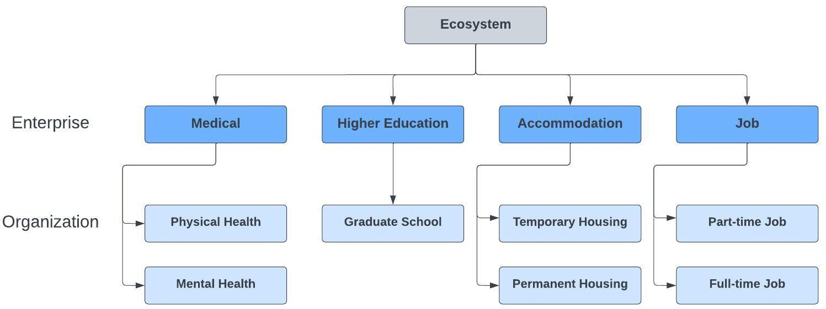
Ecosystem Architecture

Slide 13
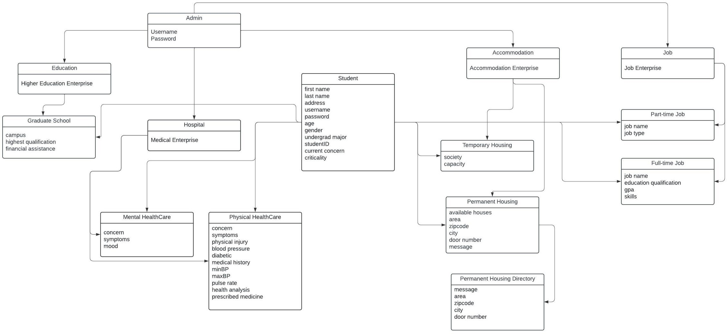
Object Model

Slide 14
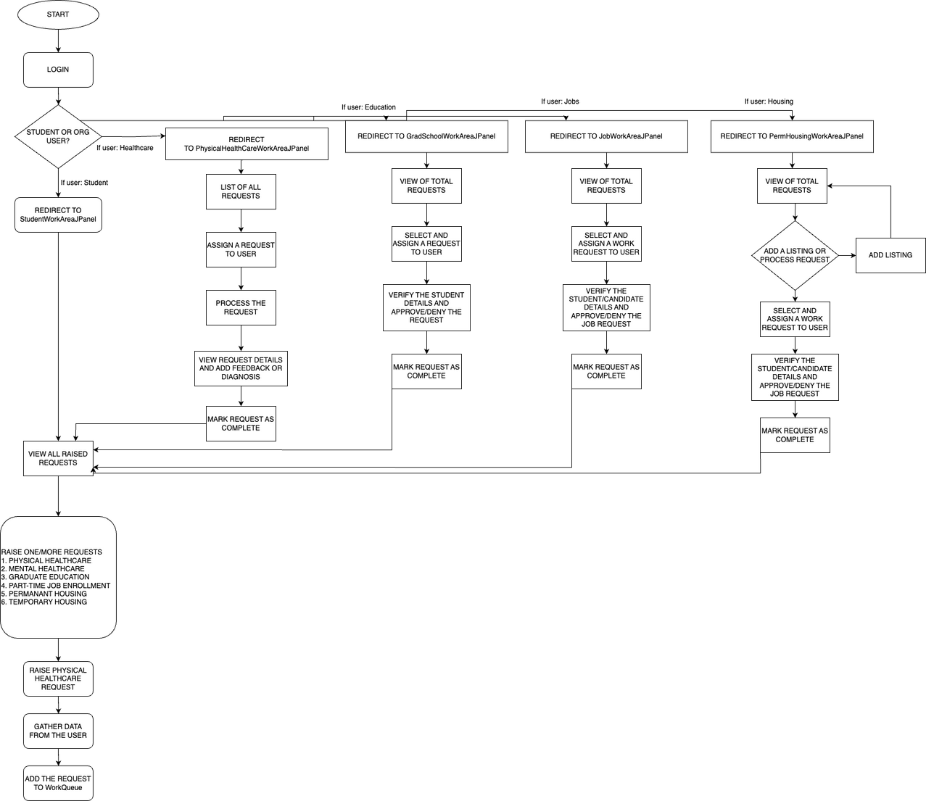
User Flow Model

Slide 15

Screenshot - Main Login page

Slide 16
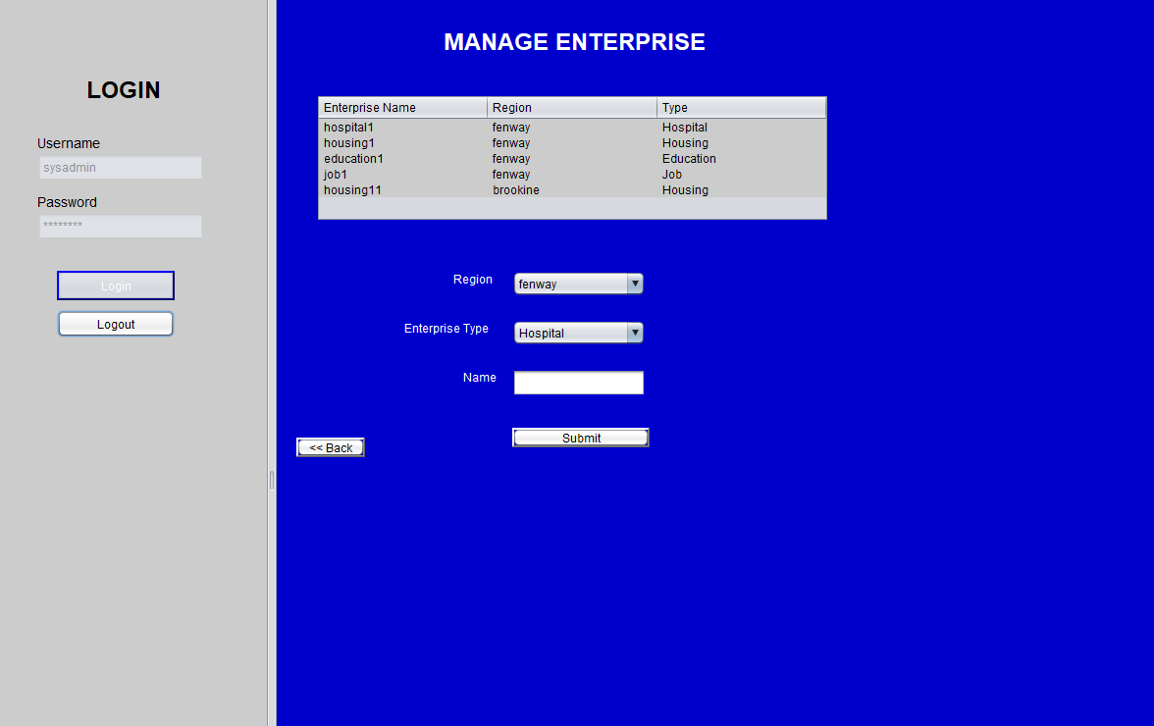
Screenshot - Enterprise Registration

Slide 17
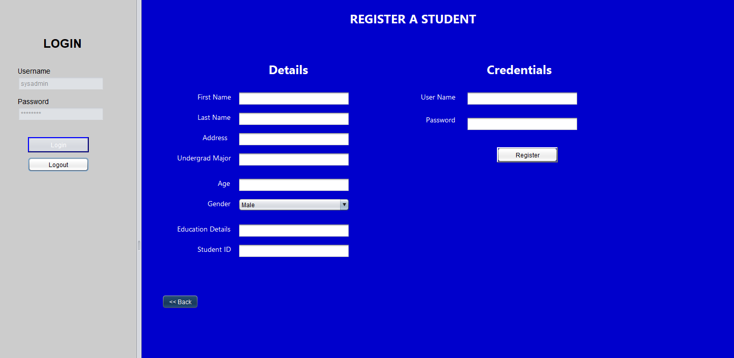
Screenshot - Student registration

Slide 18
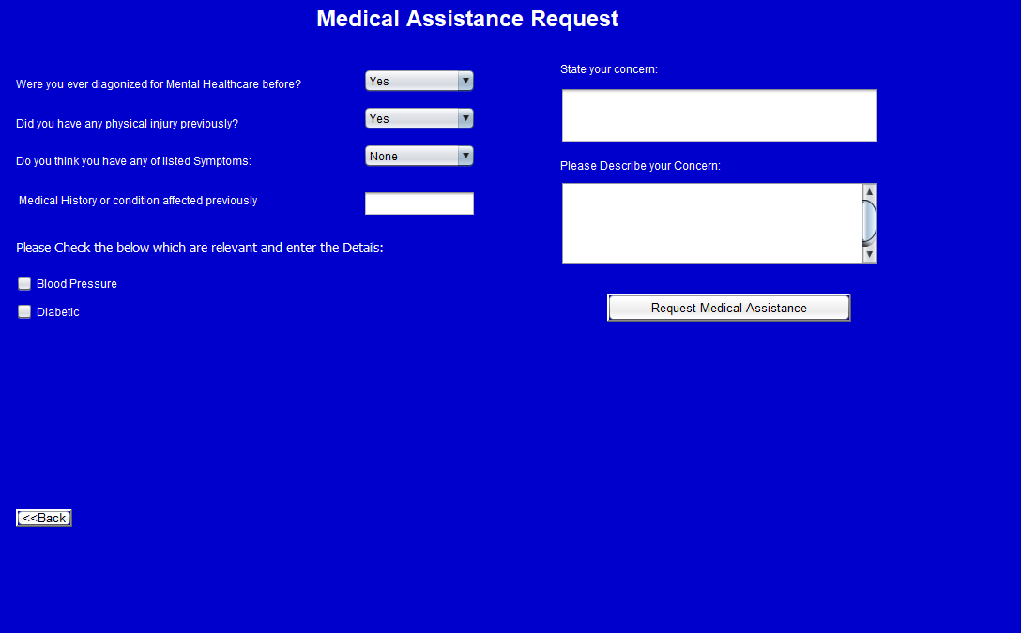
Screenshot - Medical Assistance Request

Slide 19
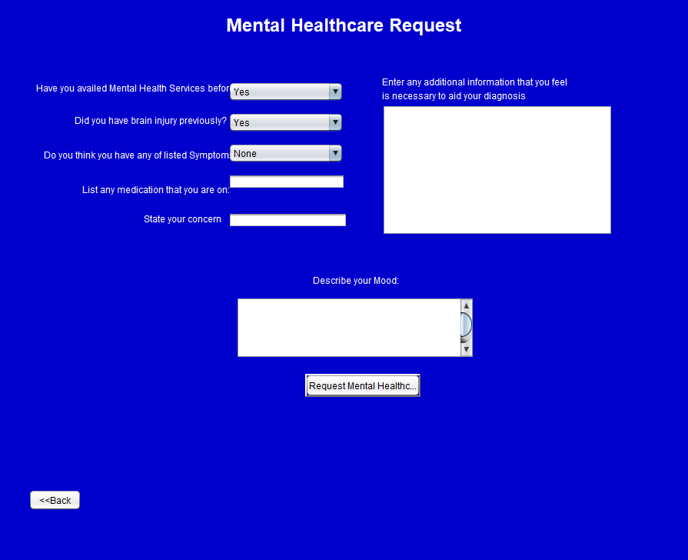
Screenshot - Mental Healthcare Request

Slide 20
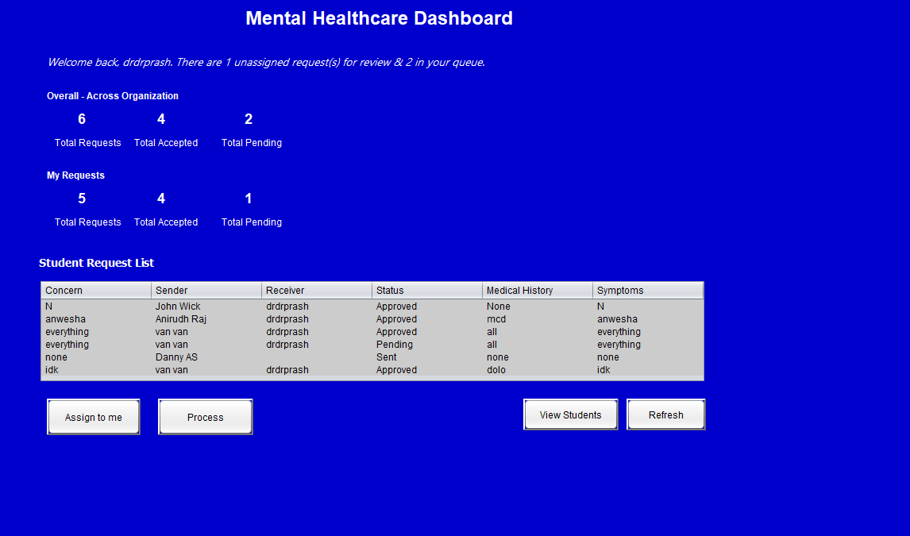
Screenshot - Mental Health Care Dashboard

Slide 21
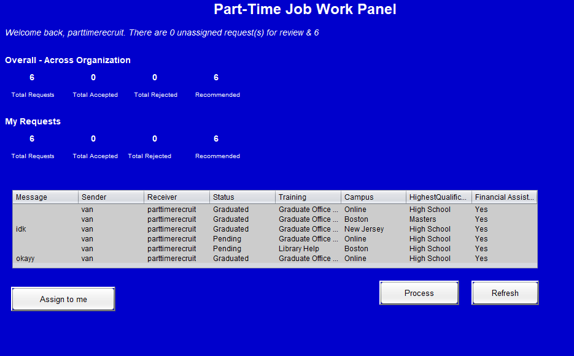
Screenshot - Job Dashboard

Slide 22
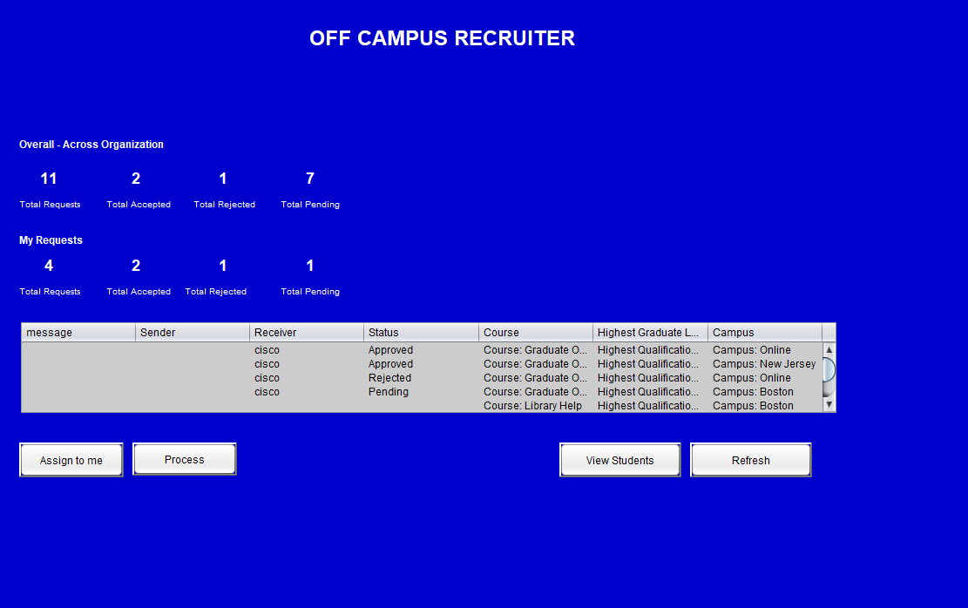
Screenshot - Job Request Queue

Slide 23
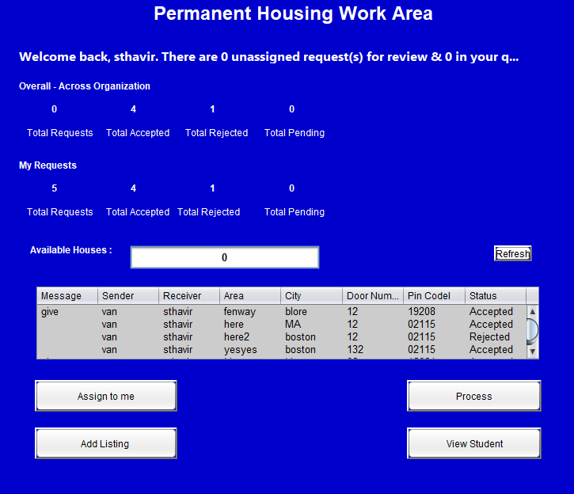
Screenshot - Housing Dashboard

Slide 24
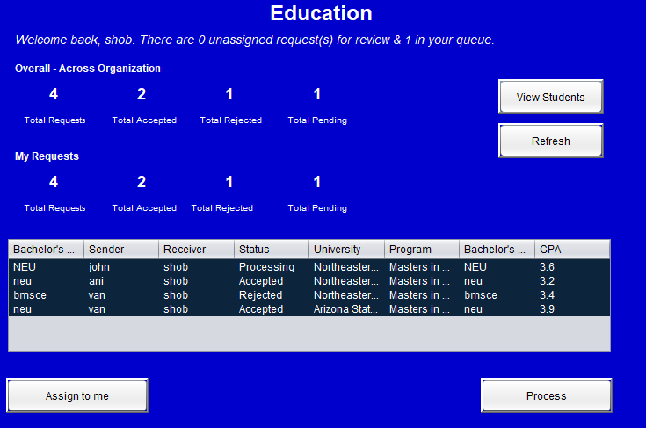
Screenshot - Education Dashboard

Slide 25
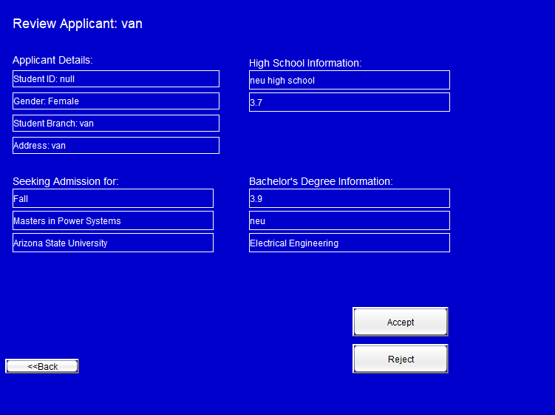
Screenshot - Education Work Queue

Slide 26
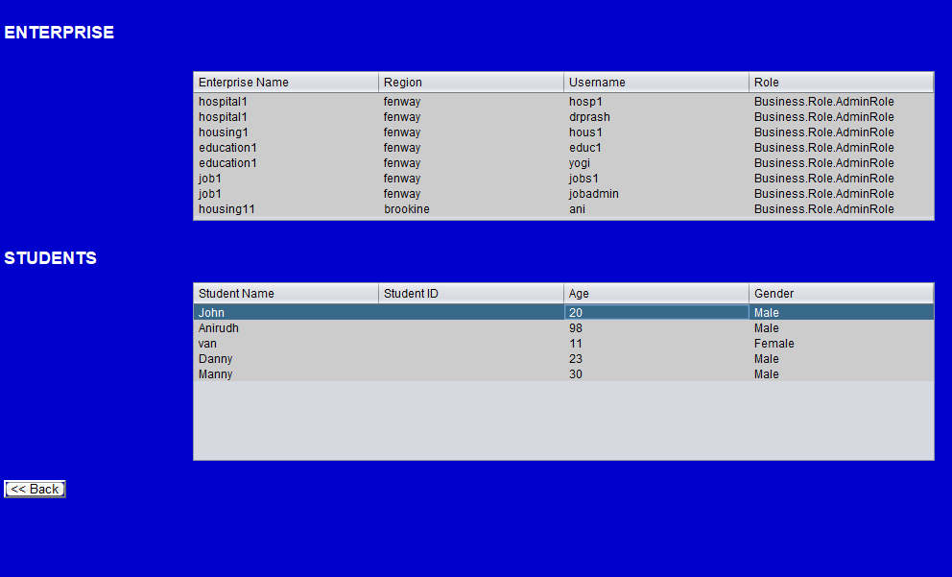
Screenshot - Report

Slide 27
Thank You

