Slide 1
Implementing A System Level Approach for Distributed Controller Synthesis
Vandan Parmar, Supervisors: James Anderson, Steven Low

Slide 2
Dynamical Systems
x[k+1] = Ax[k]

Slide 3
Dynamical Systems
x[k+1] = Ax[k]
OR
x̊ = Ax

Slide 4
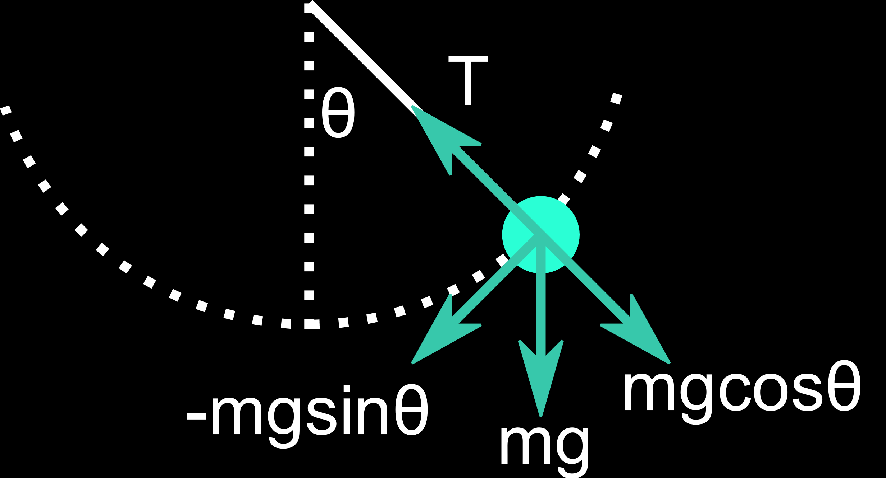
Simple Pendulum
x[k+1] = Ax[k]
OR
x̊ = Ax

Slide 5
Simple Pendulum
dθ/dt = ω
dω/dt = γω - mgsinθ

Slide 6
Simple Pendulum
dθ/dt = ω
dω/dt = γω - mgθ

Slide 7

Simple Pendulum
A = $\left[\begin{matrix}0 & 1 \\ −mg & γ\end{matrix}\right]$

Slide 8

What is a controller?
x[k+1] = Ax[k]

Slide 9

What is a controller?
x[k+1] = Ax[k]+Bu[k]

Slide 10

What is a controller?
x[k+1] = Ax[k]+Bu[k]
u[k]=Kx[k]

Slide 11
Least Quadratic Regulator (LQR)
x[k+1] = Ax[k]+Bu[k]
u[k]=Kx[k]
K = …
P = …

Slide 12
Least Quadratic Regulator (LQR)
x[k+1] = Ax[k]+Bu[k]
u[k]=Kx[k]
K = …
P = …
Example plot?

Slide 13
Youla Parameterisation?

Slide 14
System Level Approach

Slide 15
Basic Simulation

Slide 16
Comparison

Slide 17
Conclusions

Slide 18
Any questions?

