Slide 1


Slide 2
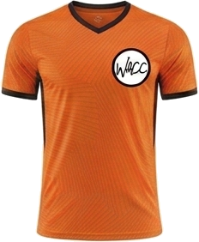
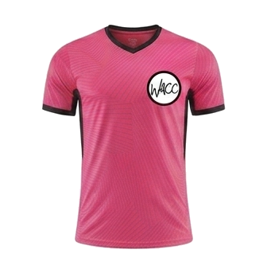
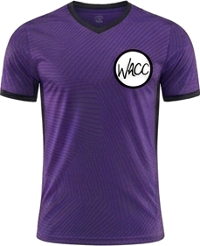
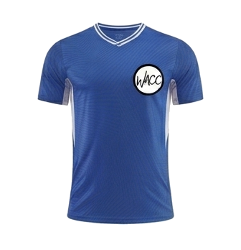
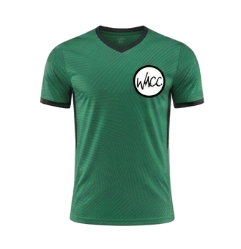
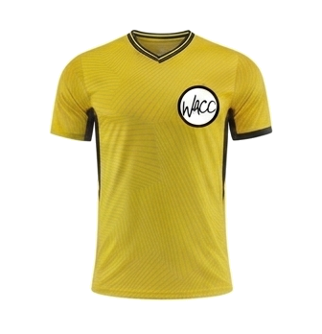
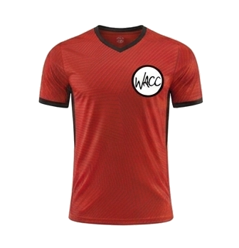
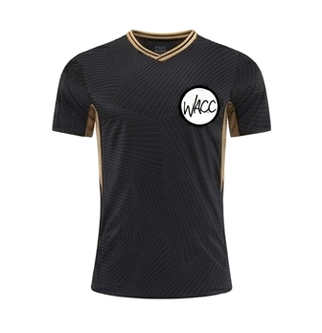
8 AM
CLINIC K
COURT 1
CK
COURT 3
CK
vs
vs
The Tigers
The Pink Tigers
Purple Hippos
Team 3
COURT 2
CK
COURT 4
CK
vs
vs
Green Dragons
Team 2
Team 5
Black Panthers
WACC SPORTS
OCTOBER 17, 2026

Slide 3
9 AM
PEE WEE
COURT 1
PW
COURT 2
PW
vs
vs
Orange Tigers
Pikachu Power
Green Dragons
Blue Pokemon
WACC SPORTS
OCTOBER 17, 2026

Slide 4
10 AM
MINOR BOYS
COURT 1
MB
COURT 2
MB
vs
vs
Team 4
Pink Doughnuts
Team 3
Minions
WACC SPORTS
OCTOBER 17, 2026

Slide 5
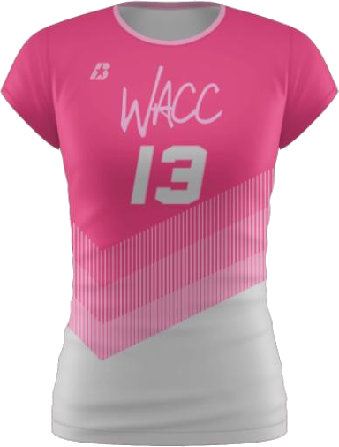
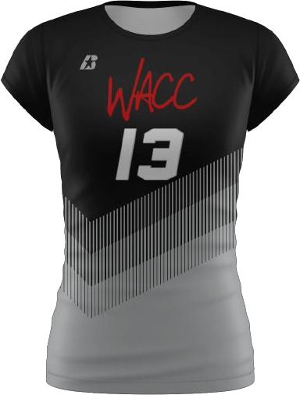
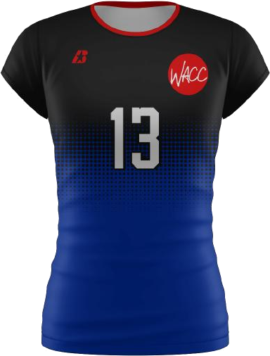
11 AM
MINOR GIRLS
COURT 1
MG
COURT 2
NO GAME
vs
at
THIS HOUR
Team Cat Girls
Pink Panthers
WACC SPORTS
OCTOBER 17, 2026

Slide 6
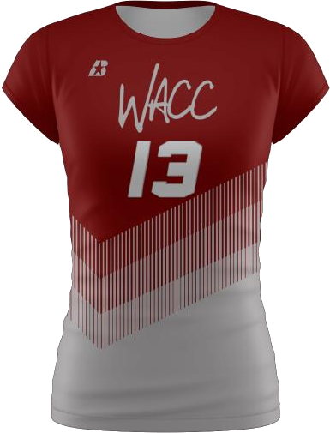
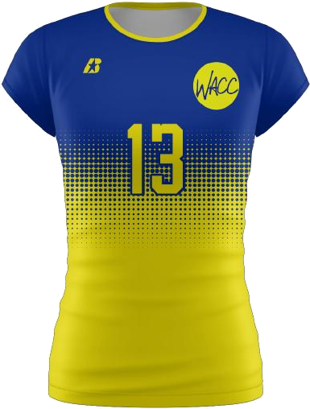
12:30 PM
MINOR BOYS & GIRLS
COURT 1
MBG
COURT 2
MBG
vs
vs
Cobras
Cherry Blossoms
Cougars
Thunderbolts
WACC SPORTS
OCTOBER 17, 2026

Slide 7
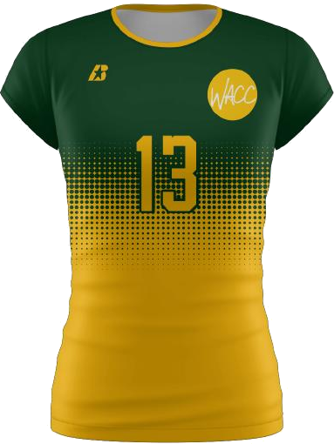
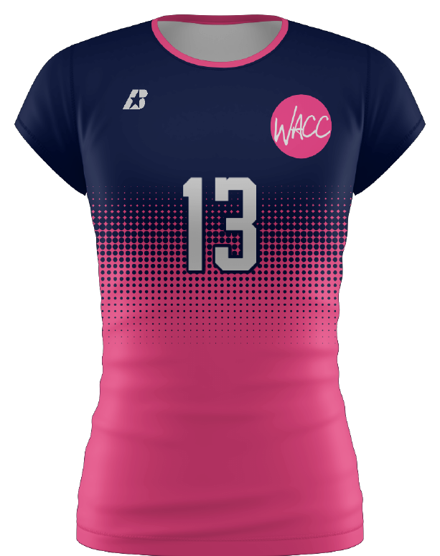
1:30 PM
MAJOR GIRLS
COURT 1
MJG
COURT 2
MJG
vs
vs
Warriors
Team 3
Team 7
Takis
WACC SPORTS
OCTOBER 17, 2026

Slide 8
2:30 PM
SENIOR GIRLS
COURT 1
SG
COURT 2
NO GAME
vs
at
THIS HOUR
Highlighters
Stingrays
WACC SPORTS
OCTOBER 17, 2026

Slide 9
3:30 PM
ELITE SENIOR GIRLS
COURT 1
ESG
COURT 2
ESG
vs
vs
Jaguars
Team 1
Blue Bananas
Team 2
WACC SPORTS
OCTOBER 17, 2026

