Slide 1


Slide 2
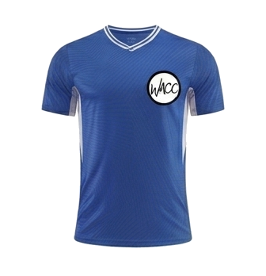
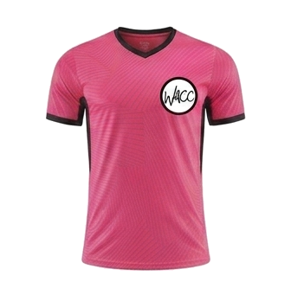
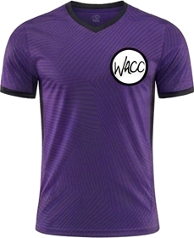
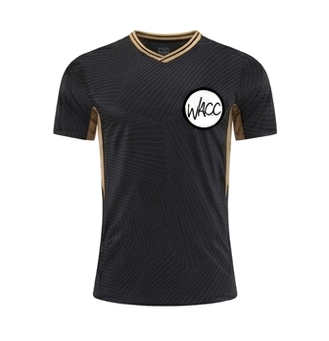
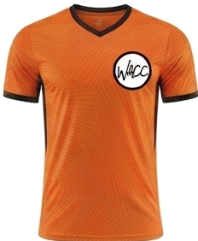
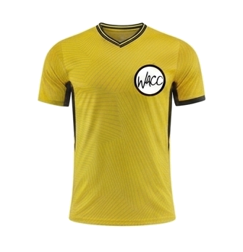
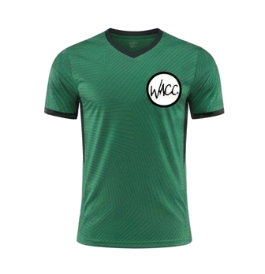
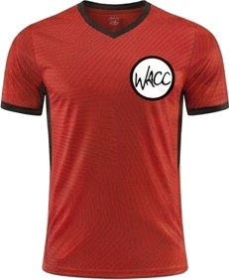
8 AM
CLINIC K
COURT 1
CK
COURT 3
CK
vs
vs
Team 3
Team 1
Purple Hippos
Black Panthers
COURT 2
CK
COURT 4
CK
vs
vs
The Tigers
Team 2
Green Dragons
Team 5
WACC SPORTS
SEPTEMBER 19, 2026

Slide 3
9 AM
PEE WEE
COURT 1
PW
COURT 2
PW
vs
vs
Team 7
Lightning Hawks
Team 5
Golden Knights
WACC SPORTS
SEPTEMBER 19, 2026

Slide 4
10 AM
MINOR BOYS
COURT 1
MB
COURT 2
MB
vs
vs
Team 4
Pink Doughnuts
Team 3
Minions
WACC SPORTS
SEPTEMBER 19, 2026

Slide 5
11 AM
MINOR GIRLS
COURT 1
MG
COURT 2
NO GAME
vs
at
THIS HOUR
Team Cat Girls
Team 1
WACC SPORTS
SEPTEMBER 19, 2026

