Slide 1


Slide 2
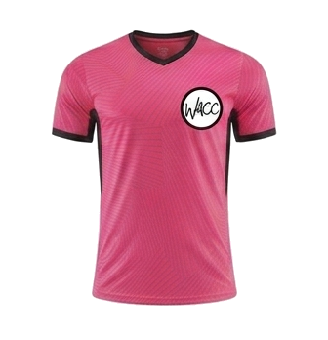
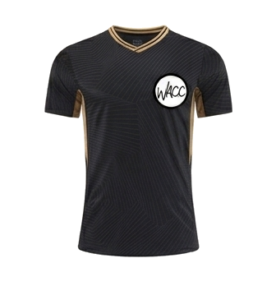
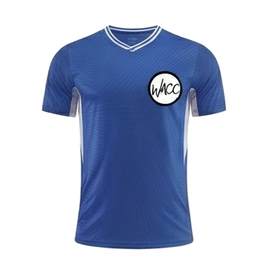

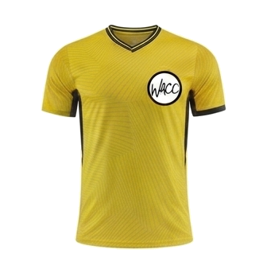

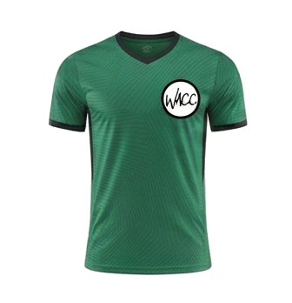
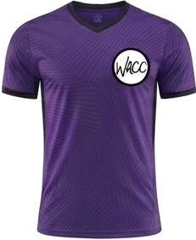
8 AM
CLINIC K
COURT 1
CK
COURT 3
CK
vs
vs
Team 1
Black Panthers
Team 3
The Tigers
COURT 2
CK
COURT 4
CK
vs
vs
Team 2
Team 5
Green Dragons
Purple Hippos
WACC SPORTS
SEPTEMBER 12, 2026

Slide 3
9 AM
PEE WEE
COURT 1
PW
COURT 2
PW
vs
vs
Team 3
Golden Knights
Lightning Hawks
Pikachu Power
WACC SPORTS
SEPTEMBER 12, 2026

Slide 4
10 AM
PEE WEE
COURT 1
PW
COURT 2
PW
vs
vs
Team 3
Team 7
Team 5
Orange Tigers
WACC SPORTS
SEPTEMBER 12, 2026

Slide 5
11 AM
MINOR BOYS
COURT 1
MB
COURT 2
MB
vs
vs
Pink Doughnuts
Minions
Team 3
Team 4
WACC SPORTS
SEPTEMBER 12, 2026

Slide 6
12 PM
MINOR GIRLS
COURT 1
MG
COURT 2
NO GAME
vs
at
THIS HOUR
Team 1
Team Cat Girls
WACC SPORTS
SEPTEMBER 12, 2026

Slide 7
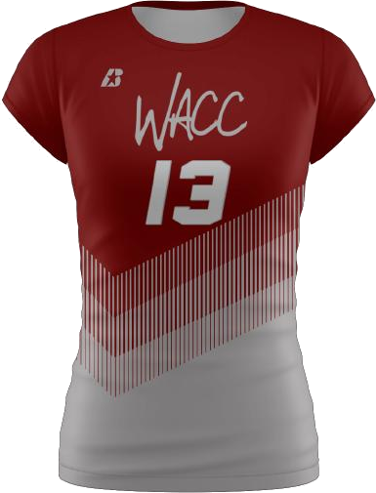
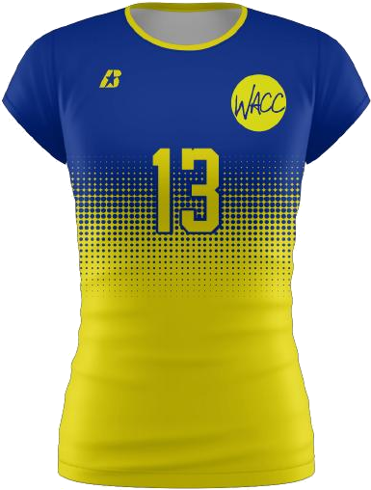
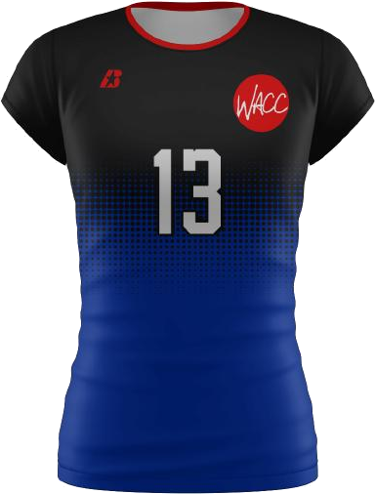
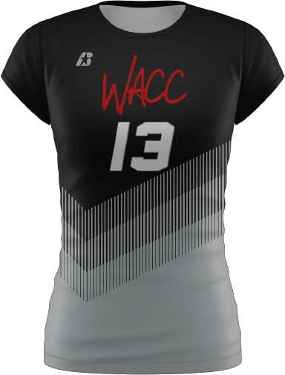
1:30 PM
MINOR BOYS & GIRLS
COURT 1
MBG
COURT 2
MBG
vs
vs
Cherry Blossoms
Team 4
Team 2
Cobras
WACC SPORTS
SEPTEMBER 12, 2026

Slide 8
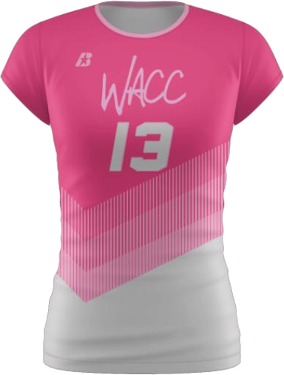
2:30 PM
MAJOR GIRLS
COURT 1
MJG
COURT 2
MJG
vs
vs
Team 3
Warriors
Cherry Blasts
Flamingo Paradise
WACC SPORTS
SEPTEMBER 12, 2026

Slide 9
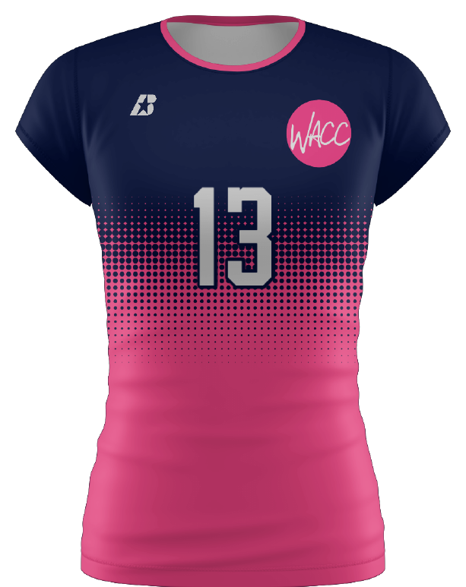
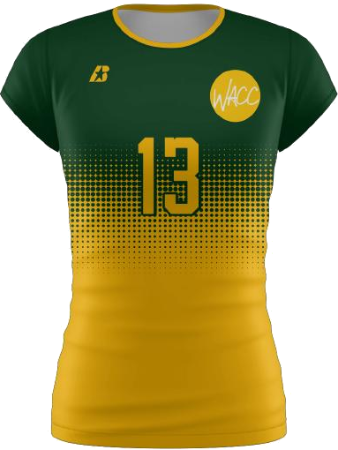
3:30 PM
MAJOR GIRLS
COURT 1
MJG
COURT 2
MJG
vs
vs
Team 2
Takis
Team 3
Team 7
WACC SPORTS
SEPTEMBER 12, 2026

Slide 10
4:30 PM
SENIOR GIRLS
COURT 1
SG
COURT 2
SG
vs
vs
Night Hawks
Stingrays
Team 4
Team 5
WACC SPORTS
SEPTEMBER 12, 2026

Slide 11
5:30 PM
SENIOR GIRLS
COURT 1
SG
COURT 2
NO GAME
vs
at
THIS HOUR
Night Hawks
Team 3
WACC SPORTS
SEPTEMBER 12, 2026

Slide 12
6:30 PM
ELITE SENIOR GIRLS
COURT 1
ESG
COURT 2
ESG
vs
vs
Team 1
Blue Bananas
Team 2
Jaguars
WACC SPORTS
SEPTEMBER 12, 2026

