Slide 1


Slide 2
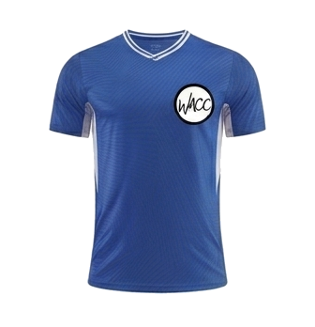
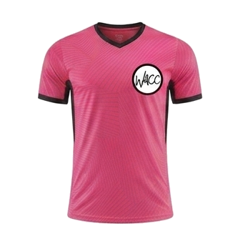
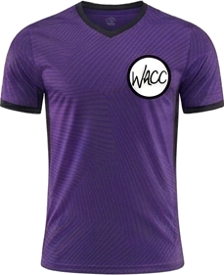
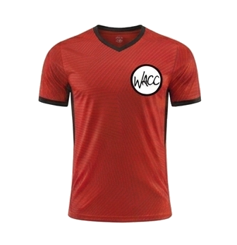
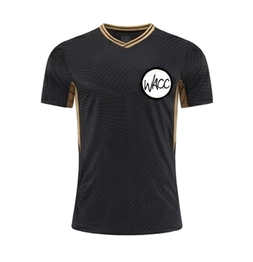
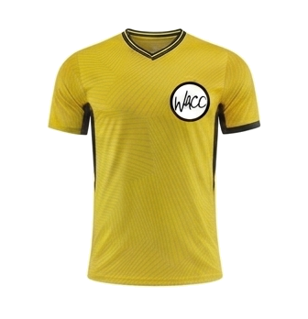
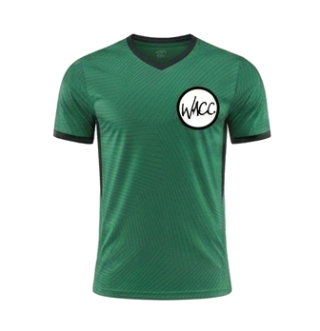
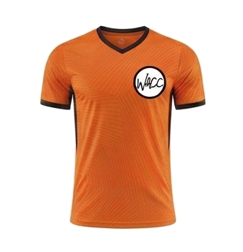
8 AM
CLINIC K
COURT 1
CK
COURT 3
CK
vs
vs
Team 3
The Pink Tigers
Purple Hippos
Team 5
COURT 2
CK
COURT 4
CK
vs
vs
Black Panthers
Team 2
Green Dragons
The Tigers
WACC SPORTS
OCTOBER 24, 2026

Slide 3
9 AM
PEE WEE
COURT 1
PW
COURT 2
PW
vs
vs
Green Dragons
Orange Tigers
Red Zombies
Pikachu Power
WACC SPORTS
OCTOBER 24, 2026

Slide 4
10 AM
PEE WEE
COURT 1
PW
COURT 2
PW
vs
vs
Orange Tigers
Lightning Hawks
Golden Knights
Blue Pokemon
WACC SPORTS
OCTOBER 24, 2026

Slide 5
11 AM
MINOR BOYS
COURT 1
MB
COURT 2
MB
vs
vs
Team 3
Pink Doughnuts
Team 4
Minions
WACC SPORTS
OCTOBER 24, 2026

Slide 6
12 PM
MINOR GIRLS
COURT 1
MG
COURT 2
NO GAME
vs
at
THIS HOUR
Team Cat Girls
Pink Panthers
WACC SPORTS
OCTOBER 24, 2026

Slide 7
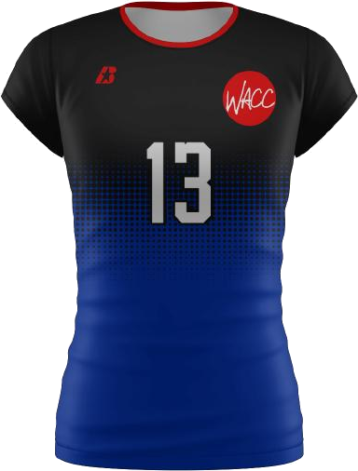
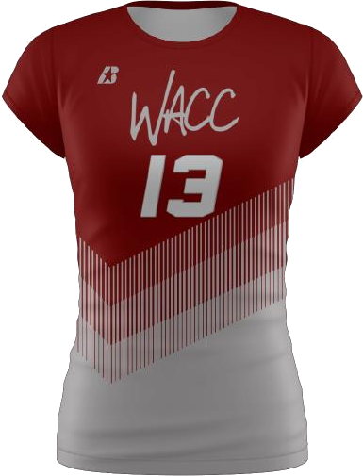
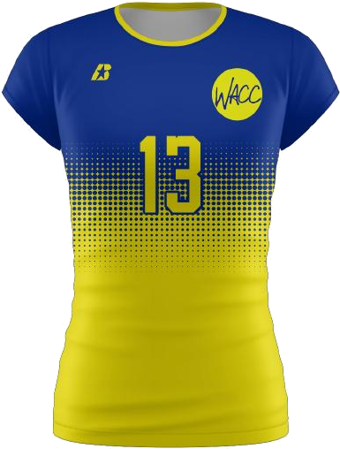
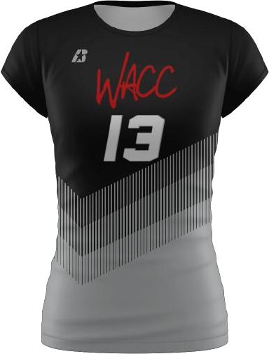
1:30 PM
MINOR BOYS & GIRLS
COURT 1
MBG
COURT 2
MBG
vs
vs
Thunderbolts
Cherry Blossoms
Cougars
Cobras
WACC SPORTS
OCTOBER 24, 2026

Slide 8
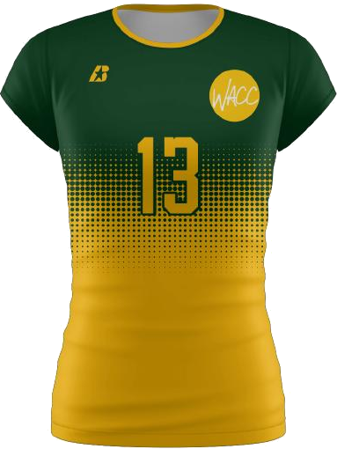
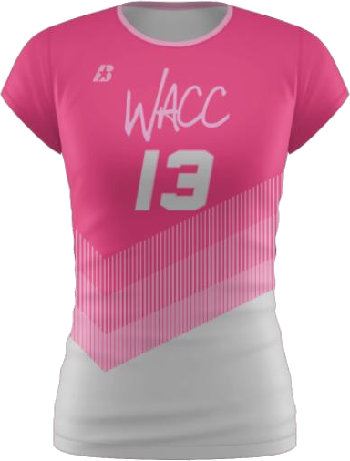
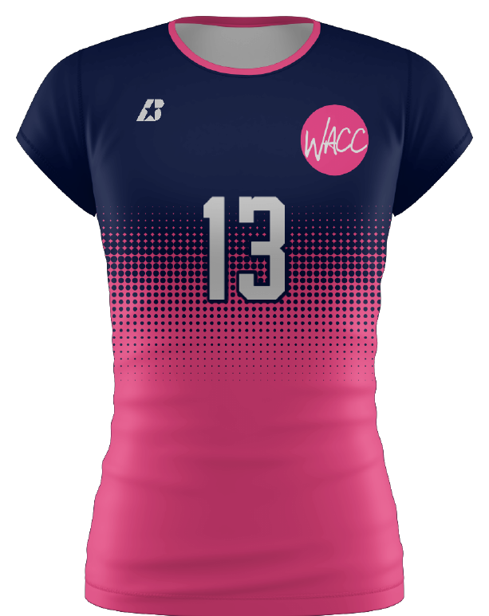
2:30 PM
MAJOR GIRLS
COURT 1
MJG
COURT 2
MJG
vs
vs
Team 7
Flamingo Paradise
Warriors
Cherry Blasts
WACC SPORTS
OCTOBER 24, 2026

Slide 9
3:30 PM
MAJOR GIRLS
COURT 1
MJG
COURT 2
MJG
vs
vs
Takis
Team 2
Flamingo Paradise
Team 3
WACC SPORTS
OCTOBER 24, 2026

Slide 10
4:30 PM
SENIOR GIRLS
COURT 1
SG
COURT 2
NO GAME
vs
at
THIS HOUR
Stingrays
Night Hawks
WACC SPORTS
OCTOBER 24, 2026

Slide 11
5:30 PM
SENIOR GIRLS
COURT 1
SG
COURT 2
SG
vs
vs
Team 5
Night Hawks
Highlighters
Team 3
WACC SPORTS
OCTOBER 24, 2026

Slide 12
6:30 PM
ELITE SENIOR GIRLS
COURT 1
ESG
COURT 2
ESG
vs
vs
Team 2
Team 1
Blue Bananas
Jaguars
WACC SPORTS
OCTOBER 24, 2026

