Slide 1
Clustering, Segmenting, and All That Jazz
Opening a Jazz Club in Toronto

Slide 2
An Opportunity
Toronto is situated between Detroit and Montreal, both of which are hubs for jazz artists and audiences.
  But, Toronto has not achieved this same distinction → Major opportunity for establishing a new jazz club in the city

Slide 3
Business Problem – Location, Location, Location
Optimal location(s) for a jazz club in Toronto?
  The establishment will provide live jazz & blues music, and serve southern-style barbecue, soul food, and Cajun cuisine

Slide 4
Data Sources
Wikipedia
  List of Toronto neighborhoods and postal codes
    https://en.wikipedia.org/List_of_postal_codes_of_Canada:_M
Coursera
  Geographic coordinates of Toronto neighborhoods
    http://cocl.us/Geospatial_data
Foursquare API
  Data on popular Toronto venues

Slide 5
Methods
Web scraping
  Toronto neighborhoods, boroughs, & postal codes acquired from Wikipedia as tabular data using Pandas
  Geographic coordinates (latitude/longitude) from Coursera site merged with existing dataframe

Slide 6
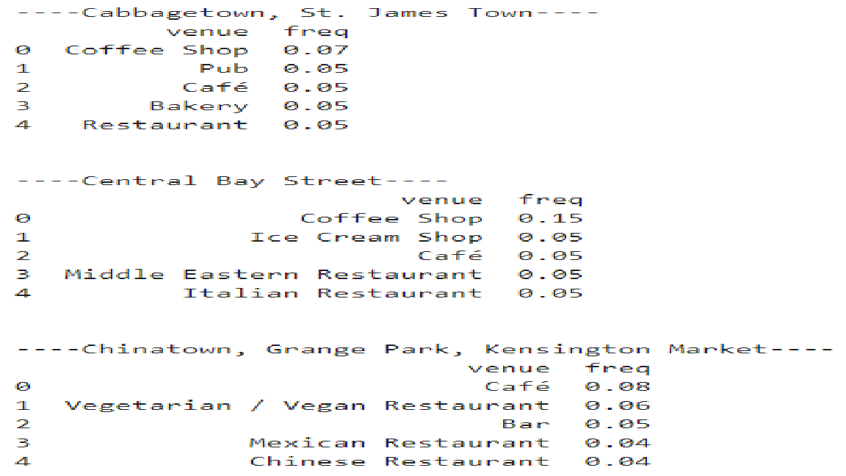
Methods
Analysis of venues
  Data from Foursquare API
    Venue categories used for analysis
  One hot encoding
    Venues grouped by category
  Frequency of each venue category within each neighborhood calculated
    Five most popular venue types per neighborhood →

Slide 7
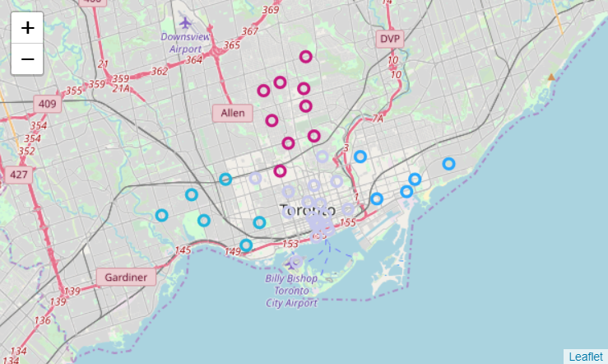
Methods
Toronto neighborhoods visualized – grouped by borough:

Slide 8
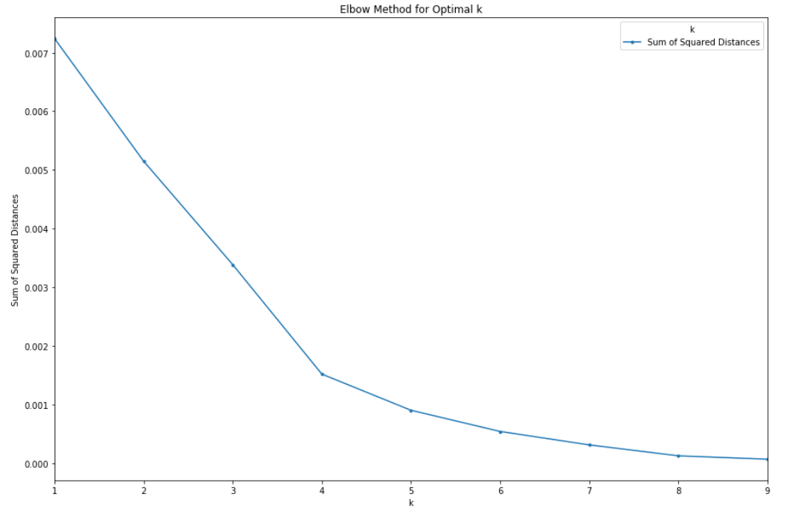
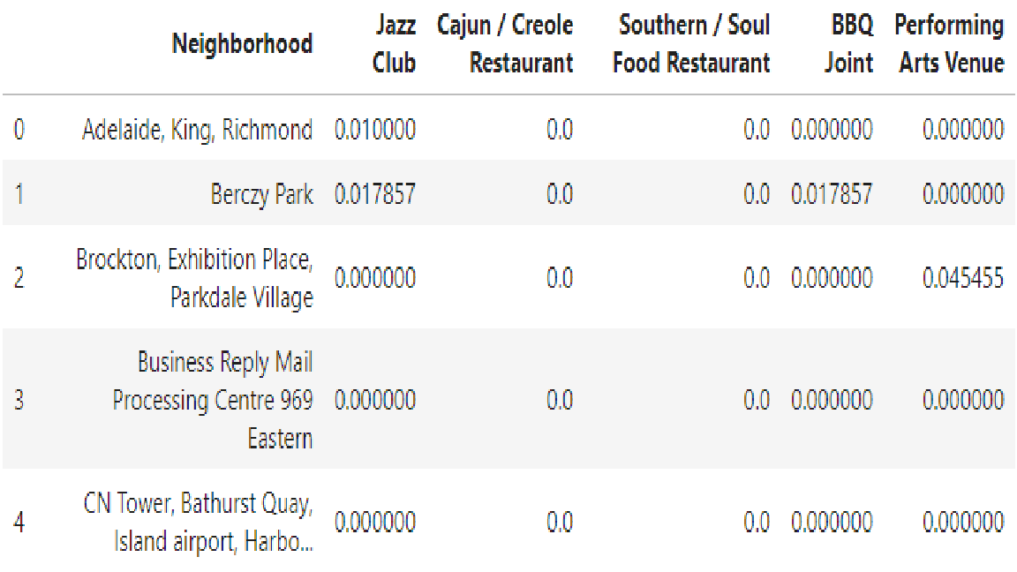
Methods
K-nearest neighbors
  Optimal k-value determined by elbow method = 4
  Clusters based on number & location of potentially competitive business types:

Slide 9
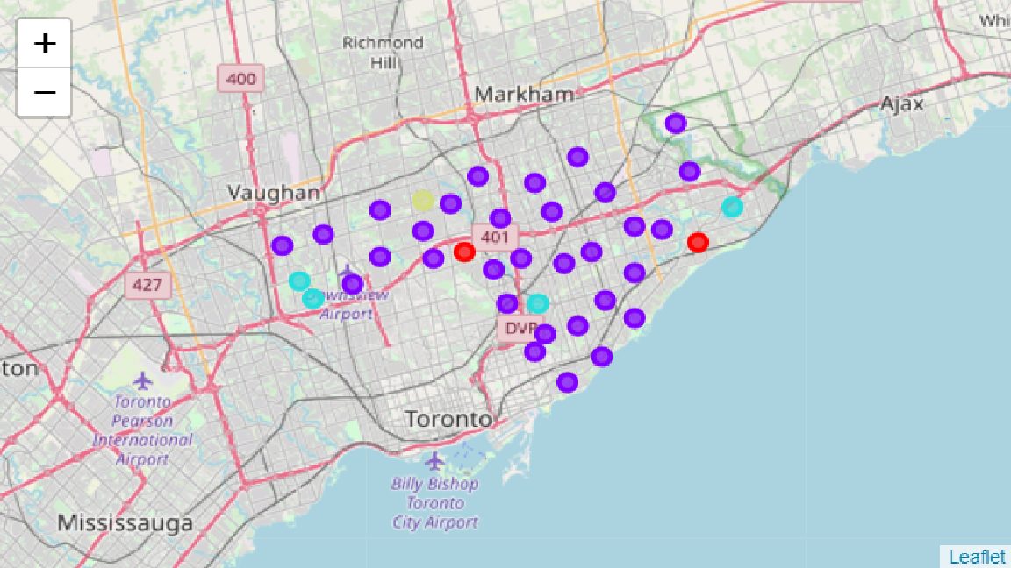
Results
Clusters visualized:

Slide 10
Conclusion
Toronto has an unfilled niche for jazz clubs & southern cuisine
Most locations are devoid of potential competitors, with a few exceptions:
  Clusters 3 & 4
  Berczy Park
  St. James Town
  High Park/The Junction South
**Maximize market share by opening establishment in a central location, away from competitors in the east and west

