Slide 1
AI and shock resilience:
Indications from euro area economies
Notes:
Commentaar: Berben, Bun, Mink

Slide 2
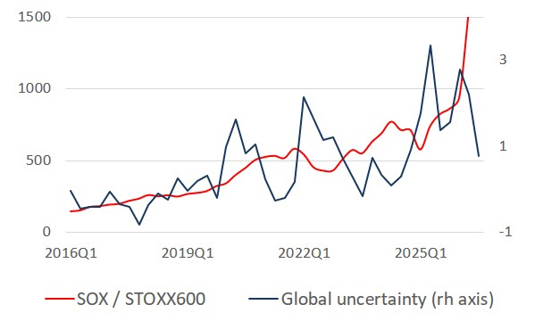
Semiconductor super-cycle seems immune to shocks
Strong upward trend in semiconductor market not derailed by global shocks
Does this mean that economies more exposed to ICT-tech (AI) are also more resilient to shocks?
Semiconductor stock index (SOX), controlled for by broad traditional stock index (STOXX Europe 600). Global uncertainty is first principal component of EPU, GPR, VIX (standardised).
Link to short-term cycle

Slide 3
Empirical approach
GDP growth surprises linked to ICT/AI-related activity
Data for 10 euro area countries, 2011-2025
Eur Com bi-annual forecast vintages
Unconditional bivariate tests
Panel regression models (linear and non-linear)

Slide 4
AI-related exposure
Investment channel
ICT/AI-investment can improve shock resilience by enhancing firms’ flexibility, information processing and supply chain management (Moujahid et al., 2025)
      digital investm by corporations, equity investm in AI firms
Trade and stock market channels
Exposure to global semiconductor cycle comes with positive trade effects from AI-related global activity (ECB, 2026)
      exports ICT/AI-related products, correlation with SOX index
Channels could capture structural and/or cyclical relations (underlying economic changes, or exposure to another cycle/factor)
Notes:
The variables for the investment channel are proxies for the use and the extent of which AI/ICT is applied by companies.

Slide 5
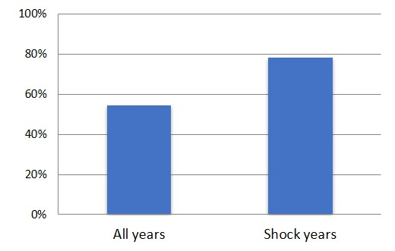
Shock resilience
Resilience → tendency of economy to bounce back from negative shocks (Eichengreen et al., 2024)
Proxied by positive GDP growth surprises (based on EC bi-annual forecasts 2011-25, 10 EA countries)
Positive growth surprises (% of EC forecasts)
Based on European Commission Spring and Autumn forecasts of GDP growth. Surprise = realised GDP growth minus forecast (all years 2011-2025, 548 obs and shock years 2020, 2022, 2025 (selection based on peaks in global uncertainty index, 120 obs).
Notes:
By pooling the GDP growth realizations in year t & t+1 and Spring & Autumn forecasts, you increases sample size and treats all forecasts as observations on the same forecasting problem.
However, surprises based on Autumn & Spring forecast and t & t+1 are not directly comparable; for instance uncertainty about t+1 forecast is higher than forecast t and similarly for Spring vs Autumn
Solution => add forecast-vintage controls: Autumn, horizon t+1, Autumn x horizon t+1 (Spring forecasts & forecasts for year t are the omitted reference categories). These terms control for systematic differences between Spring/Autumn forecasts and t/t+1 horizons….. this removes systematic differences between forecast types // interactieterm => Autumn-effect is anders voor t+1 dan voor t // holding AI constant (without controls, for instance, the AI coefficient is also estimated from variation in type of forecast)
Suppose that t+1 forecasts have more positive surprises because they are harder to predict. Then: $γ_{2}<0$ will absorb that systematic shift.
estimate how AI dependence IS associated with probability of positive GDP growth surprise, Holding constant whether the forecast is Spring or Autumn and whether it refers to year $t$or $t+1$

Slide 6
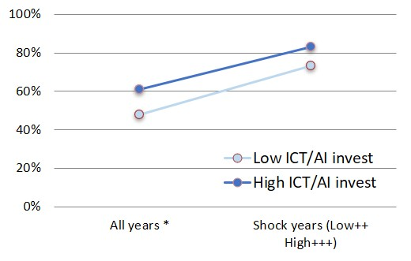
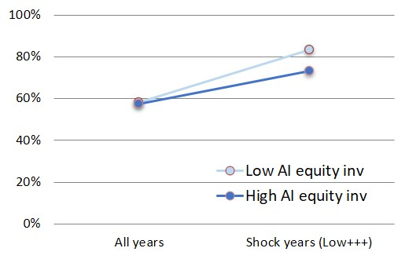
AI-related investment
Influence of AI-related investment on positive growth surprises
High ICT/AI-investm associated with more positive growth surprises …
… advantage not significant in shock years
Low equity AI invest seems to be a relative advantage in shock years (less sensitivity to shocks)
Lower vs higher than the time-varying median ICT/AI-exposure (10 EA countries, 2011-25 (all years), 2020, 2022, 2025 (shock years)). ***, **, * indicate 1%, 5%, 10% significance of difference between blue and grey dot in same period. +++, ++, + indicate 1%, 5%, 10% significance of difference between blue (grey) dots in all years vs shock years (country-clustered difference-in-shares test).

Slide 7
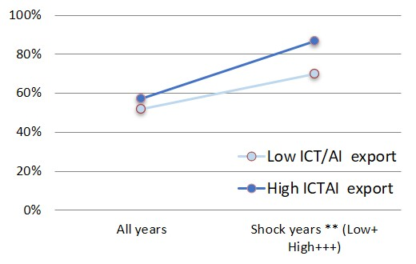
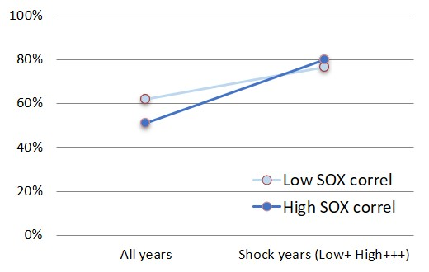
AI-related trade and stock market exposure
Influence of AI-related trade and stock market exposure
More positive growth surprises in shock years for countries with higher tech-exports …
… suggesting ICT/AI global demand is countercyclical and/or accelerates in shock years …
… which is not the case for stock market exposure; common component may dominate
Lower vs higher than the time-varying median ICT/AI-exposure (10 EA countries, 2011-25 (all years), 2020, 2022, 2025 (shock years)). ***, **, * indicate 1%, 5%, 10% significance of difference between blue and grey dot in same period. +++, ++, + indicate 1%, 5%, 10% significance of difference between blue (grey) dots in all years vs shock years (country-clustered difference-in-shares test).

Slide 8
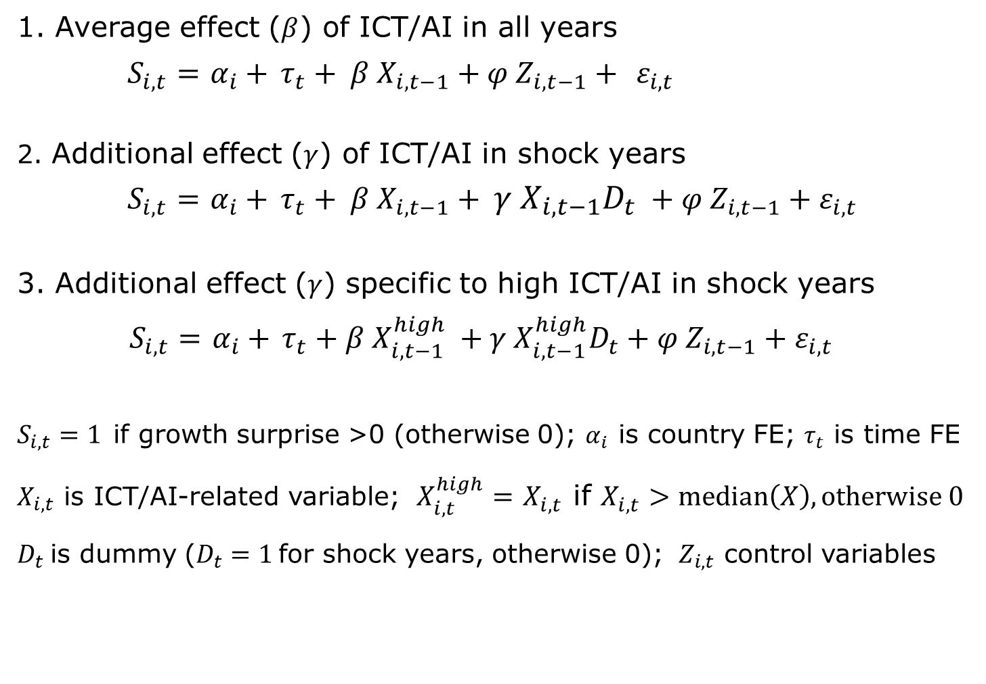
Linear probability models (LPM)
1. Average effect ($β$) of ICT/AI in all years
$S_{i,t}=$ $α_{i}+$ $τ_{t}+ β{ X}_{i,t−1}+φ{ Z}_{i,t−1}+ ε_{i,t}$
2. Additional effect ($γ$) of ICT/AI in shock years
$S_{i,t}=$ $α_{i}+$ $τ_{t}+ β{ X}_{i,t−1}+ γ X_{i,t−1}D_{t} +φ{ Z}_{i,t−1}+ε_{i,t}$
3. Additional effect ($γ$) specific to high ICT/AI in shock years
$S_{i,t}=$ $α_{i}+$ $τ_{t}+β{ X_{i,t−1}^{high}}_{ }+γ X_{i,t−1}^{high}D_{t}+φ{ Z}_{i,t−1}+ε_{i,t}$
$S_{i,t}=1$if growth surprise >0 (otherwise 0); $α_{i}$ is country FE; $τ_{t}$ is time FE
$X_{i,t}$ is ICT/AI-related variable; $X_{i,t}^{high}=$ $X_{i,t}$ if $X_{i,t}>median\left(X\right), otherwise 0$
$D_{t}$is dummy ($D_{t}=1$for shock years, otherwise 0); ${ Z}_{i,t}$ control variables
Notes:
Dependent variable is the unexpected component of GDP growth, while the explanatory variables describe the composition of GDP (investment or exports as a share of GDP). In doing so, the relationship does not describe an accounting identity. In addition, the ICT variables are recorded with a delay (previous ICT exposures explain later growth surprises).
Investing in ICT does not yet equal its effective application. It is a proxy, also for a country's exposure to the ICT factor without having to change economic processes.
Each year the median threshold for Above vs Below changes, so: each year the Above and Below groups of countries differ
The LPM-FE is attractive because country fixed effects can be included without the nonlinear incidental-parameters problem./ It allows the country effects to be arbitrarily correlated with ICT exposure
In LPM with FE the country-specific effect is treated as an unrestricted parameter that is eliminated through the within transformation. As a result, you do not need the assumption that the country effect is uncorrelated with ICT exposure (In a FE LPM, you transform the data by subtracting country means: // Therefore, estimation uses only within-country variation over time. Whether high-ICT countries have systematically larger or smaller $α_{i}$is irrelevant, because $α_{i}$has been removed)
bij een lineair model (LPM) werkt de within-transformatie, maar bij een probit-model niet (Door de niet-lineariteit blijft $α_{i}$verweven zitten in de kansfunctie en kun je hem niet wegtransformeren door te de-meanen); probit is daarom niet met FE te Schatten behalve CRE probit.

Slide 9
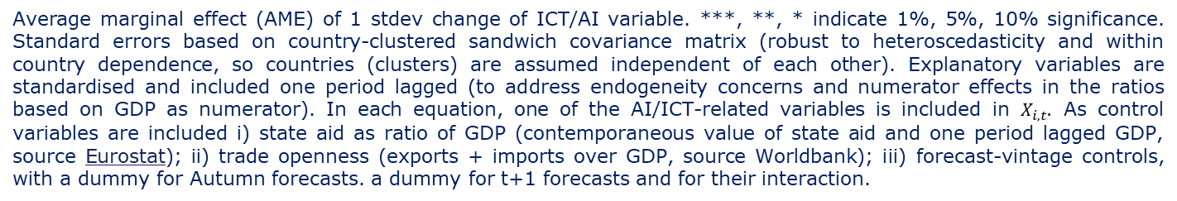
Results LPM models
ICT/AI-related investment → positive average effect on growth surprises
ICT/AI-related trade exposure → additional effect on positive growth surprise in shock years, confirming the unconditional tests
Average marginal effect (AME) of 1 stdev change of ICT/AI variable. ***, **, * indicate 1%, 5%, 10% significance. Standard errors based on country-clustered sandwich covariance matrix (robust to heteroscedasticity and within country dependence, so countries (clusters) are assumed independent of each other). Explanatory variables are standardised and included one period lagged (to address endogeneity concerns and numerator effects in the ratios based on GDP as numerator). In each equation, one of the AI/ICT-related variables is included in $X_{i,t}.$ As control variables are included i) state aid as ratio of GDP (contemporaneous value of state aid and one period lagged GDP, source Eurostat); ii) trade openness (exports + imports over GDP, source Worldbank); iii) forecast-vintage controls, with a dummy for Autumn forecasts. a dummy for t+1 forecasts and for their interaction.

Slide 10
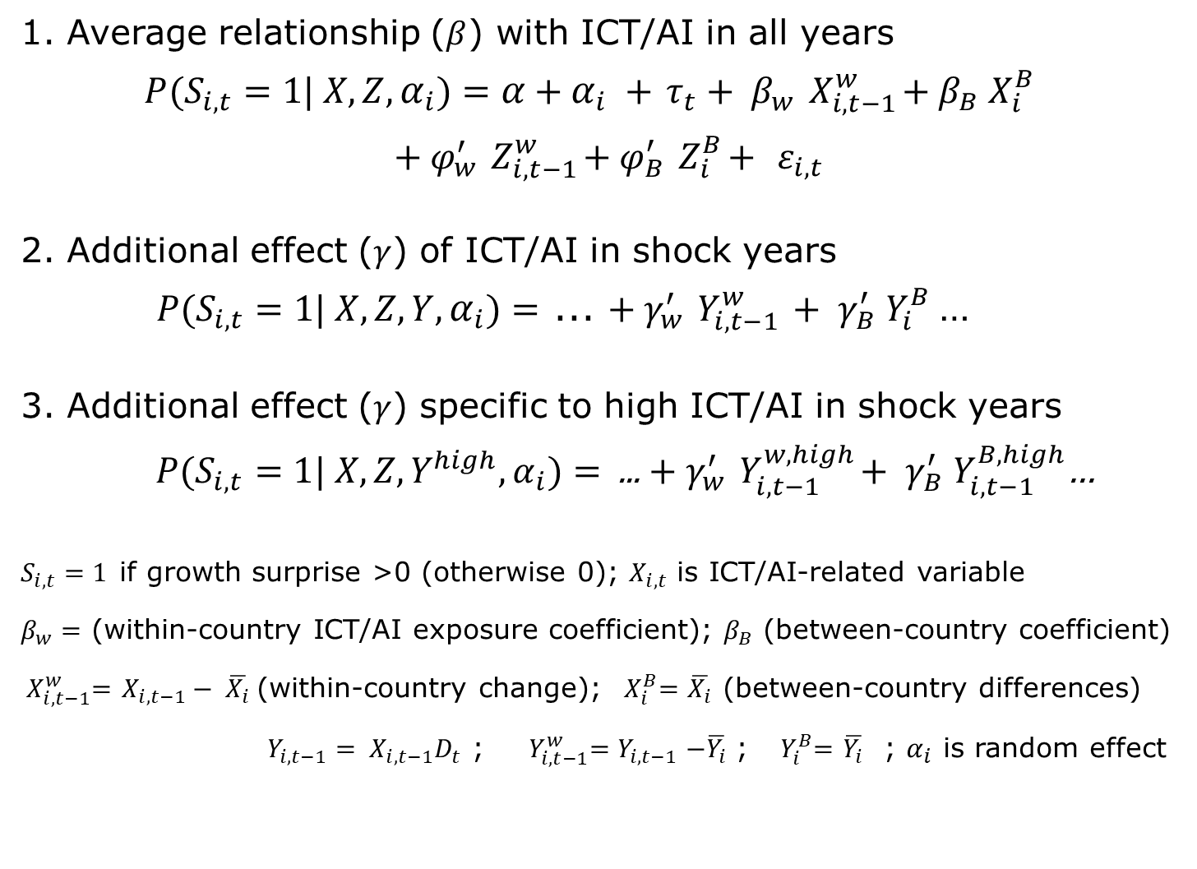
Correlated random-effects probit models (CRE)
1. Average relationship ($β$) with ICT/AI in all years
${P(S}_{i,t}=1| X, Z,α_{i})=α$ +$α_{i} +$ $τ_{t}+ β_{w}{ X}_{i,t−1}^{w}+β_{B} X_{i}^{B}$
$$+ φ_{w}^{′}{ Z}_{i,t−1}^{w}+φ_{B}^{′}{ Z}_{i}^{B}+ ε_{i,t}$$
2. Additional effect ($γ$) of ICT/AI in shock years
${P(S}_{i,t}=1| X, Z,Y,α_{i})=$ ... $+ γ_{w}^{′}{ Y}_{i,t−1}^{w} + γ_{B}^{′}{ Y}_{i}^{B}$…
3. Additional effect ($γ$) specific to high ICT/AI in shock years
${P(S}_{i,t}=1| X, Z,Y^{high},α_{i})=$ ... $+ γ_{w}^{′}{ Y}_{i,t−1}^{w, high}+ γ_{B}^{′}{ Y}_{i,t−1}^{B, high}$…
$S_{i,t}=1$if growth surprise >0 (otherwise 0); $X_{i,t}$ is ICT/AI-related variable
$β_{w}=$ (within-country ICT/AI exposure coefficient); $β_{B}$ (between-country coefficient)
${ X}_{i,t−1}^{w}=$ $X_{i,t−1}− \overline{X_{i}}$(within-country change); ${ X}_{i}^{B}=$ $\overline{X_{i}}$ (between-country differences)
$Y_{i,t−1}= X_{i,t−1}D_{t}$ ; ${ Y}_{i,t−1}^{w}{=Y}_{i,t−1}−\overline{Y_{i}}$ ; ${ Y}_{i}^{B}=$ $\overline{Y_{i}}$ ; $α_{i}$ is random effect
Notes:
The CRE probit, also known as the Mundlak approach, is the nonlinear analogue of the fixed-effects LPM.
CRE probit using Mundlak formulation, including country means of the time-varying explanatory variables and controls (within/between decompositions of ICT and the enabled time-varying controls.). This permits persistent unobserved country heterogeneity to be correlated with ICT exposure. Inference accounts for within-country dependence. Including means of explanatory variables makes random component alpha_i (=remaining unobserved country heterogeneity, = country random effect) independent of the regressors.
.Beta_w = within country effect (Beta_w * (X_t - X_mean): what happens when X changes within a country
Mundlak country means adequately capture the correlation between ICT exposure and persistent country heterogeneity => FE probit model estimates a separate intercept for each country, whereas CRE probit assumes a normally distributed country random intercept and models its correlation with the regressors through their country means

Slide 11
Results CRE probit models
ICT/AI-related investment → positive average effect on growth surprises
ICT/AI-related trade exposure → additional effect on positive growth surprise in shock years, confirming the unconditional tests
Average marginal effect (AME) of 1 stdev change of ICT/AI variable. ***, **, * indicate 1%, 5%, 10% significance. Standard errors based on country-clustered sandwich covariance matrix (robust to heteroscedasticity and within country dependence, so countries (clusters) are assumed independent of each other). Explanatory variables are standardised and included one period lagged (to address endogeneity concerns and numerator effects in the ratios based on GDP as numerator). In each equation, one of the AI/ICT-related variables is included in $X_{i,t}.$ As control variables are included i) state aid as ratio of GDP (contemporaneous value of state aid and one period lagged GDP, source Eurostat); ii) trade openness (exports + imports over GDP, source Worldbank); iii) forecast-vintage controls, with a dummy for Autumn forecasts. a dummy for t+1 forecasts and for their interaction.

Slide 12
Conclusions
Positive growth surprises more common in shock years than in normal years, pointing to larger than expected resilience
ICT/AI-related corporate investment matters in normal times
AI equity investment does not play this role and even seems to be a relative disadvantage during shocks
Trade exposure has been a resilience channel in shock years (AI-stock market correlation has not) …
… but if a future shock would originate from the AI sector itself, high-tech trade exposure could turn from an advantage into a vulnerability

Slide 13
Background slides

Slide 14
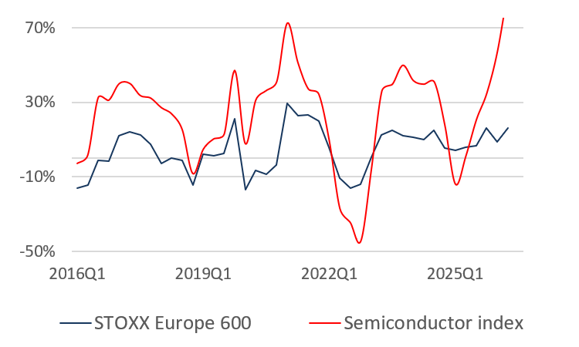
Wild swings in semiconductor short-term cycle
Short-term semiconductor cycle more volatile than traditional stocks
Annual log return of STOXX Europe 600 and Semiconductor stock index (SOX), source Yahoo Finance. Link back.

Slide 15
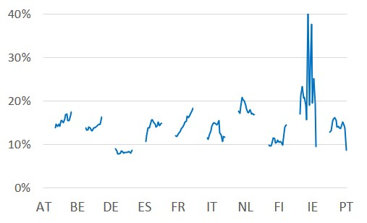
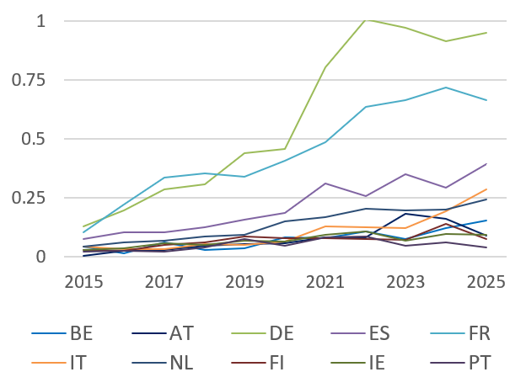
AI-related investment
ICT/AI investment ratio
Number of equity investments in AI fields
Share of ICT/AI-related investment in total GFCF
Annual data 2000-2025 (for countries of which 2025 data is not available yet; 2024 data is used). Product groups: N1132G, N1173G, N112G_secJ, N117G_secJ, N1173G_secJ (source: Eurostat).
Number of incoming equity investments in AI fields, scaled by GDP. Annual data 2015-2025 (Source: ETO's CAT, Country Activity Tracker).
Link back

Slide 16
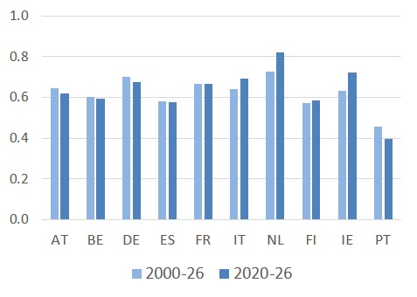
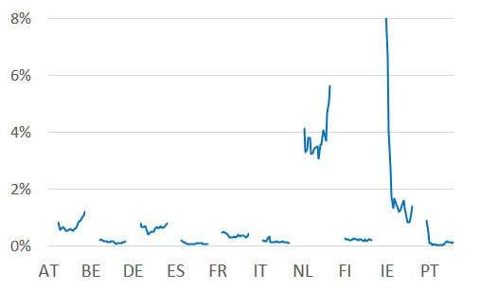
AI-related trade and stock market exposure
ICT/AI-related export share
Correlation national stock index and SOX index
Share of ICT/AI-related exports in total goods exports, Annual data 2000-2025. Products groups: HS 8471.50, HS 8471.80, HS 8473.30, HS 8486.10, HS 8486.20, HS 8486.30, HS 8486.40, HS 8486.90 (source: Eurostat, Comext, HS2022).
Rolling correlation between national stock index and SOX index (8 quarters window). Quarterly data 2000Q1-2026Q2 (Source: Yahoo Finance).
Link back

Slide 17
Robustness tests
Trade data based on Eurostat CPA instead of HS → similar results
Forecast vintage controls → similar results
Different choice of shock years (to do)
Modified stock index correlation variable (to do)
Other control variables (to do)
Notes:
Robustness check with CPA data (goods) intra + extra-EA trade for the 10 countries
CPA 2.2 261 Electronic components and boards
CPA 2.2 262 Computers and peripheral equipment
CPA 2.2 2899 Other special-purpose machinery n.e.c.
Data for computer services (Eurostat: EBOPS, International Trade in Services, ITS are just limitedly available (for some countries just starting in 2013, while 2025 data is not yet available for any country)
=> to fetch these data =>collect_ai_data_eur_serv.py // spreadsheet with data including services = ai_data_eur_serv.xls

