Slide 1
Coded UI Testing
Checklists & Guidelines
Bachelorproject

Slide 2
Overzicht
Global Checklist
Paradigm Checklist
Page Checklist
Guideline
Questions

Slide 3
Overzicht
Global Checklist
Paradigm Checklist
Page Checklist
Guideline
Questions

Slide 4
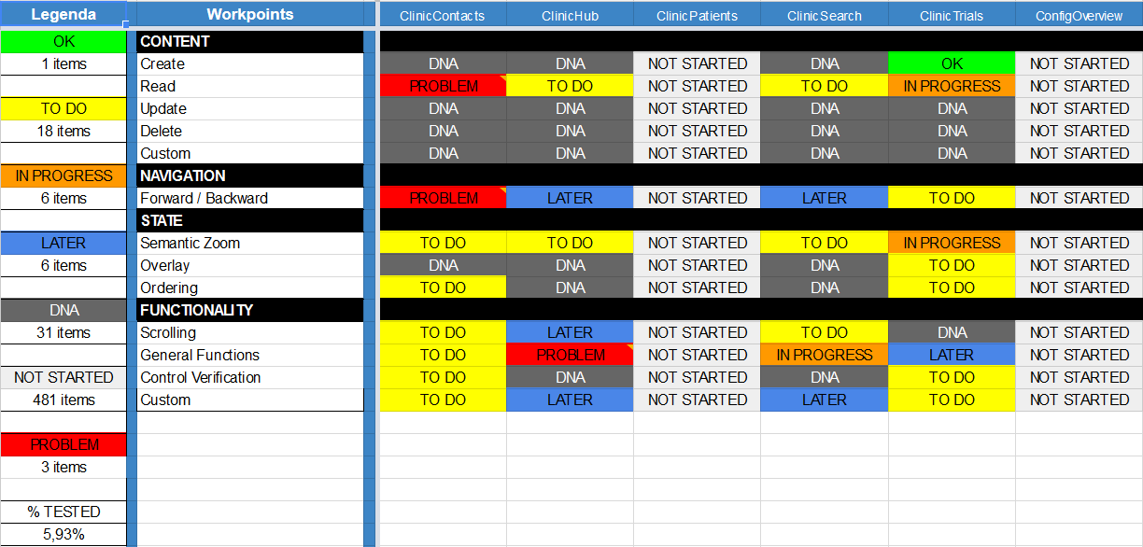
Global checklist

Slide 5
Overzicht
Global Checklist
Paradigm Checklist
Page Checklist
Guideline
Questions

Slide 6
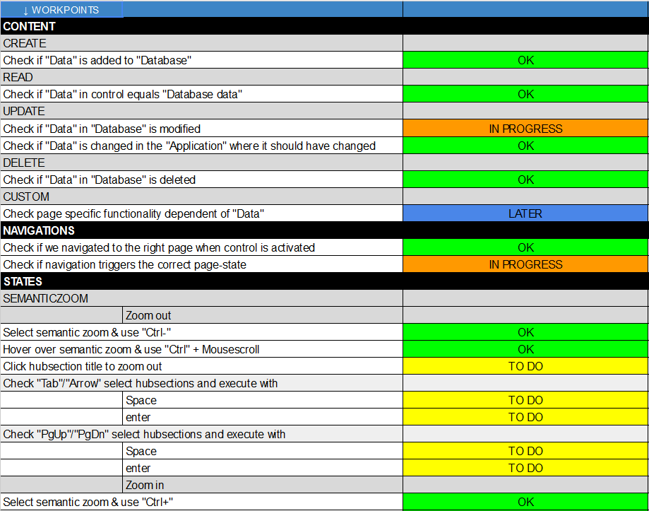
PAradigm Checklist

Slide 7
Overzicht
Global Checklist
Paradigm Checklist
Page Checklist
Guideline
Questions

Slide 8
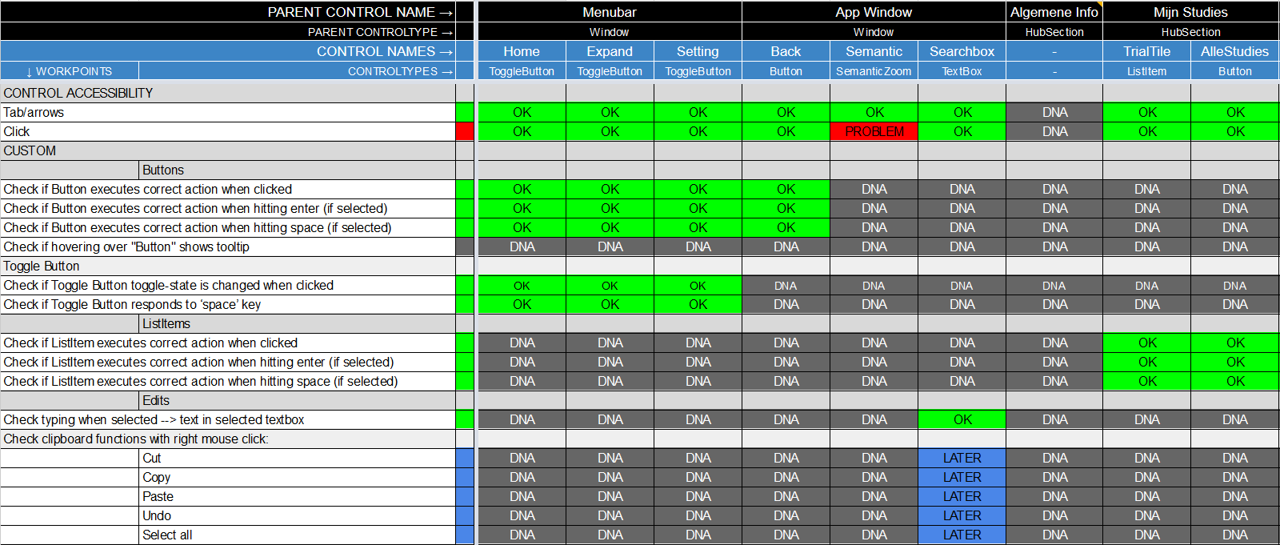
Page Checklist

Slide 9
Overzicht
Global Checklist
Paradigm Checklist
Page Checklist
Guideline
Questions

Slide 10
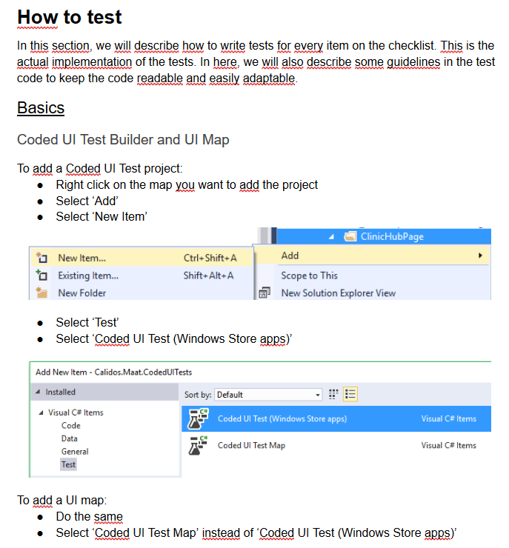
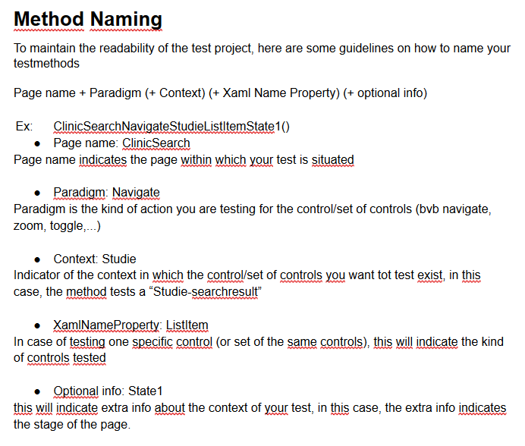
Guideline

Slide 11
Overzicht
Global Checklist
Paradigm Checklist
Page Checklist
Guideline
Questions

