Slide 1
INSTRUCTIONS FOR THE DEVLOPER OF PROXY

Slide 2
GENERALE VIEW OF THE CODE
PROXY.py : Generate Graphic User Interface
SetDATA.py : Create the Dataframe that will be used by the model
SetModel.py : Import the functions from Config.py and set the final prediction functions
SetResult.py : Create arrays that will be used by PROXY.py to plot results

Slide 3
SetData.py
Set the input and output that the model will use.
Plus, other parameters (t0,tf,..) that will be used to reconstruct the curve.
GIRi GPRi | WGV | GIP | Tcst | a | b | t0 | tf | … | …

Slide 4
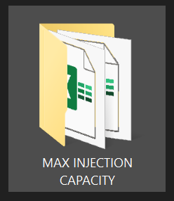
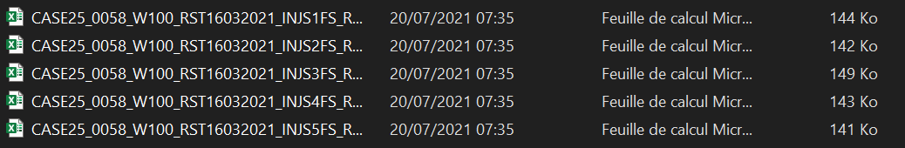
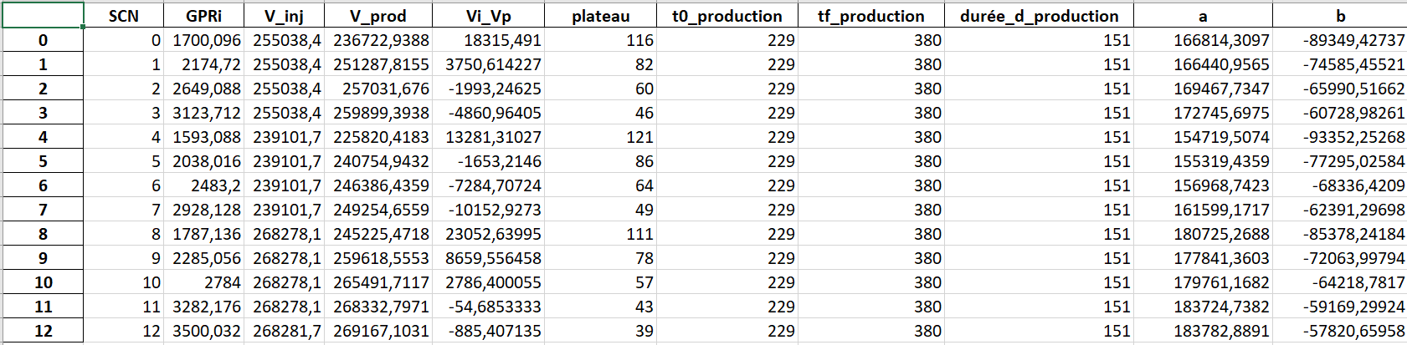
SetData.py

Slide 5
SetModel.py
Set the model as described in the file Config.py.

Slide 6
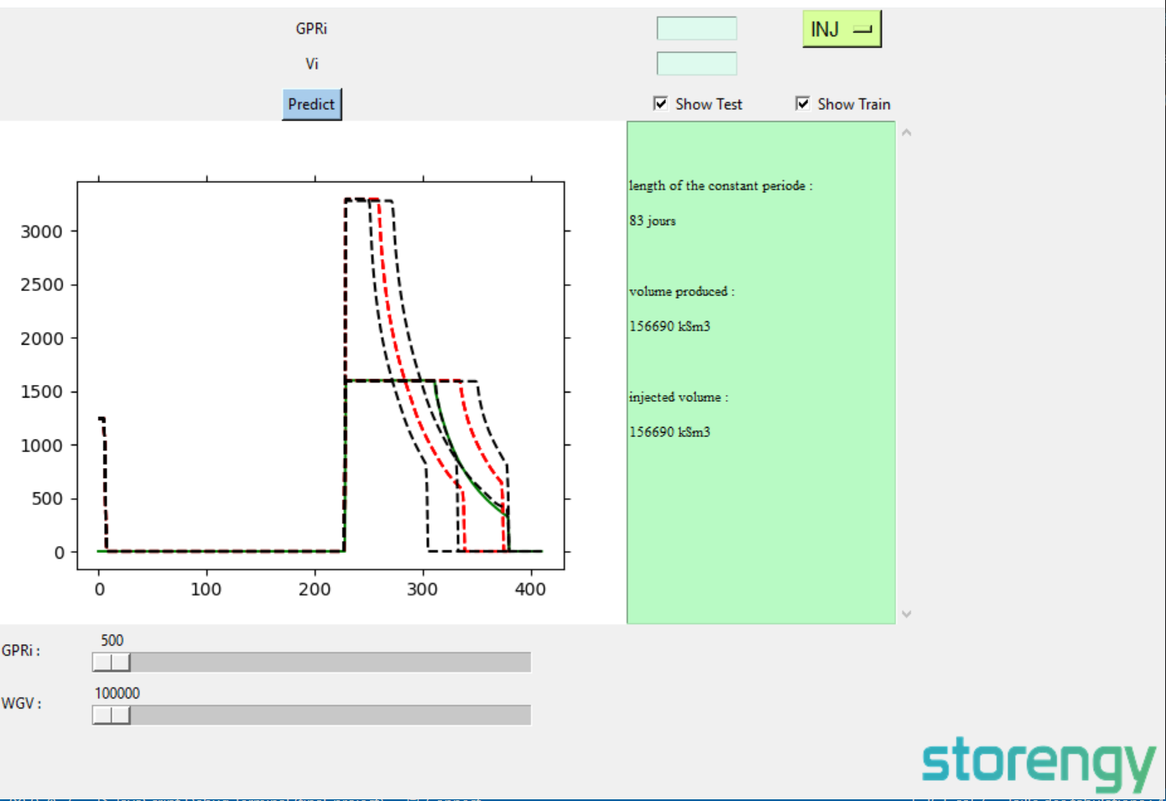
Tcst(input)
A(input)
B(input)
SetResult.py
SetModel.py
Config.py
PROXY.py

Slide 7
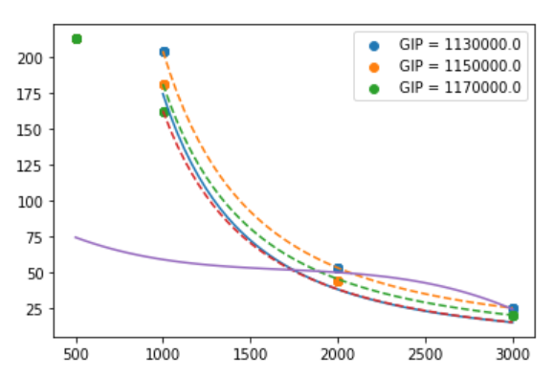
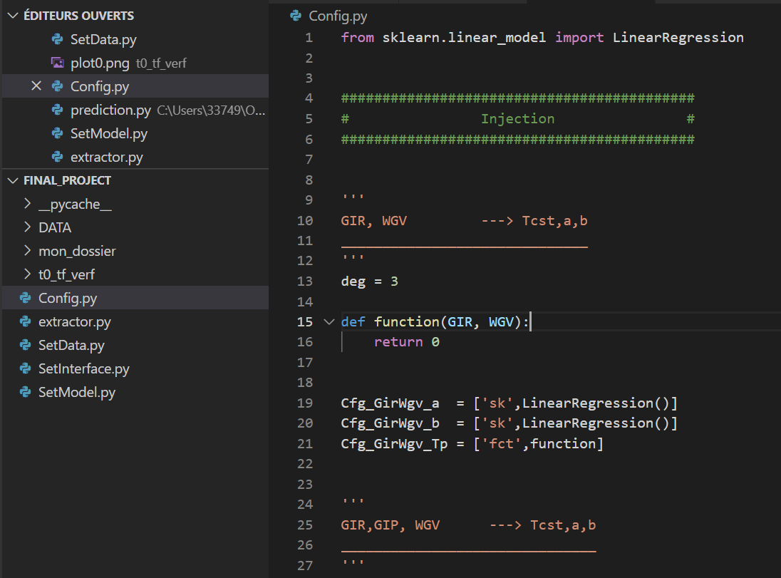

ERR Tcst
Input : GIR, GIP
Source of the problem
Config.py
SetModel.py

Slide 8
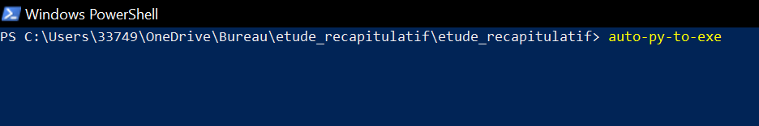
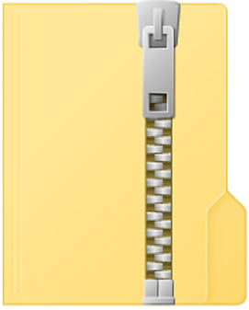
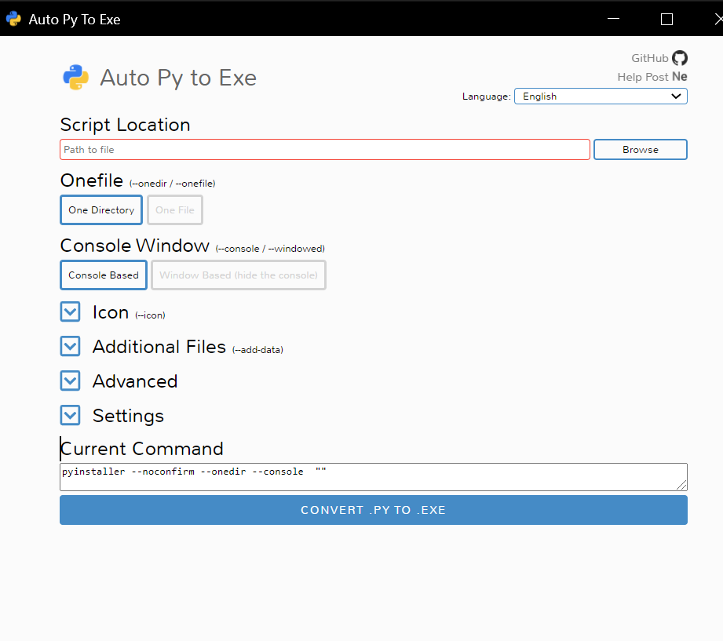
ToUser.zip
Lunch the program with an .exe

Slide 9
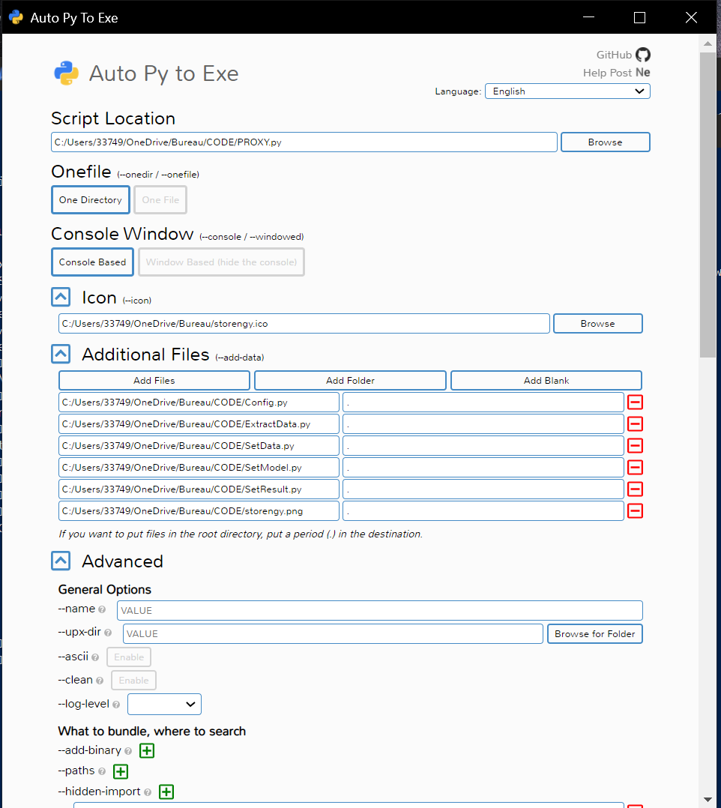
SELECT PROXY.py

Slide 10
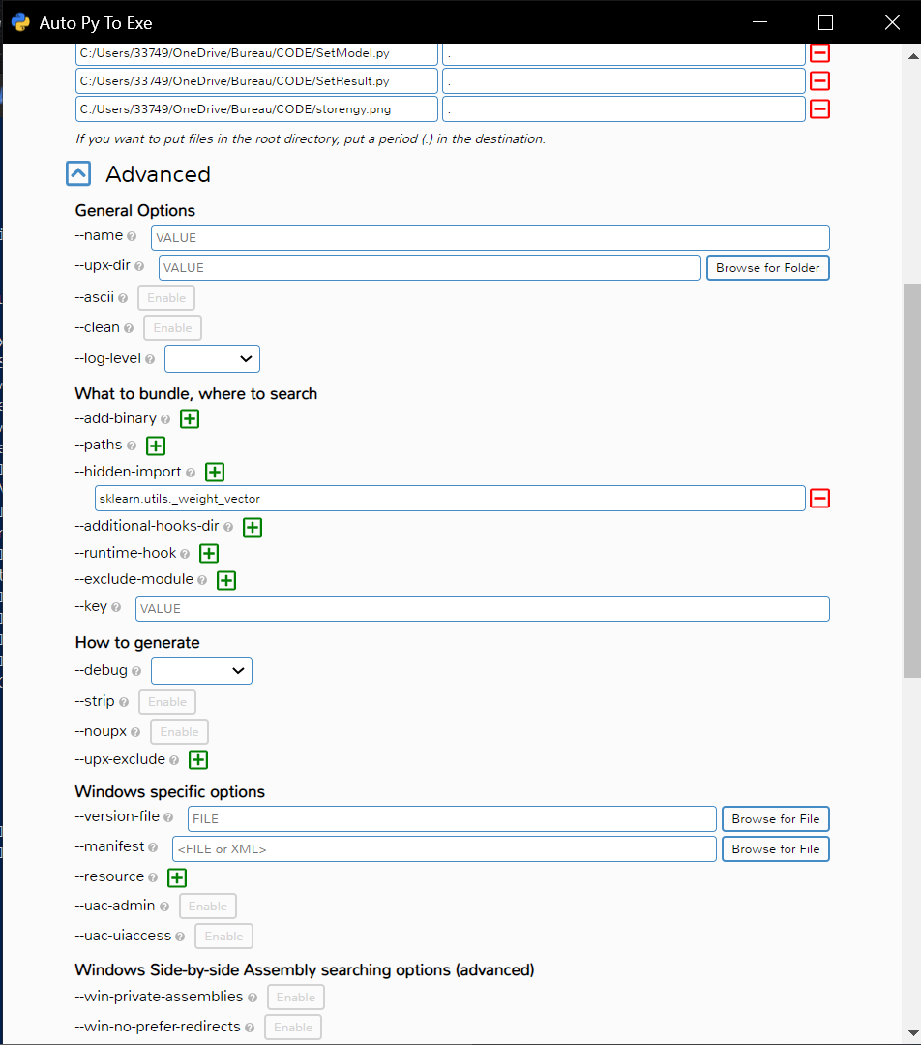
APPLIE THIS CONFIG

Slide 11
