Slide 1

Informative Censoring
Addressing Bias in Effect Estimates Due to Study Drop-out
Mark van der Laan and Maya Petersen
Division of Biostatistics, University of California, Berkeley
van der Laan Lab graphic: L. Co
Notes:
Use some of my reasearch to present an introduction to MSM. I know you already had an introduction earlier this week- but at least for me this is not something I mastered in two hours, so I thought that another introduction, with a different real world example, might be useful. Especially as You are going to see these things again, and may want to implement them your self.
Profit is figurative of course- intellectual not financial

Slide 2
Overview
What is informative censoring and how can it lead to bias?
Inverse Probability of Censoring Weighting (IPCW) to address informative censoring
  Estimation
  Assumptions
Some Examples of IPCW estimation of treatment effects
Lack of Robustness of MLE.
Targeted ML and Double Robust IPCW Estimation.
Conclusion
Notes:
Rely on real data analysis throughout for illustrations

Slide 3
Maximum Likelihood Estimation
Suppose we are concerned with estimating the causal effect of the treatment arm, or the causal effect of treatment arm, adjusted for a single baseline variable (e.g., genotype).
Fitting a Cox-proportional hazards model including all covariates and subsequently calculating the corresponding effect of interest represents the MLE approach.
The MLE approach is biased whenever the Cox-model is incorrect. As a consequence, the test of the null hypothesis of no effect is unreliable, even if censoring is non-informative.

Slide 4
Targeted MLE/DR-IPCW
We have developed two classes of fully efficient methods which allows one to obtain a MLE cox-model fit, and subsequently targets this Cox-fit to provide an unbiased estimate of the causal effect of interest.
Double robust IPCW estimating function based estimation.(van der Laan, Robins 2002)
Targeted MLE (van der Laan, Rubin, 2006)
Both classes of methods provide a valid test of the null hypothesis of no treatment effect if either the censoring mechanism is correctly estimated, or the MLE (COX) fit is consistent.

Slide 5
HIV Example: RCT of New Antiretroviral Drug
Subjects randomized to two treatment arms
  A=0: treatment with standard regimen
  A=1: treatment with new drug (+ optimized background regimen)
  Groups are equivalent at baseline
Outcome (Y) = Viral load at 24 weeks
Effect of interest: Relative Risk of suppression between two treatment arms

Slide 6
No Drop-Out
t=0
t=12 weeks
t=24 weeks
A=1
60 suppressed
60 suppressed
Prob. of
suppression:
60/100
N=100
40 unsuppressed
40 unsuppressed
A=0
40 suppressed
40 suppressed
Prob. of
suppression:
40/100
N=100
60 unsuppressed
60 unsuppressed
RR of viral suppression on new drug vs. standard: 0.6/0.4=1.5

Slide 7
With Drop-out
Those who are unsuppressed at 12 weeks drop-out with higher probability
  E.g. seek alternate treatment
Those on the reference regimen (A=0) drop out with higher probability
  E.g. due to more side effects

Slide 8
With Drop-Out
t=0
t=12 weeks
t=24 weeks
A=1
Prob. of
Suppression
Drop-out=fail: 60/100
Observed: 60/90
60 suppressed
60 suppressed
N=100
40 unsuppressed
30 unsuppressed
10 (25%) drop out
10 (25%) drop out
A=0
Prob. of
suppression:
Drop-out=fail: 30/100
Observed: 30/60
40 suppressed
30 suppressed
N=100
60 unsuppressed
30 unsuppressed
30 (50%) drop out
RR (Drop-out=Fail): 0.6/0.3=2.0
RR (Observed Data): 0.7/0.5=1.3
True RR: 1.5

Slide 9
Informative Censoring
The probability of censoring depends on the outcome the subject would have had in the absence of censoring
In particular, this arises if covariates affect both outcome and probability of being censored
Side Effects
Probability of Drop-out
Probability of Suppression

Slide 10
Inverse Probability of Censoring Weights (IPCW)
Model probability of being censored, given covariates, treatment
Use this model to assign weights to individuals that do not drop out
  Weight by the inverse of their probability of not dropping out given covariates
Weights recreate the population you would have seen with no drop-out

Slide 11
IPCW example
Probability of drop-out higher among subjects unsuppressed and with side effects at week 12
Subjects with this history that do not drop out get bigger weights
  i.e. we count these subjects more than once to make up for the people like them that we don’t see
The re-weighted population is no longer a biased sample.

Slide 12
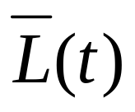
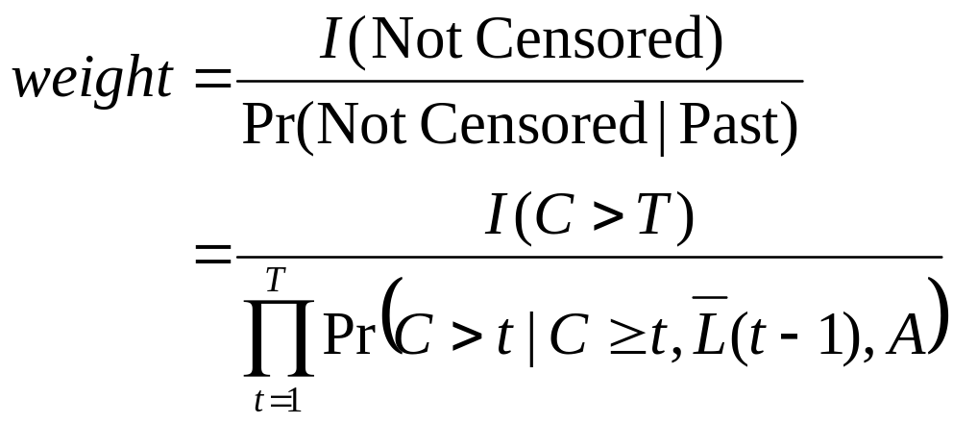
Weights
L(t) : Covariates at time t (e.g. side effects)
: Covariate history (L(0),L(1),…,L(t))
C : Censoring time
T : Time outcome is measured
  Fixed time point: e.g. viral suppression at 24 weeks
  Time till of event of interest: e.g. time till death

Slide 13
IPCW estimation
To estimate weights- fit a logistic regression of probability of being censored at each time point given observed past
For a given (non-censored subject), denominator is product of predicted probability of not being censored at each time point, given that subject’s past
Can use these weights with estimator you ideally would have used with no drop-out
  E.g. Weighted linear regression, logistic regression, Cox PH, etc…

Slide 14
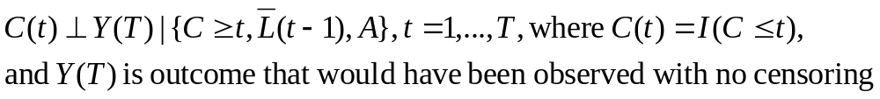

Assumptions (1)
Coarsening at Random (CAR):
  i.e. Measure enough covariates so that probability of censoring is independent of outcome (in the absence of censoring), given observed past
Consistent estimation of censoring mechanism
  i.e. Get censoring model right
  Estimate consistently
  Data-adaptive estimation and cross validation

Slide 15
Assumptions (2)
Experimentation (ETA):
  Each subject has some positive probability of not being censored, regardless of her observed past
  Practical violation of ETA can already cause serious bias and high variance. One can reduce this ETA bias and variance by using stabilizing weights.
  -One can run a bootstrap simulation to diagnose this bias and variance problem with the IPCW estimators: Wang, Petersen, van der Laan (2006).

Slide 16
Conclusion
Informative censoring/drop out/missingness can be naturally handled with Inverse Probability of Censoring Weighting of full data estimation procedures, assuming CAR and ETA.
These methods rely on correct estimation of the censoring mechanism, but will generally be less biased than methods ignoring informative censoring (e.g., Kaplan Meier).
The alternative MLE approach relies on correct estimation of the full likelihood (e.g. Cox model including all covariates) of the data.
There are empirical targeted learning methods which work if one of these approaches work, and are therefore the most robust methods, but are not available in standard software packages at this stage.

Slide 17
References
Mark J. van der Laan and Maya L. Petersen, "Statistical Learning of Origin-Specific Statically Optimal Individualized Treatment Rules" (September 2006). U.C. Berkeley Division of Biostatistics Working Paper Series. Working Paper 210.
http://www.bepress.com/ucbbiostat/paper210
Mark J. van der Laan, "Causal Effect Models for Intention to Treat and Realistic Individualized Treatment Rules" (March 2006). U.C. Berkeley Division of Biostatistics Working Paper Series. Working Paper 203.
http://www.bepress.com/ucbbiostat/paper203
Mark J. van der Laan and Maya L. Petersen, "Direct Effect Models" (August 2005). U.C. Berkeley Division of Biostatistics Working Paper Series. Working Paper 187.
http://www.bepress.com/ucbbiostat/paper187

Slide 18
Extra Slides . . . .

Slide 19
A note about Cox PH
Estimating a Relative Hazard of failure using the Cox model assumes that covariates included in the model are sufficient to ensure CAR
  May not be interested in RH conditional on all of these covariates
  If some of these covariates are affected by treatment, not appropriate to condition on them

Slide 20
Example: Difference in Survival
Suppose that the parameter of interest is the difference in survival up till time t between the two treatment arms:
P(T>t|A=1)-P(T>t|A=0)
A difference between Kaplan-Meier estimators can be biased due to informative drop out.
An IPCW estimator of the survival probabilities is obtained by weighting the full data outcome I(T>t) with weight
I(C>min(t,T)) / ∏_{s=[0,min(t,T)]}P(C>s|C¸ s,L(s),A)

Slide 21
Example: Model of Relative Risk
Suppose that the parameter of interest is β in the model
Log P(T>t|A=1)/P(T>t|A=0) =β
This corresponds with the model
P(T>t|A)=β₀ Exp(β A)
Alternatively, one might model
P(T>t|A)=1/(1+Exp(β₀+β₁A)), so that β represents the odds ratio.
IPCW estimation simply involves weighted regression of I(T>t) on A with weights.

Slide 22
Effect of Treatment in terms of Regression Model
Suppose that the effect of treatment A is represented by a regression E(Y|A)=m(A|β).
Possible outcomes are a survival time, the indicator of no failure till a time t, or a particular measurement at time t.
IPCW estimation of β corresponds with weighted least squares regression of the outcome Y on the model m(A|β) using weights Δ/P(Δ=1|X), where Delta is missing indicator and X denotes the data one would observe in the absence of censoring.
For example, if Y is CD4 at time t, then the weights are I(C>t)/P(C>t|L(t),A) as presented in previous slide.

Slide 23
Possible Strategies for dealing with drop out due to death.
Strategy I: One can treat the time till death as a censoring time. Modelling the censoring mechanism now involves modelling the probabilty of being censored by death, given the past, and probability of being censored by other causes, given the past.
Strategy II: Include the occurrence of death (due to causes related to the disease studied) at time T in the definition of the outcome. For example, one might define as outcome
Y(t)=I(CD4(t)>θ,and T>t)

