Slide 1
Assessing ETA Violations, and Selecting Attainable/Realistic Parameters
Causal Effect/Variable Importance Estimation and the Experimental Treatment Assumption
Notes:
Needs some work: organize as eta, example, assessing eta, then choosing realistic parameters

Slide 2
The Need for Experimentation
Estimation of Variable Importance/Causal Effect requires assumption not needed for prediction
“Experimental Treatment Assignment” (ETA)
  Must be some variation in treatment variable A within every stratum of confounders W
    W must not perfectly predict/determine A
    g(a|W)>0 for all (a,W)
Notes:
Additional difference between variable importance/prediction

Slide 3
ETA Violations
Ex #1: Some treatment histories perfectly predict presence of a given mutation
Ex #2: Certain types of individuals never receive once daily therapy
ETA violations imply lack of identifiability for variable importance/ causal effect
  Reliance on extrapolation
  Can lead to serious bias in estimates

Slide 4
Diagnostic for ETA Bias
Inverse Probability of Treatment Weighted (IPTW) estimators rely completely on ETA
  Don’t extrapolate, unlike MLE or T-MLE
Diagnostic tool available to quantify the extent of bias in IPTW estimators due to ETA violations
  Relies on parametric bootstrap
Serves to quantify extent to which ψ is not identifiable
  i.e. Extent to which T-MLE estimate relies on extrapolation

Slide 5
Example: Causal Effect of Adherence Interventions
Goal: Estimate the causal effect of a point treatment
  Intervention (A) aimed to improve adherence to antiretroviral drugs
    A₁=use of a pill box organizer
    A₂=use of once daily therapy
  Outcome (Y) = % of prescribed doses taken
What is the effect of pill boxes/once daily therapy on adherence?

Slide 6
Example: Parameter of Interest
Confounding by a range of covariates W
  Include: past treatment history, clinical characteristics, socioeconomic variables
  E.g. crack users may be less likely to use pill boxes and also less likely to adhere
Parameter of Interest:
  Difference in expected adherence if whole population had used the intervention E(Y₁) vs. if whole population had not used it E(Y₀)
Notes:
Equivalent to RCT

Slide 7
Example: Parameter of Interest
Parameter of Interest:
E(Y₁)-E(Y₀)
If assume no unmeasured confounders
(W sufficient to control for confounding)
Causal Effect is same as W-adjusted Variable Importance
  E(Y₁)-E(Y₀)=E[E(Y|A=1,W)-E(Y|A=0,W)]= ψ
  Same advantages to T-MLE

Slide 8
Example: Pill Box Adherence
Effect estimates suggest pill box organizers improve adherence, but one daily therapy does not
However… ETA diagnostic suggests effect of once daily therapy not identifiable from the data
  Can’t adjust for confounders that are perfect predictors
  Ex. No Latina women received once daily therapy
  Ex. Some type of regimens not available as once daily therapy
  Can’t conclude no effect for once daily therapy

Slide 9
Example: ETA Bias in the Estimated Effect of Adherence Interventions
Intervention
T-MLE Effect Estimate
Relative ETA Bias in IPTW Estimate
Pill Box Organizer
4% higher adherence (95%CI:1%-7%)
0.01%
Once Daily Therapy
0% higher adherence
(95% CI: -6%-14%)
850%
Notes:
Actually- these are the DR estimates
Absolute eta bias: once daily -0.01 and pill box 0.0004
Once daily: IPTW =0.029, eta bias would make it smaller, but point estimate itself is biased

Slide 10
ETA Violations May Be More than a Nuisance
Goal: Estimate the causal effect of a longitudinal treatment on outcome
Some subjects, over the course of follow-up, develop contraindications to the treatment
What is the real parameter of interest?
  Randomized trial in which everyone (even those who develop contraindications) forced to comply with longitudinal assigned treatment
  Randomized trial in which those who develop contra-indications over the course of the trial not forced to comply

Slide 11
Realistic Causal Effect of Point Treatment Intervention
ψ = E{E[Y|A=d(1)(W),W]-E[Y|A=d(0)(W),W]}
  d(1)(W)= {a=1 if g(1|W)>α; a=0 otherwise}
  d(0)(W)= {a=0 if g(0|W)>α; a=1 otherwise}
Similar to Intent-to-Treat analysis
  Estimates effect of randomly assigning the intervention,
  But… accepts that some individuals may not be able to comply with the regimen to which they are assigned
Targeted MLE estimators available

Slide 12
Simulation Result: Realistic vs. Truncation of Weights for IPTW
Data Generation- A is confounded, with ETA violations
  W=Uniform(-5,5); p=1/(1+e^{-1+1.5*W}); A=Binomial(p)
  No causal effect of A: Y= 2+4W²+N(0,1)
  Simulation run 5000 times for each sample size
 | N=50 | N=100 | N=250 | N=500 | N=1000
Naïve | -7.14 | -7.30 | -7.36 | -7.33 | -7.30
IPTW | 4.08 | 5.28 | 2.26 | 1.25 | 1.23
IPTW MSE | 755.3 | 2029.9 | 7077.9 | 4826.7 | 2590.9
IPTW-Truncated Weight | 3.92 | 5.75 | 6.39 | 6.84 | 6.74
IPTW-Truncated Weight MSE | 502.30 | 386.25 | 238.07 | 151.68 | 95.02
IPTW-REAL | 0.24 | 0.06 | 0.02 | 0.00 | 0.01
IPTW-REAL MSE | 12.32 | 5.42 | 1.91 | 0.89 | 0.44
Notes:
W1= uniform (0,2) – replace kelly simulation 3
So realistic is able to do truncation without misspecification of g!! While normally truncation corresponds with biassing g.

Slide 13
Example: HIV resistance mutations
Goal: Rank a set of genetic mutations based on their importance for determining an outcome
  Mutations (A) in the HIV protease enzyme
    Measured by sequencing
  Outcome (Y) = change in viral load 12 weeks after starting new regimen containing saquinavir
How important is each mutation for viral resistance to this specific protease inhibitor drug?
  Inform genotypic scoring systems

Slide 14
Example: Parameter of Interest
Need to control for a range of other covariates W
  Include: past treatment history, baseline clinical characteristics, non-protease mutations, other drugs in regimen
Parameter of Interest: Variable Importance
ψ = E[E(Y|A_{j}=1,W)-E(Y|A_{j}=0,W)]
  For each protease mutation (indexed by j)

Slide 15
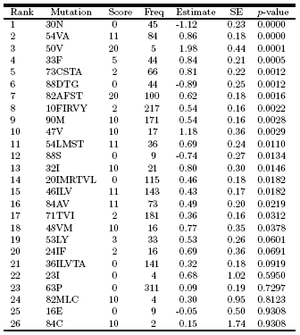
Unadjusted estimates

Slide 16
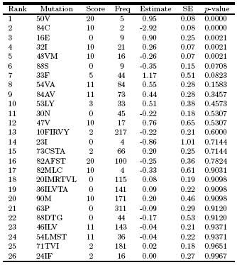
Fully adjusted estimates

Slide 17
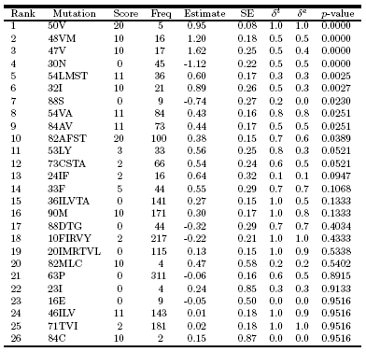
Delta-adjusted estimates

Slide 18
Summary
Variable Importance/Causal Effect estimates rely on sufficient experimentation (ETA) for identifiability
  Diagnostic tool available to diagnose ETA problems
Realistic an Delta-Variable Importance/Causal Effect ensures parameter is identifiable, even with ETA violations
  Realistic is often parameter of interest
  In general, realistic provides test of null hypothesis for standard variable importance/causal effect
ETA problems can also be avoided by selecting the appropriate adjustment set data-adaptively.

