Slide 1

Multiple Testing
Mark J. van der Laan
Division of Biostatistics
U.C. Berkeley
www.stat.berkeley.edu/~laan

Slide 2
Outline
Multiple Testing for variable importance in prediction
Overview of Multiple Testing
Previous proposals of joint null distribution in resampling based multiple testing: Westfall and Young (1994), Pollard, van der Laan (2003), Dudoit, van der Laan, Pollard (2004).
Quantile Transformed joint null distribution: van der Laan, Hubbard 2005.
Simulations.
Methods controlling tail probability of the proportion of false positives.
    Augmentation Method: van der Laan, Dudoit, Pollard (2003)
    Empirical Bayes Resampling based Method: van der Laan, Birkner, Hubbard (2005).
Summary
Methods controlling False Discovery Rate (FDR)
    Empirical Bayes FDR controlling method

Slide 3
Multiple Testing in Prediction
Suppose we wish to estimate and test for the importance of each variable for predicting an outcome from a set of variables.
Current approach involves fitting a data adaptive regression and measuring the importance of a variable in the obtained fit.
We propose to define variable importance as a (pathwise differentiable) parameter, and directly estimate it with targeted maximum likelihood methodology
This allows us to test for the importance of each variable separately and carry out multiple testing procedures.

Slide 4
Example: HIV resistance mutations
Goal: Rank a set of genetic mutations based on their importance for determining an outcome
  Mutations (A) in the HIV protease enzyme
    Measured by sequencing
  Outcome (Y) = change in viral load 12 weeks after starting new regimen containing saquinavir
  Confounders (W) = Other mutations, history of patient
How important is each mutation for viral resistance to this specific protease inhibitor drug? ψ₀=E E(Y|A=1,W)-E(Y|A=0,W)
  Inform genotypic scoring systems

Slide 5
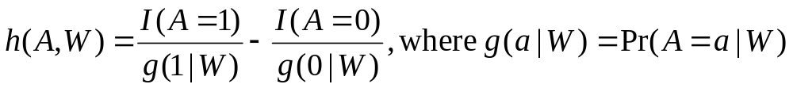
Targeted Maximum Likelihood
In regression case, implementation just involves adding a covariate h(A,W) to the regression model
Requires estimating g(A|W)
  E.g. distribution of each mutation given covariates
Robust: Estimate of ψ₀ is consistent if either
  g(A|W) is estimated consistently
  E(Y|A,W) is estimated consistently

Slide 6
Mutation Rankings Based on Variable Importance
Current Score | Mutation | VIM | VIM p-value | Crude | Crude p-value
35 | 90M | 0.70 | 0.00 | 0.76 | 0.00
40 | 48VM | 0.79 | 0.00 | 1.07 | 0.00
0 | 30N | -0.78 | 0.00 | -1.06 | 0.00
10 | 82AFST | 0.46 | 0.01 | 0.35 | 0.03
10 | 54VA | 0.46 | 0.01 | 0.31 | 0.11
10 | 73CSTA | 0.67 | 0.03 | 0.80 | 0.00
2 | 20IMRTVL | 0.32 | 0.07 | 0.26 | 0.18
1 | 36ILVTA | 0.28 | 0.10 | 0.27 | 0.12
2 | 10FIRVY | 0.27 | 0.13 | 0.48 | 0.00
5 | 88DTG | -0.23 | 0.24 | -0.50 | 0.33
2 | 71TVI | 0.18 | 0.29 | 0.14 | 0.37
5 | 32I | -0.18 | 0.58 | -0.20 | 0.55
2 | 63P | 0.06 | 0.77 | 0.11 | 0.56
5 | 46ILV | 0.13 | 0.98 | 0.27 | 0.10
Notes:
Cut crude here?
adjusted for multiple testing; excluding those mutations with ETA violations
ranked by VIM p-value
Note- 30N only strange one- some evidence that is indeed protective

Slide 7
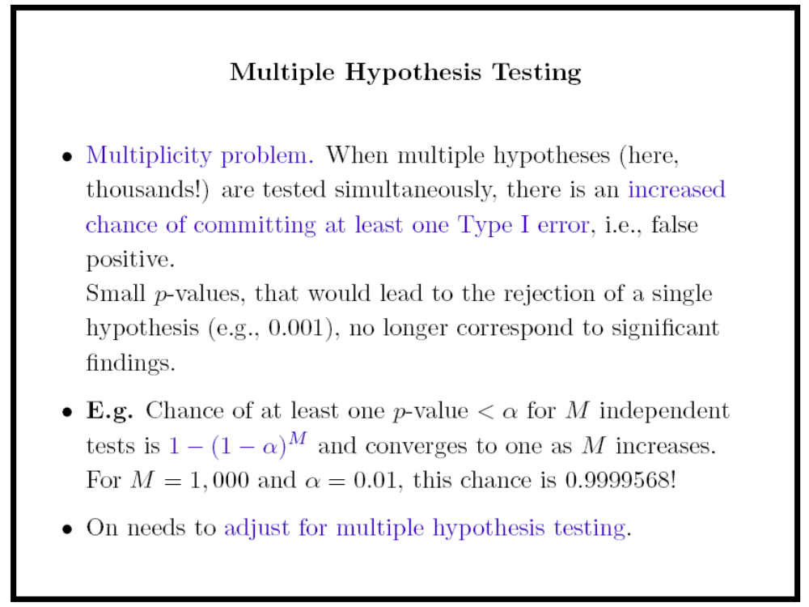

Slide 8
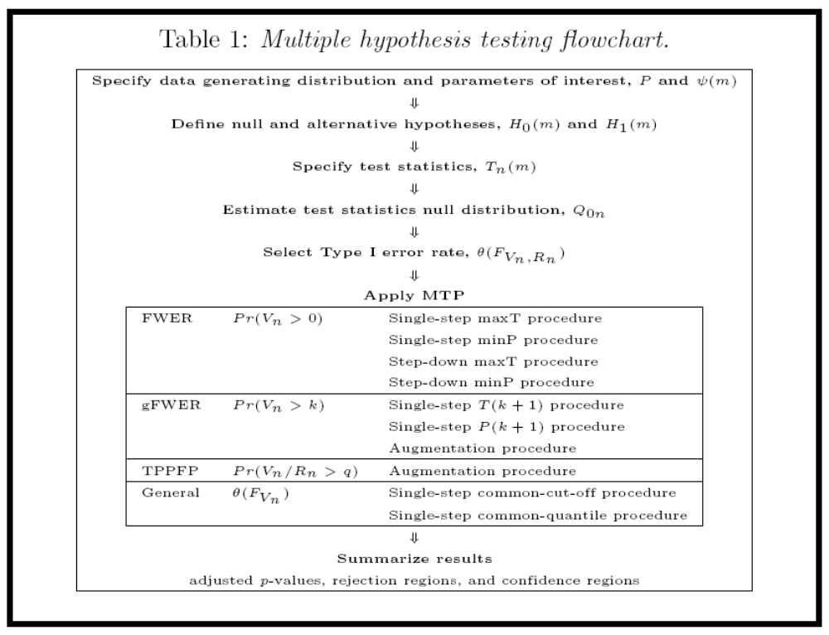

Slide 9

Hypothesis Testing Ingredients
Data (X₁,…,X_{n})
Hypotheses
Test Statistics
Type I Error
Null Distribution
    Marginal (p-values) or
    Joint distribution of the test statistics
Rejection Region
Adjusted p-values

Slide 10
Test Statistics
A test statistic is written as:
  T_{n}= (Ψ_{n} - Ψ₀)
  σ_{n}
Where σ_{n} is the standard error, Ψ_{n} is the parameter of interest, and Ψ₀ is the null value of the parameter.

Slide 11
Hypotheses
Hypotheses are created as one-sided or two sided.
A one-sided hypothesis:
    H₀(m)=I(Ψ_{n}=Ψ₀), m=1,…,M.
A two-sided hypothesis:
    H₀(m)=I(Ψ_{n} · Ψ₀), m=1,…,M.

Slide 12
Type I & II Errors
Type I errors corresponds to making a false positive.
Type II errors (β) corresponds to making a false negative.
The Power is defined as 1- β.
Multiple Testing Procedures are interested in simultaneously minimizing the Type I error rate while maximizing power.

Slide 13
Type I Error Rates
FWER: Control the probability of at least one Type I error (V_{n}): P(V_{n} > 0) · α
gFWER: Control the probability of at least k Type I errors (V_{n}): P(V_{n} > k) · α
TPPFP: Control the proportion of Type I errors (V_{n}) to total rejections (R_{n}) at a user defined level q: P(V_{n}/R_{n} > q) · α
FDR: Control the expectation of the proportion of Type I errors to total rejections: E(V_{n}/R_{n}) · α

Slide 14

Null Distribution
The null distribution is the distribution to which the original test statistics are compared and subsequently rejected or accepted as null hypotheses.
Multiple Testing Procedures are based on either Marginal or Joint Null Distributions.
    Marginal Null Distributions are based on the marginal distribution of the test statistics.
    Joint Null Distributions are based on the joint distribution of the test statistics.

Slide 15
Rejection Regions
Multiple Testing Procedures use the null distribution to create rejection regions for the test statistics.
These regions are constructed to control the Type I error rate.
They are based on the null distribution, the test statistics, and the level α.

Slide 16
Single-Step & Stepwise
Single-step procedures assess each null hypothesis using a rejection region which is independent of the tests of other hypotheses.
Stepwise procedures construct rejection regions based on the acceptance/rejection of other hypotheses. They are applied to smaller nested subsets of tests (e.g. Step-down procedures).

Slide 17
Adjusted p-values
Adjusted p-values are constructed as summary measures for the test statistics.
We can think of the adjusted p-value p(m) as the nominal level α at which test statistic T(m) would have just been rejected.

Slide 18
Multiple Testing Procedures
Many of the Multiple Testing Procedures are constructed with various assumptions regarding the dependence structure of the underlying test statistics.
We will now describe a procedure which controls a variety of Type I error rates and uses a null distribution based on the joint distribution of the test statistics (Pollard and van der Laan (2003)), with no underlying dependence assumptions.

Slide 19
Null Distribution
(Pollard & van der Laan (2003))
This approach is interested in Type I error control under the true data generating distribution, as opposed to the data generating null distribution, which does not always provide control under the true underlying distribution (e.g. Westfall & Young).
We want to use the null distribution to derive rejection regions for the test statistics such that the Type I error rate is (asymptotically) controlled at desired level α.
In practice, the true distribution Q_{n}=Q_{n}(P), for the test statistics T_{n}, is unknown and replaced by a null distribution Q₀ (or estimate, Q_{0n}).
The proposed null distribution Q₀ is the asymptotic distribution of the vector of null value shifted and scaled test statistics, which provides the desired asymptotic control of the Type I error rate.
t-statistics: For the test of single-parameter null hypotheses using t-statistics the null distribution Q₀ is an M--variate Gaussian distribution.
Q₀ = Q₀(P) ´ N(0,Σ*(P)).

Slide 20
Multiple Testing Procedures
Procedure | Error Rate | Step | Null Distribution
Bonferroni | FWER | SS | Marginal
Holm, Hochberg | FWER | SD SU | Marginal
Lehmann & Romano* | gFWER, TPPFP | SS, SD | Marginal
Genovese, Wasserman | TPPFP |  | Marginal
Benjamini & Hochberg* | FDR | SU | Marginal
Benjamini & Yekutieli | FDR | SU | Marginal
Westfall & Young* | FWER | SS, SD | Joint
Pollard & van der Laan Dudoit et al. van der Laan et al. ‘s | gFWER gFWER FWE, TPPFP | SS, SS SD | Joint

Slide 21
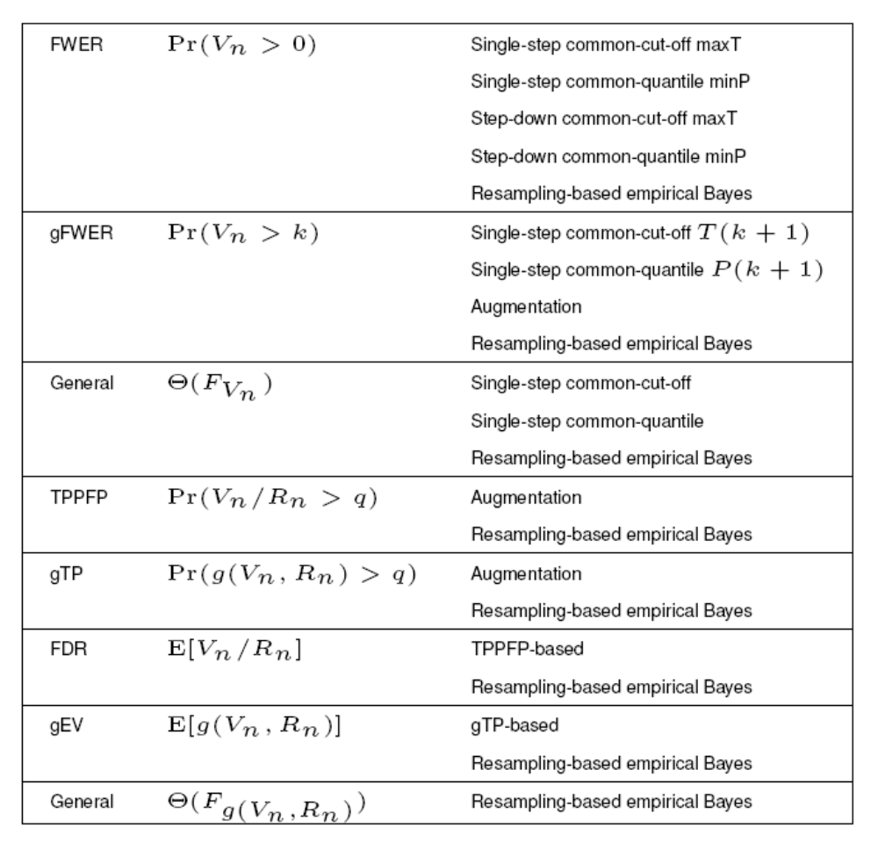

Slide 22
Algorithm: max-T Single-Step Approach (FWER)
The maxT procedure is a JOINT procedure used to control FWER.
Apply the bootstrap method (B=10,000 bootstrap samples) to obtain the bootstrap distribution of test statistics (M x B matrix).
Mean-center at null value to obtain the wished null distribution
Chose the maximum value over each column, therefore resulting in a vector of 10,000 maximum values.
Use as common cut-off value for all test statistics the (1-α) quantile of these numbers.

Slide 23
CLT-Based MTP
Identifying the Null distribution from the Influence Curve
Correct Null distribution for a set of null hypotheses H_0: Mu(j)=mu_0(j) and corresponding t-statistics, about real valued parameters of interest, has the same correlation structure as the true distribution, but with mean zero and variances one
Bootstrap re-sampling can be used to estimate this multivariate normal null distribution
  Can be computationally intensive
All necessary information is contained in the Influence Curve of the estimators used in the t-statistics:
  Correlation Matrix of the Influence Curve is equivalent to the covariance matrix of the wished multivariate normal null distribution
  For the null distribution, generate 10,000 observations from this multivariate normal null distribution
  VIM methods naturally supply us with the influence curve
Using this null distribution, multiple testing procedures based on re-sampling from the null distribution, can be applied quickly and easily

Slide 24
Augmentation Methods
Given adjusted p-values from a FWER controlling procedure, one can easily control gFWER or TPPFP.
gFWER: Add the next k most significant hypotheses to the set of rejections from the FWER procedure.
TPPFP: Add the next (q/1-q)r₀ most significant hypotheses to the set of rejections from the FWER procedure.

Slide 25

gFWER Augmentation
gFWER Augmentation set: The next k hypotheses with smallest FWER adjusted p-values.
The adjusted p-values:

Slide 26
TPPFP Augmentation
TPPFP Augmentation set: The next hypotheses with the smallest FWER adjusted p-values where one keeps rejecting null hypotheses until the ratio of additional rejections to the total number of rejections reaches the allowed proportion q of false positives.
The adjusted p-values:

Slide 27

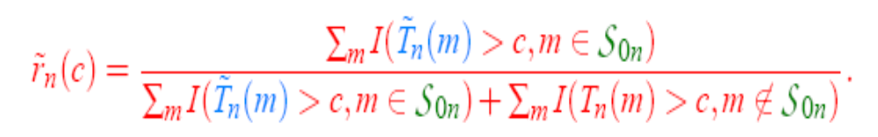
TPPFP Technique
The TPPFP Technique was created as a less conservative and more powerful method of controlling the tail probability of the proportion of false positives.
This technique is based on constructing a distribution of the set of null hypotheses S_{0n}, as well as a distribution under the null hypothesis (T_{n}). We are interested in controlling the random variable r_{n}(c).
The distribution under the null is the identical null distribution used in Pollard and van der Laan (2003): mean centered joint distribution of test-statistics.

Slide 28
Constructing S_{0n}
S_{0n} is defined by drawing a null or alternative status for each of the test statistics. The model defining the distribution of S_{0n} assumes T_{n}(m) » p₀f₀ + (1-p₀)f₁, a mixture of a null density f₀ and alternative density f₁.
The posterior probability, defined as the probability that T_{n}(m) came from a true null, H_{0m}, given its observed value:
P(B(m)=0|T_{n}(m)) = p₀ f₀(T_{n}(m))
f(T_{n}(m))
Given T_{n}, we can draw the random set S_{0n} from:
S_{0n} = ( j:C(j) = 1), C(j) » Bernoulli(min(1,p₀f₀(T_{n}(m)/f(T_{n}(m)))).
Note: We estimated f(T_{n}(m)) using a kernel smoother on a bootstrapped set on T_{n}(m), f₀ » N(0,1), and p₀=1.

Slide 29
QUANTILE TRANSFORMED JOINT NULL DISTRIBUTION
Let Q_{0j} be a marginal null distribution so that for j2 S₀
Q_{0j}⁻¹Q_{nj}(x)¸ x
where Q_{nj} is the j-th marginal distribution of the true distribution Q_{n}(P) of the test statistic vector T_{n}.

Slide 30
QUANTILE TRANSFORMED JOINT NULL DISTRUTION
We propose as null distribution the distribution Q_{0n} of
T_{n}*(j)=Q_{0j}⁻¹Q_{nj}(T_{n}(j)), j=1,…,J
This joint null distribution Q_{0n}(P) does indeed satisfy the wished multivariate asymptotic domination condition in (Dudoit, van der Laan, Pollard, 2004).

Slide 31
BOOTSTRAP QUANTILE-TRANSFORMED JOINT NULL DISTRIBUTION
We estimate this null distribution Q_{0n}(P) with the bootstrap analogue:
T_{n}#(j)=Q_{0j}⁻¹Q_{nj}#(T_{n}#(j))
where # denotes the analogue based on bootstrap sample O₁#,..,O_{n}# of an approximation P_{n} of the true distribution P.

Slide 32
Description of Simulation
  100 subjects each with one random X (say a SNP’s) uniform over 0, 1 or 2.
  For each subject, 100 binary Y’s, (Y₁,...Y₁₀₀) generated from a model such that:
    first 95 are independent of X
    Last 5 are associated with X
    All Y’s correlated using random effects model
  100 hypotheses of interest where the null is the independence of X and Y_{i} .
  Test statistic is Pearson’s χ² test where the null distribution is χ² with 2 df.
  In this case, Y₀ is the outcome if, counter to fact, the subject had received A=0.
  Want to contrast the rate of miscarriage in groups defined by V,R,A if among these women, one removed decaffeinated coffee during pregnancy.
Notes:
Include the 1 because when we start multiplying things together later, it will give an intercept.
E(Yij) = expectation - if one had an infinite random sample of Yij's and took the avevage. Notation is general - allows a different mean for each observation.
Var(Yij) is E(Yij-muij)^2 average squared departure from the mean.

Slide 33
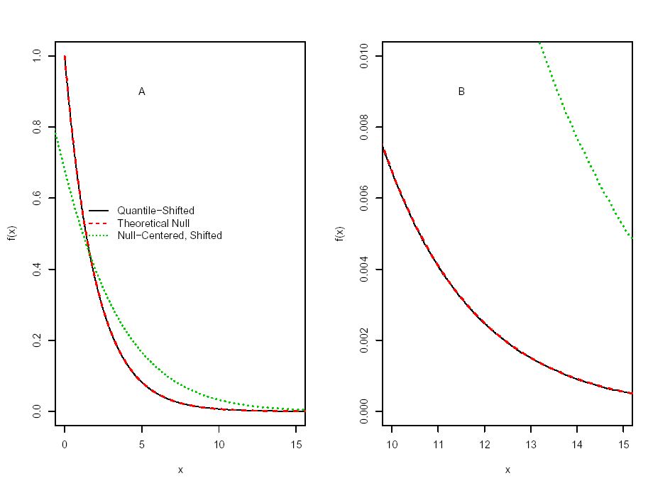
Figure 1: Density of null distributions: null-centered, rescaled bootstrap, quantile-transformed and the theoretical. A is over entire range, B is the right tail.
Notes:
Because we have to keep both individual measurements per person and vectors of measurements made on a person, we need to have some coherent notation so we don’t go crazy.

Slide 34
Description of Simulation, cont.
  Simulated data 1000 times
  Performed the following MTP’s to control FWER at 5%.
    Bonferroni
    Null centered, re-scaled bootstrap (NCRB) – based on 5000 bootstraps
    Quantile-Function Based Null Distribution (QFBND)
  Results
    NCRB anti-conservative (inaccurate)
    Bonferroni very conservative (actual FWER is 0.005)
    QFBND is both accurate (FWER 0.04) and powerful (10 times the power of Bonferroni).
Notes:
Include the 1 because when we start multiplying things together later, it will give an intercept.
E(Yij) = expectation - if one had an infinite random sample of Yij's and took the avevage. Notation is general - allows a different mean for each observation.
Var(Yij) is E(Yij-muij)^2 average squared departure from the mean.

Slide 35
SMALL SAMPLE SIMULATION
2 populations.
Sample n_{j} p-dim vectors from population j, j=1,2.
Wish to test for difference in means for each of p components.
Parameters for population j: μ_{j}, σ_{j}, ρ_{j}.
h₀ is number of true nulls

Slide 36
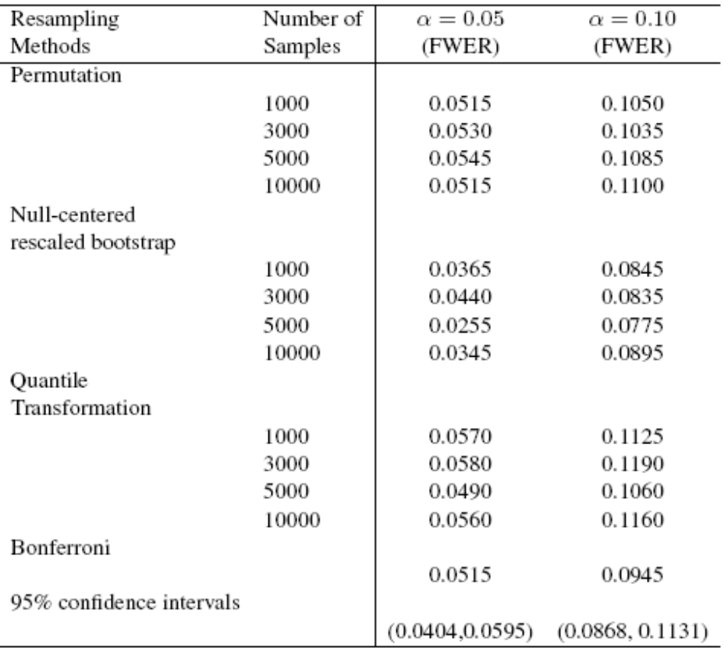

Slide 37
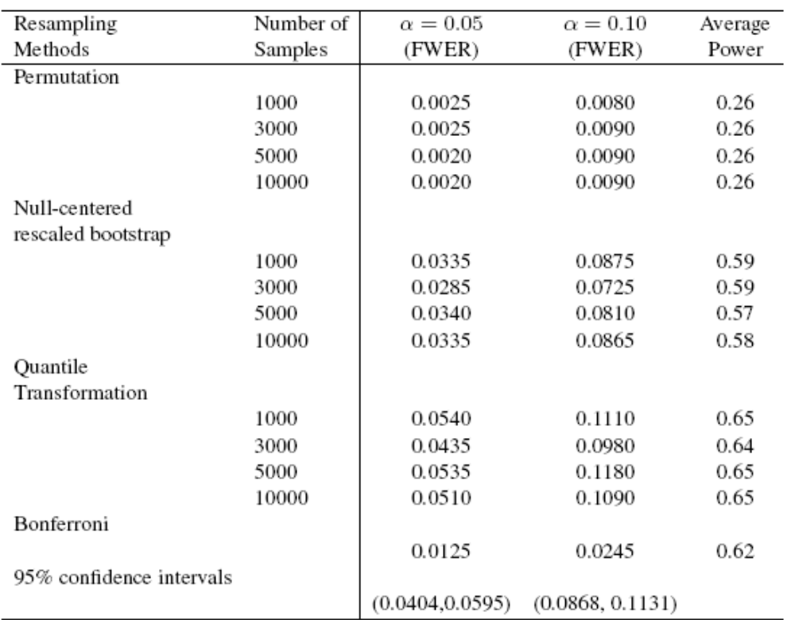

Slide 38
COMBINING PERMUTATION DISTRIBUTION WITH QUANTILE NULL DISTRIBUTION
For a test of independence, the permutation distribution is the preferred choice of marginal null distribution, due to its finite sample control.
We can construct a quantile transformed joint null distribution whose marginals equal these permutation distributions, and use this distribution to control any wished type I error rate.

Slide 39
Empirical Bayes/Resampling TPPFP Method
We devised a resampling based multiple testing procedure, asymptotically controlling (e.g.) the proportion of false positives to total rejections.
This procedure involves:
  Randomly sampling a guessed (conservative) set of true null hypotheses: e.g. H₀(j)~Bernoulli (Pr(H₀(j)=1|T_{j})=p₀f₀(T_{j})/f(T_{j}) ) based on the Empirical Bayes model: T_{j}|H₀=1 ~f₀ T_{j}~f p₀=P(H₀(j)=1) (p0=1 conservative)
  Our bootstrap quantile joint null distribution of test statistics.

Slide 40
REMARK REGARDING MIXTURE MODEL PROPOSAL
Under overall null min(1,f₀(T_{n}(j))/f(T_{n}(j)) ) does not converge to 1 as n converges to infinity, since the overall density f needs to be estimated. However, if number of tests converge to infinity, then this ratio will approximate 1.
This latter fact probably explains why, even under the overall null, we observe a good practical performance in our simulations.
Notes:
Phi_0(T)/Phi_{d_n}(T) for univariate test. d_n=root(n) mu

Slide 41

Emp. BayesTPPFP Method
Grab a column from the null distribution of length M.
Draw a length M binary vector corresponding to S_{0n}.
For a vector of c values calculate:
Repeat 1. and 2. 10,000 times and average over iterations.
Choose the c value where P(r_{n}(c) > q)· α.

Slide 42
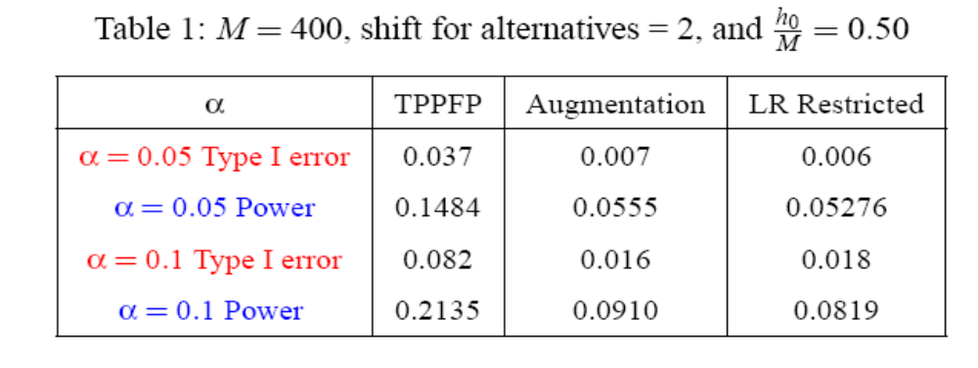
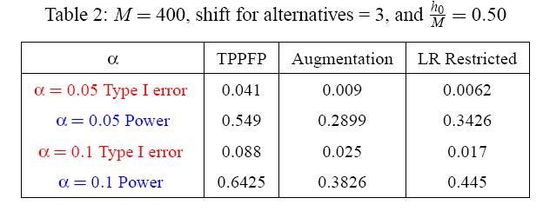
Examples/Simulations

Slide 43
Summary
Quantile function transformed bootstrap null distribution for test-statistics is generally valid and powerful in practice.
Powerful Emp Bayes/Bootstrap Based method sharply controlling proportion of false positives among rejections.
Combining general bootstrap quantile null distribution for test statistics with random guess of true nulls provides general method for obtaining powerful (joint) multiple testing procedures (alternative to step down/up methods).
Combining data adaptive regression with testing and permutation distribution provides powerful test for independence between collection of variables and outcome.
Combining permutation marginal distribution with quantile transformed joint bootstrap null distribution provides powerful valid null distribution if the null hypotheses are tests of independence.
Targeted ML estimation of variable importance in prediction allows multiple testing (and inference) of variable importance for each variable.

Slide 44
Acknowledgements
Sandrine Dudoit, for slides on MTP
Maya Petersen
Merrill Birkner
Alan Hubbard

