Slide 1
Multiple Testing Procedures
Examples and Software Implementation

Slide 2
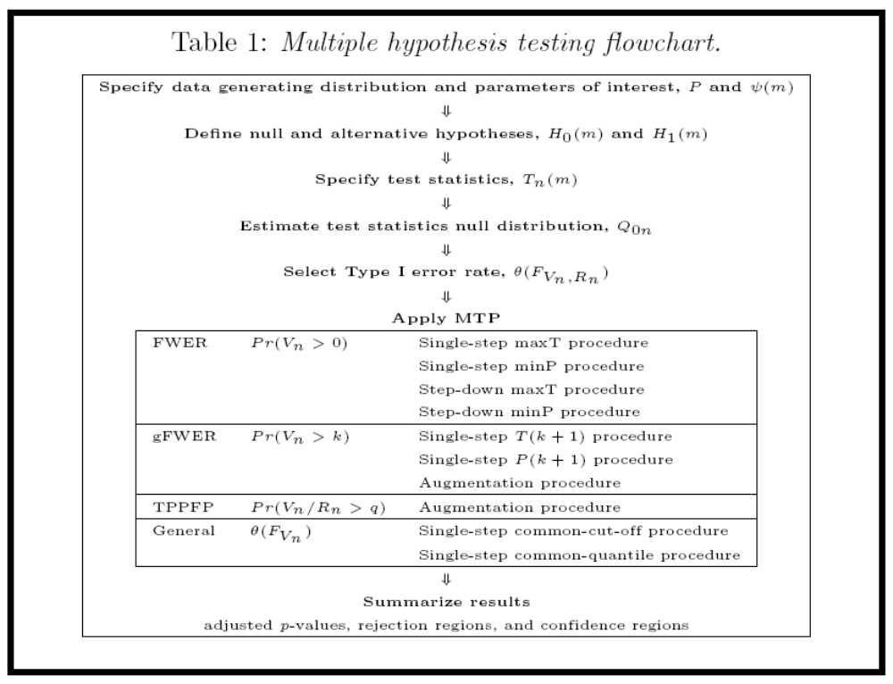

Slide 3
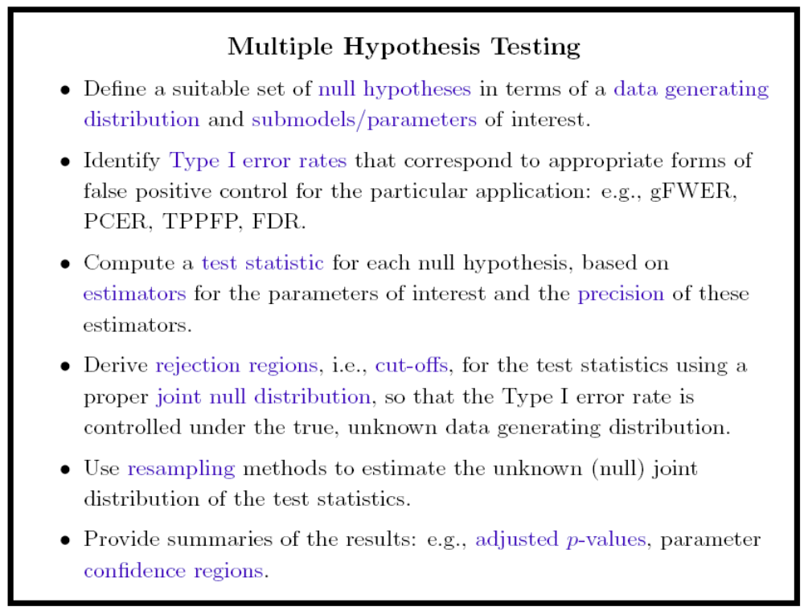

Slide 4
Multiple Testing in Action
Examples From New Book
Multiple Testing Procedures with Applications to Genomics (2007).
S. Dudoit and M. J. van der Laan.

Slide 5
Multiple Testing Software
R package
multtest()

Slide 6
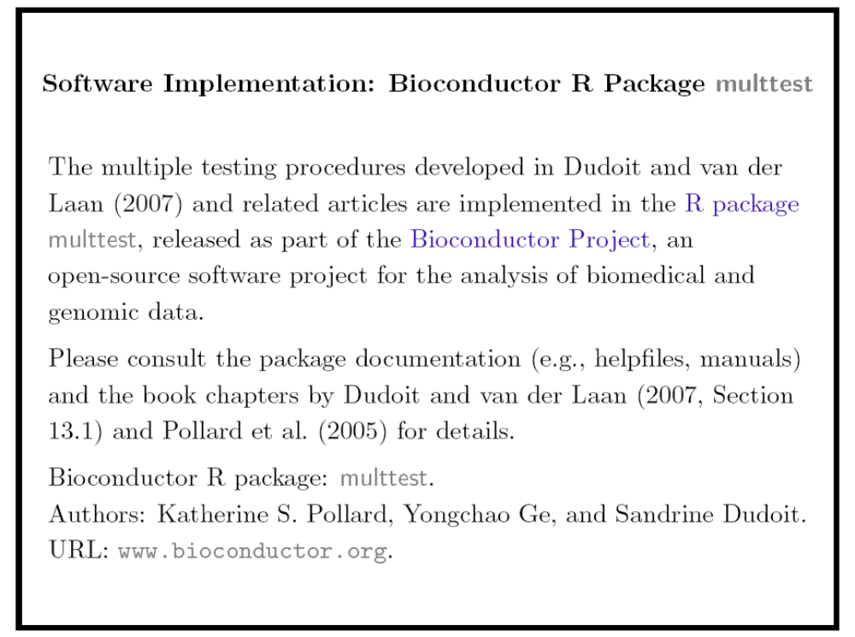
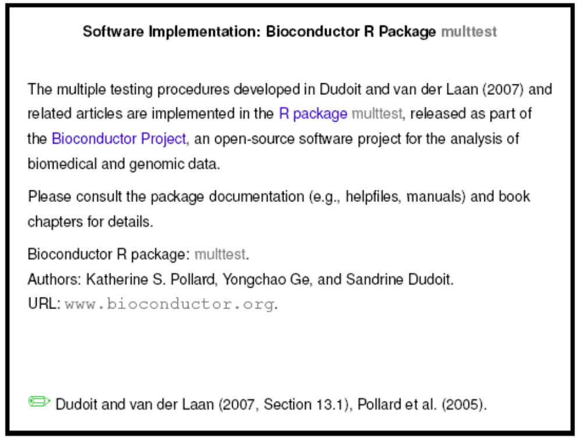

Slide 7
Main functions: mt.rawp2adjp()
Adjusted p-values are computed for simple (Marginal) FWER and FDR controlling procedures based on a vector of raw (unadjusted) p-values.
Possible methods
  Bonferroni single-step adjusted p-values for strong control of the FWER.
  Holm (1979) step-down adjusted p-values for strong control of the FWER.
  Hochberg (1988) step-up adjusted p-values for strong control of the FWER (for raw (unadjusted) p-values satisfying the Simes inequality).
  Sidak single-step adjusted p-values for strong control of the FWER (for positive orthant dependent test statistics).
  Sidak step-down adjusted p-values for strong control of the FWER (for positive orthant dependent test statistics).
  BH adjusted p-values for the Benjamini & Hochberg (1995) step-up FDR controlling procedure (independent and positive regression dependent test statistics).
  BY adjusted p-values for the Benjamini & Yekutieli (2001) step-up FDR controlling procedure (general dependency structures).
Returns adjusted p-values and rank index

Slide 8
Main functions: MTP()
A user-level function to perform multiple testing procedures (MTP).
Available Tests (robust versions available for t-tests and f-tests)
  One-sample t-test
  Two-sample t-test (equal unequal variances, and paired)
  F-test (block design as well)
  lm.XvsZ : t-stat for coefficients of X_{j} ~Z, for each gene (X_{j} ) in matrix
  lm.YvsXZ : t-stat for coefficients of Y~X_{j} + Z, where Z are additional covariates
  coxph.YvsXZ: same as lm.YvsXZ but for cox proportional hazards survival models
Controls Error Rates
  Fwer
  gFwer
  FDR
  TPPFP
Multiple Testing Methods
  single-step maxT
  single-step minP
  step-down maxT
  step-down minP
Bootstrap and permutation null distributions are available.
Returns estimates, statistics, raw and adjusted p-values, etc.

Slide 9
Software Example
Objective: Identify differentially expressed genes between B-cell acute lymphoblastic leukemia (ALL) patients with BCR/ABL fusion and cytogenetically normal B-cell ALL patients
BCR/ABL is one of the most frequent cytogenetic abnormalities in human leukemia
Known to be highly expressed in chronic myeloid leukemia (CML) and acute myeloid leukemia (AML), studies are investigating its prognostic relevance in B-cell ALL patients
Identify differentially expressed genes which distinguish BCR/ABL ALL patients from normal ALL patients.
Data available online in Bioconductor experimental data package ALL
Data is reduced to only B-cell ALL samples of BCR/ABL or NEG (normal) molecular types
79 patients total: 37 BCR/ABL and 42 NEG
Probe set (12,625) is filtered according to von Heydebreck et al. (2004), and mapped into genes → 2073 genes remaining

Slide 10
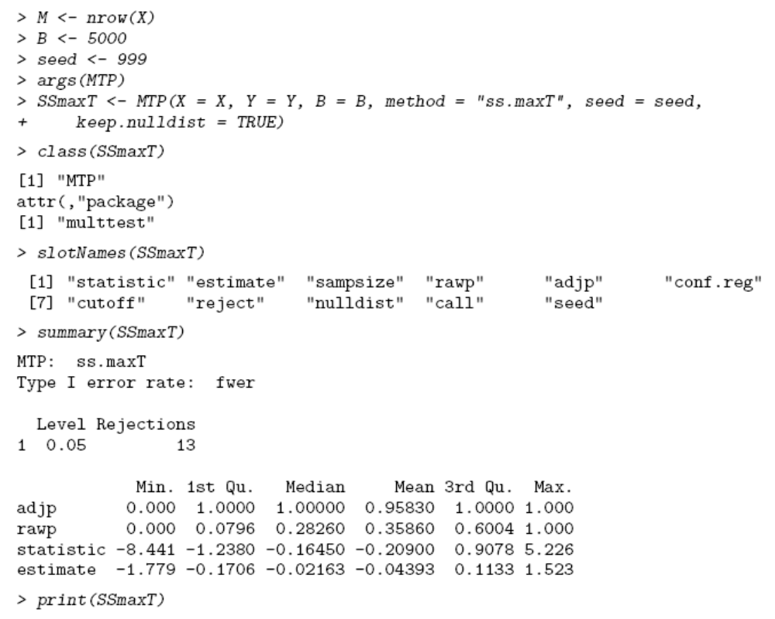
Single-step maxT procedure using MTP()
Based on 2-sample Welch t-statistics and non-parametric estimation of null distribution using bootstrap sample of B=5,000
X=gene set, Y=BCR/ABL classification, seed=999
SSmaxT is class MTP with attributes
Summary, print, and plot methods are available

Slide 11
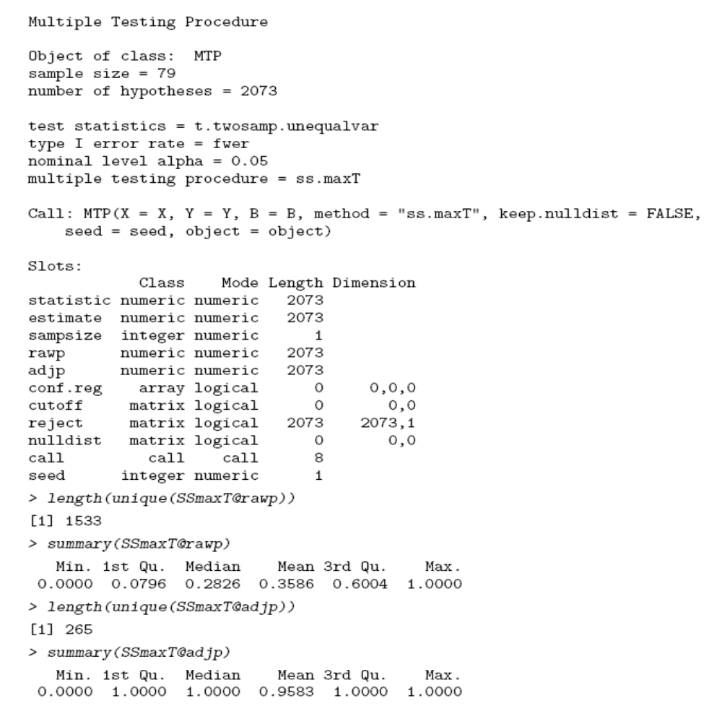
maxT Results
summary(SSmaxT)
print(SSmaxT)

Slide 12
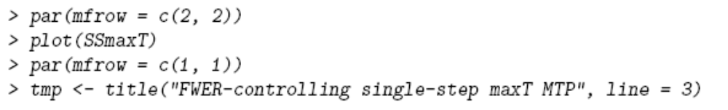
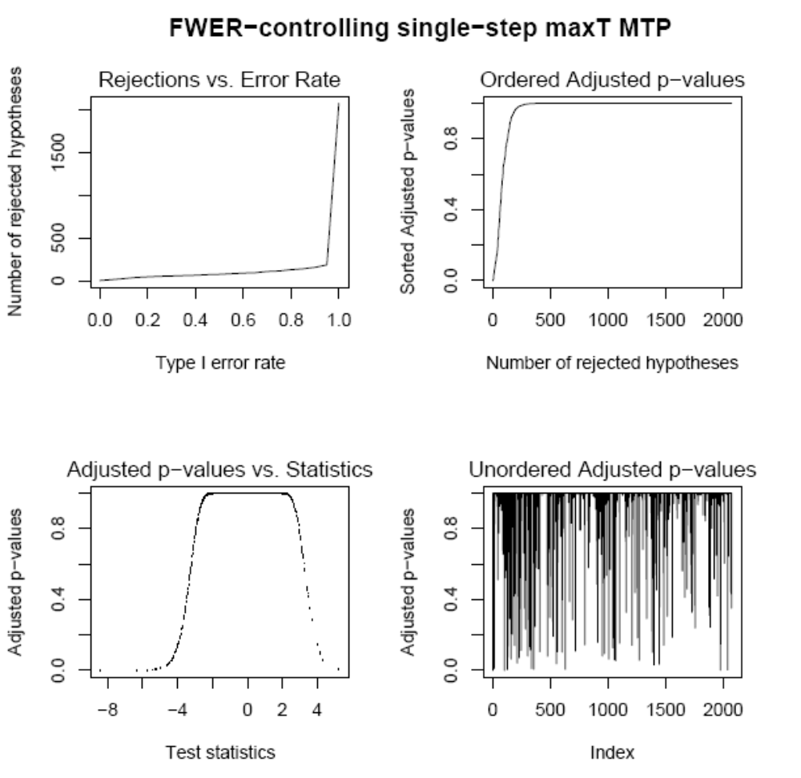
plot(SSmaxT)

Slide 13
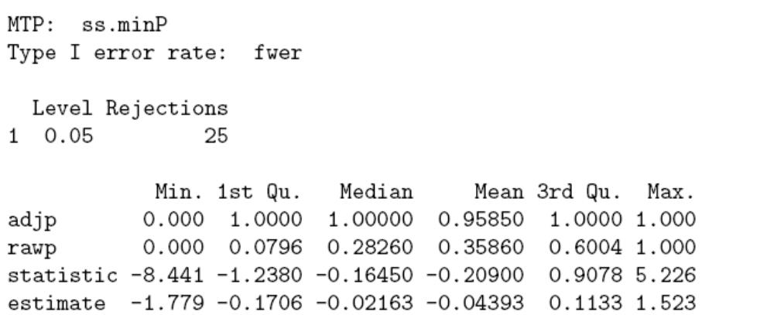
Single-step minP procedure using MTP()
If keep.nulldist=TRUE in original MTP call, to apply alternative multiple testing procedure, MTP() object can be updated
summary(SSminP)

Slide 14
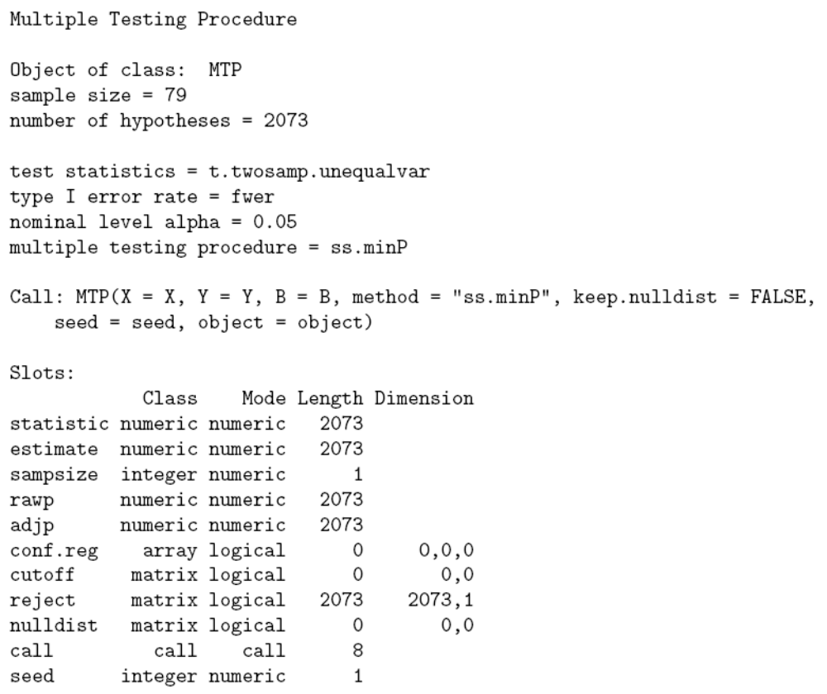
minP Results
print(SSmaxT)

Slide 15
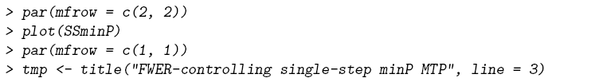
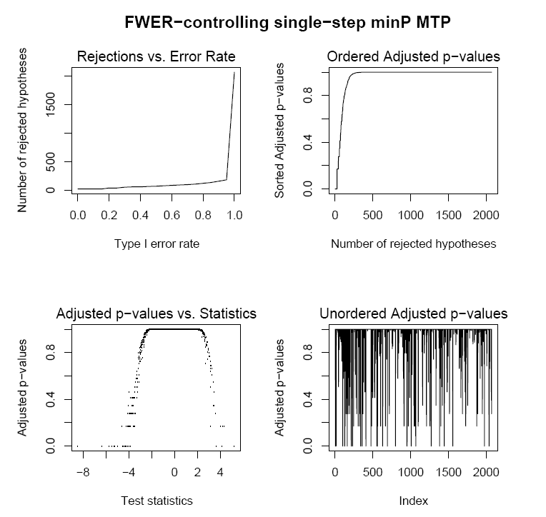
plot(SSminP)

Slide 16
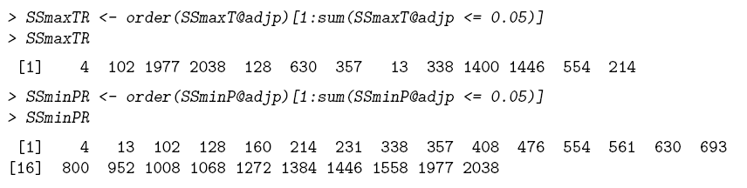
Comparing Single-step minP and maxT Results
At FWER level α=0.05
  maxT identifies 13 genes
  minP identifies 25 genes
12 genes are identified by both methods

Slide 17
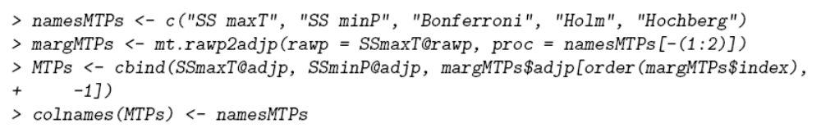
FWER controlling Marginal Mutiple testing using mt.rawp2adjp()
Bootstrap unadjusted p-values are provided by MTP() call (SSmaxT)
Apply Marginal FWER controlling procedures (Bonferroni, Holm, and Hochberg) using mt.rawp2adjp()

Slide 18
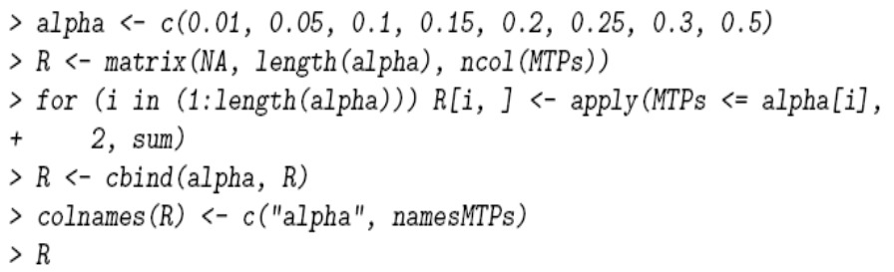

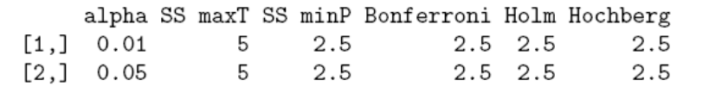
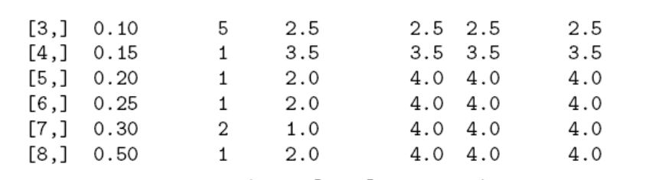
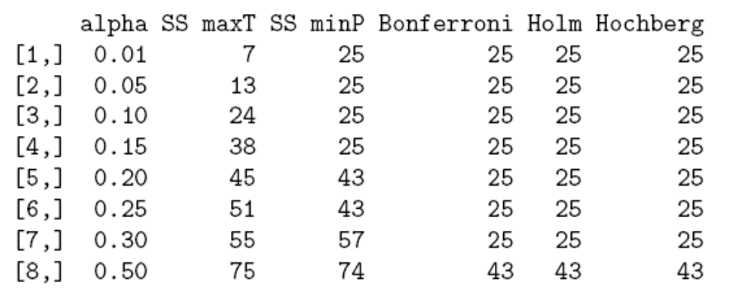
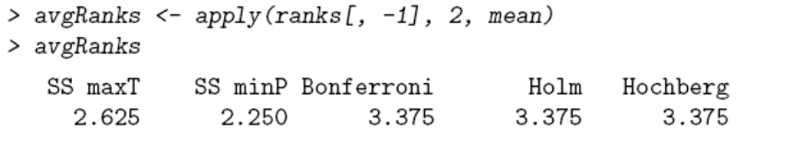
FWER controlling Marginal Mutiple testing using mt.rawp2adjp()
Compare the number of rejected null hypotheses and their ranks at various α cut-offs

Slide 19
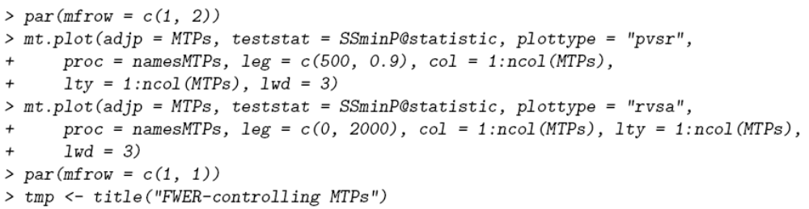
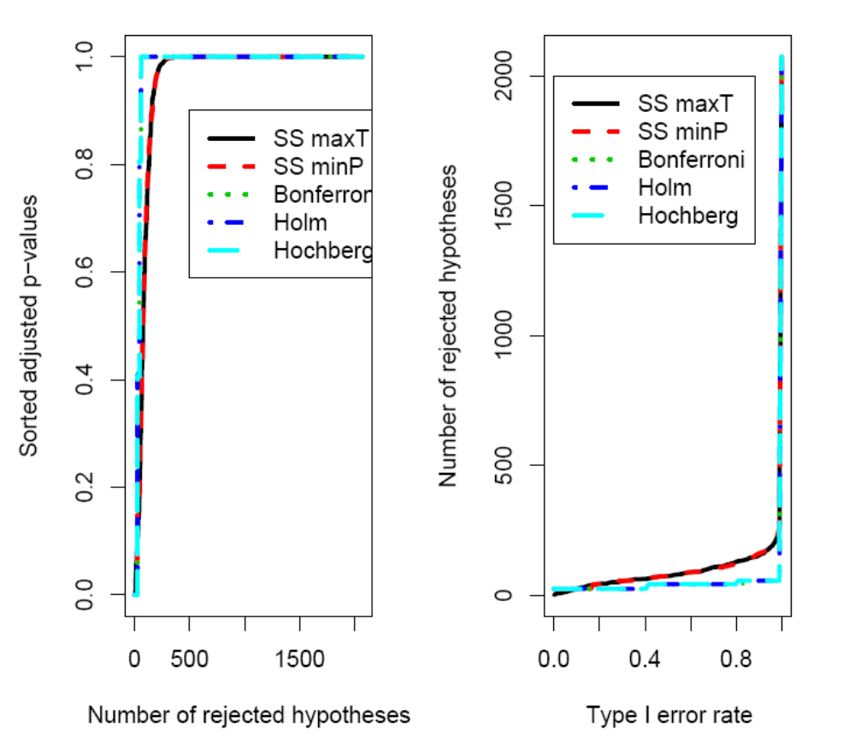
Comparison Plots

Slide 20
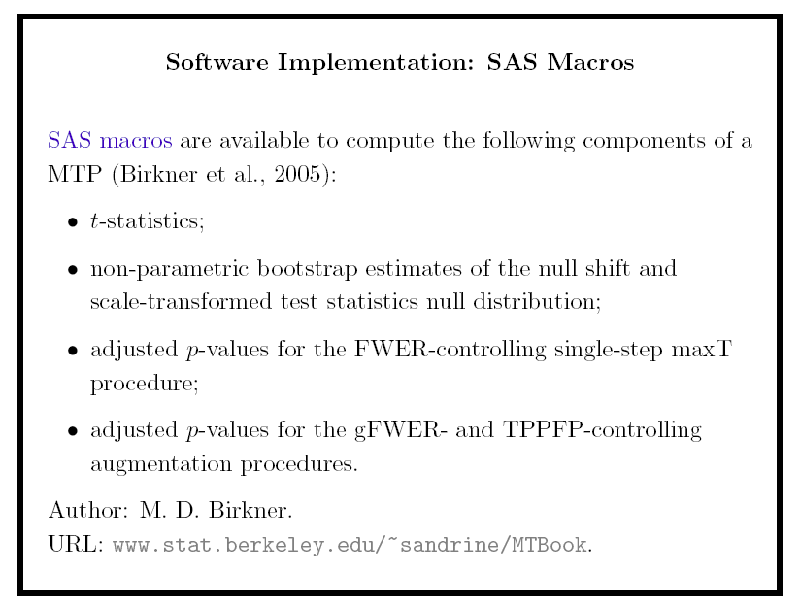

Slide 21
Summary

Slide 22
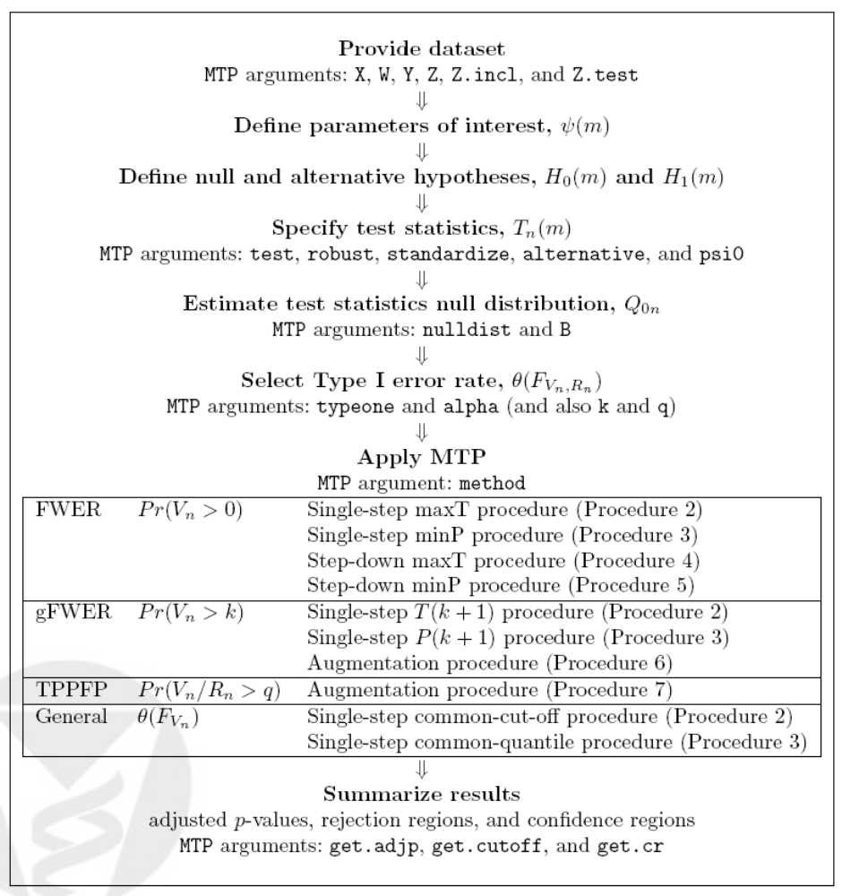
MTPs

Slide 23
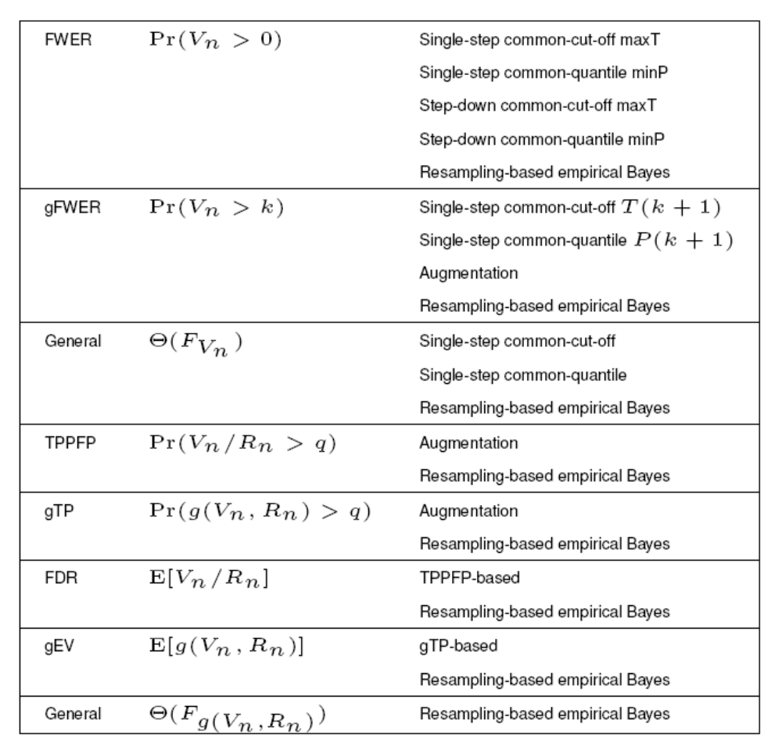

Slide 24
Acknowledgments
Sandrine Dudoit who provided the slides and examples for this presentation
Mark van der Laan

Slide 25
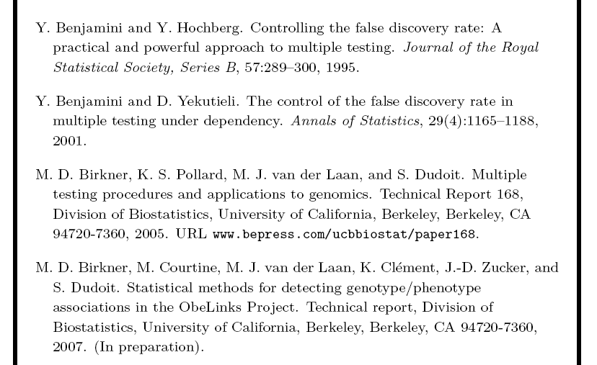
References for Section 3

Slide 26
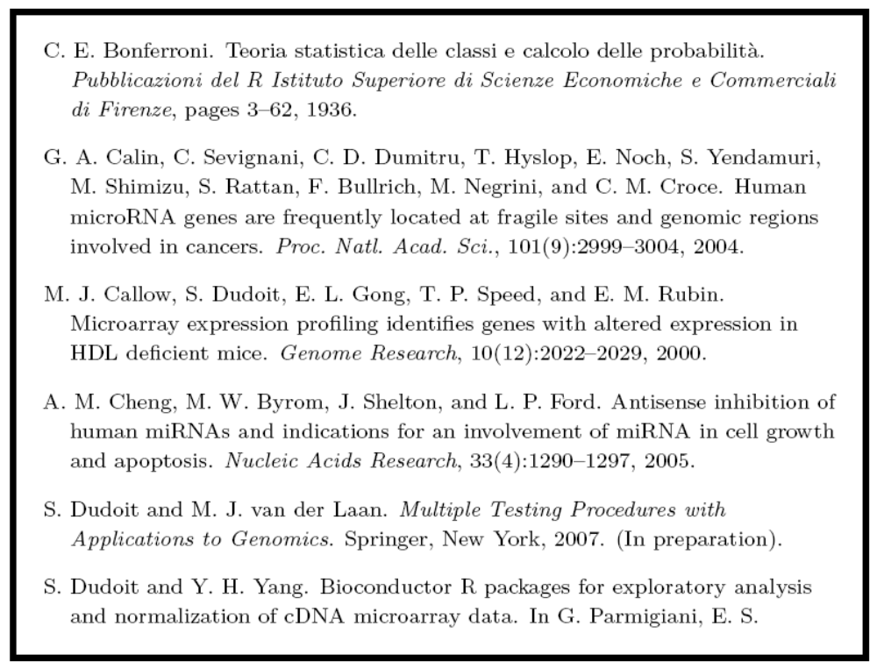
References for Section 3 (con’t)

Slide 27
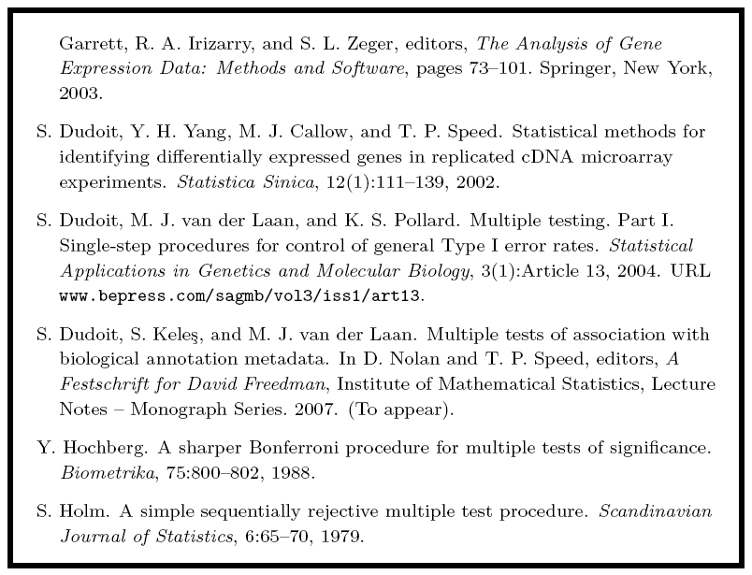
References for Section 3 (con’t)

Slide 28
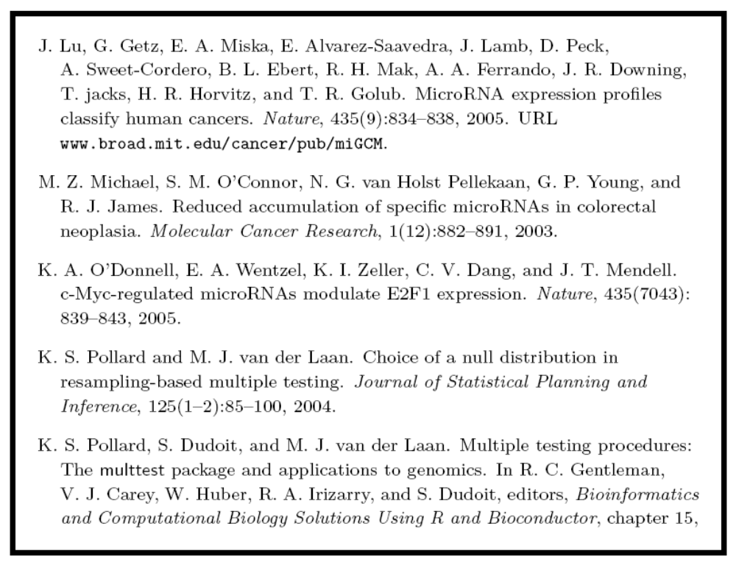
References for Section 3 (con’t)

Slide 29
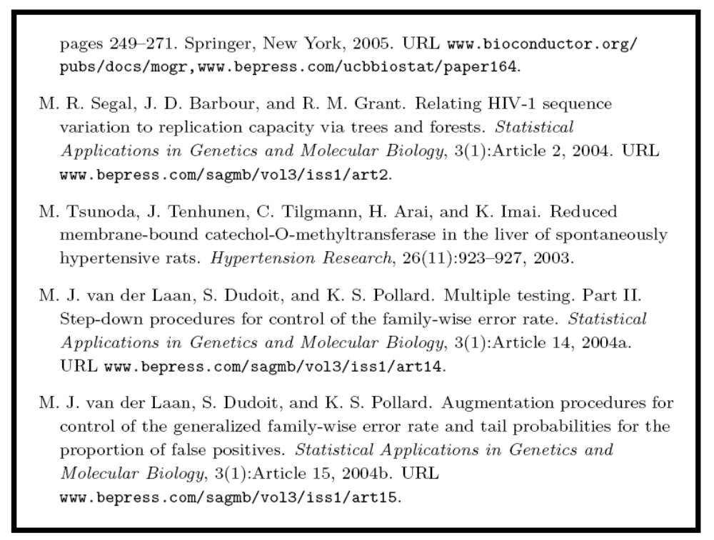
References for Section 3 (con’t)

Slide 30
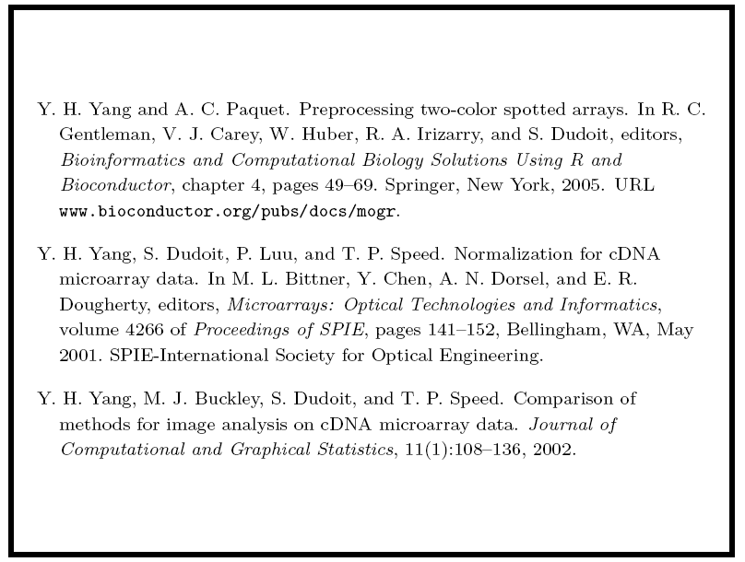
References for Section 3 (con’t)

Slide 31
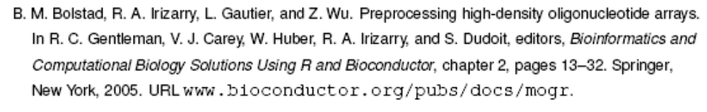
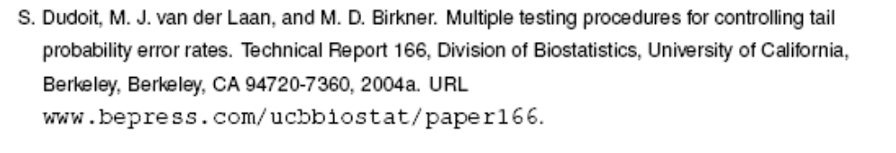
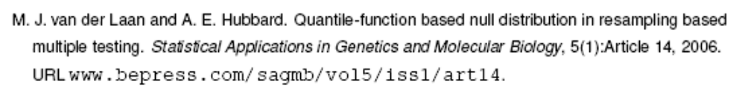

References for Section 3 (con’t)

