Slide 1
Controlling FDR in Second Stage Analysis
Catherine Tuglus
Work with Mark van der Laan
UC Berkeley Biostatistics

Slide 2
Outline
What is a Second Stage Analysis
Issues with MTP for Secondary Analysis
Proposed solution for Marginal FDR controlling procedure
Simulations
Data Example: Golub et al 1999

Slide 3
Second Stage Analysis
Given large dataset (50,000 variables)
Dimension reduction is performed using supervised analysis
  Univariate regression
  RandomForest selection, etc.
Additional analysis is applied to reduced dataset (~1000 variables)
  “Secondary Analysis”
  Variable Importance Methods for instance
Would like to adjust for multiple testing

Slide 4
MTP for Secondary Analysis
Supervised reduction of the data invalidates standard MTPs
  Adds Bias to analysis
  Cannot account for initial screening using standard MTPs
  MTP will not control Type I and Type II error appropriately

Slide 5
Marginal FDR controlling MTP for Secondary Analysis
Process
  Given (Y,W)~P, where W contains M variables
  Initial analysis reduces the set to N variables
  Complete secondary analysis on reduced dataset (N variables), obtaining p-values
  Add to list of p-values (M-N) 1’s
    Thus, all tests not completed are insignificant
  Apply marginal Benjamini & Hochberg step-up FDR controlling procedure
If FDR applied to all variables would select a subset of the N variables, then this two-stage FDR method will be equivalent with applying FDR to all variables. Thus, loss in power only occurs if the N variables exclude significant variables.
  Should be generous in the reduction of the data
  To maximize power, the reduced dataset should include all significant variables.

Slide 6
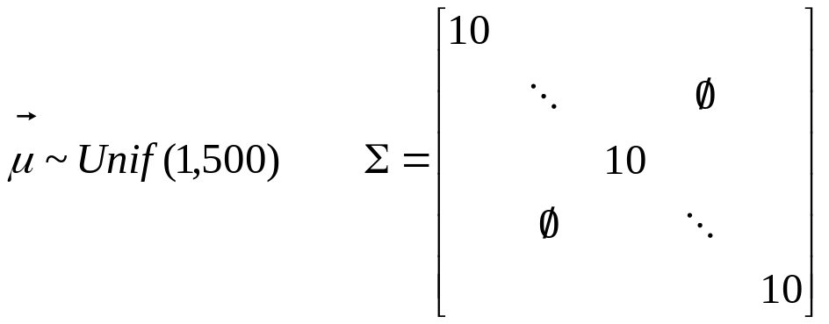

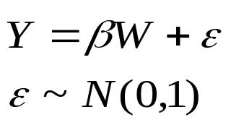
Simulations: Set-up
Simulate 100 variables from Multivariate Normal Distribution
with random mean
and identity covariance
matrix with variance 10
Y is dependent on
10 variables, equally
Using results from univariate linear regression apply VIM method to variable subsets with raw p-values less than 0.05, 0.1, 0.2, 0.3, and 1
MTP for secondary analysis is applied to p-values from all 5 sets of VIM results

Slide 7
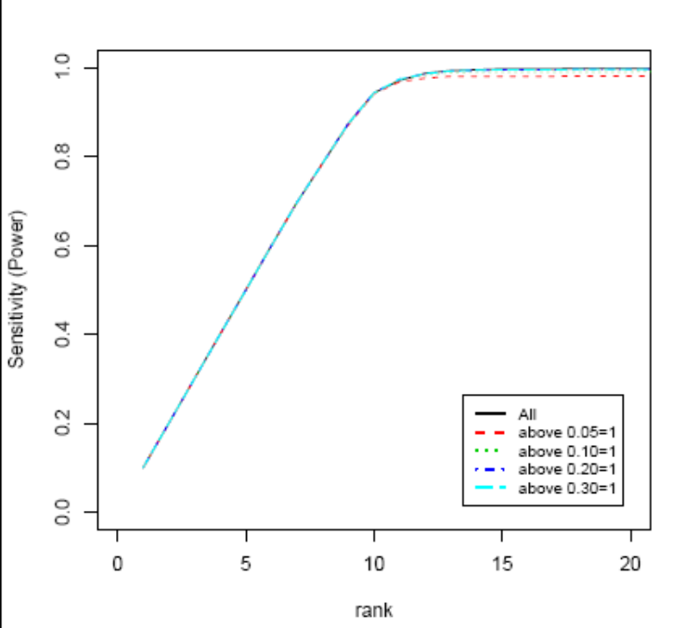
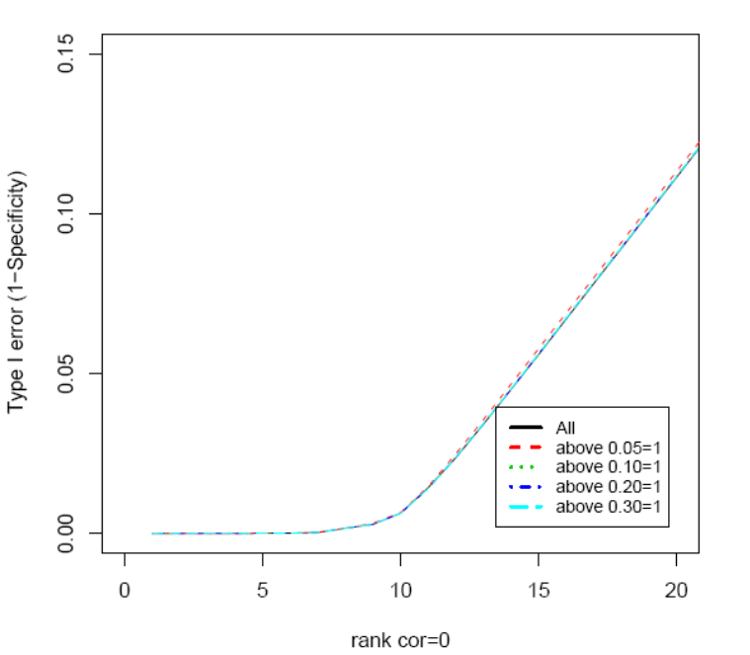
Simulations: Results
Ranking of P-values
Type I error (1-Specificity)
Sensitivity (Power)
P-value Rank
P-value Rank

Slide 8
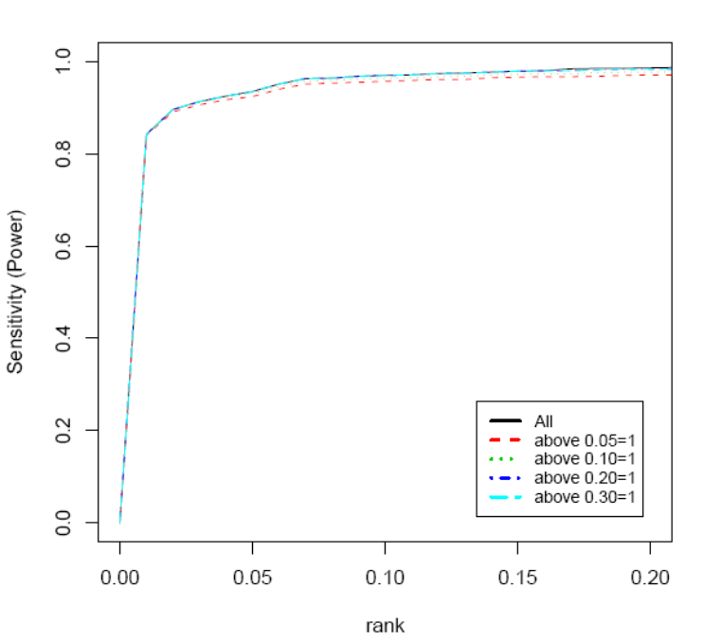
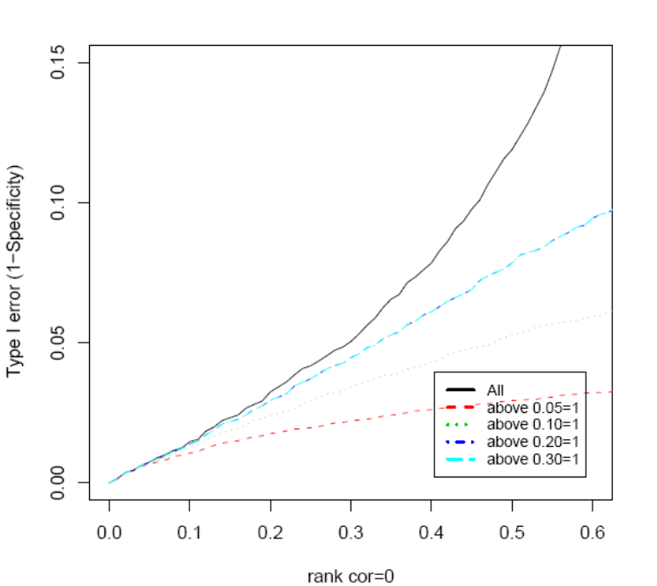
Simulations: Results
P-value cut-off
Type I error (1-Specificity)
Sensitivity (Power)
P-value cut-off
P-value Rank

Slide 9
Application: Golub et al. 1999
Classification of AML vs ALL using microarray gene expression data
38 individuals (27 ALL, 11 AML)
Originally 6817 human genes, reduced using pre-processing methods outlined in Dudoit et al 2003 to 3051 genes
Objective: Identify biomarkers which are differentially expressed (ALL vs AML)
Univariate generalized linear regression is applied
VIM method is applied to subsets with raw p-values less than 0.01, 0.025, 0.05, 0.1, 0.2, 0.3, and 1
MTP for secondary analysis is applied to p-values from all 7 sets of VIM results

Slide 10
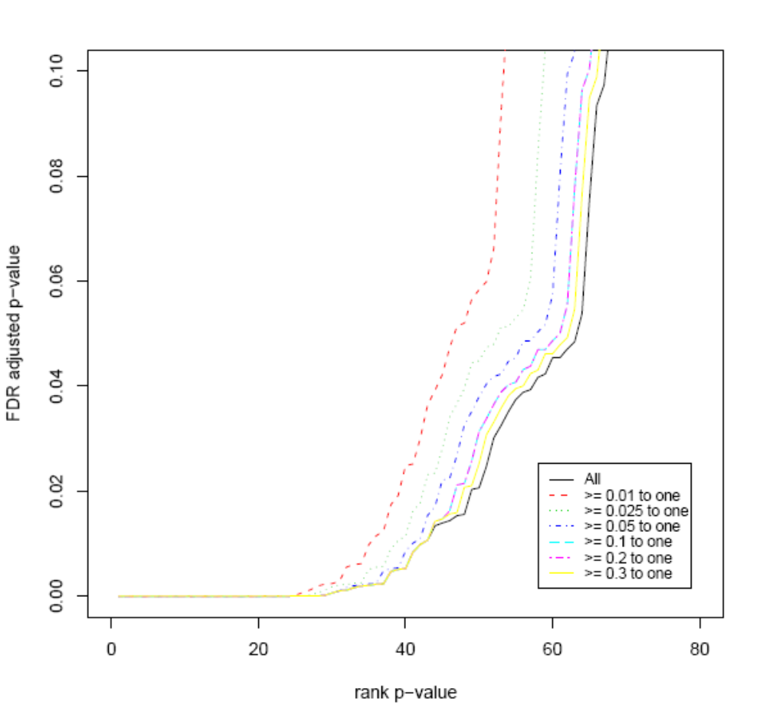
Application: Results
Ranked vs P-value
FDR adjusted p-values
P-value rank

Slide 11
Summary
Assuming all significant variables are present in the reduced set of variables, MTP for secondary analysis has equivalent Power and Type I error control
Can still control FDR even if secondary analysis is only completed on a subset of the original variables

Slide 12
References
“Short Note: FDR Controling Multiple Testing Procedure for Secondary Analysis” (Tech Report. . .)
Y. Ge, S. Dudoit, and T. P. Speed (2003). Resampling-based multiple testing for microarray data analysis. TEST, Vol. 12, No. 1, p. 1-44 (plus discussion p. 44-77). [PDF] [Tech report #633]
Golub et al. (1999). Molecular classification of cancer: class discovery and class prediction by gene expression monitoring, Science, Vol. 286:531-537. <URL: http://www-genome.wi.mit.edu/MPR/> .

