Slide 1

Targeted Maximum Likelihood Learning of Scientific Causal Questions
Mark J. van der Laan
Division of Biostatistics
U.C. Berkeley
JSM July 31, 2007, Salt Lake City
www.bepres.com/ucbbiostat
www.stat.berkeley.edu/~laan

Slide 2
Targeted Maximum Likelihood
Estimation Flow Chart
Inputs
The model is a set of possible probability distributions
of the data
Initial P-estimator of the
probability distribution of the data: P
ˆ
Model
ˆ
ˆ
User Dataset
P
P*
Targeted P-estimator of the
probability distribution
of the data
O(1), O(2),
… O(n)
P
Observations
_{TRUE}
True probability distribution
Target feature map: Ψ( )
Ψ(P_{TRUE})
Initial feature estimator
ˆ
ˆ
Ψ(P)
Ψ(P*)
Targeted feature estimator
Target feature values
True value
of the target feature
Target Feature
better estimates are closer to ψ(P_{TRUE})

Slide 3
Philosophy of the
Targeted P Estimator
^
Find element P* in the model which gives
Large bias reduction for target feature, e.g., by requiring that it solves the efficient influence curve equation
∑_{i=1}D*(P)(O_{i})=0 in P
Small increase of log-likelihood relative to the initial P estimator (This usually results in a small increase in variance and preserves the overall quality of the initial P estimator)
An iterative targeted maximum likelihood procedure can be used to construct a targeted P estimator (described later)

Slide 4

An example of targeted MLE for a survival probability
The transformed distribution ˆ solves the efficient influence curve equation
  The area under the curve of to the right of 28 (the target feature) equals the actual proportion of observations >28 in our sample
P*
ˆ
P*
ˆ
P*
ˆ
P
ˆ
density of P – initial P estimator
p_{TRUE}
actual
probability
distribution
function
ˆ
density of P* – targeted P estimator
Targeted feature estimate:
Blue striped area under the blue curve.
0
20
0
10
28
30
40
Survival time
Target feature: Survival at 28 years
Red striped area under the red curve
Initial feature estimate: Green striped
area under the green curve

Slide 5
The iterative Targeted MLE
^
Identify a strategy for “stretching” the function P so that a small “stretch” yields the maximum change in the target feature. Mathematically, this is achieved by constructing a path P(ε) with free parameter ε through P whose score at ε = 0 equals the efficient influence curve at P.
Given this optimal “stretching strategy”, we must determine the optimum amount of stretch, ε_{OPT}. This value is obtained by maximizing the likelihood of the dataset over ε.
Applying the optimal amount of stretch ε_{OPT} to P using our optimal stretching function P(ε) yields a new probability distribution P₁, which is called the first step targeted maximum likelihood estimator.
P₁ can be substituted for P in the above process, producing an estimate P₂.
This process continues until the incremental “stretch” is essentially zero.
The last probability distribution generated is P*, which solves the efficient influence curve equation, thereby achieving the desired bias reduction with a small increase in likelihood relative to P.
In many cases, the convergence occurs in one step.
The iterative targeted MLE is double robust locally efficient.
^
^
^
^
^
^
^
^
^
^

Slide 6
The iterative Targeted MLE
Identify a strategy for “stretching” the initial P so that a small “stretch” yields the maximum change in the target feature. Mathematically, this is achieved by constructing a path P(ε) with free parameter ε through P whose score at ε = 0 equals the efficient influence curve.
Given this optimal “stretching strategy”, we must determine the optimum amount of stretch, ε_{OPT}. This value is obtained by maximizing the likelihood of the dataset over ε.
Applying the optimal amount of stretch ε_{OPT} to P using our optimal stretching function P(ε) yields a new probability distribution, which is called the first step targeted maximum likelihood estimator.
This process continues until the incremental “stretch” is essentially zero.
The last probability distribution generated is P*, which solves the efficient influence curve equation, thereby achieving the desired bias reduction with a small increase in likelihood relative to P.
In many cases, the convergence occurs in one step.
The iterative targeted MLE is double robust locally efficient.
^
^
^
^
^
^
^
^
^
^
^

Slide 7
This process continues until the incremental “stretch” is essentially zero.
The last probability distribution generated is P*, which solves the efficient influence curve equation, thereby achieving the desired bias reduction with a small increase in likelihood relative to P.
In many cases, the convergence occurs in one step.
The iterative targeted MLE is double robust locally efficient in causal inference/censored data applications.

Slide 8
An example of iterating with targeted MLE to estimate a median
ˆ
Starting with the initial P estimator P⁰, determine optimal “stretching function” and “amount of stretch”, producing a new P estimator P¹
Continue repeating until further stretching is essentially zero
ˆ
ˆ
ˆ
ˆ
ˆ
ˆ
ˆ
p – density of P – initial P estimator
ˆ
p₁
ˆ
p₂
p_{TRUE}
actual
probability
distribution
function
…
ˆ
p_{k-1}
ˆ
ˆ
p_{k} = density of P* – targeted P estimator
0
20
0
10
40
Survival time
Median for P_{TRUE}

Slide 9
Targeted MLE for finding a median
Data is n survival times O₁,…,O_{n} with common probability density p₀
Model for p₀ is nonparametric
Target feature is median of p₀
Initial P estimator is an (say) estimator p_{n} (e.g., kernel density estimator, or estimator based on working model such as the normal distributions)
Fluctuation p_{n}(ε)=c(ε,p_{n})Exp(ε D(p_{n}))p_{n}, where
D(p_{n})=I(O· Median(p_{n}))-0.5
is the efficient influence curve of median at p_{n}
Let ε_{n}¹ be MLE, and set p_{n}¹=p_{n}(ε_{n}¹), which is the first step targeted MLE: this is a new curve in which the median is moved in the direction of the empirical median.
Iterate until convergence In the limit, we have that the update p_{n}* has a median equal to the empirical median, i.e. the value at which 50% of data points are smaller than that value

Slide 10
Targeted MLE for Causal Effect
Dose-Response Curve
O=(W,A,Y=Y(A)) drawn from probability distribution P_{True}, W baseline covariates, A dose of drug, Y outcome, Y(a) counterfactual dose-specific outcomes
No unmeasured confounders so that we have Missing at Random
Model for P_{True} is nonparametric
E(Y(a)|V) dose response curve by strata V of a user supplied choice of effect modifier V ⊂ W
Target feature is a weighted least squares projection of the dose response curve on the working model m(a,V|β) where the weight function is denoted with h(A,V)
Initial P estimator is (say) logistic regression fit of binary outcome Y on A,W
First step targeted MLE is obtained by adding to the logistic regression fit a covariate extension ε h(A,V)/g(A|W) δ/ δβ m(a,V|β) and computing the MLE of the coefficient ε
If the working model is linear in parameter β, then the iterative targeted MLE converges in one step
Note: In a randomized trial the targeted MLE typically converges in ZERO steps.

Slide 11
Outline
Multiple Testing for variable importance in prediction
Overview of Multiple Testing
Previous proposals of joint null distribution in resampling based multiple testing: Westfall and Young (1994), Pollard, van der Laan (2003), Dudoit, van der Laan, Pollard (2004).
Quantile Transformed joint null distribution: van der Laan, Hubbard 2005.
Simulations.
Methods controlling tail probability of the proportion of false positives.
    Augmentation Method: van der Laan, Dudoit, Pollard (2003)
    Empirical Bayes Resampling based Method: van der Laan, Birkner, Hubbard (2005).
Data Applications.
Pathway Testing: Birkner, Hubbard, van der Laan (2005).
Conclusion

Slide 12
Multiple Testing in Prediction
Suppose we wish to estimate and test for the importance of each variable for predicting an outcome from a set of variables.
Current approach involves fitting a data adaptive regression and measuring the importance of a variable in the obtained fit.
We propose to define variable importance as a (pathwise differentiable) parameter, and directly estimate it with targeted maximum likelihood methodology
This allows us to test for the importance of each variable separately and carry out multiple testing procedures.

Slide 13
Example: HIV resistance mutations
Goal: Rank a set of genetic mutations based on their importance for determining an outcome
  Mutations (A) in the HIV protease enzyme
    Measured by sequencing
  Outcome (Y) = change in viral load 12 weeks after starting new regimen containing saquinavir
  Confounders (W) = Other mutations, history of patient
How important is each mutation for viral resistance to this specific protease inhibitor drug? ψ₀=E E(Y|A=1,W)-E(Y|A=0,W)
  Inform genotypic scoring systems

Slide 14
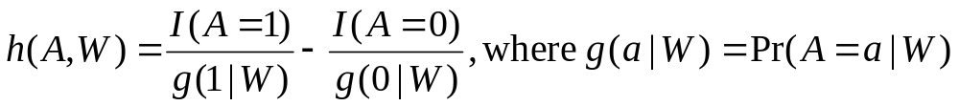
Targeted Maximum Likelihood
In regression case, implementation just involves adding a covariate h(A,W) to the regression model
Requires estimating g(A|W)
  E.g. distribution of each mutation given covariates
Robust: Estimate of ψ₀ is consistent if either
  g(A|W) is estimated consistently
  E(Y|A,W) is estimated consistently

Slide 15
Mutation Rankings Based on Variable Importance
Current Score | Mutation | VIM | VIM p-value | Crude | Crude p-value
35 | 90M | 0.70 | 0.00 | 0.76 | 0.00
40 | 48VM | 0.79 | 0.00 | 1.07 | 0.00
0 | 30N | -0.78 | 0.00 | -1.06 | 0.00
10 | 82AFST | 0.46 | 0.01 | 0.35 | 0.03
10 | 54VA | 0.46 | 0.01 | 0.31 | 0.11
10 | 73CSTA | 0.67 | 0.03 | 0.80 | 0.00
2 | 20IMRTVL | 0.32 | 0.07 | 0.26 | 0.18
1 | 36ILVTA | 0.28 | 0.10 | 0.27 | 0.12
2 | 10FIRVY | 0.27 | 0.13 | 0.48 | 0.00
5 | 88DTG | -0.23 | 0.24 | -0.50 | 0.33
2 | 71TVI | 0.18 | 0.29 | 0.14 | 0.37
5 | 32I | -0.18 | 0.58 | -0.20 | 0.55
2 | 63P | 0.06 | 0.77 | 0.11 | 0.56
5 | 46ILV | 0.13 | 0.98 | 0.27 | 0.10
Notes:
Cut crude here?
adjusted for multiple testing; excluding those mutations with ETA violations
ranked by VIM p-value
Note- 30N only strange one- some evidence that is indeed protective

Slide 16
Hypothesis Testing Ingredients
Data (X₁,…,X_{n})
Hypotheses
Test Statistics
Type I Error
Null Distribution
    Marginal (p-values) or
    Joint distribution of the test statistics
Rejection Region
Adjusted p-values

Slide 17
Type I Error Rates
FWER: Control the probability of at least one Type I error (V_{n}): P(V_{n} > 0) · α
gFWER: Control the probability of at least k Type I errors (V_{n}): P(V_{n} > k) · α
TPPFP: Control the proportion of Type I errors (V_{n}) to total rejections (R_{n}) at a user defined level q: P(V_{n}/R_{n} > q) · α
FDR: Control the expectation of the proportion of Type I errors to total rejections: E(V_{n}/R_{n}) · α

Slide 18
QUANTILE TRANSFORMED JOINT NULL DISTRIBUTION
Let Q_{0j} be a marginal null distribution so that for j2 S₀
Q_{0j}⁻¹Q_{nj}(x)¸ x
where Q_{nj} is the j-th marginal distribution of the true distribution Q_{n}(P) of the test statistic vector T_{n}.

Slide 19
QUANTILE TRANSFORMED JOINT NULL DISTRUTION
We propose as null distribution the distribution Q_{0n} of
T_{n}*(j)=Q_{0j}⁻¹Q_{nj}(T_{n}(j)), j=1,…,J
This joint null distribution Q_{0n}(P) does indeed satisfy the wished multivariate asymptotic domination condition in (Dudoit, van der Laan, Pollard, 2004).

Slide 20
BOOTSTRAP QUANTILE-TRANSFORMED JOINT NULL DISTRIBUTION
We estimate this null distribution Q_{0n}(P) with the bootstrap analogue:
T_{n}#(j)=Q_{0j}⁻¹Q_{nj}#(T_{n}#(j))
where # denotes the analogue based on bootstrap sample O₁#,..,O_{n}# of an approximation P_{n} of the true distribution P.

Slide 21
Description of Simulation
  100 subjects each with one random X (say a SNP’s) uniform over 0, 1 or 2.
  For each subject, 100 binary Y’s, (Y₁,...Y₁₀₀) generated from a model such that:
    first 95 are independent of X
    Last 5 are associated with X
    All Y’s correlated using random effects model
  100 hypotheses of interest where the null is the independence of X and Y_{i} .
  Test statistic is Pearson’s χ² test where the null distribution is χ² with 2 df.
  In this case, Y₀ is the outcome if, counter to fact, the subject had received A=0.
  Want to contrast the rate of miscarriage in groups defined by V,R,A if among these women, one removed decaffeinated coffee during pregnancy.
Notes:
Include the 1 because when we start multiplying things together later, it will give an intercept.
E(Yij) = expectation - if one had an infinite random sample of Yij's and took the avevage. Notation is general - allows a different mean for each observation.
Var(Yij) is E(Yij-muij)^2 average squared departure from the mean.

Slide 22
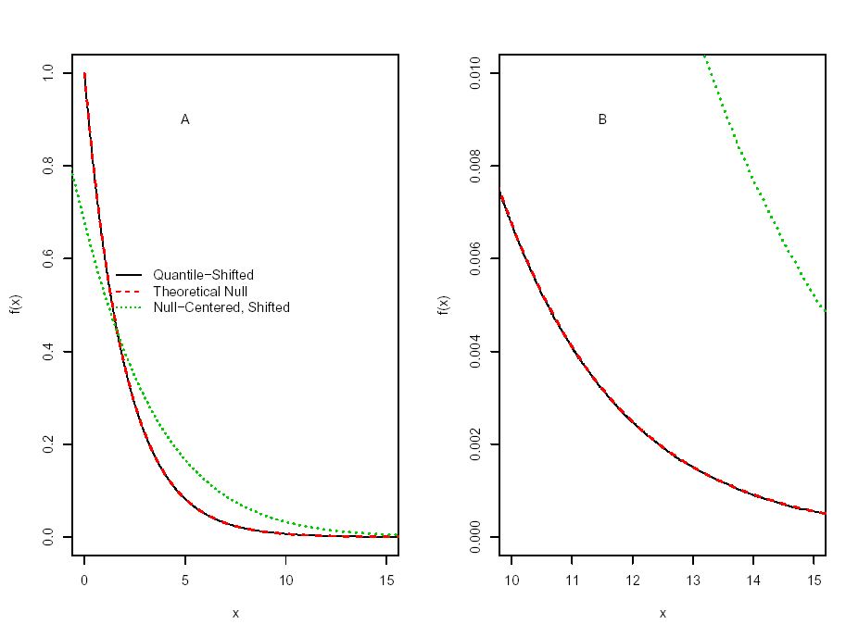
Figure 1: Density of null distributions: null-centered, rescaled bootstrap, quantile-transformed and the theoretical. A is over entire range, B is the right tail.
Notes:
Because we have to keep both individual measurements per person and vectors of measurements made on a person, we need to have some coherent notation so we don’t go crazy.

Slide 23
Description of Simulation, cont.
  Simulated data 1000 times
  Performed the following MTP’s to control FWER at 5%.
    Bonferroni
    Null centered, re-scaled bootstrap (NCRB) – based on 5000 bootstraps
    Quantile-Function Based Null Distribution (QFBND)
  Results
    NCRB anti-conservative (inaccurate)
    Bonferroni very conservative (actual FWER is 0.005)
    QFBND is both accurate (FWER 0.04) and powerful (10 times the power of Bonferroni).
Notes:
Include the 1 because when we start multiplying things together later, it will give an intercept.
E(Yij) = expectation - if one had an infinite random sample of Yij's and took the avevage. Notation is general - allows a different mean for each observation.
Var(Yij) is E(Yij-muij)^2 average squared departure from the mean.

Slide 24
SMALL SAMPLE SIMULATION
2 populations.
Sample n_{j} p-dim vectors from population j, j=1,2.
Wish to test for difference in means for each of p components.
Parameters for population j: μ_{j}, σ_{j}, ρ_{j}.
h₀ is number of true nulls

Slide 25
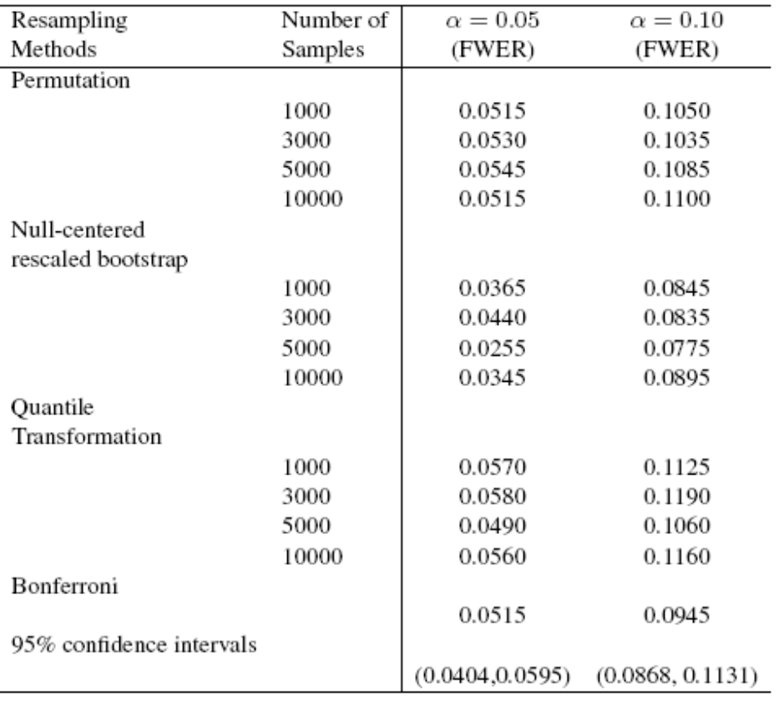

Slide 26
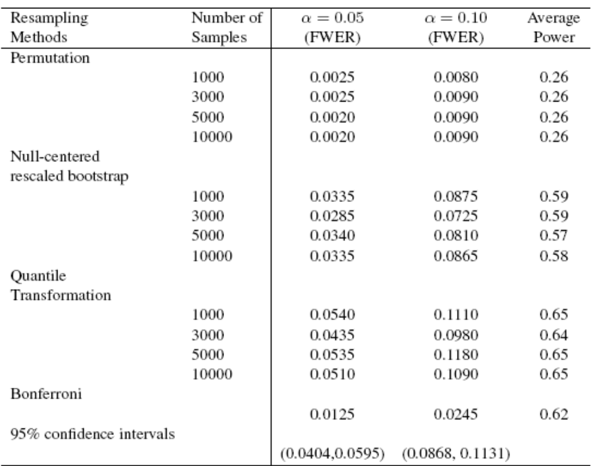

Slide 27
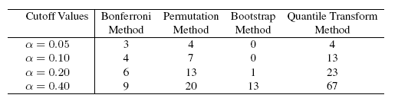

Slide 28
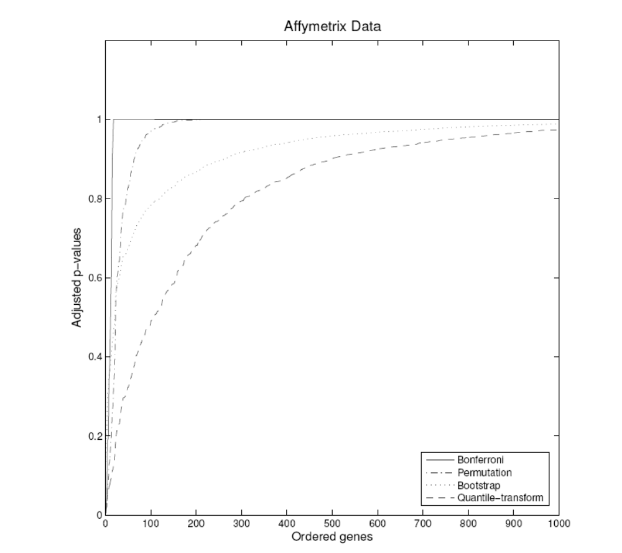
ADJUSTED P VALUES

Slide 29
Empirical Bayes/Resampling TPPFP Method
We devised a resampling based multiple testing procedure, asymptotically controlling (e.g.) the proportion of false positives to total rejections.
This procedure involves:
  Randomly sampling a guessed (conservative) set of true null hypotheses: e.g. H₀(j)~Bernoulli (Pr(H₀(j)=1|T_{j})=p₀f₀(T_{j})/f(T_{j}) ) based on the Empirical Bayes model: T_{j}|H₀=1 ~f₀ T_{j}~f p₀=P(H₀(j)=1) (p0=1 conservative)
  Our bootstrap quantile joint null distribution of test statistics.

Slide 30
REMARK REGARDING MIXTURE MODEL PROPOSAL
Under overall null min(1,f₀(T_{n}(j))/f(T_{n}(j)) ) does not converge to 1 as n converges to infinity, since the overall density f needs to be estimated. However, if number of tests converge to infinity, then this ratio will approximate 1.
This latter fact probably explains why, even under the overall null, we observe a good practical performance in our simulations.
Notes:
Phi_0(T)/Phi_{d_n}(T) for univariate test. d_n=root(n) mu

Slide 31

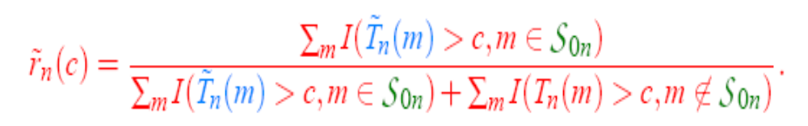
Emp. BayesTPPFP Method
Grab a column from the null distribution of length M.
Draw a length M binary vector corresponding to S_{0n}.
For a vector of c values calculate:
Repeat 1. and 2. 10,000 times and average over iterations.
Choose the c value where P(r_{n}(c) > q)· α.

Slide 32
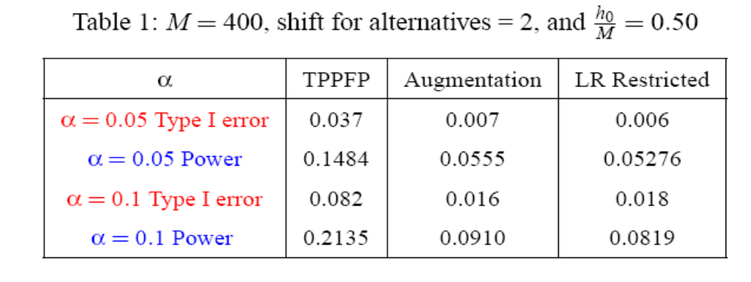
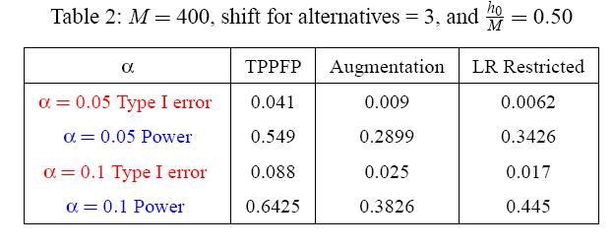
Examples/Simulations

Slide 33
Bacterial Microarray Example
Airborne bacterial levels in specific cities over a span of several weeks are being collected and compared.
A specific Affymetrics array was constructed to quantify the actual bacterial levels in these air samples.
We will be comparing the average (over 17 weeks) strain-specific intensity in San Antonio versus Austin, Texas.
Notes:
The following 7 slides 24-32 can be skipped if time pressure, so skip to
Pathway. If that also is too much skip to conclusions.

Slide 34
420 Airborne Bacterial Levels
17 time points
San Antonio vs Austin
Procedure | α | Number Rejected
Bonferroni FWE | α = 0.05 | 5
 | α = 0.10 | 6
Augmentation TPPFP | α = 0.05 | 11
 | α = 0.10 | 14
E.Bayes/Bootstrap TPPFP | α = 0.05 | 13
 | α = 0.10 | 21

Slide 35
Protein Data Example
We are interested in analyzing mass-spectrometry data to determine specific mass-to-charge ratios (m/z) which significantly differ in mean intensity between two types of leukemia, ALL and AML.
The data structure consists of two replicates each for 7 samples of AML and 13 samples of ALL.
The data has undergone preprocessing to correct for baseline spectral shifts.

Slide 36
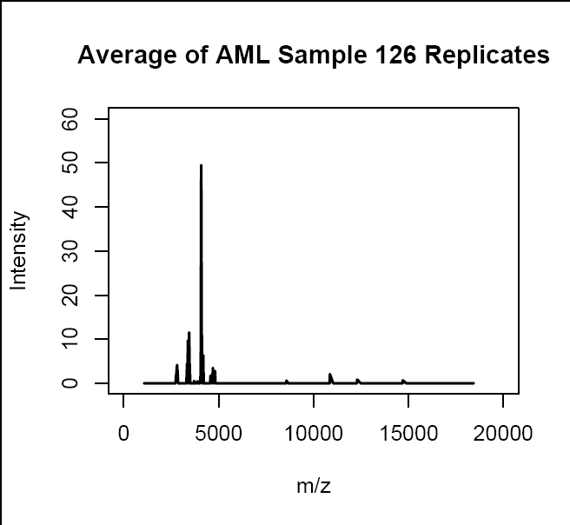
Mass Spectrometry Data

Slide 37
204 Protein Levels:
AML (7) vs ALL (13)
Procedure | α | Number Rejected
Bonferroni FWE | α = 0.05 | 0
 | α = 0.10 | 1
Augmentation TPPFP | α = 0.05 | 1
 | α = 0.10 | 1
E.Bayes/Bootstrap TPPFP | α = 0.05 | 3
 | α = 0.10 | 3

Slide 38

CGH Arrays and Tumors in Mice
    11 Comparative genomic hybridization (CGH) arrays from cancer tumors of 11 mice.
DNA from test cells is directly compared to DNA from normal cells using bacterial artificial chromosomes (BACs), which are small DNA fragments placed on an array.
    With CGH:
      differentially labeled test [tumor] and reference [healthy] DNA are co-hybridized to the array.
      Fluorescence ratios on each spot of the array are calculated.
      The location of each BAC in the genome is known and thus the ratios can be compiled into a genome-wide copy number profile

Slide 39
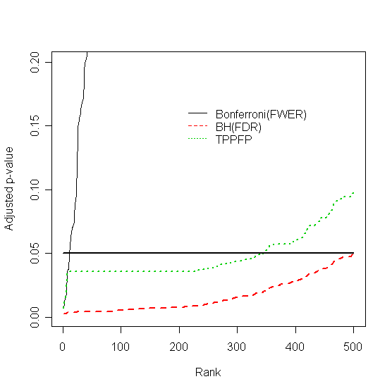
Plot of Adjusted p-values for 3 procedures vs. Rank of BAC (ranked by magnitude of T-statistic)

Slide 40
Pathway Testing
Biologists are often interested in testing the relationship between a collection of genes or mutations and a specific outcome.
For example, imagine the situation with 10 potential mutations and an outcome of cancer/no cancer.
We propose using the Residual Sum of Squares (RSS) or Likelihood Ratio (LR) as a test statistic for the model, after fitting the data with a data adaptive regression algorithm.
The null distribution is obtained under the permutation distribution.

Slide 41
Simulations
Underlying Model (10 total Xs) : ln(P/(1-P)) = β₀ + β₁X₁X₂.
Method | Power (rejections/500 simulations)
Polyclass | 0.762
Regression X₁ + X₂ | 0.204
Regression X₁ + X₂ + … X₁₀ | 0.14
Forward/Backward Selection | 0.154
Global Test (Pathway Testing) | 0.184
FWER | 0.062
Notes:
Mention that we can use permutation as marginal distribution and still use bootstrap overall.

Slide 42
COMBINING PERMUTATION DISTRIBUTION WITH QUANTILE NULL DISTRIBUTION
For a test of independence, the permutation distribution is the preferred choice of marginal null distribution, due to its finite sample control.
We can construct a quantile transformed joint null distribution whose marginals equal these permutation distributions, and use this distribution to control any wished type I error rate.

Slide 43
Conclusions
Quantile function transformed bootstrap null distribution for test-statistics is generally valid and powerful in practice.
Powerful Emp Bayes/Bootstrap Based method sharply controlling proportion of false positives among rejections.
Combining general bootstrap quantile null distribution for test statistics with random guess of true nulls provides general method for obtaining powerful (joint) multiple testing procedures (alternative to step down/up methods).
Combining data adaptive regression with testing and permutation distribution provides powerful test for independence between collection of variables and outcome.
Combining permutation marginal distribution with quantile transformed joint bootstrap null distribution provides powerful valid null distribution if the null hypotheses are tests of independence.
Targeted ML estimation of variable importance in prediction allows multiple testing (and inference) of variable importance for each variable.

Slide 44
Multiple Testing in Prediction
Suppose we wish to estimate and test for the importance of each variable for predicting an outcome from a set of variables.
Current approach involves fitting a data adaptive regression and measuring the importance of a variable in the obtained fit.
We propose to define variable importance as a (pathwise differentiable) parameter, and directly estimate it with general estimating function methodology
This allows us to test for the importance of each variable separately and carry out multiple testing procedures.

Slide 45
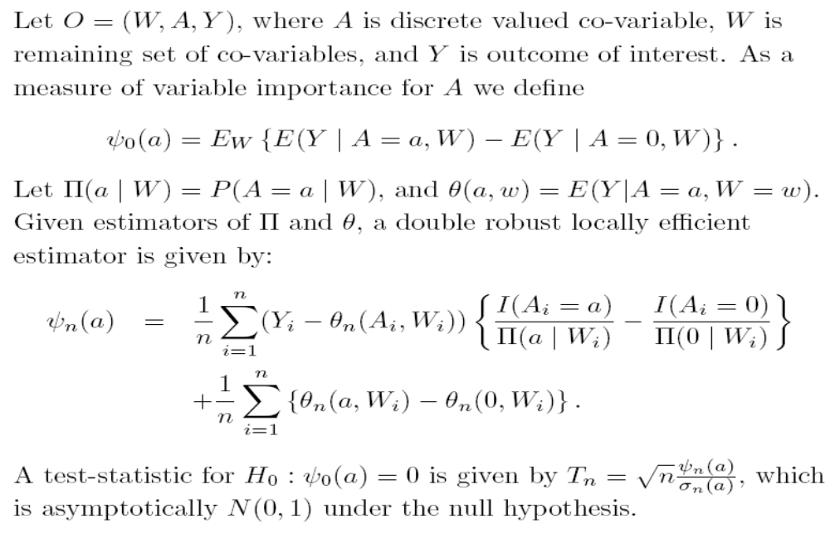
Multiple Testing in Prediction

Slide 46
Multiple Testing in Prediction
Suppose we wish to estimate and test for the importance of each variable for predicting an outcome from a set of variables.
Current approach involves fitting a data adaptive regression and measuring the importance of a variable in the obtained fit.
We propose to define variable importance as a (pathwise differentiable) parameter, and directly estimate it with general estimating function methodology
This allows us to test for the importance of each variable separately and carry out multiple testing procedures.

Slide 47
Application in HIV Sequence Analysis
336 patients for which we measure sequence of HIV virus, and replication capacity of virus.
The PRO positions 4-99 and RT positions 38-222 are used, resulting in a total of 282 positions, which are coded as a binary covariate.
We wish to test for the importance of each mutation.
Running a data adaptive regression algorithm resulted in

Slide 48
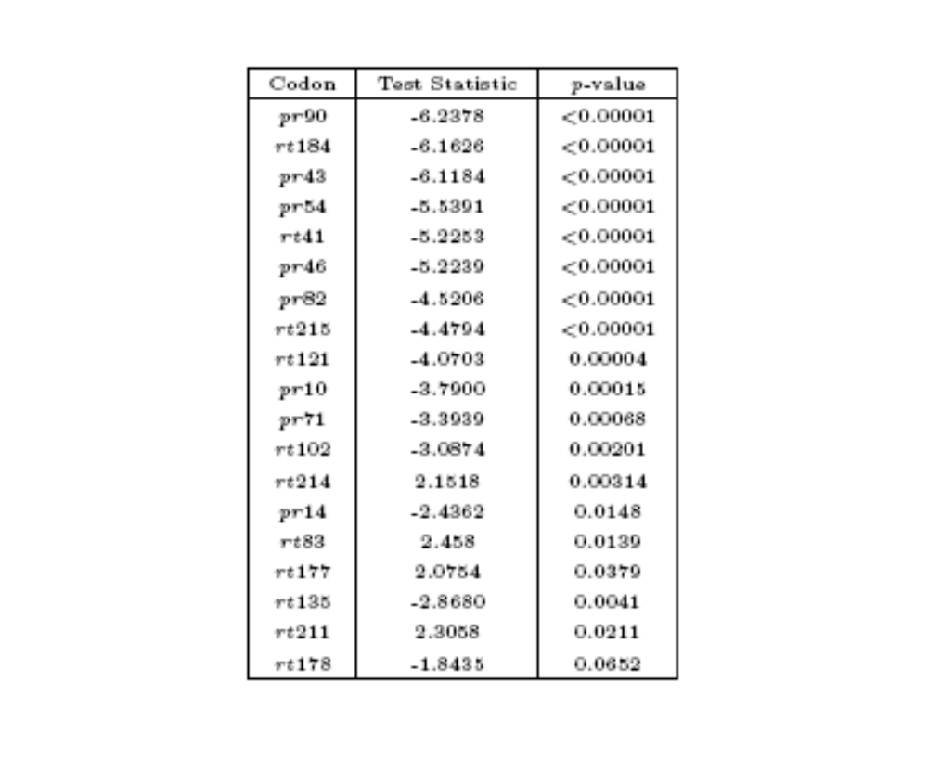

Slide 49
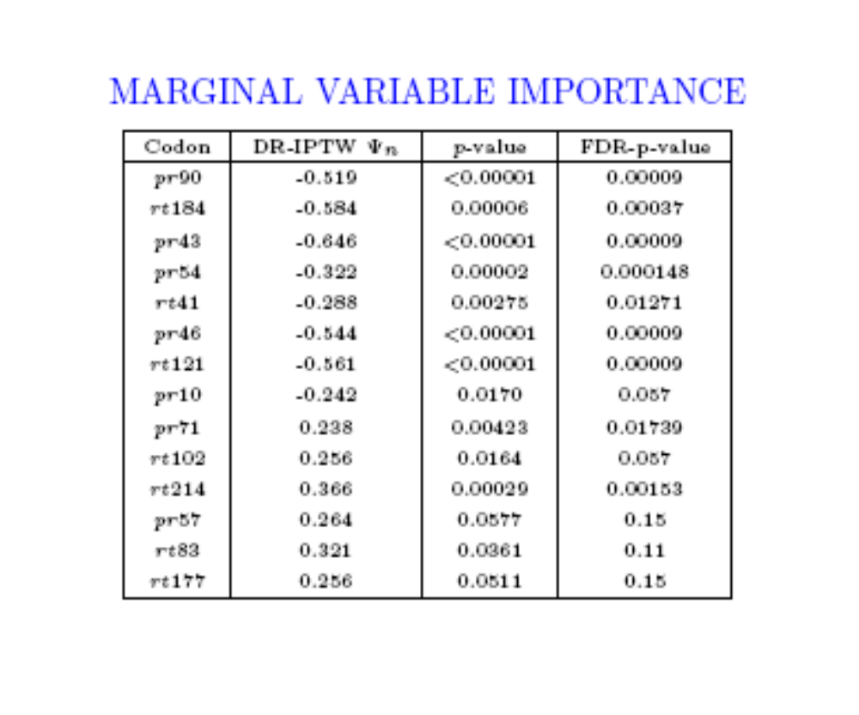

Slide 50
Algorithm: max-T Single-Step Approach (FWER)
The maxT procedure is a JOINT procedure used to control FWER.
Apply the bootstrap method (B=10,000 bootstrap samples) to obtain the bootstrap distribution of test statistics (M x B matrix).
Mean-center at null value to obtain the wished null distribution
Chose the maximum value over each column, therefore resulting in a vector of 10,000 maximum values.
Use as common cut-off value for all test statistics the (1-α) quantile of these numbers.

Slide 51
FPRP and FDR
P0=Prob(Null is true)
T=test statistic
Prob(T>c| Null is true)=S0(c)
Prob(T>c)=S(c) (=P0*S0(c)+(1-P0)S1(c))
FPRP(c)=Prob(Null is true|T>c) = P0*S0(c)/S(c)
Fact: If FPRP(c(j))< alpha for a list of independent tests statistics T(j), then FDR=E(V/R)< alpha.

Slide 52
Proof:
V_{n}(c)=∑_{j} I(T_{n}(j)>c_{j},H₀(j)=1)
R_{n}(c)=∑_{j} I(T_{n}(j)>c_{j})
Take conditional expectation of V_{n}(c), given (T_{n}(j)>c_{j}) for all j, to obtain
∑ I(T_{ν}(j)>c(j))*FPRP(c(j))
Thus, if FPRP(c_{j})· α, then E(V_{n}(c)/R_{n}(c))· α

Slide 53
Empirical Bayes FDR and BH-FDR
1) Assume common mixture model for all test-statistics, 2) fit FPRP() (i.e., marginal null distribution S0 and true distribution S) from data, and 3) reject the null hypothesis if FPRP at the value of the observed test statistic is smaller than alpha (Storey et al. late 90’s).
The above method controls FDR at level alpha, and is equivalent with frequentist Benjamini-Hochberg FDR method (1995).

Slide 55


Slide 56
What is our test-statistic?
The test-statistic of interest is:
    T_{n} = μ_{dif} – 0
    σ_{dif}
Where μ_{dif} is the mean difference over the 17 weeks and σ_{dif} is respective the standard error.
We applied several methods to this analysis: Bonferroni, Joint-bootstrap null distribution method & Augmentation, and TPPFP (q=0.1).

Slide 57
What is our test statistic?
We are interested in testing the difference in the mean intensities of the AML versus the ALL samples at each of the 204 m/z ratios.
The test-statistic of interest is:
        T_{n}= μ_{AML} - μ_{ALL}
        σ_{AML/ALL}
Where μ_{AML} is the mean difference of AML samples, μ_{ALL} is the mean difference of ALL samples, and σ_{AML/ALL} is the pooled standard error of AML and ALL.
We applied several methods to this analysis: Bonferroni, Joint-bootstrap null distribution method & Augmentation, and TPPFP (q=0.1).

Slide 58
Extra Slides

Slide 59
Multiple Testing Procedures
  Order genes by p-value based on t-statistic (the natural null here is the means for each row are 0 implying no mean difference in copy number for a particular BAC).
  Compare Benjamini and Hochbergs FDR and Bonferonni’s FWER adjusted p-values to those based on the re-sampling TPPFP method (in this case, set q = 0.10).

Slide 60
Test Statistics
A test statistic is written as:
  T_{n}= (Ψ_{n} - Ψ₀)
  σ_{n}
Where σ_{n} is the standard error, Ψ_{n} is the parameter of interest, and Ψ₀ is the null value of the parameter.

Slide 61
Hypotheses
Hypotheses are created as one-sided or two sided.
A one-sided hypothesis:
    H₀(m)=I(Ψ_{n}=Ψ₀), m=1,…,M.
A two-sided hypothesis:
    H₀(m)=I(Ψ_{n} · Ψ₀), m=1,…,M.

Slide 62
Type I & II Errors
Type I errors corresponds to making a false positive.
Type II errors (β) corresponds to making a false negative.
The Power is defined as 1- β.
Multiple Testing Procedures are interested in simultaneously minimizing the Type I error rate while maximizing power.

Slide 63
Null Distribution
The null distribution is the distribution to which the original test statistics are compared and subsequently rejected or accepted as null hypotheses.
Multiple Testing Procedures are based on either Marginal or Joint Null Distributions.
    Marginal Null Distributions are based on the marginal distribution of the test statistics.
    Joint Null Distributions are based on the joint distribution of the test statistics.

Slide 64
Rejection Regions
Multiple Testing Procedures use the null distribution to create rejection regions for the test statistics.
These regions are constructed to control the Type I error rate.
They are based on the null distribution, the test statistics, and the level α.

Slide 65
Single-Step & Stepwise
Single-step procedures assess each null hypothesis using a rejection region which is independent of the tests of other hypotheses.
Stepwise procedures construct rejection regions based on the acceptance/rejection of other hypotheses. They are applied to smaller nested subsets of tests (e.g. Step-down procedures).

Slide 66
Adjusted p-values
Adjusted p-values are constructed as summary measures for the test statistics.
We can think of the adjusted p-value p(m) as the nominal level α at which test statistic T(m) would have just been rejected.

Slide 67
Multiple Testing Procedures
Many of the Multiple Testing Procedures are constructed with various assumptions regarding the dependence structure of the underlying test statistics.
We will now describe a procedure which controls a variety of Type I error rates and uses a null distribution based on the joint distribution of the test statistics (Pollard and van der Laan (2003)), with no underlying dependence assumptions.

Slide 68
Null Distribution
(Pollard & van der Laan (2003))
This approach is interested in Type I error control under the true data generating distribution, as opposed to the data generating null distribution, which does not always provide control under the true underlying distribution (e.g. Westfall & Young).
We want to use the null distribution to derive rejection regions for the test statistics such that the Type I error rate is (asymptotically) controlled at desired level α.
In practice, the true distribution Q_{n}=Q_{n}(P), for the test statistics T_{n}, is unknown and replaced by a null distribution Q₀ (or estimate, Q_{0n}).
The proposed null distribution Q₀ is the asymptotic distribution of the vector of null value shifted and scaled test statistics, which provides the desired asymptotic control of the Type I error rate.
t-statistics: For the test of single-parameter null hypotheses using t-statistics the null distribution Q₀ is an M--variate Gaussian distribution.
Q₀ = Q₀(P) ´ N(0,Σ*(P)).

Slide 69

gFWER Augmentation
gFWER Augmentation set: The next k hypotheses with smallest FWER adjusted p-values.
The adjusted p-values:

Slide 70
TPPFP Augmentation
TPPFP Augmentation set: The next hypotheses with the smallest FWER adjusted p-values where one keeps rejecting null hypotheses until the ratio of additional rejections to the total number of rejections reaches the allowed proportion q of false positives.
The adjusted p-values:

Slide 71

TPPFP Technique
The TPPFP Technique was created as a less conservative and more powerful method of controlling the tail probability of the proportion of false positives.
This technique is based on constructing a distribution of the set of null hypotheses S_{0n}, as well as a distribution under the null hypothesis (T_{n}). We are interested in controlling the random variable r_{n}(c).
The distribution under the null is the identical null distribution used in Pollard and van der Laan (2003): mean centered joint distribution of test-statistics.

Slide 72
Constructing S_{0n}
S_{0n} is defined by drawing a null or alternative status for each of the test statistics. The model defining the distribution of S_{0n} assumes T_{n}(m) » p₀f₀ + (1-p₀)f₁, a mixture of a null density f₀ and alternative density f₁.
The posterior probability, defined as the probability that T_{n}(m) came from a true null, H_{0m}, given its observed value:
P(B(m)=0|T_{n}(m)) = p₀ f₀(T_{n}(m))
f(T_{n}(m))
Given T_{n}, we can draw the random set S_{0n} from:
S_{0n} = ( j:C(j) = 1), C(j) » Bernoulli(min(1,p₀f₀(T_{n}(m)/f(T_{n}(m)))).
Note: We estimated f(T_{n}(m)) using a kernel smoother on a bootstrapped set on T_{n}(m), f₀ » N(0,1), and p₀=1.

Slide 73
Multiple Testing in Prediction

Slide 74
Augmentation Methods
Given adjusted p-values from a FWER controlling procedure, one can easily control gFWER or TPPFP.
gFWER: Add the next k most significant hypotheses to the set of rejections from the FWER procedure.
TPPFP: Add the next (q/1-q)r₀ most significant hypotheses to the set of rejections from the FWER procedure.

Slide 75
Multiple Testing in Prediction

Slide 76
Application in HIV Sequence Analysis
336 patients for which we measure sequence of HIV virus, and replication capacity of virus.
The PRO positions 4-99 and RT positions 38-222 are used, resulting in a total of 282 positions, which are coded as a binary covariate.
We wish to test for the importance of each mutation.
Running a data adaptive regression algorithm resulted in

Slide 79
Multiple Testing Procedures
Procedure | Error Rate | Step | Null Distribution
Bonferroni | FWER | SS | Marginal
Holm, Hochberg | FWER | SD SU | Marginal
Lehmann & Romano* | gFWER, TPPFP | SS, SD | Marginal
Genovese, Wasserman | TPPFP |  | Marginal
Benjamini & Hochberg* | FDR | SU | Marginal
Benjamini & Yekutieli | FDR | SU | Marginal
Westfall & Young* | FWER | SS, SD | Joint
Pollard & van der Laan Dudoit et al. van der Laan et al. ‘s | gFWER gFWER FWE, TPPFP | SS, SS SD | Joint

Slide 80
Notes for preparing presentation
Joint null distribution
Estimation of set of nulls, mixture model.
Under overall null this mixture estimate is inconsistent, but if the number of tests increrasses the bias will go to zero. That might explain why still robust and good performance in simulations of houston.
If one is not a null then it is a consistent estimate sincce posterior prob B_n=0 is estmated as f_0(T_n)/f(T_n), f shifts to right, so if T_n from null then this converges to infinity and thus is set to 1

Slide 81
