Slide 1

Prediction Methods
Mark J. van der Laan
Division of Biostatistics
U.C. Berkeley
www.stat.berkeley.edu/~laan

Slide 2
Outline
Overview of Common Approaches to Prediction
  Regression
  randomForest
  DSA
Cross-Validation
Super Learner Method for Prediction
Example
Conclusion

Slide 3
If Scientific Goal . . .
Predict phenotype from genotype
of the HIV virus
. . . Prediction
If Scientific Goal . . .
For HIV-positive patient, determine importance of genetic mutations on treatment response
. . .Variable Importance!

Slide 4
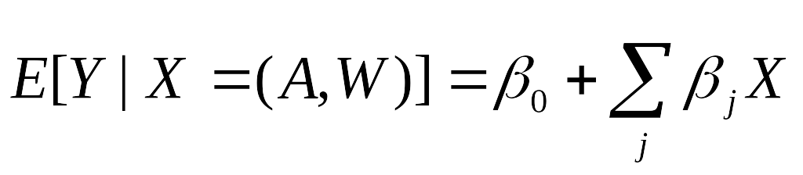
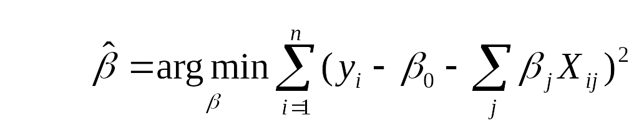
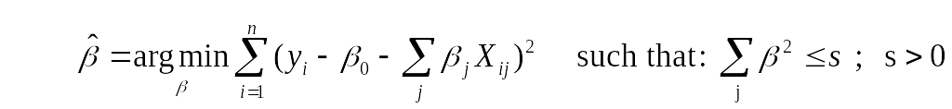
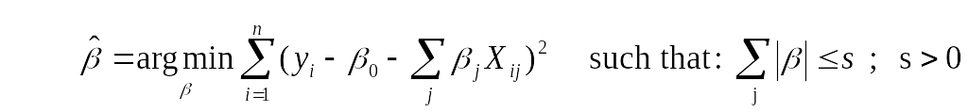
Common Methods
Linear Regression
Penalized Regression
Ridge Regression:
Lasso Regression
Least Angle Regression
Simple, less greedy Forward Stagewise regression

Slide 5
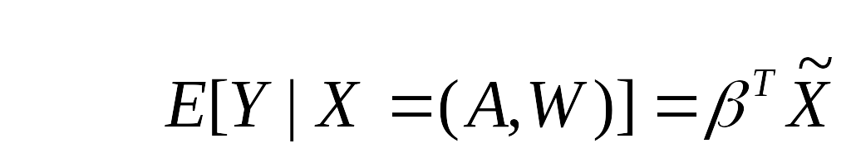
Common Methods
Logic Regression:
Finds predictors that are Boolean (logical) combinations of
the original (binary) predictors
Semi-parametric Regression:
Non-parametric Regression:
Polymars: Uses piece-wise linear splines
Knots selected using Generalized Cross-Validation
Notes:
Can you get rid of s is nonparametric estimate and replace by s is unspecified function, similarl below this.

Slide 6


Random Forest
Breiman (1996,1999)
Classification and Regression Algorithm
Seeks to estimate E[Y|A,W], i.e. the prediction of Y given a set of covariates {A,W}
Bootstrap Aggregation of classification trees
  Attempt to reduce bias of single tree
Cross-Validation to assess misclassification rates
  Out-of-bag (oob) error rate
W₁
W₂
W₃
sets of covariates,
W={ W₁ , W₂ , W₃ , . . .}
0
0
1
1
Permutation to determine variable importance
Assumes all trees are independent draws from an identical distribution, minimizing loss function at each node in a given tree – randomly drawing data for each tree and variables for each node

Slide 7
Random Forest
The Algorithm
  Bootstrap sample of data
  Using 2/3 of the sample, fit a tree to its greatest depth determining the split at each node through minimizing the loss function considering a random sample of covariates (size is user specified)
  For each tree. .
    Predict classification of the leftover 1/3 using the tree, and calculate the misclassification rate = out of bag error rate.
    For each variable in the tree, permute the variables values and compute the out-of-bag error, compare to the original oob error, the increase is a indication of the variable’s importance
  Aggregate oob error and importance measures from all trees to determine overall oob error rate and Variable Importance measure.
    Oob Error Rate: Calculate the overall percentage of misclassification
    Variable Importance: Average increase in oob error over all trees and assuming a normal distribution of the increase among the trees, determine an associated p-value
Resulting predictor set is high-dimensional

Slide 8
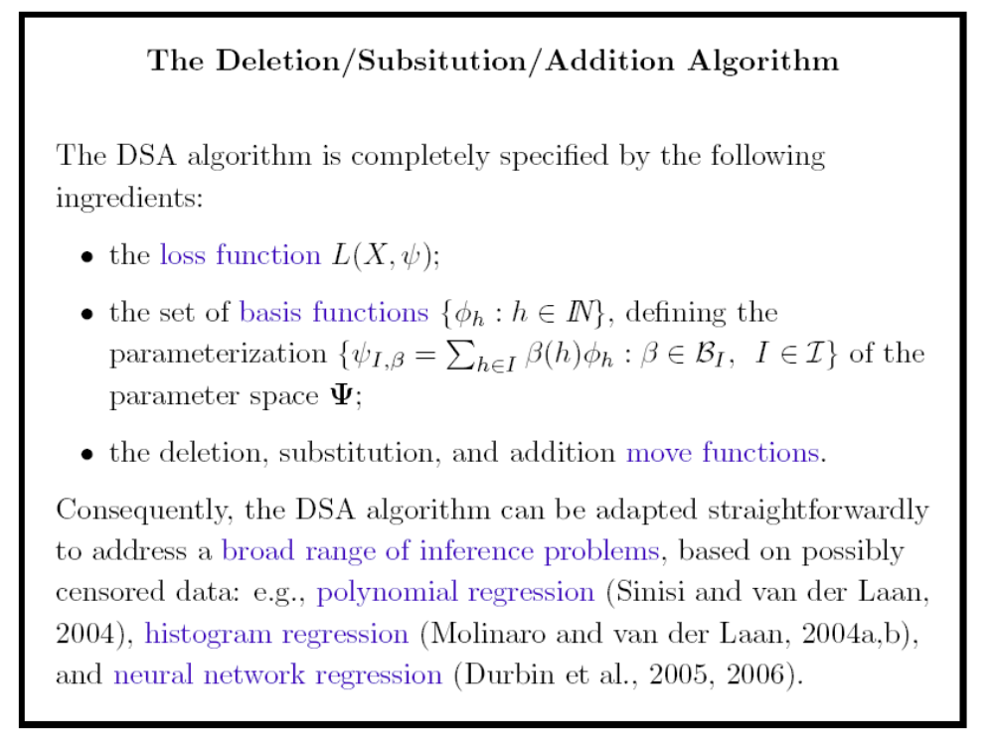
Deletion/Substitution/Addition Algorithm
(DSA)

Slide 9
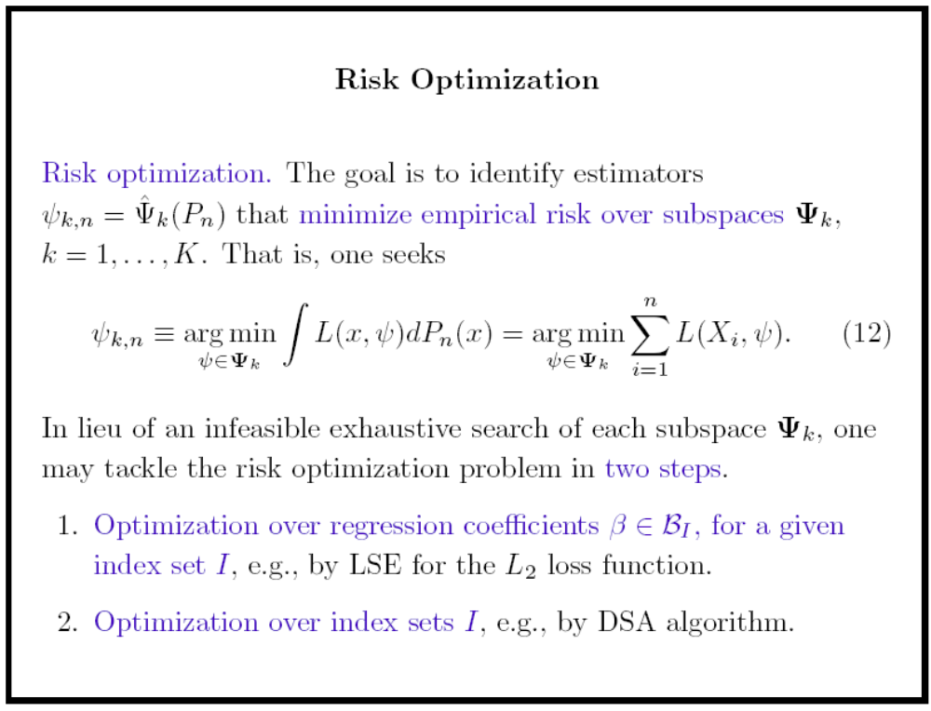

Slide 10
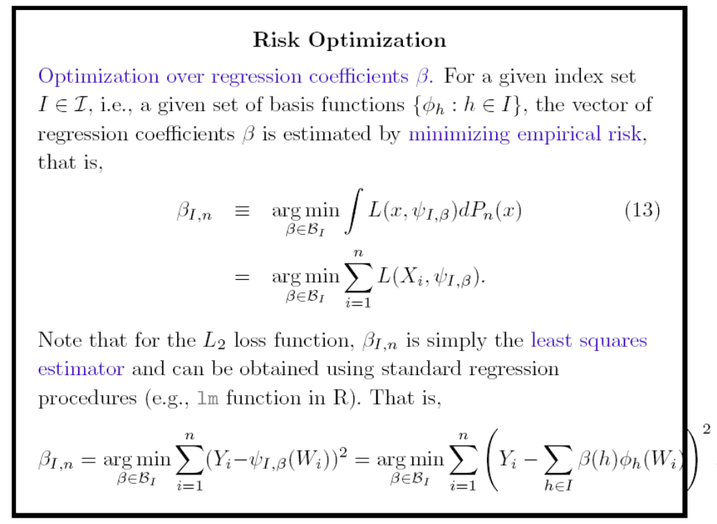

Slide 11
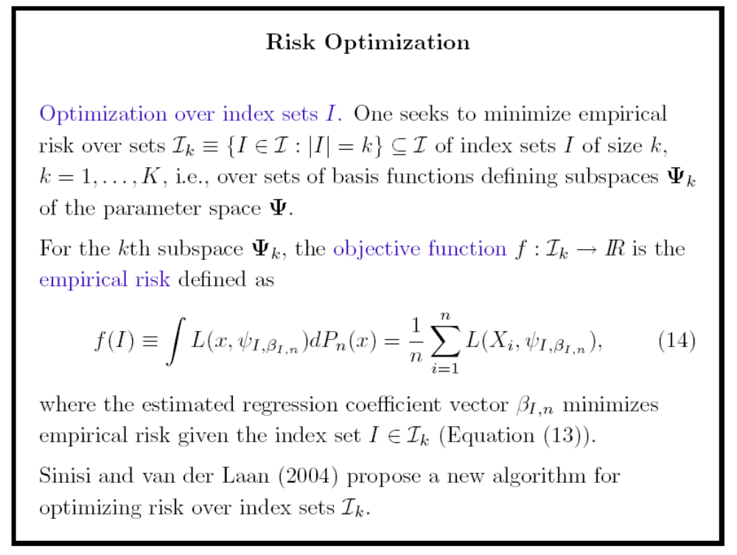

Slide 12
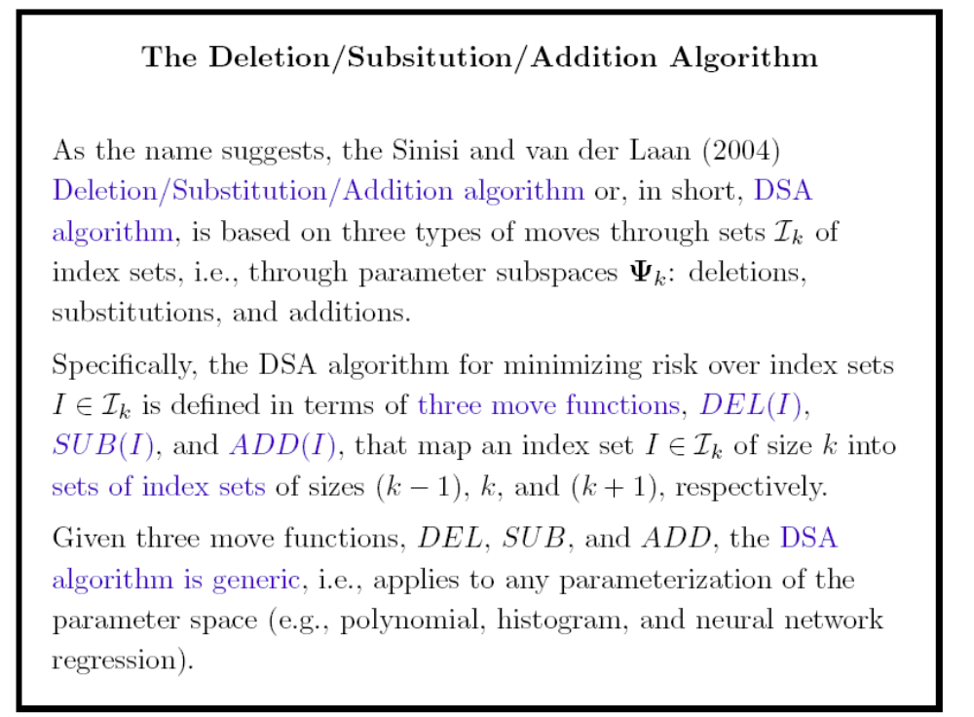

Slide 13
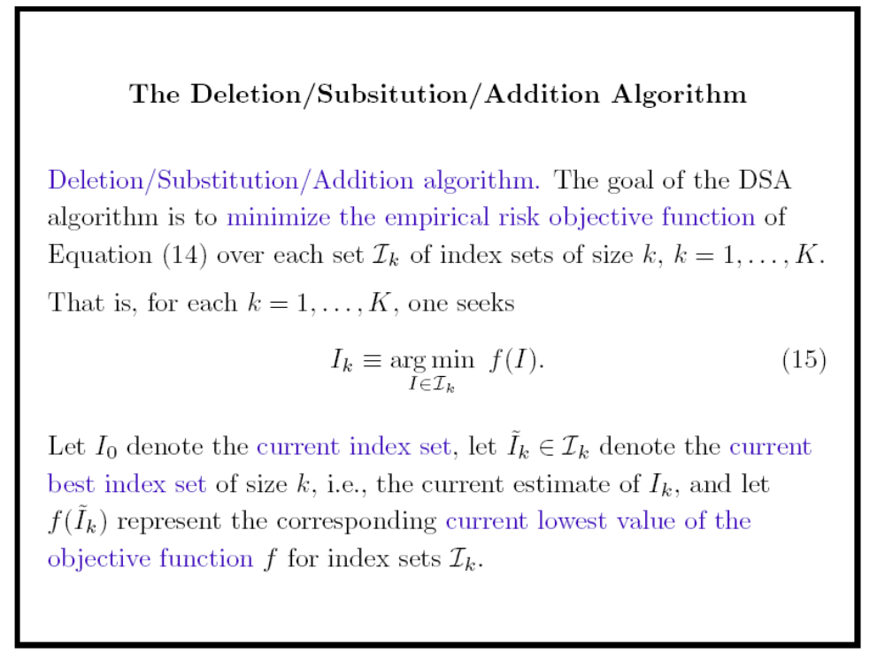

Slide 14
