Slide 1

Super Learning in Prediction
HIV Example
Mark van der Laan
www.bepress.com/ucbbiostat
Division of Biostatistics,
University of California, Berkeley

Slide 2
Outline
Super Learning in Prediction of HIV Phenotype based on HIV Genotype

Slide 3
Scientific Goal
Predict phenotype from genotype of the HIV virus
  Phenotype: in vitro drug susceptibility
  Genotype: mutations in the protease and reverse transcriptase regions of the viral strand

Slide 4
HIV-1 Data (Rhee et al.)
HIV-1 sequences from publicly available isolates in the Stanford HIV Sequence Database (Bob Shafer)
Predictor: Genotype
  Based on amino acid sequences of protease positions 1-99
  Mutations defined as differences from the subtype B consensus wildtype sequence
  We used a subset consisting of 58 treatment-selected mutations (Rhee. et.al.)
Outcome: Drug Susceptibility
  Standardized log fold change in susceptibility to Nelfinavir (NFV) (n=740 isolates)
  Fold change defined as the ratio of IC₅₀ of an isolate to a standard wildtype control isolate

Slide 5
Possible Prediction Algorithms
Rhee et al., for example, applied:
  Decision Trees
  Neural Networks
  Support Vector Regression
  Main Term Linear Regression
  Least Angle Regression (LARS)
  Random Forest
We also applied
  Logic Regression
  Deletion/Substitution/Addition Regression

Slide 6
Super Learner
Selects best learner from a set of candidates
  Selection based on cross validation
Performs (asymptotically) as well as oracle selector

Slide 7
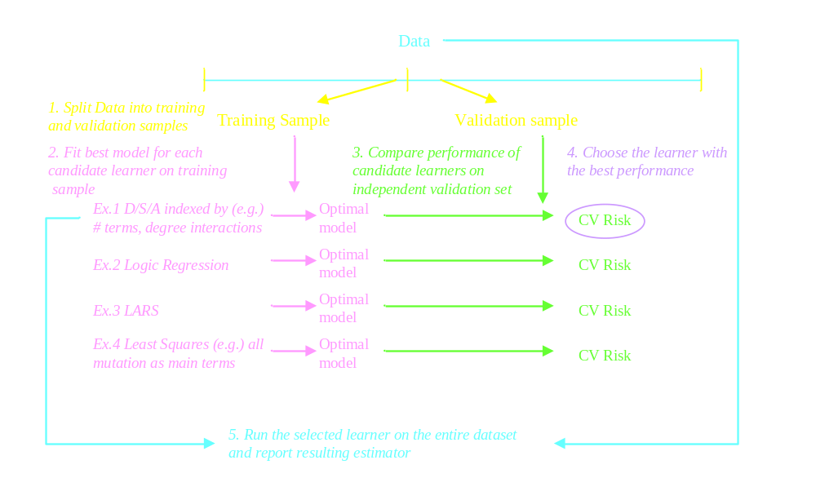
Super Learner

Slide 8
Super Learning:
Minimizing cross-validated risk over all linear combinations of the candidate algorithms

Slide 9
The Super Learner as Linear Combination
Cross-Validation risk used to determine appropriate weights for each candidate

Slide 10
Candidate | 10-fold Cross Validation
 | Mean CV Risk
Main Term Linear Regression | 0.1727
LARS | 0.1820
Logic Reg | 0.2621
CART | 0.3059
Random Forest | 0.1749
Super Learner | 0.1505
Notes:
Only this one

Slide 11
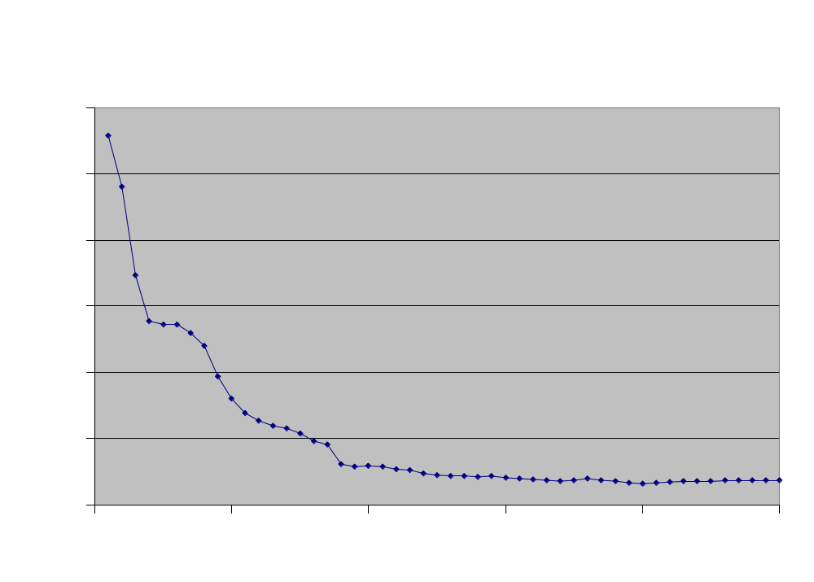
DSA Estimator
Cross-Validated Risk
Minimum CV Risk
Number of Terms
v=10
Main terms only → Number of terms={1,…,50}
Best number of terms=40

Slide 12
DSA Estimator
Best Model of Sizes 1-20
Mutation | Ranking | Mutation | Ranking
90M | 1 | 20I | 11
30N | 2 | 50L | 12
54V | 3 | 73S | 13
46I | 4 | 24I | 14
84C | 5 | 54S | 15
84A | 6 | 74S | 16
88S | 7 | 82F | 17
54T | 8 | 10F | 18
84V | 9 | 54M | 19
82A | 10 | 88D | 20
Notes:
Could we clarify where the ranking comes from? How clacualted? It would also be nice to see the best models of each size…

Slide 13
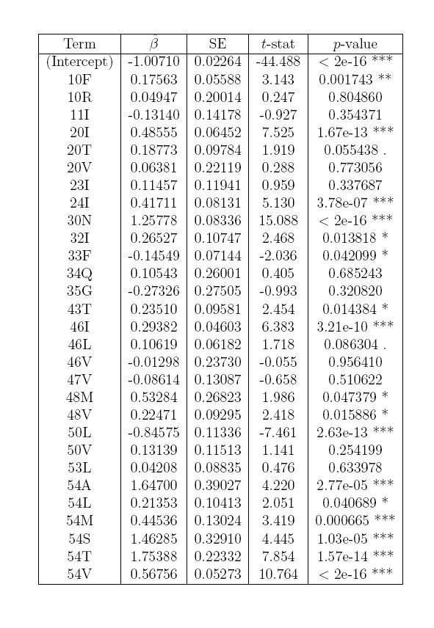
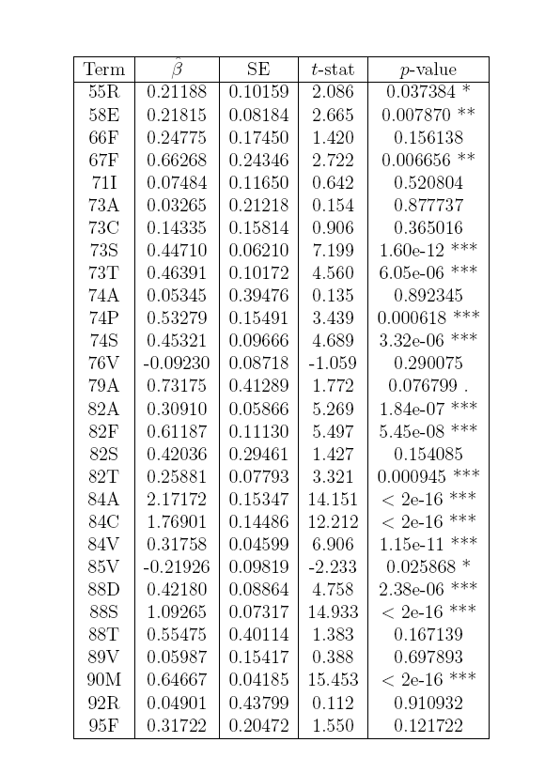
Super Learner
Final Estimator= Least Squares Regression with all mutations included as main terms
Notes:
Can we say what this is

Slide 14
Closing Remarks
Do not know a priori which candidate will work best, but Super Learner is data adaptive
Unlke other “meta-learners” in the machine learning literature (that we know of), we use cross-validated risk to estimate the candidate weights.
Combining super learning with Targeted MLE (in the estimation of the Q(A,W) function) for better efficiency in the variable importance problem.

Slide 15
References for Section 1
Mark J. van der Laan, Eric C. Polley, and Alan E. Hubbard, "Super Learner" (July 2007). U.C. Berkeley Division of Biostatistics Working Paper Series. Working Paper 222.
http://www.bepress.com/ucbbiostat/paper222
L. Breiman. Random Forests. Machine Learning, 45:5–32, 2001.
L. Breiman, J. H. Friedman, R. A. Olshen, and C. J. Stone. Classification and
Regression Trees. TheWadsworth Statistics/Probability series. Wadsworth International Group, 1984.
Hastie, T. J. (1991) Generalized additive models. Chapter 7 of Statistical Models in S eds J. M. Chambers and T. J. Hastie, Wadsworth & Brooks/Cole.
Venables, W. N. and Ripley, B. D. (2002) Modern Applied Statistics with S. New York: Springer.
S. Dudoit and M. J. van der Laan. Asymptotics of cross-validated risk estimation in estimator selection and performance assessment. Statistical Methodology, 2:131–154, 2005.
B. Efron, T. Hastie, I. Johnstone, and R. Tibshirani. Least Angle Regression. Annals of Statistics, 32(2):407–499, 2004.
J. H. Friedman. Multivariate adaptive regression splines. Annals of Statistics, 19(1):1–141, 1991. Discussion by A. R. Barron and X. Xiao.
A.E. Hoerl and R.W. Kennard. Ridge regression: Biased estimation for nonorthogonal problems. Technometrics, 12(3):55–67, 1970.
S. Rhee, J. Taylor, G. Wadhera, J. Ravela, A. Ben-Hur, D. Brutlag, and R. W. Shafer. Genotypic predictors of human immunodeficiency virus type 1 drug resistance. Proceedings of the National Academy of Sciences USA, 2006.

Slide 16
References for Section 1 (con’t)
R. W. Shafer. Genotypic predictors of human immunodeficiency virus type 1 drug resistance. Proceedings of the National Academy of Sciences USA, 2006.
I. Ruczinski, C. Kooperberg, and M. LeBlanc. Logic Regression. Journal of Computational and Graphical Statistics, 12(3):475–511, 2003.
S. E. Sinisi and M. J. van der Laan. Deletion/Substitution/Addition algorithm in learning with applications in genomics. Statistical Applications in Genetics and Molecular Biology, 3(1), 2004. Article 18.
S. E. Sinisi, E. C. Polley, S.Y. Rhee, and M. J. van der Laan. Super learning: An application to the prediction of HIV-1 drug resistance. Statistical Applications in Genetics and Molecular Biology, 6(1), 2007.
M. J. van der Laan and S. Dudoit. Unified Cross-Validation Methodology for Selection Among Estimators and a General Cross- Validated Adaptive Epsilon-Net Estimator: Finite Sample Oracle Inequalities and Examples. Technical Report 130, Division of Bio-19 Hosted by The Berkeley Electronic Press statistics, University of California, Berkeley, Nov. 2003. URL http://www.bepress.com/ucbbiostat/paper130/.
M. J. van der Laan and D. Rubin. Targeted maximum likelihood learning. International Journal of Biostatistics, 2(1), 2007.
M. J. van der Laan, S. Dudoit, and A. W. van der Vaart. The cross-validated adaptive epsilon-net estimator. Statistics and Decisions, 24(3):373–395, 2006.
A.W. van der Vaart, S. Dudoit, and M.J. van der Laan. Oracle inequalities for mulit-fold cross vaidation. Statistics and Decisions, 24(3), 2006.

