Slide 1

US Customer
Reviews Dataset
– big data final project
Li Yuan and Matthew Flaherty (group 8)

Slide 2
Executive Summary
Objective
Approach
Key Findings
Challenges
Build recommendation system based on previous purchases
Predict rating star solely based on the reviews
Cluster reviews into categories other than the true categorical variable
Alternating Least Squares (ALS) to build recommendation system
Transformers bert-base-multilingual-uncased-sentiment
K-means and Minhash LSH
Our ALS recommender predicts rating well with low RMSE
Our transformers predict rating well especially for 5 star rating
However, our k-means doesn’t cluster well due to poor capability of word2vec
There are over 10 million customers, we can’t build recommender for each
Our limited GPU resources are unable to run all reviews of size over 30 million
Word2vec is inability of transformer reviews into vectors

Slide 3
Data Description
The original data collection contains 37 dataset for each product category of size 54.41 GB.
We chose 12 product category dataset for our analysis of size 21.78 GB.
Big Data
Sports (4,849,945 rows) | Baby (1,752,598 rows) | Apparel (5,902,724 rows) | Grocery (2,400,612 rows)
Electronics (3,093,705 rows) | Automotive (3,514,816 rows) | Books (3,102,417 rows) | Music (4,749,744 rows)
Furniture (792,035 rows) | Personal Care Appliances (85,976 rows) | Camera (1,801,821 rows) | Beauty (5,113,668 rows)

Slide 4
Data Features
Each product category dataset has 15 same columns.
customer_id | review_id | product_id | product_parent
product_title | product_category | star_rating | helpful_votes
total_votes | vine | verified_purchase | review_headline
review_body | review_date | marketplace

Slide 5
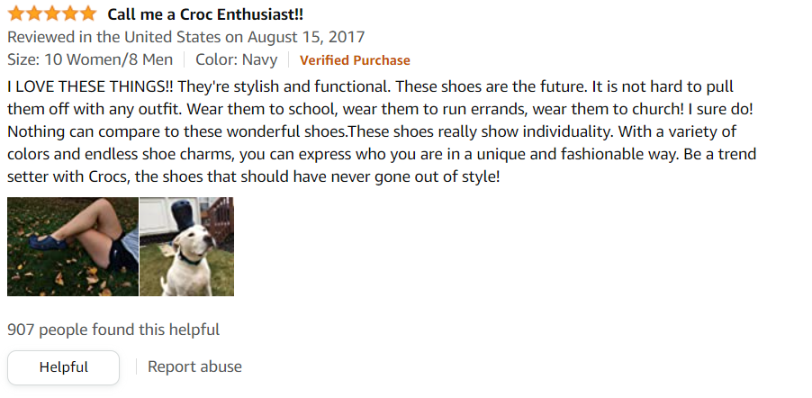
Review Example

Slide 6


Platform and Softwares (Cloud Computing)
Google Colaboratory: https://colab.research.google.com/
Google Cloud: https://cloud.google.com/
PySpark, Spark DataFrame, Spark SQL, Spark MLlib
transformers, sklearn, pandas, numpy

Slide 7
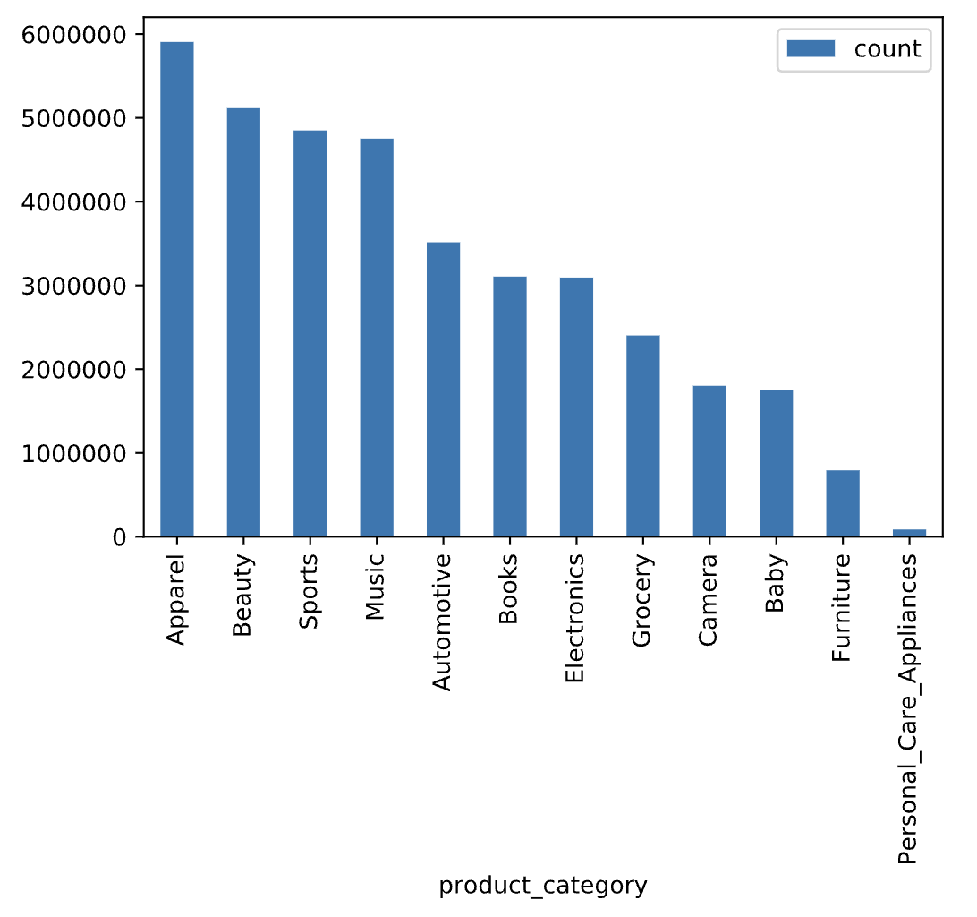
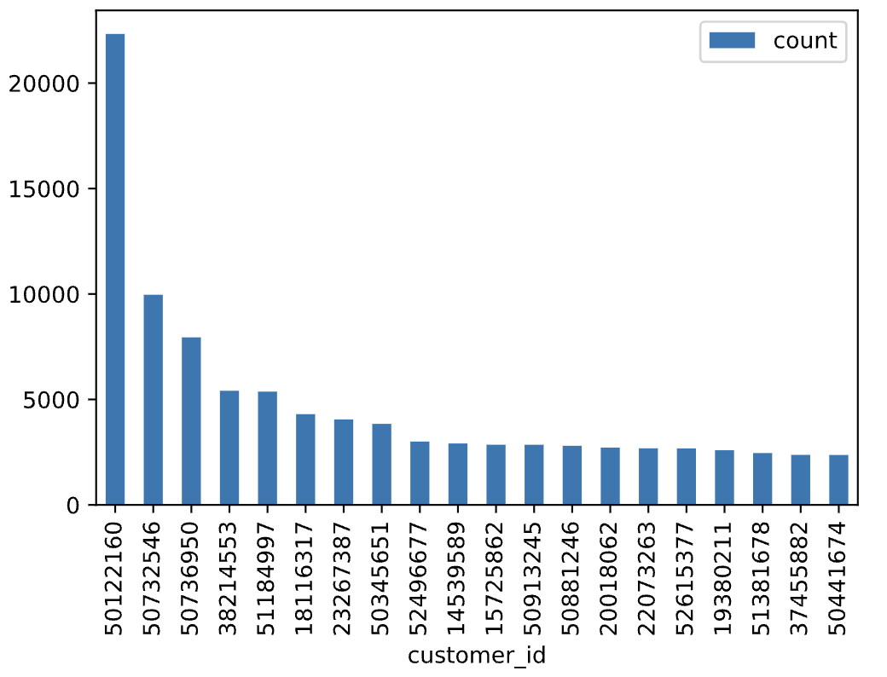
Simple EDA on these 12 dataset
Review Count by each Product
Review Count by each top 20 Customer

Slide 8
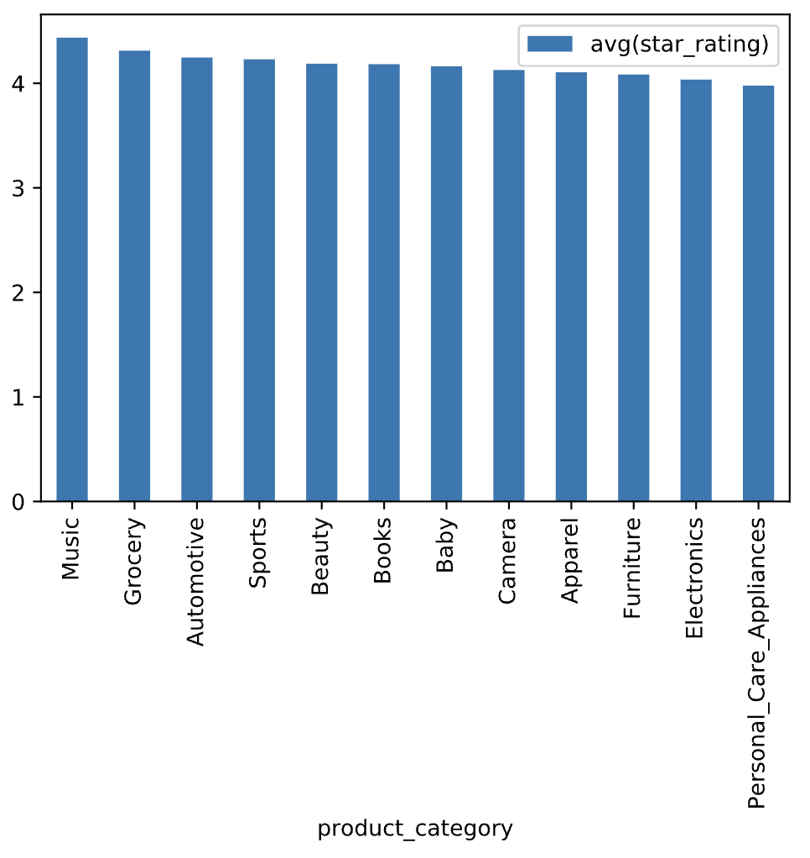
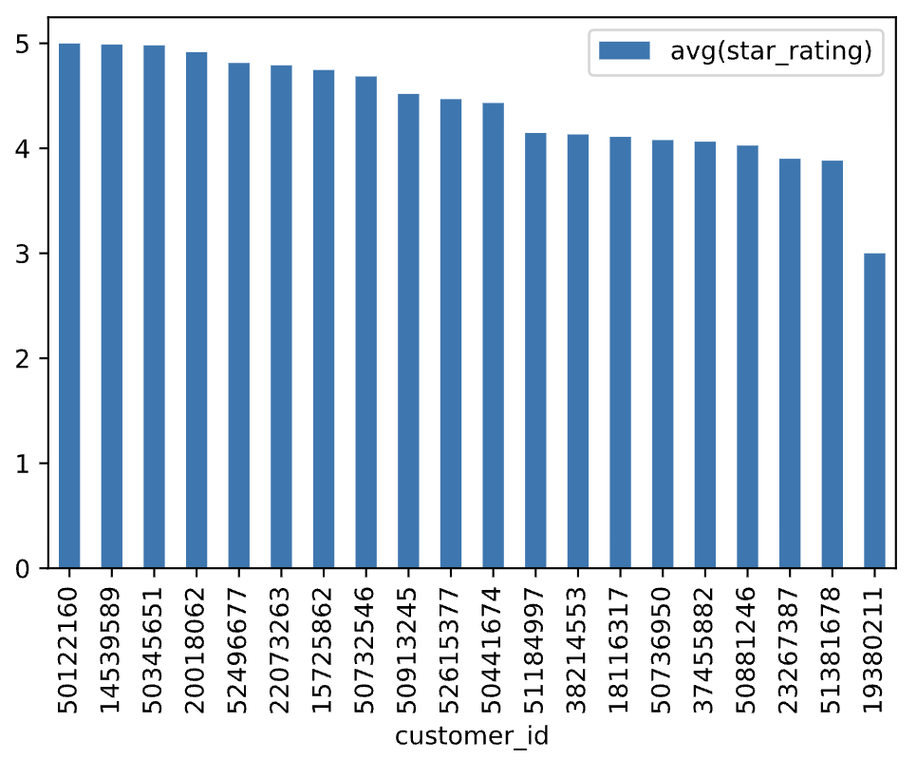
Simple EDA on these 12 dataset
Average Rating by each Product
Average Rating by each top 20 Customer

Slide 9
Simple EDA (cont.)
01
users who write trusted reviews
Amazon Vine
02
Rate the trust of the review by separating Vine from non-Vine
Should see similar averages
Confirm trusted reviews
03
Average Vine rating = 4.29
Average non-Vine rating = 4.18
Vine vs non-Vine
Notes:
Vine users have similar averages to non-vine users. Thus, there is no bias among vine users.

Slide 10
Recommender System
The 12 dataset in total has 13,863,467 unique customers. We only chose 20 customers who posted reviews the most among all.
50122160 | 50732546 | 50736950 | 38214553
51184997 | 18116317 | 23267387 | 50345651
52496677 | 14539589 | 15725862 | 50913245
50881246 | 20018062 | 22073263 | 52615377
19380211 | 51381678 | 37455882 | 50441674

Slide 11
Recommender System
Our item unit is each product category.
We calculated these top 20 customers’ average ratings by each product category.
customer_id | product_category | avg(star_rating)
23267387 | Books | 5.0
23267387 | Beauty | 4.0
38214553 | Sports | 4.0
50913245 | Automotive | 3.92
18116317 | Grocery | 4.31

Slide 12
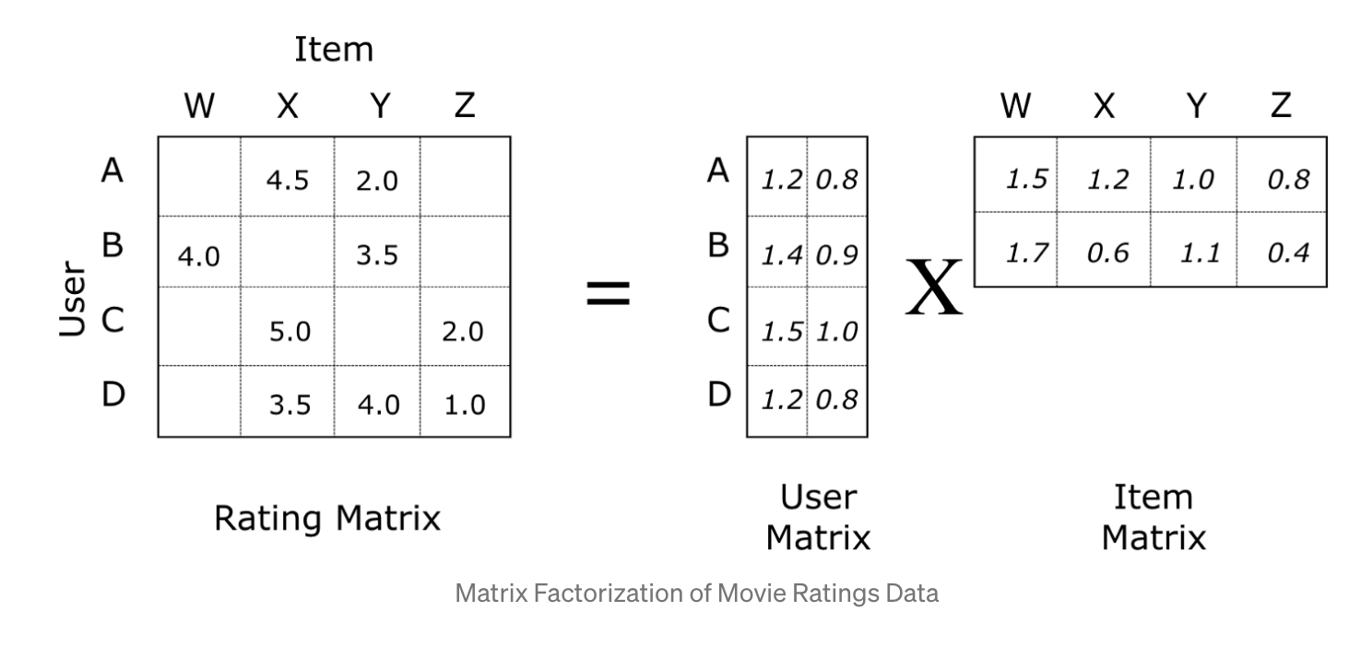
Recommender System: alternating least squares (ALS)

Slide 13
Recommender System
Splitting
We Split data into 80% training and 20% test set.
Fitting
als = ALS(maxIter=5, regParam=0.01, userCol="customer_id", itemCol="product_id", ratingCol="avg(star_rating)", coldStartStrategy="drop")
model = als.fit(training)
Testing: Root-mean-square error = 2.7508469558718445
predictions = model.transform(test)
predictions = predictions.dropna()
evaluator = RegressionEvaluator(metricName="rmse", labelCol="product_id",predictionCol="prediction")
rmse = evaluator.evaluate(predictions)
print("Root-mean-square error = " + str(rmse))

Slide 14
Recommender System: Predictions
customer_id | Recommendation 1st | Recommendation 2nd | Recommendation 3rd
52496677 | Apparel: 5.02 | Grocery: 5.01 | Baby: 5.00
51184997 | Music: 4.14 | Electronics: 3.85 | Grocery: 3.54
52615377 | Books: 4.46 | Grocery: 3.59 | Apparel: 3.20

Slide 15
Transformer Prediction Ratings:
bert-base-multilingual-uncased-sentiment
Rating Star | Probability
1 star | 0.003
2 stars | 0.003
3 stars | 0.040
4 stars | 0.386
5 stars | 0.568
Input Review
I love this product.

Slide 16
Transformers Model Hardware on Colab
GPU Hardware
Tesla V100-SXM2-16GB
Virtual Memory
54.8 GB

Slide 17
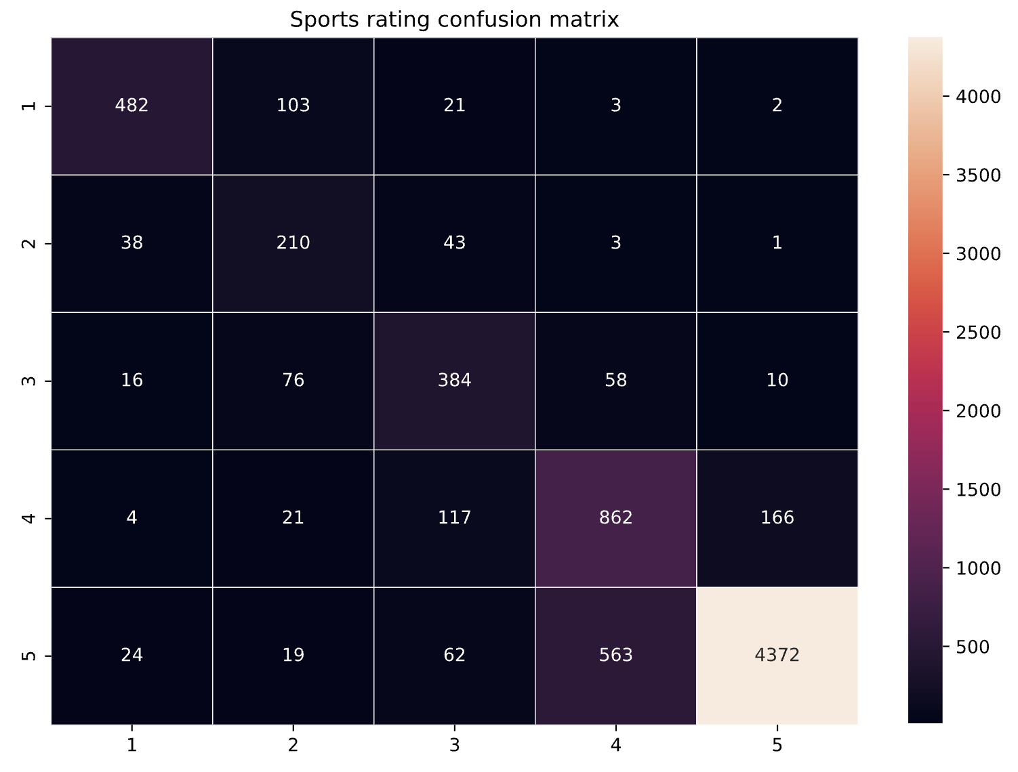
Transformer Confusion Matrix for each product sample
Sports Sample:
7660 rows
True rating
Prediction rating

Slide 18
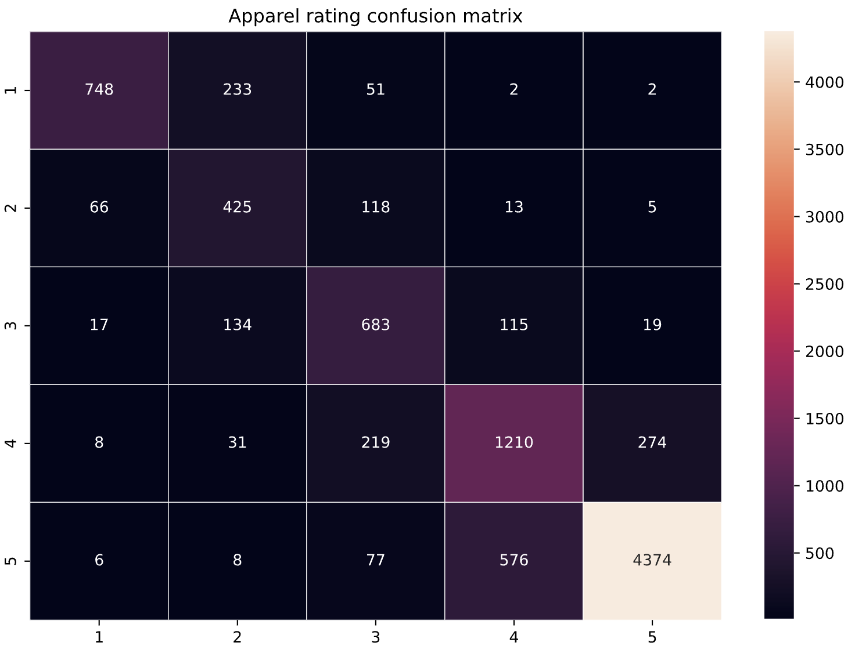
Transformer Confusion Matrix for each product sample
Apparel Sample:
9414 rows
True rating
Prediction rating

Slide 19
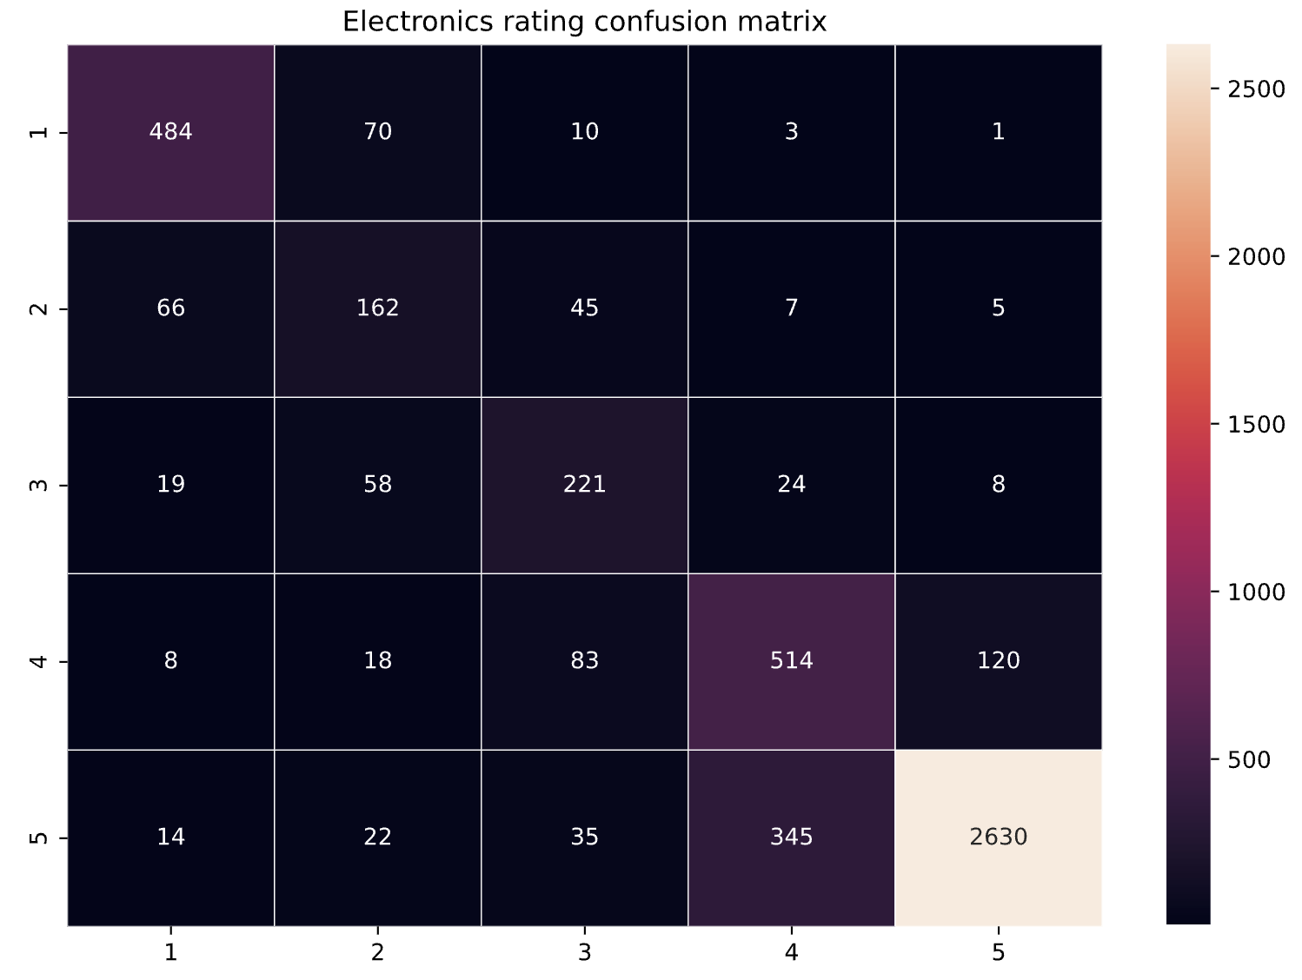
Transformer Confusion Matrix for each product sample
Electronics Sample:
4972 rows
True rating
Prediction rating

Slide 20
K-means:
Cluster product titles into product category
Tokenize title column
Learn a mapping from words to Vectors
Trains a k-means model
Get the clustering prediction
product_title | product_category | words | features | prediction
DC Sports Muffler... | Automotive | [dc, sports, muff... | [0.32148125022649... | 11
Thrush 17713 Turb... | Automotive | [thrush, 17713, t... | [0.18454607890453... | 11

Slide 21
K-means:
Within Set Sum of Squared Errors = 4398708.45345352
product_category | prediction | count
Baby | 3 | 521556
Sports | 4 | 1501059
Books | 0 | 1178054
Camera | 2 | 1049634
Music | 6 | 1544974
Personal_Care | 3 | 22766
Beauty | 10 | 2316860
Electronics | 2 | 2316860
Apparel | 9 | 2859932
Automotive | 11 | 1782192
Furniture | 3 | 386240
Grocery | 0 | 846514

Slide 22
Locality-Sensitive Hashing (LSH) (in progress)
Useful for large dataset
Find x most similar items by product title
Jaccard similarity
High similarity = similar products
Notes:
Find x most similar items by title using jaccard similarity

Slide 23
LSH Steps
Tokenize product title
Ngrams (2)
minhashing to generate LSH
Remove stop words
Hashing to create term frequency
Calculate Jaccard similarity
Notes:
Once lsh vector has been formed, train a model using the vector to calculate Jaccard similarity between products
This can be used for either clustering or recommending because customers can be recommended products with similar titles

Slide 24
Next Steps
Scale up our 20 customer recommender system to 100 or 200 customers
Fine-tune our transformers on subset with true rating star and test on held-out dataset
Use bert model to embed the review instead of word2vec
Grid search the best hyperparameter for K-means of clustering into 12 product categories

