Slide 1
Nissan Car reviews with Transformers (NLP)
Li Yuan, Dong Chen, Fan Bu
-Advised by Jesse Smith

Slide 2
Background
Currently Nissan uses a survey to measure opinion/brand preference, brand awareness, and attribute association for automotive brands and models.
Goal
Find out what attributes are naturally associated with which models, both outside of and including the existing attributes we track

Slide 3
Attributes currently being tracked in survey
Functional Attributes: Dependable, Lasts long, Value for money, Quality fit and finish, Attractive styling, Safe, Retains resale value, Driver comfort, Fun to drive, Advanced features, Responsive handling, Prestigious, Dealerships, Fuel efficient, Quick acceleration, Environmentally friendly, Affordable
Personality Attributes: Trusted, Leader, Responsible, Confident, Innovative, Exciting, Practical, Adventurous, Passionate, Distinctive, Youthful, Aggressive
Model scope
Nissan Rogue, Chevy Equinox, Ford Escape, Ford Bronco Sport, Honda CR-V, Hyundai Tucson, Kia Sportage, Mazda CX-5, Subaru Forester, Toyota RAV4

Slide 4
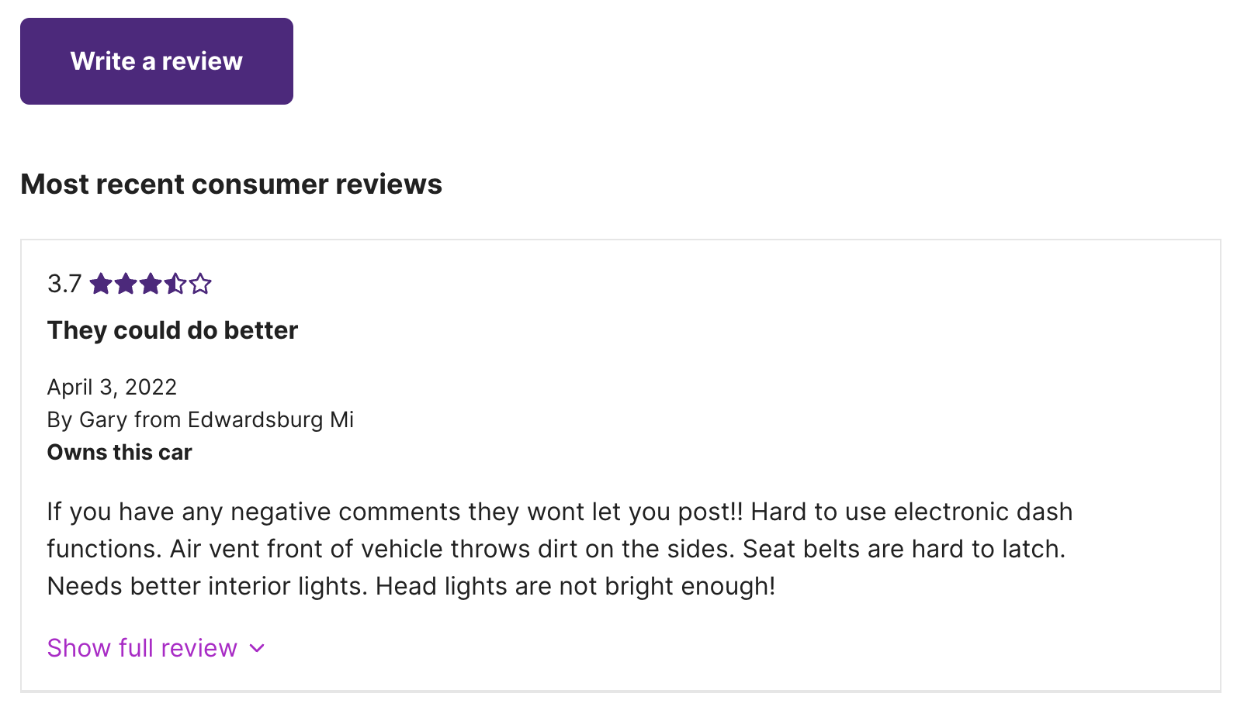
First Stage: Web Scrape car reviews online and merge them
Model | Source Type | Sources | Link
Rogue | Owner & expert reviews | Cars.com | 2021 Nissan Rogue Specs, Price, MPG & Reviews | Cars.com
Equinox | Owner & expert reviews | Cars.com | 2021 Chevrolet Equinox Specs, Price, MPG & Reviews | Cars.com
Escape | Owner & expert reviews | Cars.com | 2021 Ford Escape Specs, Price, MPG & Reviews | Cars.com
Bronco Sport | Owner & expert reviews | Cars.com | 2021 Ford Bronco Sport Specs, Price, MPG & Reviews | Cars.com

Slide 5
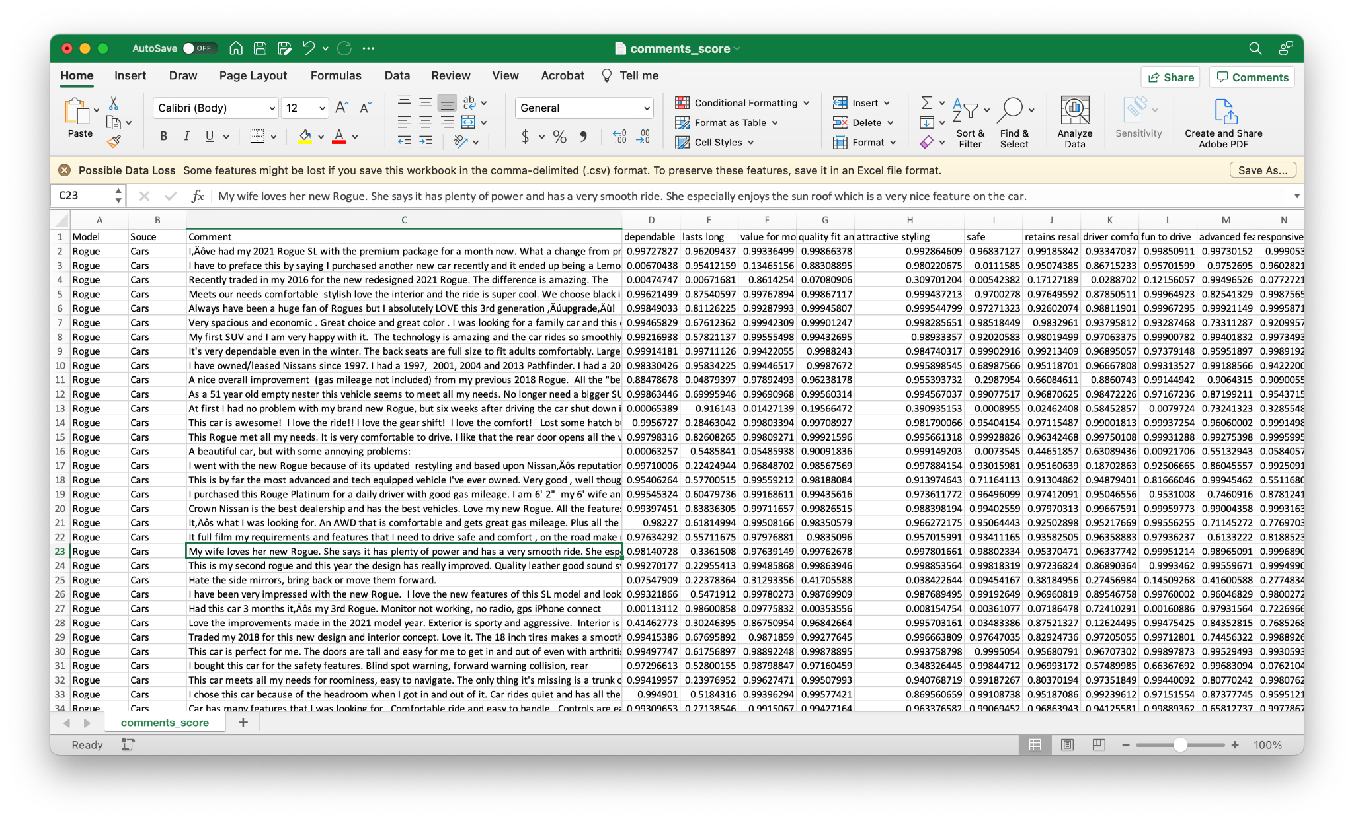
Second Stage: Baseline Model
– directly apply zero-shot classification on all attributes

Slide 6
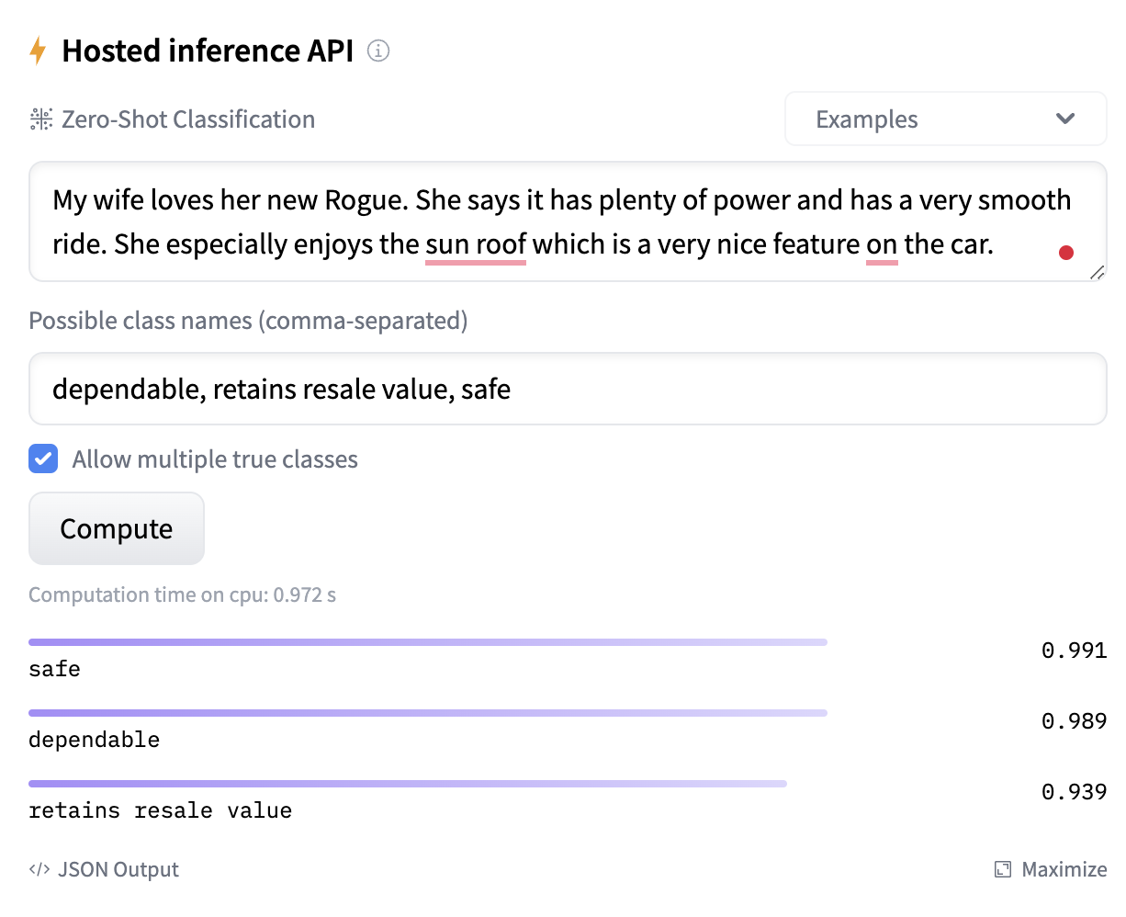
Problems with directly applying it
This car review doesn’t include “retains resale value”, but was given 0.939 probability only because of this positive review.

Slide 7
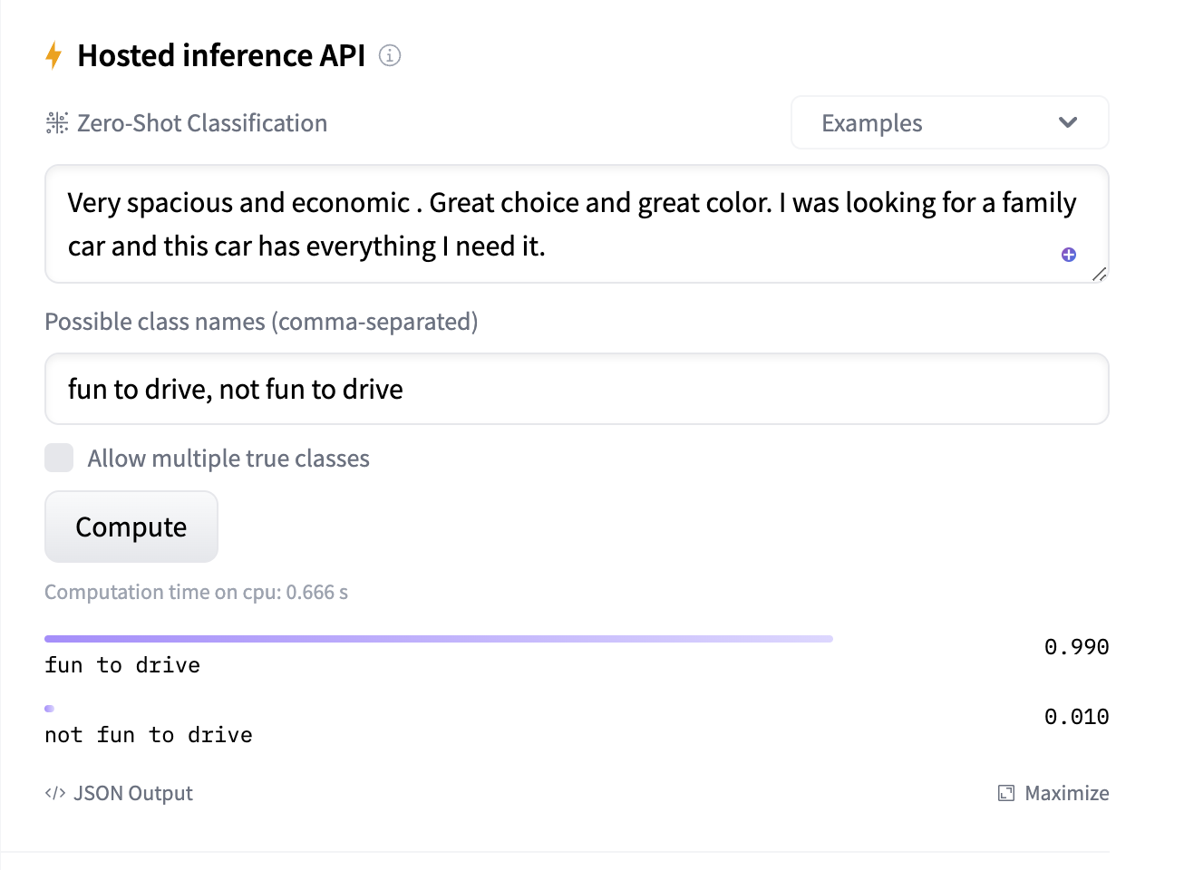
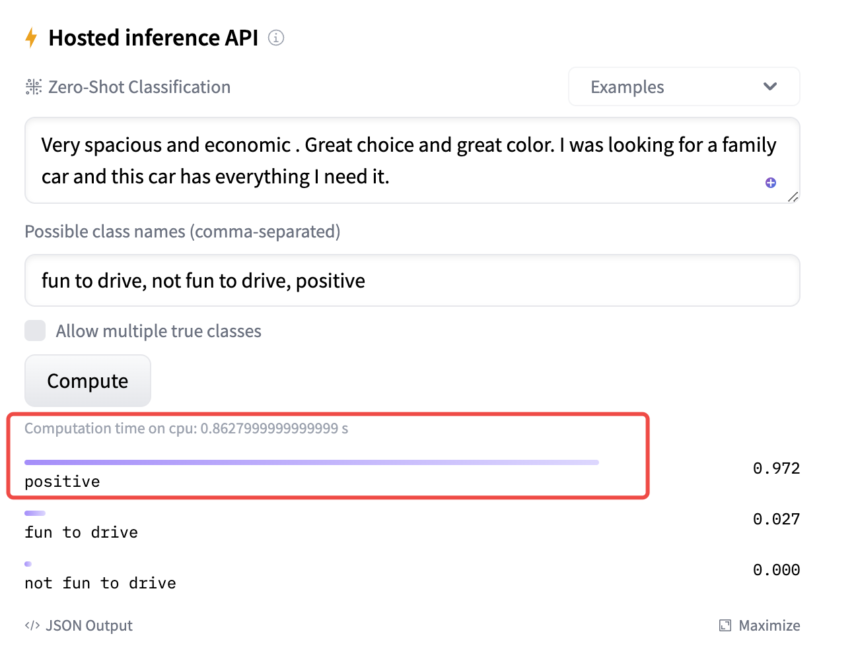
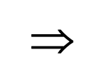
Potential Solution: Add other features to “absorb” attributes
Bring new issue: The degree of “absorption” is not the same. Thus, the final score is not based on the same criteria.

Slide 8
We design a two-stage modeling
Judge if this attribute is mentioned in each car review by applying transformers question-answering to it.
2. If Yes (this attribute is included in this car review), proceed to apply zero-shot classification for each attribute (eg. dependable, not dependable); If No, ignore.

Slide 9
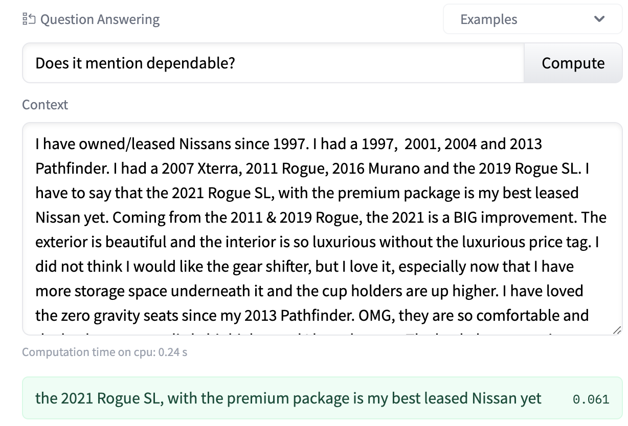
Question-Answering on each attribute
We set a threshold 0.1; if the probability is lower, we assume the comment does not mention it.

Slide 10
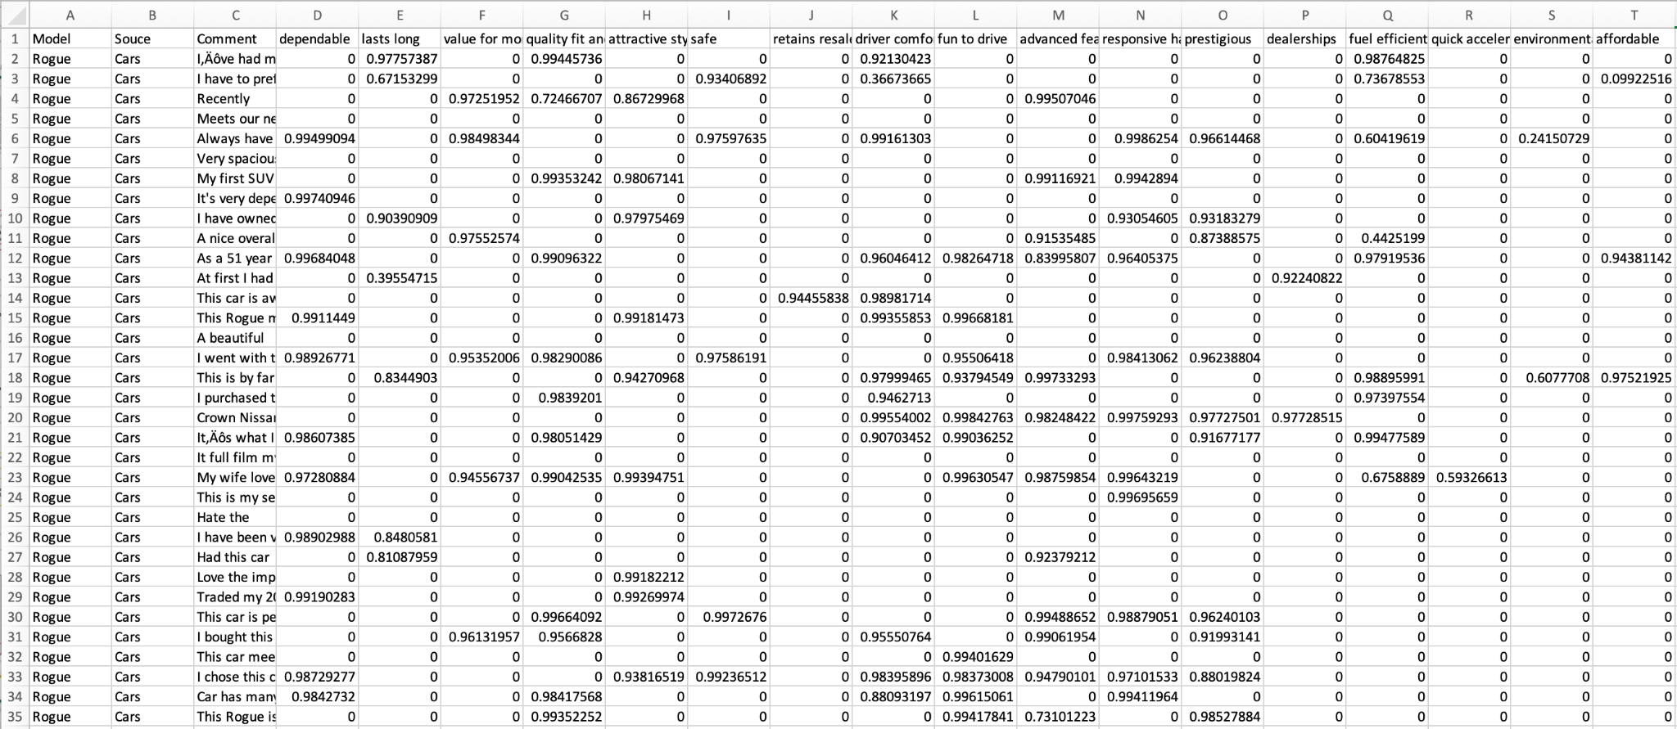
Improved results

Slide 11
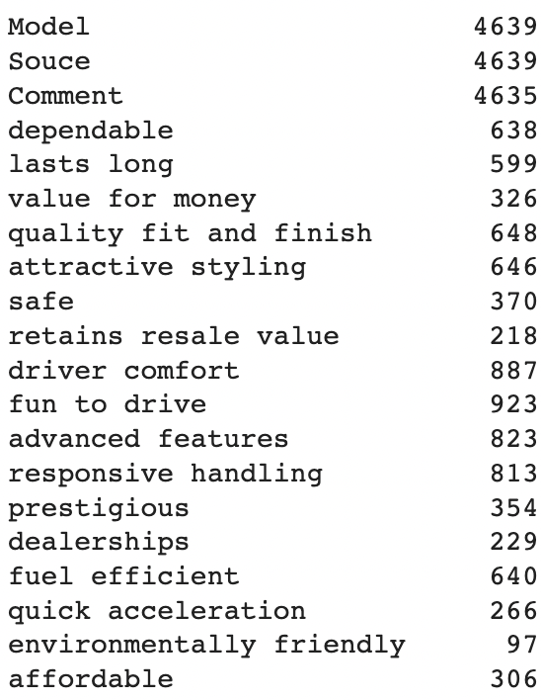
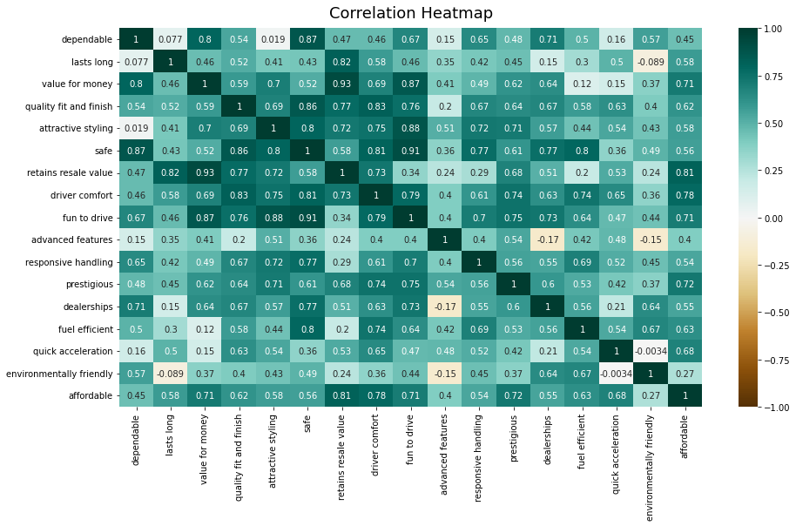
Correlation of each attributes

Slide 12
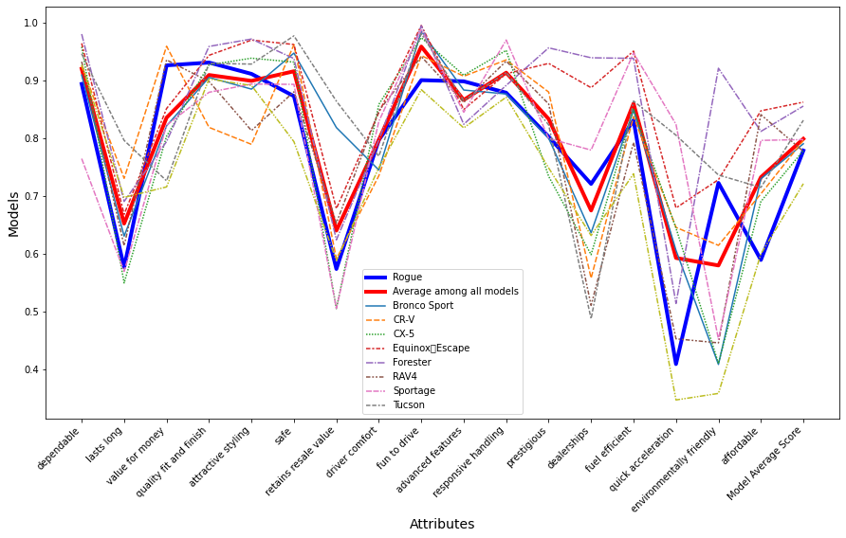
Comparing each model

Slide 13
Critical Analysis and Future Work
The Rogue's overall rating is slightly below average, especially when it comes to car acceleration and fun to drive. We checked the car configs and Rogue has 180 hp and the others are around 200 hp. We think this is the main reason.
We think Rogue can bring more at this price compared with other models, which means better value for money. We think the potential customers of these models are price-sensitive, and Rogue should improve on the premise of maintaining value for money
Some attributes are overlapped or unclearly defined, we may optimize them later. Since zero-shot model has limitations, we will choose another model, such as GPT-3, to try fine-tuning. This is also our future work.

Slide 14
Thank you!

