Slide 1
Node(available memory)
Use Case 1: random submit
Job1 * 79
Job2*121
Job2
Job2
Job2
Job2
Job2
Job2
Job1
Job2
Job1
Job2
Job2
Job2
Job2
Assumption:
Reserve one node
Job1 & Job2 memory allocation are fixed
All jobs wall time are identical
Experiment:
Random submit vs. Job array vs. OnTheFly
Job order
Job2
Job1
Job2
Slurm
schedule
Job1

Slide 2
Node(available memory)
Use Case 2: Job Array
Job1 * 79
Job2*121
Job1:1
Job1:2
Job2
Job2
Job2
Job2
Job2
Job1
Job1
Job1
Job2
……..
Job2
Job2
Job2
……..
Job2:1-121
Assumption:
Reserve one node
Job1 & Job2 memory allocation are fixed
All jobs wall time are identical
Experiment:
Random submit vs. Job array vs. OnTheFly
Job1:79
#SBATCH - array=x-y
Job2
Job2
Job2
Job2
Job2
……..
Slurm
schedule

Slide 3
Node(available memory)
Use Case 3: On The Fly
Job1 * 79
Job2*121
Job1:1
Job2
Job2
Job2
Job2
Job2
Job2
Job1:2
Job2
line1
line2
……..
……..
Assumption:
Reserve one node
Job1 & Job2 memory allocation are fixed
All jobs wall time are identical
Experiment:
Random submit vs. Job array vs. OnTheFly
Job1:79
Job2
Job2
Job2
Job2
Job2
Job2
……..
……..
……..
……..
OnTheFly
Job2
Job2
Job2
Job2
line3
line4
line5
line6

Slide 4
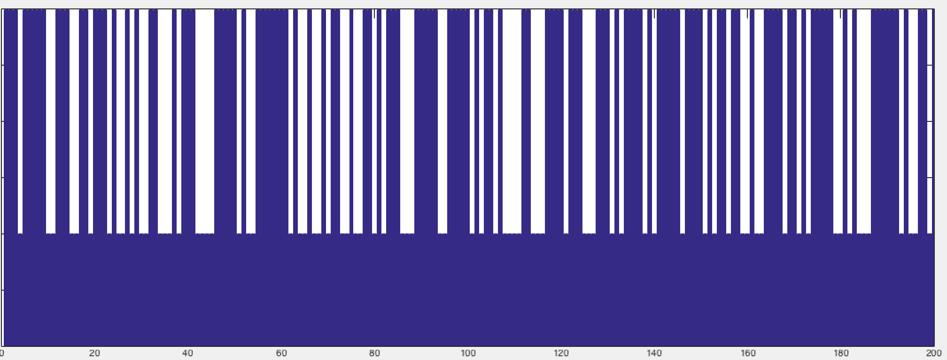
Random submit
Throughput (Job / min)
Random submit | Job array | On the fly
2 | 1.92 | 2.27
On the fly 13.5% better than job array, 17.5% better than random submit
If job fully blocked whole node, job array performs = on the fly
Apply to multi-core job blocking scenario

