Slide 1
P2POLLDER Bringing the Pollder to the people.
Dutch Blockchain Hackathon
12/02/2017

Slide 2


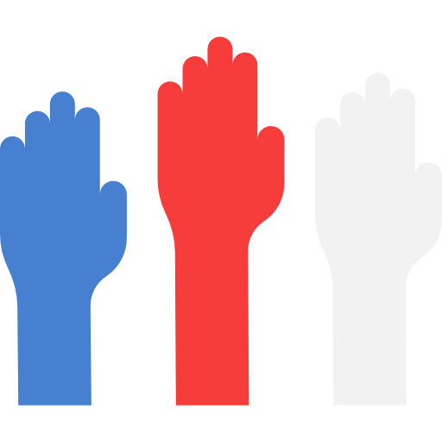
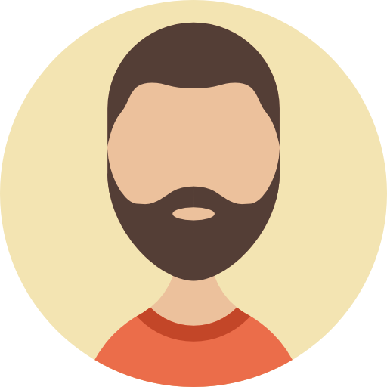


The essence of P2POLLDER
while
enabling
Binding citizen input into policy-making processes
keeping checks & balances to the government
a smaller gap between policy-making and citizen preferences.
1

Slide 3

What is the problem?
Misplaced trust in politics
No accountability to campaign promises
Limited trust & feedback from current e-participation participation
Hierarchical citizen participation processes
Limited citizen participation process
Discrepancy between citizen participation and policies
Hierarchical citizen participation processes
2

Slide 4


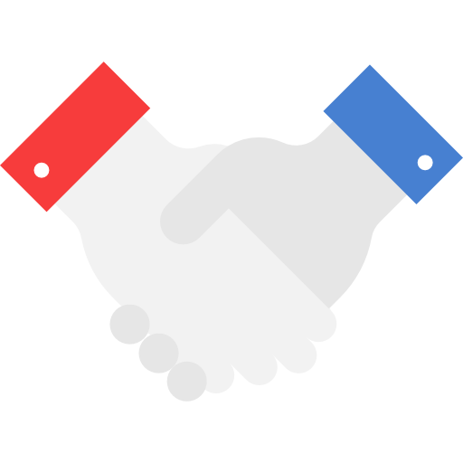
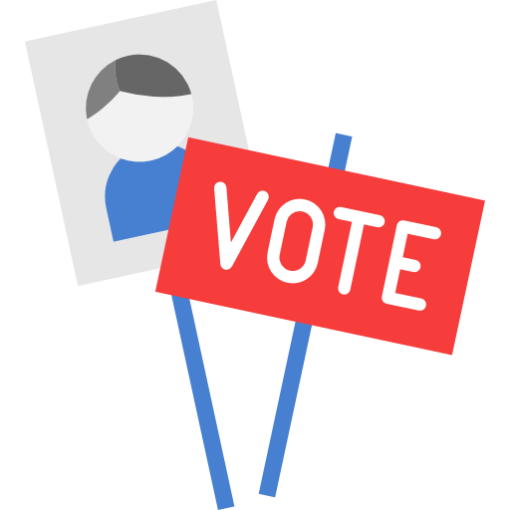
Current policy-making process
Agenda setting
Policy formulation
Execution
Political games
Decision-makers’ personal preferences
False campaign promises
Large gap between formulated policy and citizen preferences
Vote on political party that matches personal preferences once every 4 years
3

Slide 5
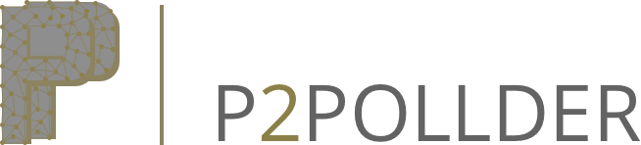
Involving the citizen directly in policy formulation
Agenda setting
Policy formulation
Execution
4

Slide 6
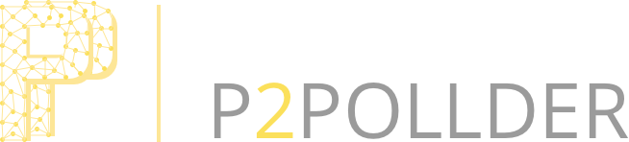
How P2POLLDER works
Policy-maker
Policy content
Time-frame for voting
Defined follow-up actions
Proposal for new policy
Voting on policy proposals
Voting with explanation
Citizen
5

Slide 7
Citizen input throughout the whole decision-making process
Input on proposals
Follow-up action logging
Overview of citizen sentiment
Policy-maker
Inquiry
Policy shaping
Policy proposal
Display of community sentiment
Accountability through follow-up action logging
Transparency in proposer of policy
Citizen
6

Slide 8
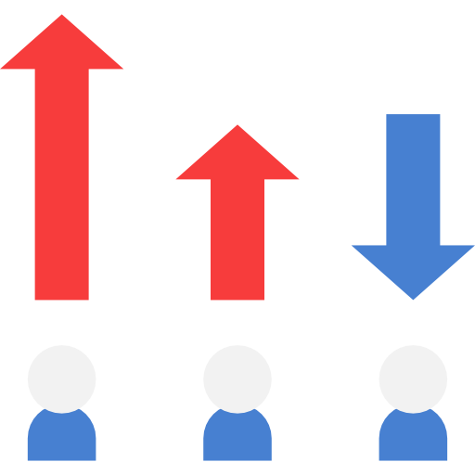
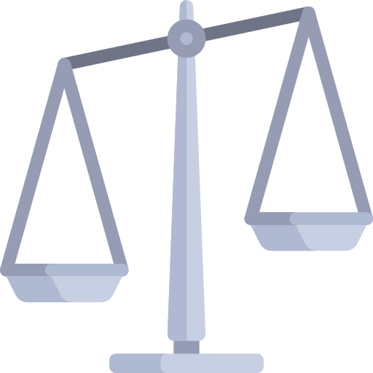

X-Factors of P2POLLDER
1. Accountability through follow-up logging
2. Display of community sentiment
3. Fits within current judicial system
7

Slide 9

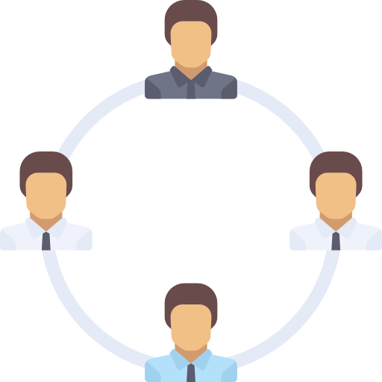

Potential application areas
Political parties
National governments
City councils
(Private) communities
8
Notes:
E-petitions, local electronic plebiscites, electronic referenda
Primaries and other political processes
Voting for local councils and parliaments
Voting for any groups and communities, and for other purposes

Slide 10

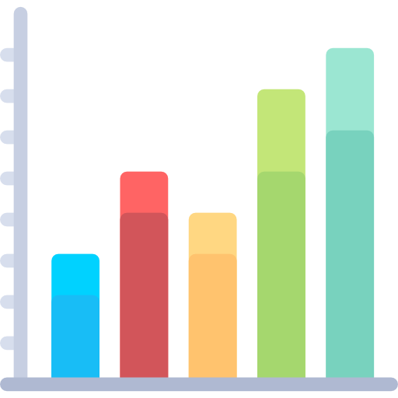
Embed in the blockchain ecosystem
Identity management system to avoid double voting
Incorporate verified data
9

Slide 11

Impact on: the user
Auditable commitment from policy makers
Transparency of policy decision-making processes
Direct participation in policy-making arena
Citizen
Knowing that your opinion matters
10

Slide 12




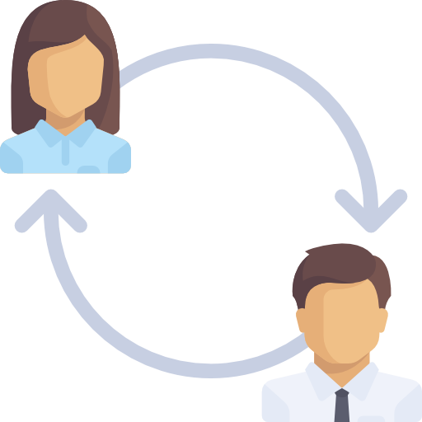
Impact on: the user-context
Citizen participation in desired topics
Trust in participation input
Faster and more transparent policy decision-making
Closer gap between policy and agenda setting
Government
No middle man between government and citizen
11

Slide 13
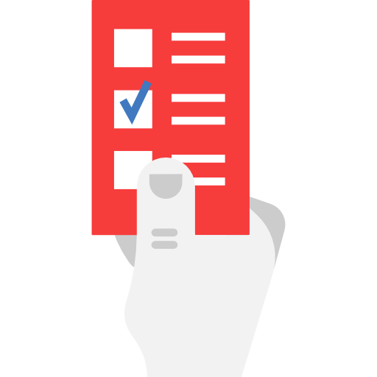
Impact on: society
A smaller gap between policy-making and citizen preferences.
Benefits of both direct and indirect democracy
12

Slide 14
Three-month plan
13

Slide 15
P2POLLDER Bringing the Pollder to the people.
Dutch Blockchain Hackathon
12/02/2017

Slide 16


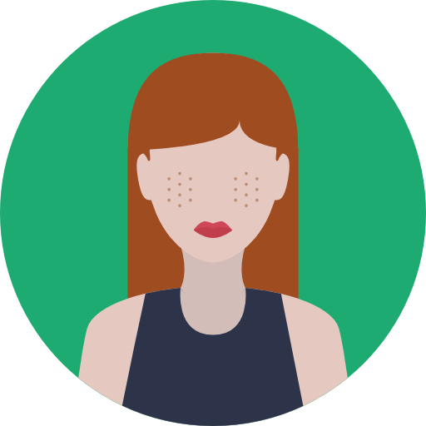
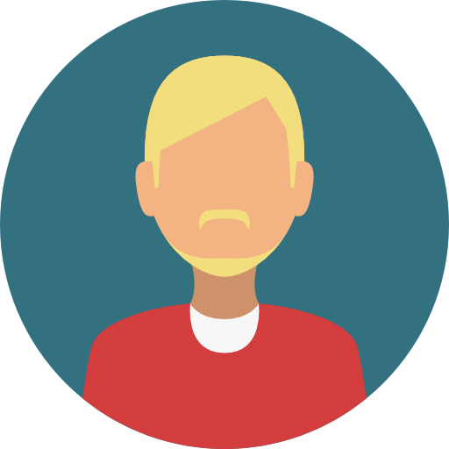
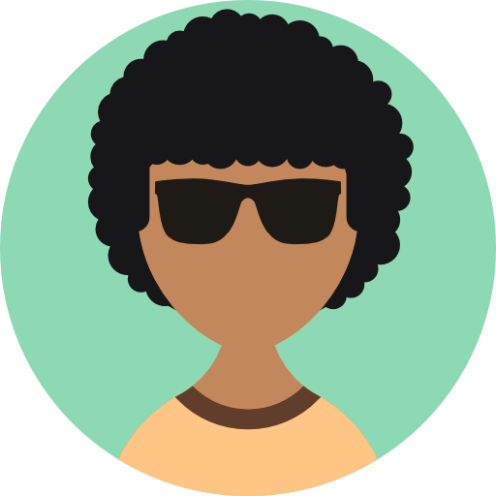


The P2POLLDER Team
André van der Heijden Block Builder
Pascal van Kooten Blockchain Guru
Harmke Alkemade
Data Wizard
Bas van Berkel
The Python
David Allessie
the New Kid on the Block
Ad Reijngoudt
Admin
Acknowledgements
Pictograms: designed by Freepik from Flaticon
Martin Kisjes
The UX Guy
Remi Sloot
The Backbone
15

