Slide 1




Demystifying Black-box Models with Symbolic Metamodels
Machine Learning and Artificial Intelligence for Medicine
Ahmed M. Alaa
Mihaela van der Schaar
NeurIPS 2019

Slide 2
Demystifying Black-box Models
Our focus: Black-box machine learning models with small to moderate number of features used in applications where the physical interpretation of features is important.
Key Example: ML models for medical risk prediction…
Need a transparent risk equation describing the model for approval in practice guidelines.
Need to understand what the model discovered!
Need to trust the model predictions for every individual…
2

Slide 3
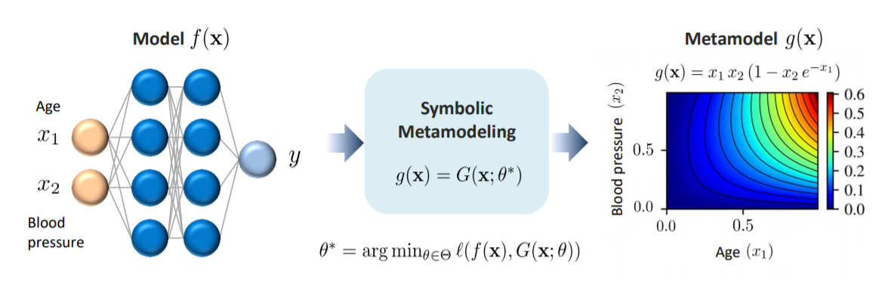
Symbolic Metamodeling
A symbolic metamodel takes as an input a trained machine learning model and outputs a transparent mathematical equation describing the model’s prediction surface.
Need only query access to the model.
3

Slide 4
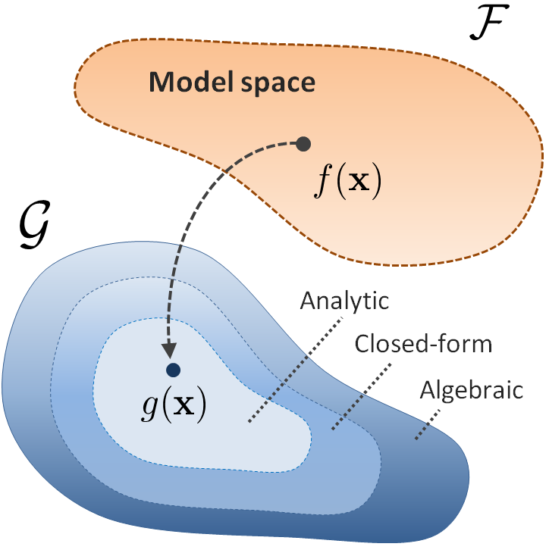
Symbolic Metamodeling
The symbolic metamodel problem formulation
Model space
For neural networks: space of all composite functions with ReLU activation
Metamodel space
Combination of simple functions (polynomials, closed-form or analytic expressions)
4

Slide 5


Symbolic Metamodeling
The symbolic metamodel problem formulation
Metamodel optimization problem
Metamodeling loss
5

Slide 6
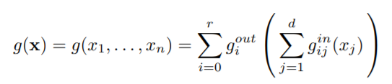

Metamodeling via Meijer-G functions
Parameterize the metamodeling space using two steps
1 - Decompose the metamodel into univariate functions
2 - Model basis functions via Meijer-G functions
6

Slide 7
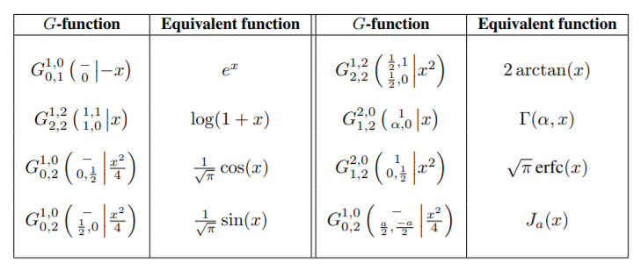
What are Meijer-G functions?
A univariate special function given by the following line integral in the complex plane.
Reduces to almost all known basic functions for different selections of the poles and zeros.
7

Slide 8

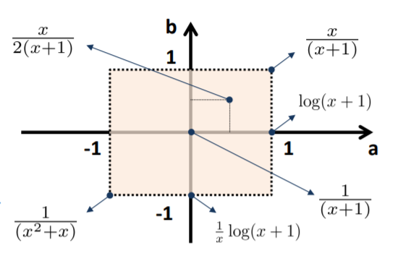
Advantages
This means that we can learn symbolic equations by tuning real-valued parameters using gradient descent!
Example:
8

Slide 9
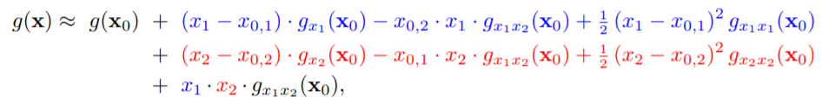
Connection to related works
Can reduce to different forms of model explanation by analytic derivations of the symbolic expression.
Derivative: instance-wise feature importance
(INVASE, L2X, SHAP, DeepLIFT)
Interaction terms: feature interactions (GAM2)
9

Slide 10
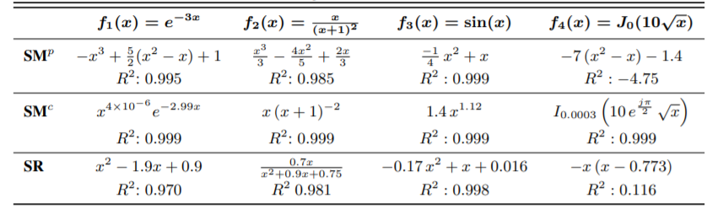
Experiments
Synthetic experiments: Can recover richer symbolic expressions compared to existing symbolic regression methods based on genetic programming
10

Slide 11
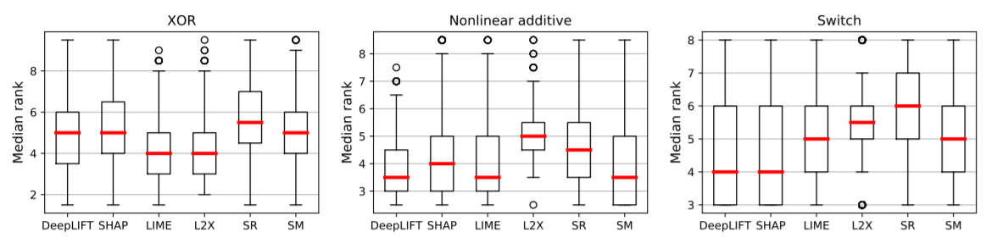
Experiments
Instance-wise feature importance: 3 synthetic datasets for which true feature importance is known.
Symbolic metamodeling performs competitively compared to methods tailored for feature importance
11

Slide 12
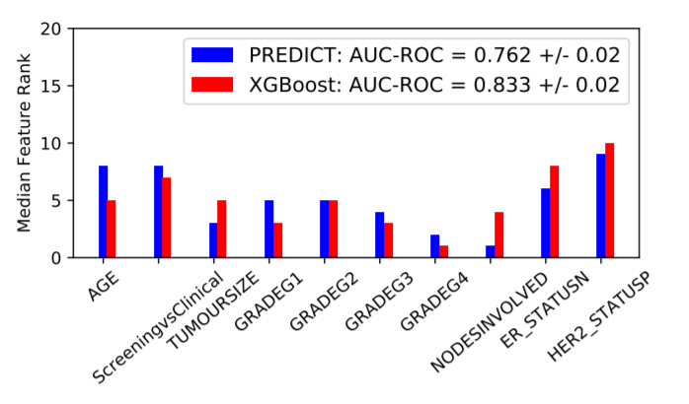
Experiments
Medical applications: debugs the discrepancies in assigning feature importance in machine learning models and existing medical scores.
12

