Slide 1
EV CHARGING SLOT SCHEDULER
Smart scheduling for faster, fairer and more efficient EV charging
SMART MOBILITY
EV + AI
HACKATHON 2026
PRESENTED BY:
M.Lavanya, P.Akshaya, P.Srinithya, P.Vandhana
Problem Domain:
Electric Vehicle Infrastructure & Smart Mobility

Slide 2
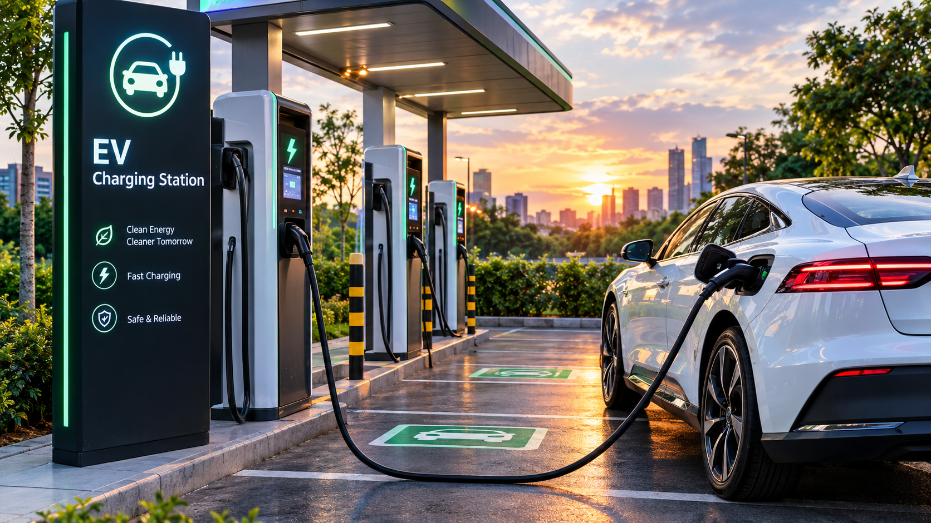
2. The Challenge
Why EV charging needs smarter scheduling ?
Real-World Problem
• Charging stations can become overcrowded during peak hours.
• Drivers may waste time waiting for an available slot.
• Manual or first-come scheduling can create inefficient utilization.
Why It Matters
• EV adoption is increasing rapidly.
• Long queues reduce user convenience and trust.
• Better scheduling can improve charger utilization and reduce idle time.
Key Challenges
• Different charging durations and battery levels.
• Multiple users competing for limited chargers.
• Balancing user priority with station capacity.
2

Slide 3
3. Our Innovation
A smart, user-friendly scheduler for EV charging
Core Idea
• Users enter vehicle details, preferred time and charging requirement.
• The scheduler assigns the most suitable available slot automatically.
Key Features
• Real-time slot availability
• Automatic slot allocation
• Estimated waiting/charging time
• Priority-aware scheduling
• Booking confirmation
• Admin view for charger utilization
Unique Approach
• Combines availability, estimated charging time and user priority.
• Reduces conflicts and spreads demand across available chargers.
3

Slide 4
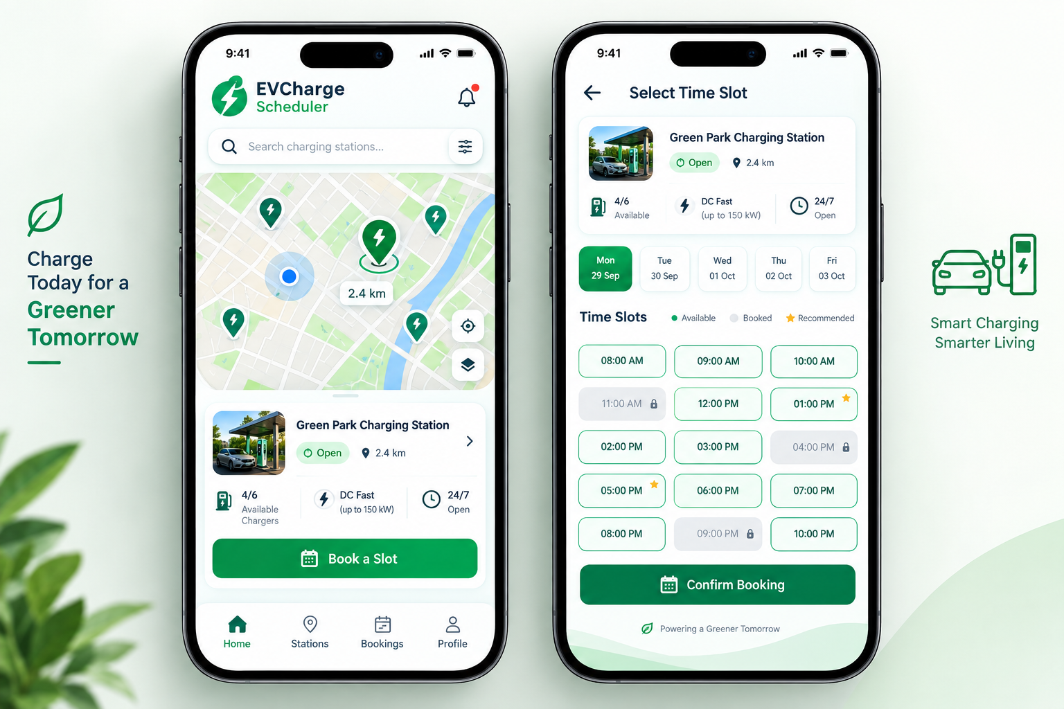
4. How It Works
Simple workflow: Input → Processing → Algorithm → Output
1
2
3
4
User Input
• Vehicle, battery level, preferred time
Check Data
• Available chargers and existing bookings
Scheduler
• Find feasible slots and rank them
Output
• Best slot + booking confirmation
User Journey: Open app → Select station → Enter requirement → Get recommended slot → Confirm booking → Charge
4

Slide 5
5. Technology & Algorithm
Simple, practical technology choices
Tech Stack
• Frontend: HTML, CSS, JavaScript / React
• Backend: Python / Node.js
• Database: SQLite / MySQL
• API: RESTful services
• Optional: Maps & notifications
Main Algorithm
• Filter unavailable chargers.
• Calculate feasible charging windows.
• Score slots using availability, waiting time and priority.
• Choose the highest-scoring feasible slot.
Complexity
• For S slots and C chargers, basic scheduling is approximately O(S × C).
• Database indexing can reduce lookup time.
• Designed to scale by adding more stations and users.
5

Slide 6
6. Demo & Impact
Illustrative prototype results
Sample Output
• Recommended slot: 11:30 AM • Charger 02 • Estimated charge: 45 min
EV ChargePoint — Slot Booking
10:00 AM Available
Practical Benefits
• Less waiting • Better charger utilization • Simple booking experience
11:30 AM Recommended
01:00 PM Available
Demo Metrics to Track
• Average waiting time, slot utilization, booking conflicts, successful bookings
02:30 PM Full
6

Slide 7
7. Future Vision
Future Improvements
• Live charger status
• Dynamic pricing
• EV battery/vehicle integration
• Notifications and reminders
Scalability
• Multiple charging stations
• Cloud deployment
• Predictive demand forecasting
• Smart-grid integration
Current Achievement
• Working scheduling concept
• Slot allocation workflow
• User-friendly booking interface
• Priority-aware logic
“Charge smarter. Wait less. Move greener.”

Slide 8
THANK YOU

