Slide 1
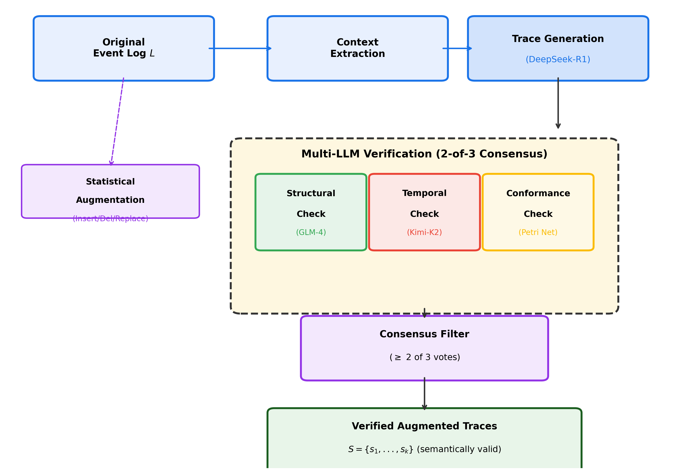
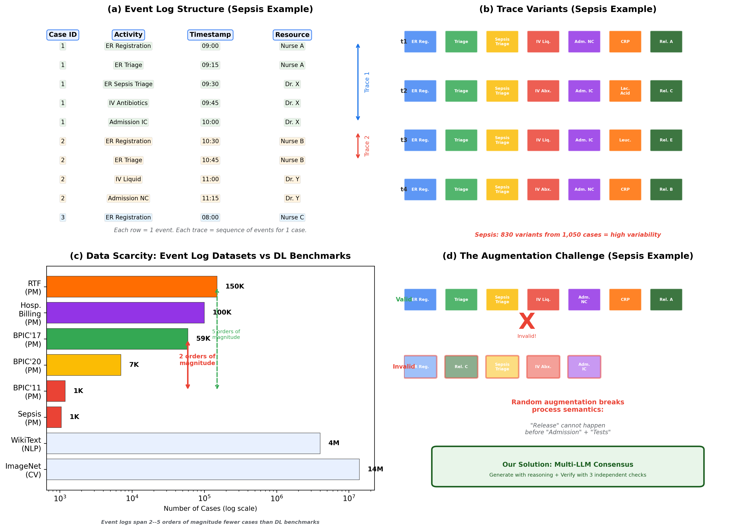
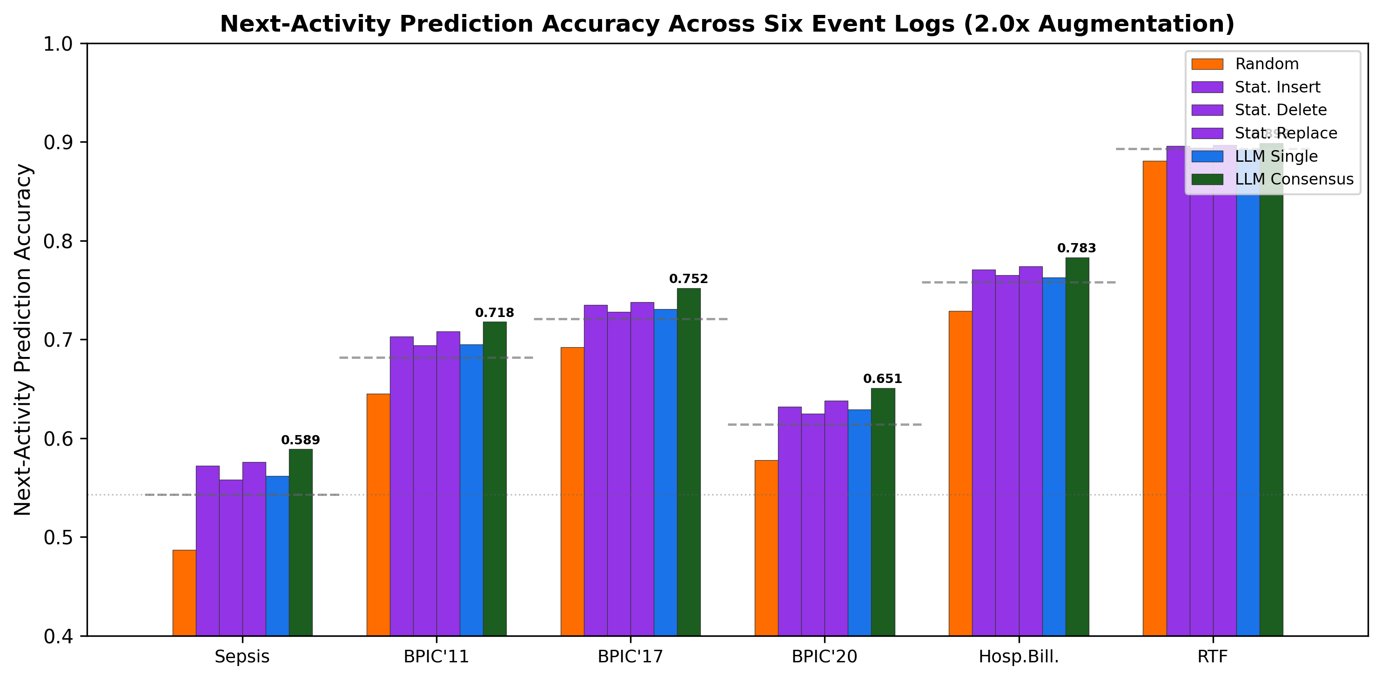
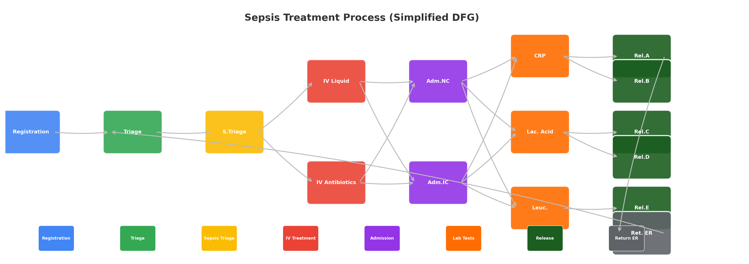

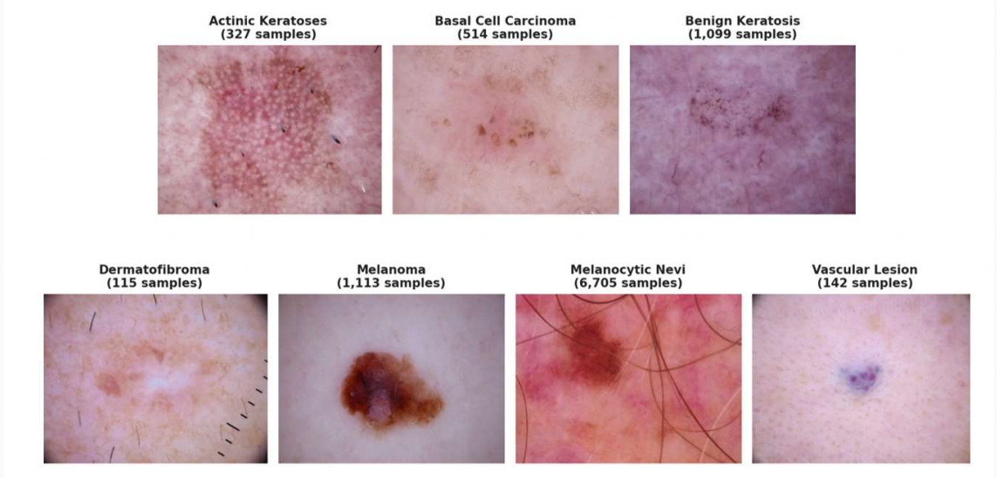
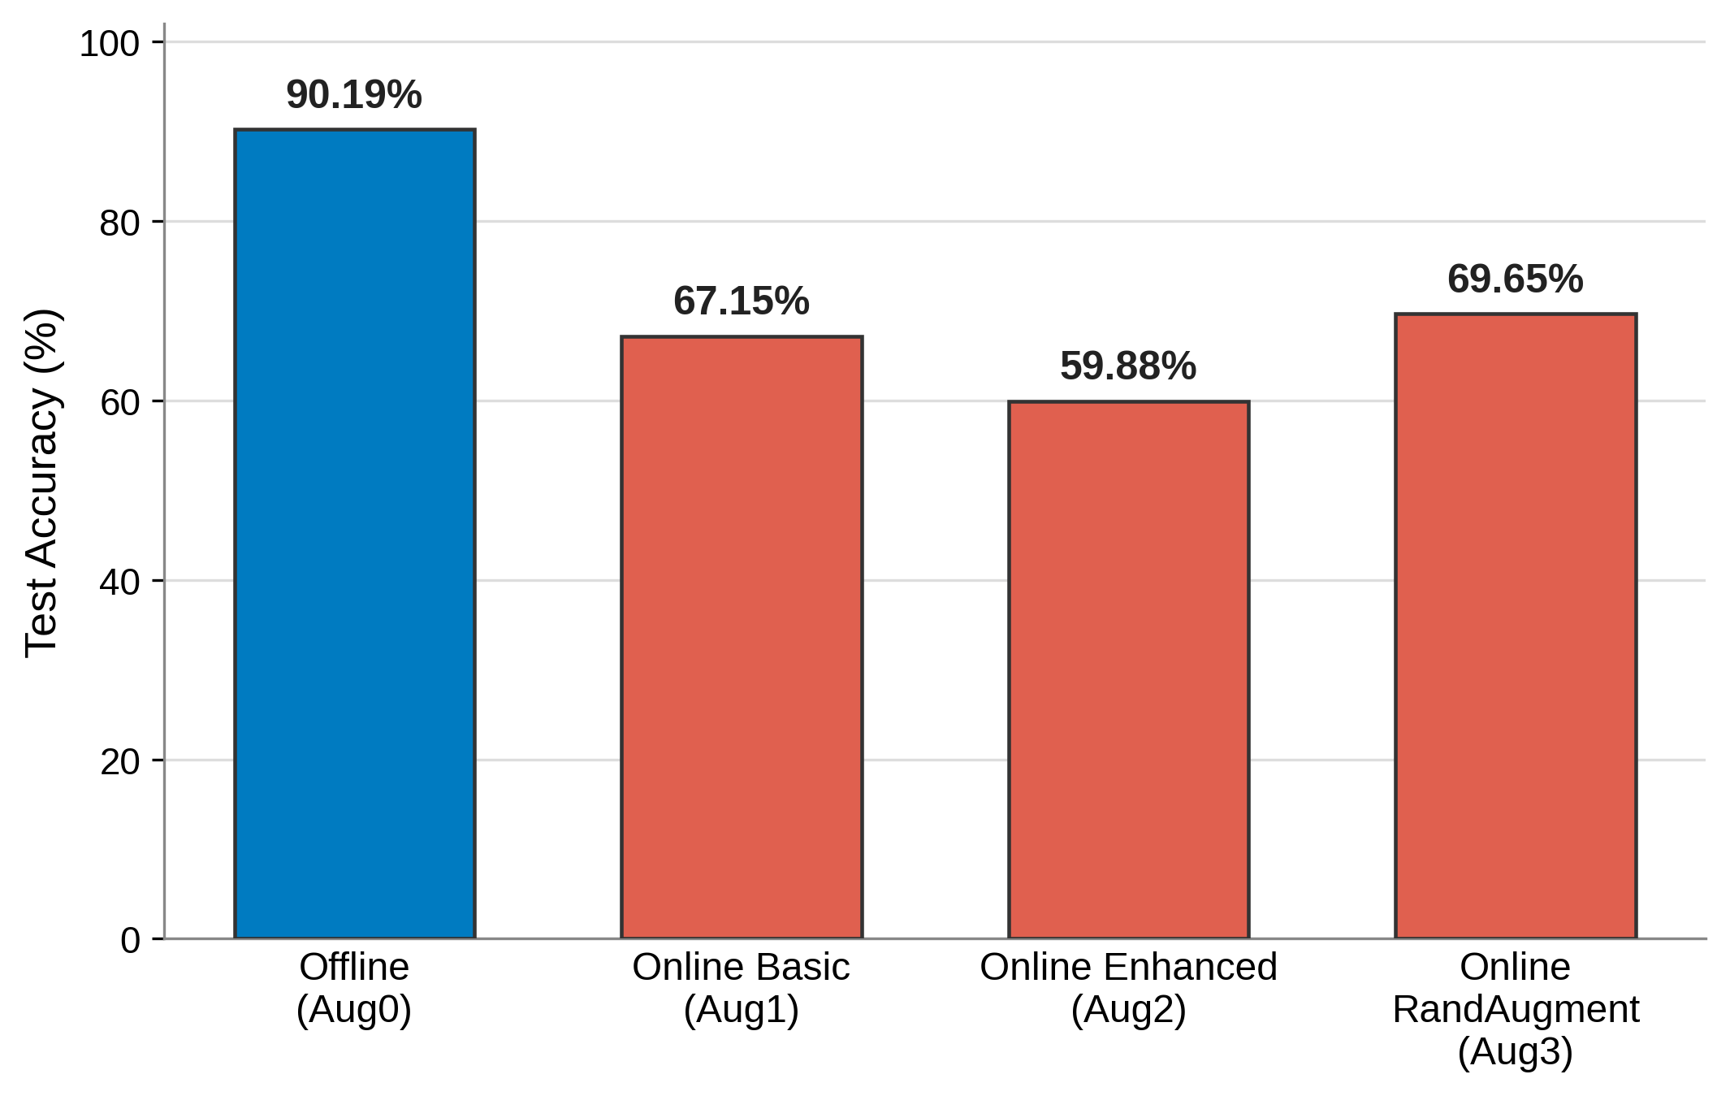

Multi-LLM Consensus for Semantic-Preserving Event Log Augmentation in Predictive Process Monitoring
Ifrina Nuritha
Vandha Pradwiyasma Widartha
Chang-Soo Kim†
1
Department of Information Systems, Universitas of Jember, Indonesia & Pukyong National University, South Korea
ASPAI 2026 — 2nd Asia-Pacific Symposium on Process and AI
INTRODUCTION
RESULTS
Predictive process monitoring (PPM) applies ML to event logs for next-activity prediction. A fundamental challenge is data scarcity: real-world event logs are often small, exhibit low variability, and contain imbalanced outcomes.
Data augmentation can help, but event log augmentation differs fundamentally from image/text augmentation. Traces are sequentially dependent: activity B follows A due to causal constraints. Random insertion, deletion, or replacement frequently produces semantically invalid sequences (e.g., "Deliver before Ship").
Statistical methods (SiamSA-PPM) preserve control-flow patterns but cannot generate novel variants. LLMs can generate plausible traces but hallucinate invalid transitions. No prior work combines LLM generative capabilities with systematic verification.
Problem. We propose a multi-LLM consensus framework: DeepSeek-R1 generates candidates, GLM-4 verifies structural validity, Kimi-K2 verifies temporal consistency, and programmatic conformance checking provides a third vote. Traces pass only with ≥ 2-of-3 agreement.
Multi-LLM consensus (2-of-3) achieves the highest conformance fitness (0.82–0.91) across all six datasets, outperforming statistical baselines (best: 0.74–0.87) and single-model LLM (0.63–0.78). Improvement is largest for small, high-variability logs (Sepsis: +4.6pp) and smallest for large, low-variability logs (RTF: +0.6pp).
Table 1. Conformance fitness across six event logs (2.0× augmentation)
Method | Sepsis | BPIC'11 | BPIC'17
Original | 1.00 | 1.00 | 1.00
Random | 0.42 | 0.48 | 0.35
Stat. Insert | 0.78 | 0.82 | 0.71
Stat. Replace | 0.76 | 0.80 | 0.69
METHODOLOGY
Multi-LLM Consensus Framework
Stage 1 — Context Extraction: From training log, extract activity alphabet, DFG with frequency counts, start/end activities, and top-k frequent variants. Context C provided to all LLMs as structured input.
Stage 2 — Trace Generation: DeepSeek-R1 (671B MoE) generates N candidate traces conditioned on C. Prompt specifies valid start/end activities, DFG constraints, and domain-specific rules. Output requested as JSON list of activity sequences.
Stage 3 — Multi-Model Verification: Each candidate independently evaluated by three verifiers:
• Structural (GLM-4): checks DFG transition validity, temp 0.1
• Temporal (Kimi-K2): checks temporal ordering, 1M-token context
• Conformance (Petri Net): token-based replay, fitness ≥ 0.9
Stage 4 — 2-of-3 Consensus: Trace accepted if ≥ 2 verifiers agree.
Model Selection Justification
Fig 2. Next-activity prediction accuracy across six event logs (2.0×)
DeepSeek-R1 as Generator: Chain-of-thought architecture. Achieves 80% fully-valid trace rate vs. 60% (GLM-4) and 40% (Kimi-K2).
GLM-4 as Structural Verifier: Tool-use and API integration strength. 90% accuracy, F1 = 0.91. Low temperature (0.1) for deterministic evaluation.
Kimi-K2 as Temporal Verifier: 1M-token context window processes full traces without truncation. Catches long-range ordering errors.
Heterogeneous > Homogeneous: 3-model consensus (90%) outperforms homogeneous (70-80%).
Inter-Model Agreement (IMA) quantifies verifier alignment. RTF: 0.89 (simple). BPIC'17: 0.71 (complex). Structural violations: 35-42% of rejections.
Table 2. Ablation: conformance fitness (2.0× augmentation)
Datasets
Config | Sepsis | BPIC’11
Full (2-of-3) | 0.85 | 0.88
Without GLM | 0.79 | 0.83
Without Kimi | 0.82 | 0.86
Six publicly available event logs spanning four domains:
• Sepsis (Healthcare): 1,050 cases, 16 activities, 830 variants — high variability, small size
• BPIC 2011 (Healthcare): 1,187 cases, 7 activities, 423 variants — moderate variability
• BPIC 2017 (Loan): 59,148 cases, 21 activities, 21,500 variants — very high variability
• BPIC 2020 (Municipality): 7,014 cases, 27 activities, 2,932 variants
• Hospital Billing: 100,000 cases, 18 activities, 1,000 variants
• Road Traffic Fines (Govt): 150,370 cases, 11 activities, 4 variants — very low variability
Train/Test: 80/20 temporal split. Augmentation factor: 2.0× (doubling training set).
Prediction model: LSTM (2-layer, 128 hidden units) with prefix encoding.
CONCLUSION
Multi-LLM consensus achieves highest semantic validity (0.82-0.91 fitness) and improves prediction accuracy by 0.6-4.6pp.
• H1 Confirmed: Multi-LLM consensus > statistical baselines
• H2 Confirmed: Augmented data improves prediction accuracy
• H3 Confirmed: Heterogeneous consensus (90%) > homogeneous (70-80%)
Future: multi-perspective augmentation, deep generative baselines, domain fine-tuning.
REFERENCES & ACKNOWLEDGMENT
Fig 1. Six event log datasets spanning four domains
This work was supported by the Department of Information System, Pukyong National University.
Key References:
[1] van Straten et al. (2025) SiamSA-PPM. arXiv:2507.18293
[2] Padella et al. (2025) Comparison of Augmentation Techniques. arXiv:2511.01896
[3] Berti et al. (2024) PM-LLM-Benchmark. ICPM Workshops
[4] Karpathy (2024) llm-consortium. PyPI
[5] van der Aalst (2025) No AI Without PI. arXiv:2508.00116

