Slide 1

Movie Recommendation System
Guided by: Prepared by:
Prof. Bhoomika Modi Vandit Vora – IU1941230182
Hrishikesh Suthar – IU1941230170
Sem – 7
Computer Science & Engineering
Indus University

Slide 2
Intoducation
The basic concept behind a movie recommendation system is quite simple. In particular, there are two main elements in every recommender system: users and items. The system generates movie predictions for its users, while items are the movies themselves.
The primary goal of movie recommendation systems is to filter and predict only those movies that a corresponding user is most likely to want to watch.
Notes:
Implemented popularity model, content based model, collaborative filtering model and latent factor based model and combining the above to form a hybrid model.
Hyperparameter tuning, testing accuracy and evaluation of recommendations of each model

Slide 3
Contd..
A recommendation system is a system that provides suggestions to users for certain resources like books, movies, songs, etc., based on some data set. Movie recommendation systems usually predict what movies a user will like based on the attributes present in previously liked movies.
Such recommendation systems are beneficial for organizations that collect data from large amounts of customers, and wish to effectively provide the best suggestions possible.

Slide 4
Abstract
A lot of factors can be considered while designing a movie recommendation system like the genre of the movie, actors present in it or even the director of the movie.
The systems can recommend movies based on one or a combination of two or more attributes. The recommendation system has been built on the type of genres that the user might prefer to watch.

Slide 5
Recommendation System
Recommendation system produce a ranked list of items on which a user might be interested, in the context of his current choice of an item.
It helps deciding in what to wear, what to buy, what to watch movies etc.
Movie recommendation systems use a set of different filtration strategies and algorithms to help users find the most relevant films. The most popular categories of the ML algorithms used for movie recommendations include content-based filtering and collaborative filtering systems.

Slide 6
Content based filtering
Content-based filtering approaches uses a series of discrete characteristics of an item in order to recommend additional items with similar properties.
Content-based filtering methods are totally based on a description of the item and a profile of the user’s preferences. It recommends items based on the user’s past preferences.

Slide 7
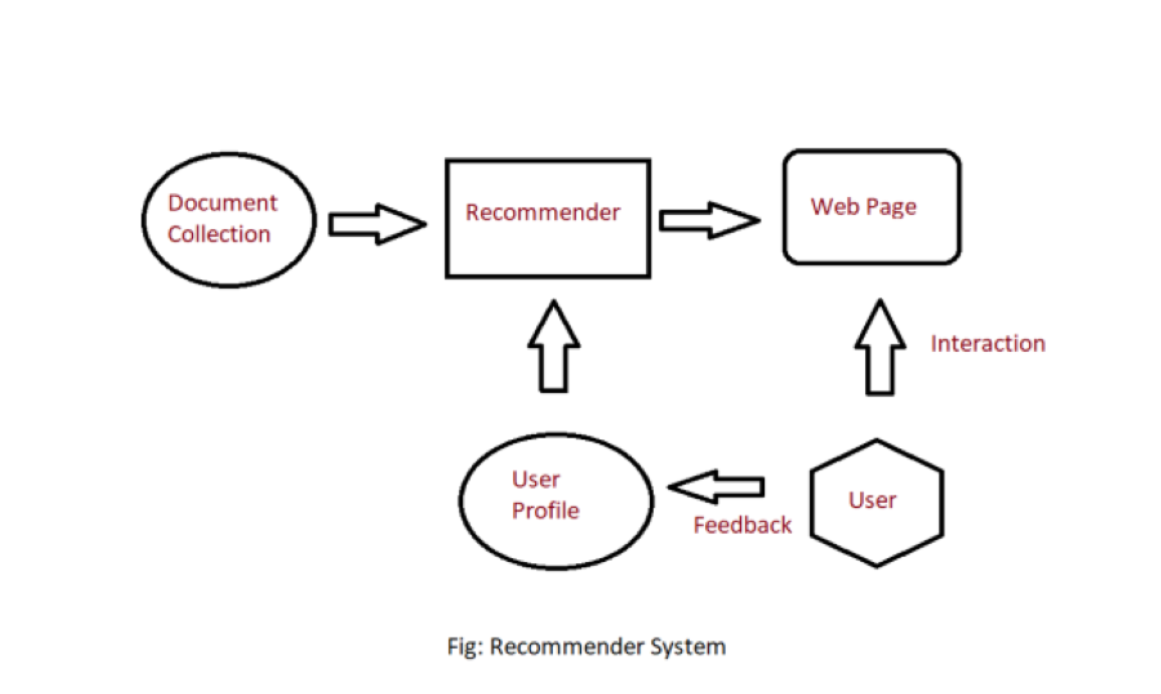
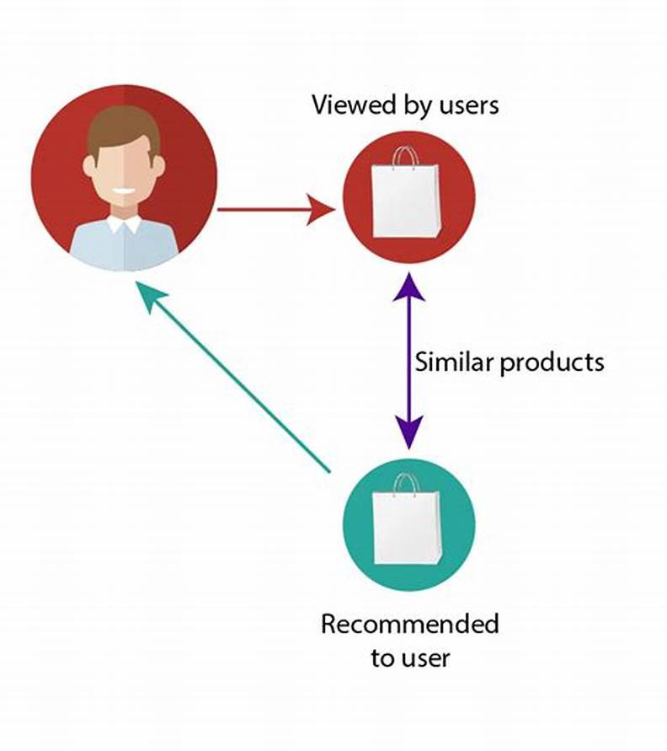
Content based filtering diagram

Slide 8
Purpose
The purpose of a movie recommendation system basically is to search for content that would be interesting to an individual. Moreover, it involves a number of factors to create personalized lists of useful and interesting content specific to each user/individual.

Slide 9
DataSet
Movie titles dataset
Movies: 6k+
Release year: 1970 – 2019
Categories: 10+
Source of Data : https://www.kaggle.com/netflix-inc/netflix-prize-data
Notes:
The primary dataset used for this project is the movielens review dataset. consisting of 27,753,444 reviews over 58,098 different movies by 283,228 users.

Slide 10
Technology Used
Python
Machine Learning
CSS
HTML
Flask Module

Slide 11
Outcomes

Slide 12
Thank you

