Slide 1

Text Cryptography
Prepared By:
Vandit Rogheliya

Slide 2

Definition
Webpage to encrypt and decrypt text/message –
AES(Advanced Encryption Standard)
DES(Data Encryption Standard)
Caesar Cipher

Slide 3
Functionality/features
Provide GUI for encryption/decryption of text - entered by user
Choose algorithm (AES, DES, Caesar-cipher) to encrypt/decrypt

Slide 4
Working
Go to webpage - message
3 options - algorithm – encryption/decryption
Enter text - to encrypt/decrypt
Show the encrypted/decrypted message

Slide 5
Flowchart
Application starts
Select algorithm for encryption
Enter text to encrypt
Display Encrypted text
Display decrypted msg
Decrypt message
Yes
Decrypt message ?
No
Exit ?
Exit
Yes
No

Slide 6
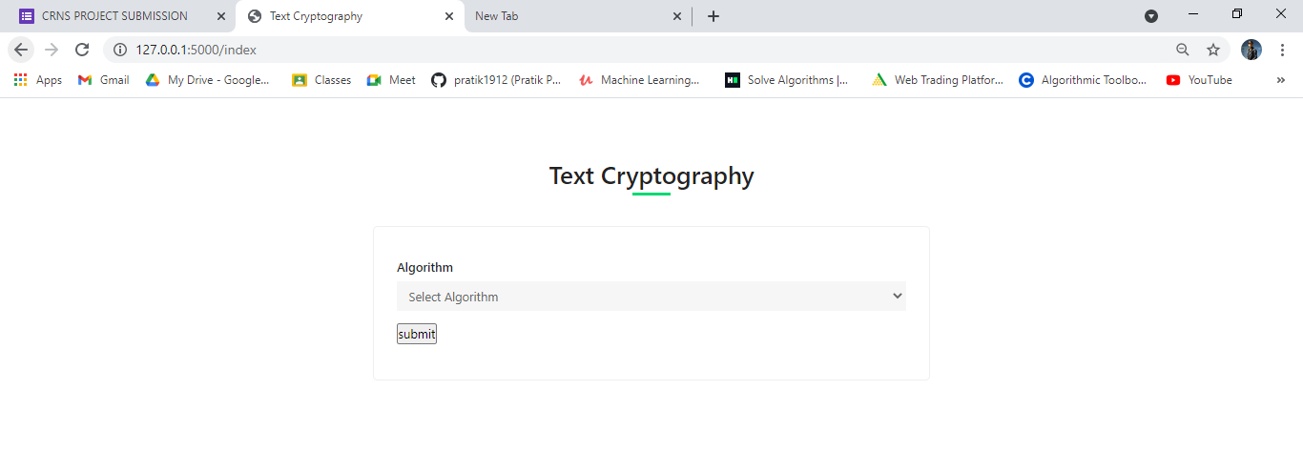
Output..

Slide 7
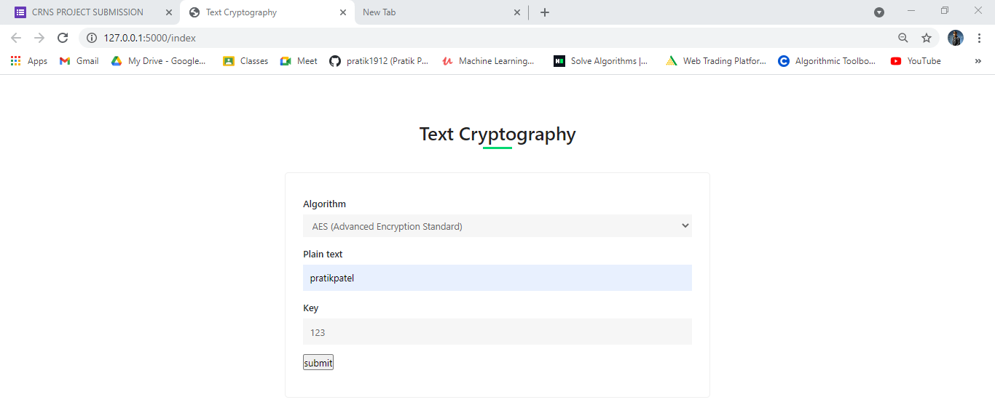
Output FOR AES ALGORITHM..

Slide 8
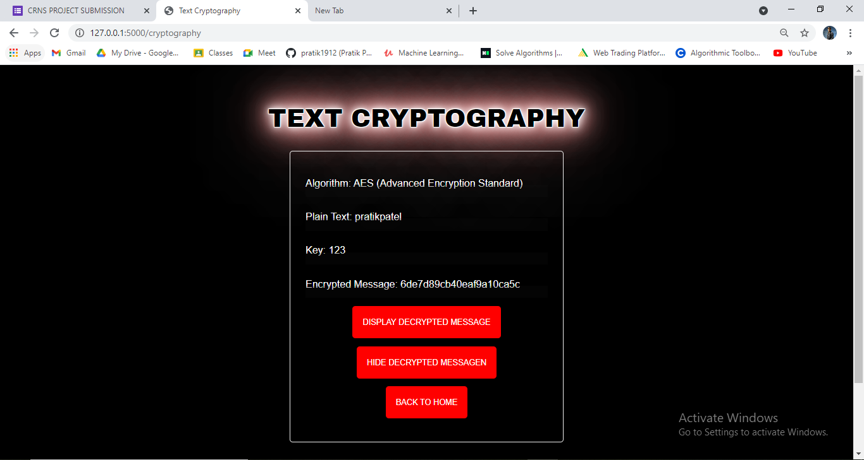
Output FOR AES ALGORITHM..

Slide 9
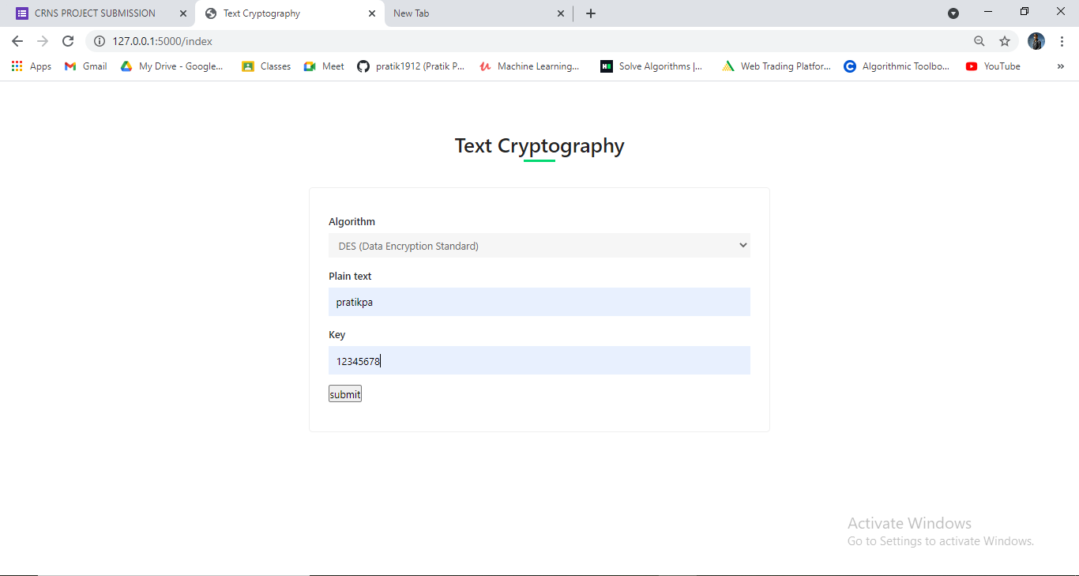
Output FOR DES ALGORITHM..

Slide 10
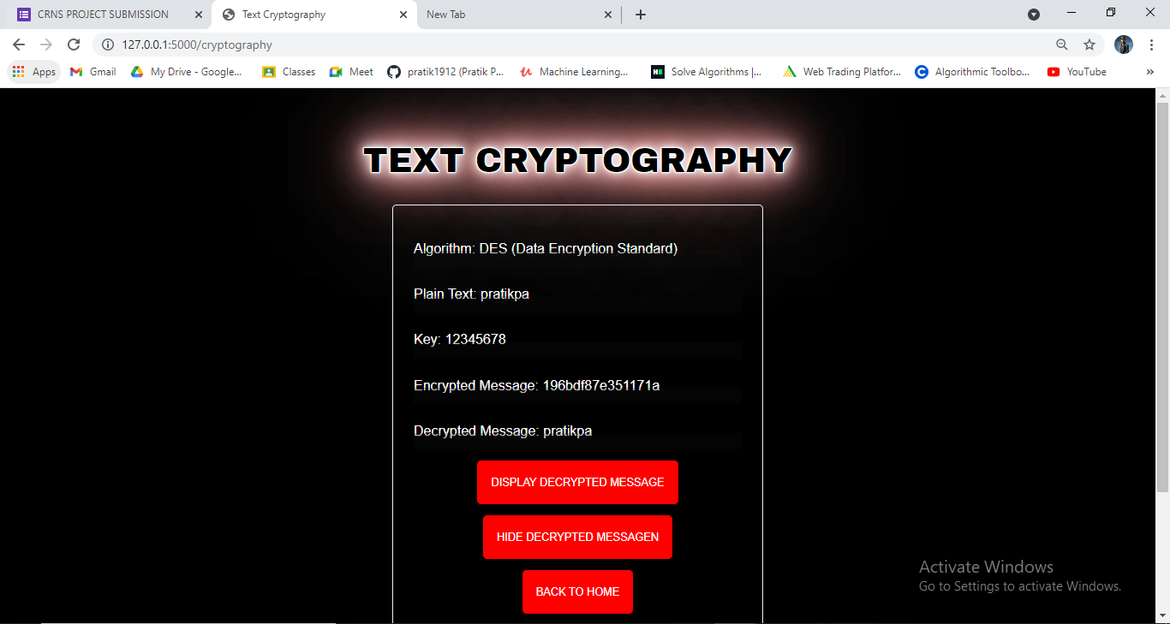
Output FOR DES ALGORITHM..

Slide 11
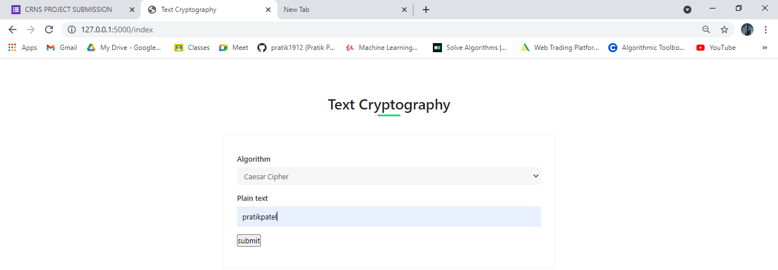
Output FOR Caesar Cipher ALGORITHM..

Slide 12
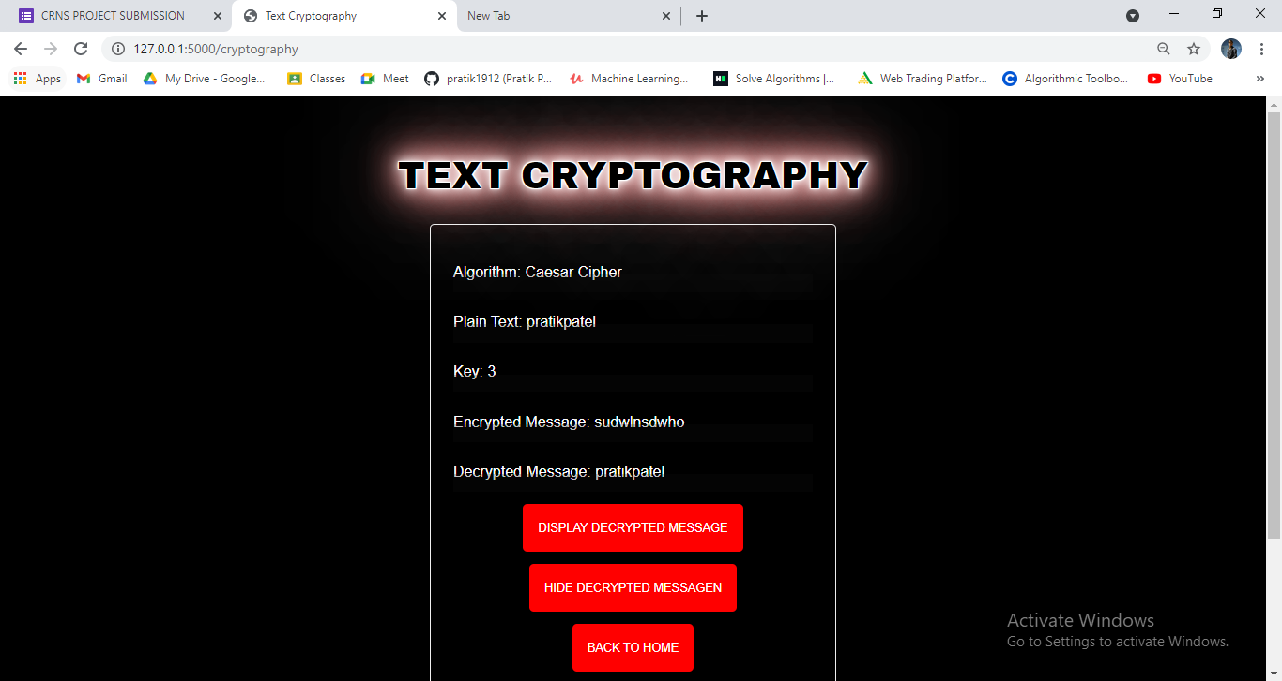
Output FOR Caesar Cipher ALGORITHM..

Slide 13
References
https://www.educative.io/edpresso/what-is-the-aes-algorithm
https://en.wikipedia.org/wiki/Advanced_Encryption_Standard
http://www.programming-algorithms.net/article/40203/Caesar-cipher
https://www.youtube.com/watch?v=cefmnVaDab4

Slide 14
THANK YOU!

