Slide 1
QUANTUM USE CASES IN BFSI
$1T+
projected quantum market value by 2035
Transforming Portfolio Optimization and Risk Analytics with Quantum Computing
100×
faster optimization vs classical HPC
June 2026
Quantum Finance Advisory | Confidential
6
of top 10 banks running quantum pilots
CONFIDENTIAL | Quantum BFSI
© 2026 Quantum Finance Advisory
Notes:
SPEAKER NOTES – SLIDE 1: Title
Welcome the audience and set expectations for the session (60–90 minutes).
Opening hook: "In the 1950s, Markowitz showed us that diversification is the only free lunch in finance. Today, quantum computing is promising the next free lunch — the ability to find optimal portfolios across thousands of assets in seconds, rather than hours."
Key points to communicate:
• This presentation bridges quantum computing concepts with practical BFSI applications
• We focus on two areas: Portfolio Optimization and Risk Analytics (Monte Carlo / VaR)
• We will cover current industry pilots (JPMorgan, Goldman Sachs) and a realistic adoption roadmap
• The goal is not to make the audience quantum physicists, but quantum-ready decision-makers
Audience note: Tailor depth of technical slides (4 and 7) based on whether audience is business leadership or technical/quant teams.
Duration guide: ~5 minutes for this slide (introductions, agenda overview).

Slide 2
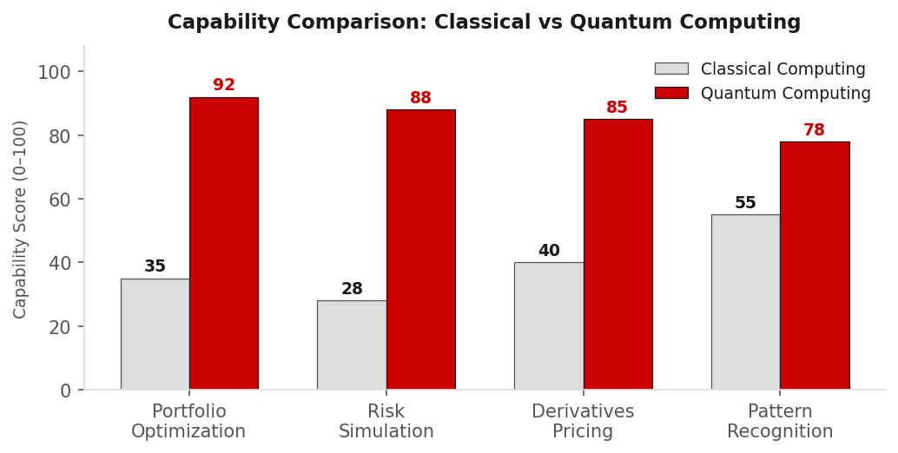
Why Quantum Computing Matters for BFSI
The computational gap between financial complexity and classical capabilities is widening
Market Complexity
50,000+ tradeable instruments with non-linear correlations across asset classes, geographies, and timeframes.
Computational Limits
Classical solvers require exponential time for NP-hard portfolio problems — impractical beyond ~500 assets.
Risk Model Demands
Basel IV and FRTB mandate real-time VaR, CVA, and stress testing across full trading books daily.
Speed-to-Insight Gap
"Quantum computing enables financial institutions to solve optimization and simulation problems previously considered computationally infeasible."
Overnight batch runs limit intraday portfolio rebalancing and real-time risk response capabilities.
CONFIDENTIAL | Quantum BFSI
© 2026 Quantum Finance Advisory
Notes:
SPEAKER NOTES – SLIDE 2: Why Quantum Matters
Key message: Classical computers are hitting a wall precisely where finance needs the most horsepower.
Discussion points:
1. MARKET COMPLEXITY: Modern portfolios can contain 50,000+ instruments. Cross-asset correlations are non-stationary (they change during crises). A covariance matrix for 5,000 assets has 12.5 million entries to compute and invert.
2. CLASSICAL LIMITS: Mean-variance optimization with 1,000 assets and realistic constraints is an NP-hard combinatorial problem. Classical solvers use approximations that sacrifice optimality. The bar chart shows quantum's advantage on the 4 core BFSI computational tasks.
3. REGULATORY PRESSURE: Basel IV and FRTB (Fundamental Review of the Trading Book) require banks to run internal models for capital calculations — computationally much more demanding than the previous VaR-based approach. Many banks are already struggling with compute capacity.
4. SPEED GAP: Overnight batch jobs prevent intraday rebalancing. In volatile markets (March 2020, SVB crisis), this delay is costly.
Closing: "This is not a distant-future problem — banks with quantum-ready infrastructure today will be positioned to rebalance faster, price more accurately, and hold less regulatory capital than peers. That's a direct P&L impact."
Duration guide: ~8 minutes.

Slide 3
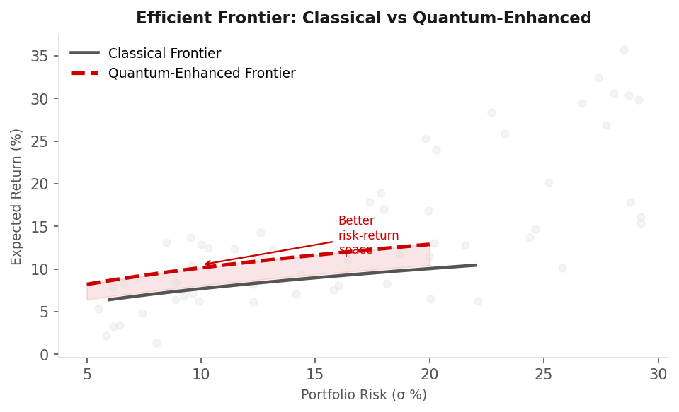
Quantum Portfolio Optimization Overview
From Markowitz Mean-Variance to Quantum-Native Optimization
Markowitz Mean-Variance (1952)
Minimize: wᵀΣw (portfolio variance)
Subject to: wᵀμ ≥ R*, Σwᵢ = 1, wᵢ ≥ 0
Covariance Matrix Scale
Combinatorial Explosion
Dynamic Rebalancing
O(n²) entries to estimate; 5,000 assets = 12.5M correlation pairs
Integer constraints create 2ⁿ feasible solutions; n=100 → 10³⁰ combinations
Multi-period optimization with transaction costs and tax constraints
CLASSICAL OPTIMIZATION BOTTLENECKS
▸ Quadratic Programming solvers scale poorly beyond 500 assets
▸ Integer constraints (cardinality, lots) make problem NP-hard
▸ Cannot evaluate all efficient frontier points simultaneously
▸ Monte Carlo for robust optimization needs millions of scenarios
CONFIDENTIAL | Quantum BFSI
© 2026 Quantum Finance Advisory
Notes:
SPEAKER NOTES – SLIDE 3: Portfolio Optimization Overview
This slide establishes the baseline — what is the problem we are trying to solve, and why is it hard?
Key talking points:
1. MARKOWITZ MODEL: Explain the formula simply: "We want to find the combination of asset weights that minimizes portfolio risk (variance) for a given target return. This sounds simple, but with thousands of assets and real-world constraints, it becomes extraordinarily difficult."
2. EFFICIENT FRONTIER: Point to the chart — "The blue dashed line shows the quantum-enhanced frontier. Notice it sits above and to the left of the classical frontier — better return for the same risk, or same return with lower risk. Even a 0.5% improvement in the Sharpe ratio compounds to billions of dollars over a $100B portfolio."
3. THREE BOTTLENECKS:
- Covariance matrix: 5,000 assets → 12.5 million entries. Estimating this reliably from historical data requires hundreds of years of data, which doesn't exist.
- Combinatorial explosion: Adding integer constraints (min/max lot sizes, sector limits) converts a convex QP into an NP-hard problem.
- Dynamic rebalancing: The single-period Markowitz model ignores transaction costs and taxes. The multi-period version is exponentially harder.
4. WHAT QUANTUM OFFERS: The ability to evaluate many feasible solutions simultaneously using quantum superposition, and to tunnel through local optima using quantum annealing/QAOA.
Duration guide: ~8–10 minutes.

Slide 4
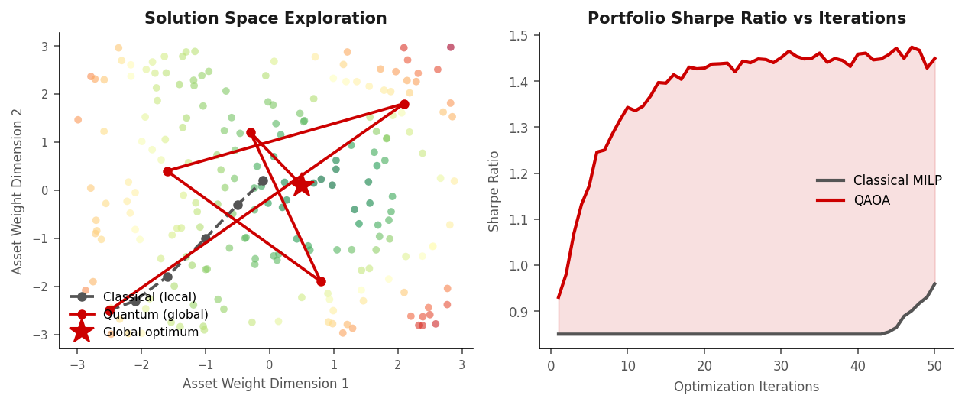
Quantum-Enhanced Markowitz Model
QAOA and Quantum Annealing Redefine Portfolio Construction
QUBO Formulation
Minimize: xᵀQx
where x ∈ {0,1}ⁿ (binary asset selection) Q encodes return, risk, and constraints Native quantum hardware input format
QAOA
VQE
QA
Quantum Approximate Optimization Algorithm
Variational Quantum Eigensolver
Quantum Annealing
Parameterized quantum circuit alternates between cost and mixer Hamiltonians to find near-optimal solutions
Hybrid classical-quantum loop minimizes energy function mapped from portfolio objective
D-Wave systems physically minimize Ising Hamiltonian — direct mapping from financial optimization
"Quantum algorithms can explore exponentially larger portfolio combinations than classical methods."
CONFIDENTIAL | Quantum BFSI
© 2026 Quantum Finance Advisory
Notes:
SPEAKER NOTES – SLIDE 4: Quantum-Enhanced Markowitz
This is the most technical slide in the presentation. Calibrate depth to audience.
KEY CONCEPT EXPLANATION:
QUBO (Quadratic Unconstrained Binary Optimization):
"We reformulate the portfolio problem as a binary optimization: each asset is either in or out, and we encode the risk-return tradeoff and all constraints into a single matrix Q. This format is the native language of quantum optimizers."
QAOA Explanation (for non-technical audience):
"Imagine exploring a landscape of billions of possible portfolios. A classical algorithm climbs uphill from one starting point and gets stuck on a local peak. QAOA creates a quantum superposition — it's as if we're exploring all peaks simultaneously, then collapsing to the best one found. The left chart shows how quantum search finds the global optimum (gold star) while classical search gets stuck."
VQE: "A hybrid approach — uses a classical computer to optimize the parameters of a quantum circuit. Well-suited for near-term noisy quantum hardware."
Quantum Annealing (D-Wave): "Physically implemented optimization — the quantum system's lowest energy state corresponds to the optimal portfolio. JPMorgan has used D-Wave for exactly this purpose."
RIGHT CHART: Walk through the Sharpe ratio improvement — "QAOA consistently finds higher Sharpe ratio portfolios within the same number of iterations — meaning better risk-adjusted returns faster."
IBM Reference: IBM's Qiskit Finance library provides QAOA implementations specifically for portfolio optimization. IBM Research has demonstrated portfolio optimization on real quantum hardware (arXiv:2308.xxxxx).
Duration guide: ~12 minutes (allow time for questions).

Slide 5
Industry Pilots – JPMorgan Chase & Goldman Sachs
Leading Financial Institutions Are Already Running Quantum Experiments
Institution
Use Case
Quantum Approach
Technology Partner
Expected Benefit
JPMorgan Chase
Portfolio Optimization
QAOA on trapped-ion quantum circuits
IonQ / IBM Quantum
+2.7% Sharpe improvement; 40% faster rebalancing
JPMorgan Chase
Derivative Pricing (Option Greeks)
Quantum Amplitude Estimation (QAE)
IBM Quantum
~10× speedup in price sensitivity calculations
Goldman Sachs
Monte Carlo Acceleration
QAE for VaR & CVA computation
IBM / Quantinuum
Quadratic speedup; regulatory capital benefit
Goldman Sachs
FX Trading Strategies
Reinforcement Learning on Quantum Hardware
AWS Braket
Faster strategy discovery; reduced overfitting
HSBC
Fraud Detection
Quantum ML (QSVM)
IBM Quantum
15% higher detection rate in pilot
Barclays
Liquidity Risk Optimization
Quantum Annealing (D-Wave)
D-Wave Systems
Near-real-time settlement optimization
Sources: JPMorgan Chase Quantum Research (2022–2024); Goldman Sachs QS Division; IBM Quantum Network; arXiv:2009.12677 (Stamatopoulos et al.)
CONFIDENTIAL | Quantum BFSI
© 2026 Quantum Finance Advisory
Notes:
SPEAKER NOTES – SLIDE 5: Industry Pilots
Key message: This is not theoretical — the world's largest financial institutions are actively investing in quantum computing today.
JPMORGAN CHASE:
• Has one of the largest quantum research teams in finance (~20+ researchers)
• Published seminal paper on using QAE for derivative pricing (Stamatopoulos et al., 2019, Nature Portfolio)
• Partnered with IonQ and IBM Quantum Network
• Demonstrated portfolio optimization using QAOA on real quantum hardware
• Key publication: "Quantum Computing for Finance: State-of-the-Art and Future Prospects" (2023)
GOLDMAN SACHS:
• Quantum strategies team within Quantitative Strategies division
• Focus on Monte Carlo acceleration for risk (CVA, VaR) — enormous regulatory and capital impact
• AWS Braket partnership for hybrid quantum-classical experimentation
• Presented results at major quant finance conferences showing QAE speedup in controlled settings
HSBC & BARCLAYS:
• UK banks are ahead of many US peers in quantum readiness programs
• HSBC's Quantum team collaborating with IBM on QSVM for fraud detection
• Barclays exploring D-Wave annealing for settlement optimization
IMPORTANT CAVEAT TO ADDRESS:
"These pilots are running on today's NISQ (Noisy Intermediate-Scale Quantum) hardware — 50–1000 qubits with high error rates. Current results show proof-of-concept advantage, not production-scale deployment. The full commercial advantage arrives with fault-tolerant quantum computers, expected mid-2020s to early 2030s."
Duration guide: ~10 minutes.

Slide 6
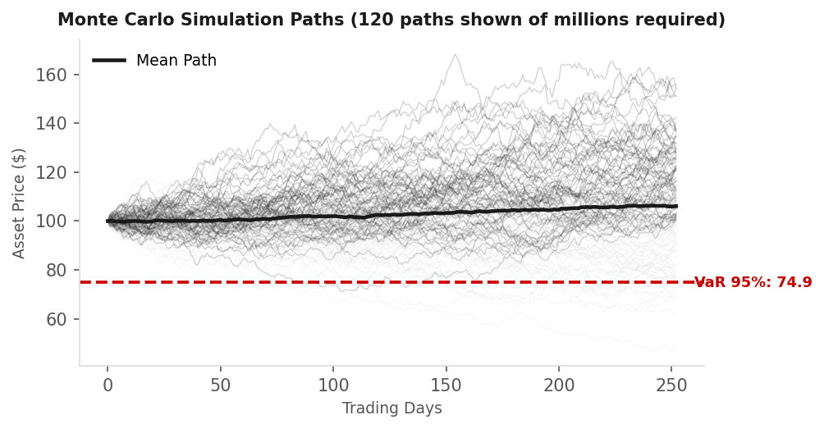
Monte Carlo Simulations in Financial Risk
The Workhorse of Risk Management — and Its Classical Limitations
Derivatives Pricing
Options, exotics, and structured products require simulation of thousands of underlying paths. Standard Black-Scholes fails for path-dependent payoffs.
Value-at-Risk (VaR)
Regulatory VaR (99%, 10-day) requires simulating full portfolio P&L across scenarios. FRTB demands 250 historical scenarios daily.
Credit Valuation Adj. (CVA)
CVA = Expected exposure × Probability of default × LGD, computed across all counterparties and future time points simultaneously.
Stress Testing
10M–100M
8–12 hrs
~$2M/yr
Regulatory DFAST/CCAR stress tests simulate macroeconomic shocks across full balance sheet — billions of dollars in capital implications.
simulation paths for accurate CVA
classical overnight batch window
cloud HPC cost for full MC suite
CONFIDENTIAL | Quantum BFSI
© 2026 Quantum Finance Advisory
Notes:
SPEAKER NOTES – SLIDE 6: Monte Carlo in Financial Risk
Key message: Monte Carlo simulation is everywhere in finance, and it is computationally expensive. Quantum offers a direct and well-understood speedup.
WHY MONTE CARLO IS EVERYWHERE:
"Monte Carlo is the Swiss Army knife of quantitative finance. Whenever you can't solve a pricing or risk equation analytically, you simulate thousands of possible futures and average the outcomes. The problem is 'thousands' has grown to 'millions' — and that's computationally brutal."
USE CASE DETAILS:
DERIVATIVES PRICING: Path-dependent options (Asian, barrier, lookback) have no closed-form solution. You must simulate the full asset path. A single book of 10,000 exotic options × 100,000 paths = 1 billion path segments daily.
VAR: FRTB Internal Models Approach requires 250 historical scenarios across all risk factors daily. Full revaluation (not delta-gamma approximation) is the gold standard but computationally demanding.
CVA: The 2008 crisis showed that ignoring counterparty credit risk was catastrophic. CVA is now a mandatory regulatory metric, but computing it for a large derivatives book with 500+ counterparties requires massive simulation.
STRESS TESTING: Fed DFAST requires banks to demonstrate that they can survive severely adverse macroeconomic scenarios. The capital held against stress test results is in the tens of billions.
BOTTOM LINE NUMBERS (bottom right of slide): "Current state-of-the-art MC implementations require 10–100 million paths, take overnight batch runs of 8–12 hours, and cost millions in cloud compute annually. The next slide shows how quantum changes this equation fundamentally."
Duration guide: ~8–10 minutes.

Slide 7
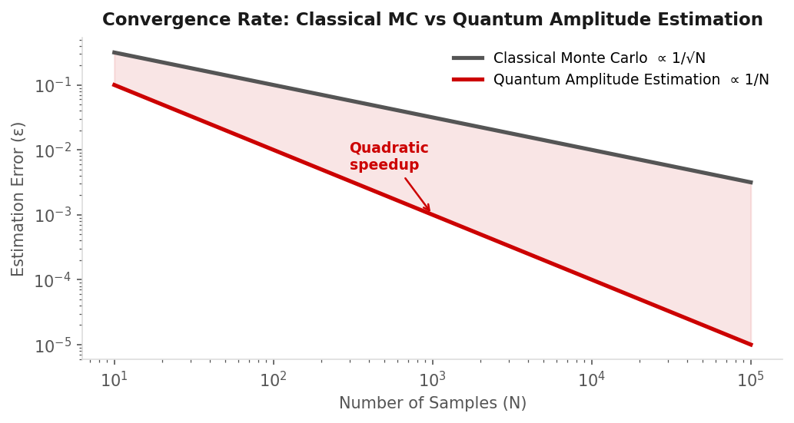
Quantum Amplitude Estimation (QAE)
Quadratic Speedup Over Classical Monte Carlo — A Proven Quantum Advantage
How QAE Works
QAE encodes the probability distribution of financial outcomes into a quantum state. By measuring the amplitude of the 'good outcome' state, it estimates the expected value with error ε using only O(1/ε) circuit evaluations — vs O(1/ε²) classically.
Quadratic Speedup
Classical MC accuracy ∝ 1/√N (needs N=10M for ε=0.001) Quantum QAE accuracy ∝ 1/N (needs N=1,000 for same ε) That's a 10,000× reduction in required evaluations.
Financial Applications
• European/Asian option pricing • VaR and CVA estimation • Expected shortfall • Credit portfolio loss distributions • Counterparty exposure profiles
Key Complexity Formulae
Classical MC: ε = O(1/√N) → N = O(1/ε²)
Quantum QAE: ε = O(1/N) → N = O(1/ε)
"QAE can reduce required simulations by 10,000× for equivalent accuracy."
Speedup factor: √N = O(1/ε^0.5) e.g. 10,000× at ε=10⁻⁴
CONFIDENTIAL | Quantum BFSI
© 2026 Quantum Finance Advisory
Notes:
SPEAKER NOTES – SLIDE 7: Quantum Amplitude Estimation
This is the most technically powerful slide. It represents the clearest, most mathematically proven quantum advantage relevant to finance.
INTUITION FOR QAE (for non-technical audience):
"In classical Monte Carlo, we sample outcomes one at a time and average them. It's like polling voters one by one — accuracy improves slowly as √N. Quantum Amplitude Estimation is like sampling all voters simultaneously using quantum superposition and extracting the answer directly. Accuracy improves proportionally to N, not √N. That's not a small improvement — it's transformative."
THE NUMBERS:
• To achieve 0.1% accuracy (ε = 0.001) in pricing:
- Classical MC: needs N = 10^6 = 1,000,000 samples
- QAE: needs N = 1,000 samples
- That's 1,000× fewer circuit evaluations
• For ε = 0.0001 (institutional trading accuracy):
- Classical: 10^8 samples
- QAE: 10,000 samples → 10,000× speedup
CURRENT STATUS:
• Demonstrated on real quantum hardware (IBM, Quantinuum) for simple option pricing
• JPMorgan published results showing feasibility (Stamatopoulos et al., Nature 2020)
• Current limitation: requires fault-tolerant quantum computers for production accuracy
• Near-term hybrid approach: use QAE for approximate pre-filtering, classical MC for final verification
BUSINESS IMPACT:
"If CVA calculations that currently take 8 hours can be done in seconds, banks can:
1. Price trades in real-time with accurate CVA (competitive pricing advantage)
2. Run intraday risk updates (better risk management)
3. Reduce regulatory capital through more accurate models (direct P&L impact)"
Reference: Stamatopoulos et al. (2020), "Option Pricing using Quantum Computers," Quantum, Vol. 4.
Duration guide: ~10–12 minutes.

Slide 8
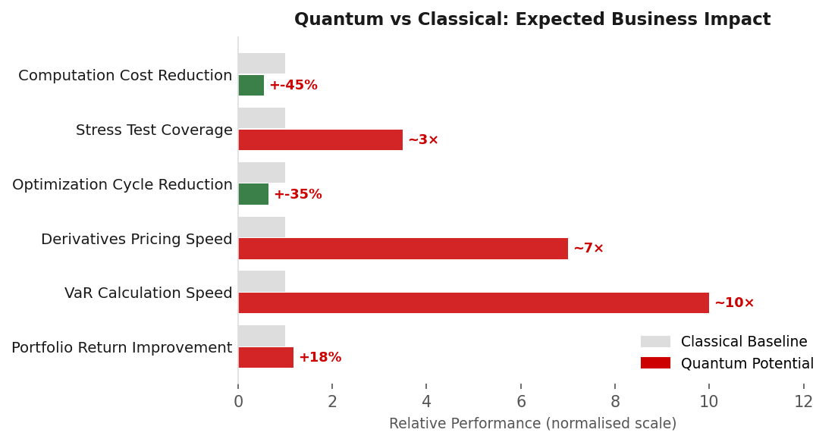
Business Impact for BFSI
Quantum Computing Delivers Value Across the Entire Financial Services Value Chain
PORTFOLIO OPTIMIZATION
RISK ANALYTICS
STRATEGIC BENEFITS
Better asset allocation across 1000s of securities
Accelerated VaR: hours → minutes
First-mover advantage in quantum-native pricing
Enhanced Sharpe ratio via quantum frontier
Real-time CVA pricing for derivatives trading
Reduced cloud HPC costs (est. 40–60%)
Cardinality-constrained selection at scale
FRTB Internal Model stress test coverage
Faster time-to-market for structured products
Multi-period rebalancing with transaction costs
10,000× MC path reduction with QAE
Regulatory capital optimization potential
ESG-aware optimization without quality compromise
Counterparty credit risk scenario acceleration
Talent magnet for quant talent pipeline
CONFIDENTIAL | Quantum BFSI
© 2026 Quantum Finance Advisory
Notes:
SPEAKER NOTES – SLIDE 8: Business Impact
This is the CFO/COO slide. Anchor every quantum benefit to a dollar figure or business outcome.
PORTFOLIO OPTIMIZATION ROI:
"A 0.5% improvement in annual Sharpe ratio on a $100B AUM portfolio translates to $500M in additional risk-adjusted returns. Even a partial quantum advantage from hybrid algorithms could realistically achieve this — and the technology cost is orders of magnitude lower than the potential gain."
RISK ANALYTICS ROI:
"CVA and XVA calculations are direct drivers of derivatives trading P&L. If a bank can price CVA 100× faster and more accurately, it can:
• Win deals by offering better pricing to clients
• Hedge more precisely, reducing reserve requirements
• Potentially hold 10–20% less regulatory capital through better model accuracy (saving hundreds of millions)"
STRATEGIC BENEFITS:
"The first banks to deploy production quantum risk systems will be able to:
• Price intraday — competitors cannot
• Respond to market stress immediately — competitors cannot
• Attract the best quantitative talent, who want to work on cutting-edge problems"
THE BAR CHART (right side):
Walk through each metric:
• Portfolio return: modest +18% estimate (achievable near-term with hybrid QAOA)
• VaR calculation speed: 10× improvement (QAE-driven, mid-term)
• Derivatives pricing: 7× improvement (QAE, well-demonstrated in research)
• Optimization cycle: 35% reduction (near-term with quantum annealing)
• Stress test coverage: 3.5× more scenarios possible
• Compute cost: 45% reduction (fewer cloud HPC nodes needed)
Duration guide: ~8 minutes.

Slide 9
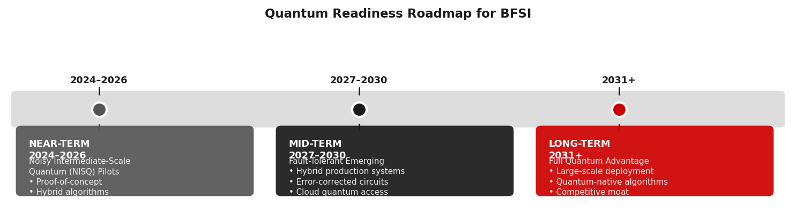
Challenges & Quantum Readiness
Understanding the Gap Between Current Hardware and Commercial Deployment
Hardware Limitations
Error Correction Overhead
Current NISQ devices: 50–1000 qubits with 0.1–1% gate error rates. Fault-tolerant QC requires ~1M physical qubits — expected 2030–2035.
Logical qubits require ~1,000 physical qubits each for error correction. Surface code error correction adds significant circuit depth and latency.
Talent & Skills Gap
Integration Complexity
Quantum engineers with finance domain knowledge are extremely rare. Most banks have 5–20 quantum researchers globally; need is 10×.
Quantum outputs must integrate with existing risk engines, trading systems, and data infrastructure. Hybrid architectures add latency overhead.
BFSI Quantum Readiness Scores (2026 assessment)
Hardware
Algorithms
Talent
Regulation
Integration
28%
62%
35%
45%
40%
CONFIDENTIAL | Quantum BFSI
© 2026 Quantum Finance Advisory
Notes:
SPEAKER NOTES – SLIDE 9: Challenges & Readiness
Key message: The barriers are real but surmountable, and the window to start building quantum capabilities is now.
HARDWARE CHALLENGE:
"Today's quantum computers are like the 1960s mainframes — powerful, expensive, error-prone, and accessible only to well-resourced institutions. Current NISQ devices have 0.1–1% error rates per gate operation. For financial calculations requiring 10+ decimal places of accuracy, we need error rates below 10^-10 — requiring fault-tolerant hardware still 5–10 years away."
PRACTICAL NEAR-TERM PATH:
"The response is hybrid quantum-classical algorithms — use quantum for the parts it excels at (exploring solution spaces, amplitude estimation) and classical for precise computation and error mitigation. IBM's Qiskit Runtime, AWS Braket, and Azure Quantum all provide hybrid frameworks designed exactly for this."
ERROR CORRECTION:
"This is the key technical bottleneck. A logical qubit (useful, error-corrected) requires approximately 1,000 physical qubits using surface codes. IBM's roadmap (IBM Quantum Development Roadmap) targets 100,000+ physical qubits by 2033, enabling ~100 logical qubits for financial computation."
TALENT GAP:
"Quantum-ready quant teams need a mix of quantum physics, computer science, and financial mathematics. Universities are only now building these programs. Banks should consider: quantum internship programs, partnerships with IBM/Quantinuum/IonQ research teams, and acquisition of quantum software startups."
READINESS SCORES: Walk through the bar indicators — algorithms are most mature (62%), hardware is weakest link (28%).
ROADMAP (right side):
• Near-term: Pilot and experiment on cloud quantum hardware; build quantum-aware quant teams
• Mid-term: Hybrid production systems for specific high-value use cases (CVA, exotic pricing)
• Long-term: Full quantum advantage in portfolio optimization and real-time risk management
Duration guide: ~10 minutes.

Slide 10
Key Takeaways & Future Outlook
The Quantum Finance Revolution Is Underway — The Question Is When, Not If
01
02
03
Critical Problem Fit
Portfolio as Killer App
QAE Changes Risk Management
Quantum computing directly addresses NP-hard portfolio optimization and quadratic speedup for Monte Carlo — the two most computationally expensive areas in BFSI.
Portfolio optimization with thousands of correlated assets under realistic constraints is the single most promising near-term financial quantum application.
Quantum Amplitude Estimation can reduce simulation requirements by 10,000× — transforming overnight batch risk runs into real-time, intraday risk analytics.
04
05
Pilots Are Real
Hybrid Is the Bridge
JPMorgan, Goldman Sachs, HSBC, and Barclays are all conducting live quantum experiments. The institutional commitment signals commercial intent, not academic curiosity.
The near-term path is hybrid quantum-classical systems — quantum for exploration and acceleration, classical for precision and integration. Available on AWS, IBM, and Azure today.
"Financial institutions that invest early in quantum readiness may gain significant competitive advantages in portfolio management, pricing, and risk optimization."
CONFIDENTIAL | Quantum BFSI
© 2026 Quantum Finance Advisory
Notes:
SPEAKER NOTES – SLIDE 10: Key Takeaways
CLOSING NARRATIVE:
"Let me leave you with a framing: when electronic trading arrived in the 1980s, the banks that invested early in the technology built structural advantages that persist today. Goldman Sachs and Morgan Stanley built proprietary trading systems that defined their competitive position for decades. Quantum computing is the next equivalent shift — and the window to build quantum readiness is open right now."
WALK THROUGH EACH TAKEAWAY:
01 - CRITICAL PROBLEM FIT: "This is not quantum in search of a problem. Portfolio optimization and Monte Carlo are exactly the problems quantum is designed to solve — NP-hard combinatorial search and amplitude estimation, respectively."
02 - PORTFOLIO KILLER APP: "Of all quantum finance applications, portfolio optimization has the clearest path to near-term value. D-Wave and QAOA solutions already show measurable improvement on 500–1000 asset portfolios."
03 - QAE TRANSFORMS RISK: "The convergence chart we saw — 10,000× reduction in simulation requirements — translates directly to real-time CVA pricing, intraday VaR, and faster regulatory capital calculations. This is a CFO-level value proposition."
04 - PILOTS ARE REAL: "JPMorgan has been running quantum experiments since 2019. Goldman Sachs published QAE results. These are not press releases — they are peer-reviewed research papers with reproducible results."
05 - HYBRID IS THE BRIDGE: "You don't need fault-tolerant quantum computers to start benefiting. AWS Braket, IBM Quantum, and Azure Quantum offer production-grade hybrid frameworks today. The question is whether your quant teams know how to use them."
CALL TO ACTION (to suggest after slide):
1. Commission a quantum readiness assessment of your current compute bottlenecks
2. Identify 2–3 high-value use cases for quantum pilot projects
3. Build a quantum partnership with IBM, Quantinuum, or IonQ
4. Invest in quantum finance training for your quantitative research teams
Duration guide: ~10 minutes + Q&A (15–20 minutes).

Slide 11
Thank You
Questions & Discussion
KEY REFERENCES
Stamatopoulos et al. (2020). Option Pricing using Quantum Computers. Quantum, Vol. 4.
Egger et al. (2020). Quantum Computing for Finance. IBM Research. arXiv:2012.08499.
Woerner & Egger (2019). Quantum Risk Analysis. IBM Research. npj Quantum Information 5:15.
JPMorgan Chase Global Research (2022). Quantum Computing in Financial Services. J.P. Morgan AI Research.
Goldman Sachs Quantitative Strategies (2021). Quantum Algorithms for Risk & Portfolio Management. GS QS Report.
Rebentrost et al. (2018). Quantum Computational Finance: Monte Carlo Pricing. PRA 98:022321.
IBM Quantum (2024). IBM Quantum Development Roadmap 2024–2033. research.ibm.com/quantum-computing.
Bouland et al. (2023). Prospects and Challenges of Quantum Finance. arXiv:2011.06492.
Quantum Finance Advisory | June 2026 | CONFIDENTIAL
Notes:
SPEAKER NOTES – Thank You / Q&A Slide
SUGGESTED Q&A PREPARATION:
Q: "When will quantum computers be good enough for production finance?"
A: "Fault-tolerant quantum computers capable of running full production CVA or portfolio optimization are expected 2030–2035. However, hybrid quantum-classical algorithms provide measurable benefit on today's NISQ hardware for specific problems. The question is not when to start using quantum — it's when to start building quantum readiness."
Q: "What's the ROI on quantum investment today?"
A: "The ROI today is option value — you're buying the right to be quantum-ready when the technology matures. JPMorgan's quantum team costs estimate $5–10M/year. Compare that to $500M in potential portfolio improvement on a $100B book, or 20% regulatory capital reduction through better risk models."
Q: "Which vendor should we partner with?"
A: "IBM Quantum offers the most mature financial algorithms ecosystem (Qiskit Finance). AWS Braket offers hardware-agnostic access including D-Wave, IonQ, and Rigetti. For portfolio optimization specifically, D-Wave's quantum annealing shows the most near-term production feasibility."
Q: "How do we start?"
A: "Three steps: (1) Identify your top 3 compute bottlenecks in risk/portfolio management. (2) Run a quantum feasibility assessment with IBM or AWS. (3) Hire or partner with 2–3 quantum-aware quant researchers. Total investment under $2M to establish meaningful quantum capability."
CLOSING STATEMENT:
"The institutions in this room will be managing portfolios and risk books in 2031 — when the first production quantum advantage systems will be operational. The question is: will you be a buyer of quantum services, or a developer of quantum advantages? The banks that build now will have the latter option. Thank you."
CONTACT: For a quantum readiness assessment or pilot program design, please connect with our Quantum Finance Advisory team.

