Slide 1

Online Chabot-Based Ticketing System for Museums
MINOR PROJECT-II
AD-608
Problem Statement: Chabot-Based Ticketing System for Museums
Project Group Number: 18
Group Member Details:
Sanjana Lodhi 0187AS221053
Vandana Yadav 0187AS221064
Sonu Kushwah 0187AS221060
Guide Details: Dr. Vasima Khan

Slide 2
Idea/Approach Details
Abstract:
The AI-powered chatbot automates museum ticket booking by collecting user details, processing reservations, and providing instant confirmations. Built with Flask and MySQL, it ensures secure data handling, seamless communication, and an efficient booking experience.
Solution and Prototype :
The AI-powered chatbot automates museum ticket bookings by interacting with users, collecting details, and providing instant confirmations. Built with Flask and MySQL, it ensures secure data storage, seamless communication, and a user-friendly experience, making the booking process efficient and accessible 24/7.
Technology stack here:
Programming Language - Python
Python is widely used for web development,
automation, and AI-driven applications. It
provides a rich ecosystem of libraries and
frameworks, making it ideal for building
interactive chatbots. Framework :
Flask is a lightweight and flexible web framework used for developing the chatbot’s backend. It enables seamless integration with MySQL for data storage, ensuring efficient booking management and user interaction.
.

Slide 3

Project Requirements
Functional requirements
Non functional requirements
User Interaction: The chatbot should interact with users to collect booking details such as name, email, phone number, and the number of visitors.
Ticket Booking: Users should be able to request and confirm museum ticket bookings through the chatbot.
Real-time Responses: The chatbot should provide instant responses and confirmations for user queries and bookings.
Performance: The chatbot should provide fast responses with minimal latency to ensure a smooth user experience.
Scalability: The system should handle multiple user requests simultaneously without performance degradation.
Usability: The chatbot should have a user-friendly interface with simple and intuitive interactions..

Slide 4
Project Requirements
Hardware and software requirements
Software Requirements:--
Storage: Adequate storage space to store user booking data and chatbot logs in MySQL.
Programming Environment: Install a Python environment with necessary libraries like Flask, MySQL Connector, and requests.
Machine Learning Frameworks: Install machine learning frameworks like Flask.
Operating System : Choose an operating system for the server or cloud infrastructure where the system will run. Common choices include Linux distributions (e.g., Ubuntu, CentOS) or cloud-based platforms (e.g., AWS, Azure, Google Cloud).

Slide 5
Design
Data Preprocessing diagram
Data Collection
Check missing values
Feature section
Encoding
Data Distribution
Split the data
Train model

Slide 6
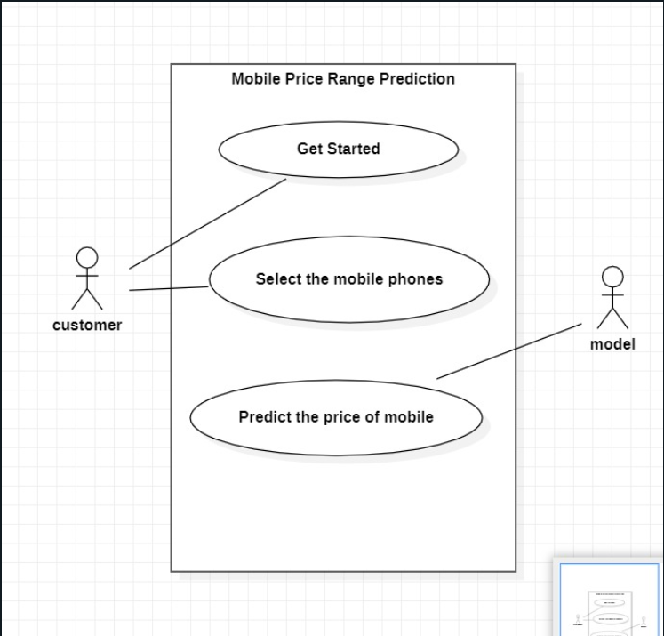
Design
Use Cases
Dependencies and Show stopper
Dependencies :-
Web Framework :If the system includes a web interface, it depends on a web framework like Flask.
Data Sources: Data collection relies on external sources, such as e-commerce websites and data providers.
Machine Learning Libraries: Ensuring compatibility and managing updates for these libraries is essential to keep the models functioning correctly.
Show stopper:--
Model Overfitting: : Overfitting occurs when the model fits the training data too closely, resulting in poor generalization.
Data Quality Issues: Implement rigorous data preprocessing and validation to minimize data quality issues. Continuously monitor data sources for changes.
Scalability Challenges: Plan for scalability from the start, using load balancing and cloud resources to handle increased demand.

Slide 7
Deployment Details
Deployment Details
Continuous Monitoring: Regularly review and analyze monitoring data to identify performance bottlenecks and areas for improvement.
Documentation: Maintain detailed documentation for deployment procedures, configurations, and troubleshooting steps to assist in system management and maintenance.
User Access and Authentication: Implement user access control and authentication mechanisms to protect user data and the system's functionalities.
Testing and Staging Environments: Maintain separate testing and staging environments to validate changes and updates before deploying to the production environment.

Slide 8
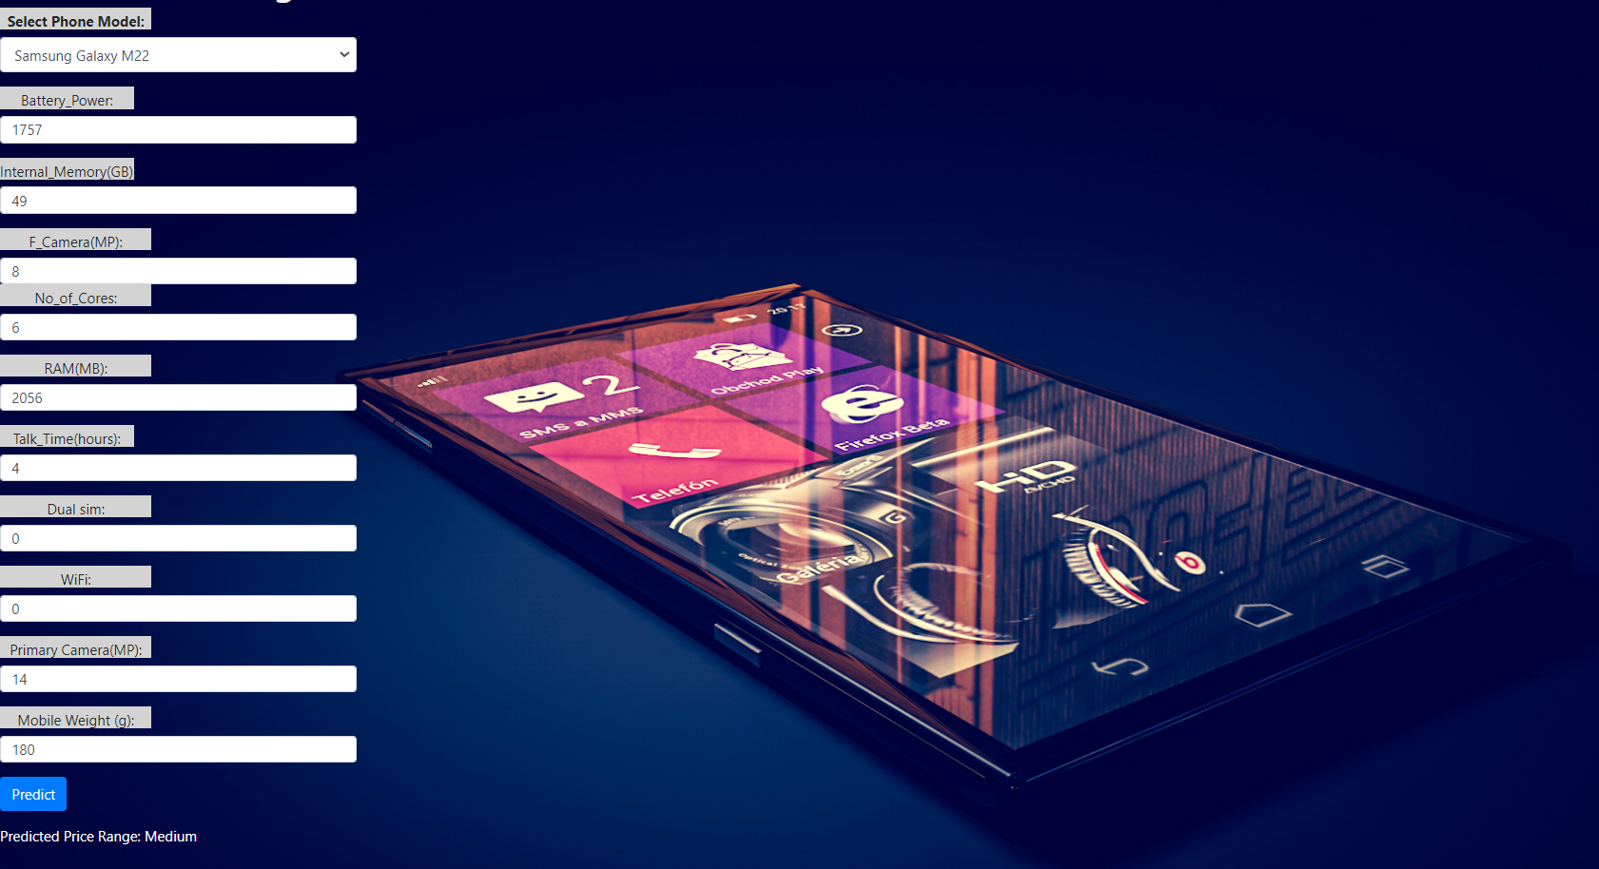
Output Screen

Slide 9


Slide 10
Important Pointers
Please ensure below pointers are met while
Kindly keep the maximum slides limit to 10 pages
All the topics should be utilized for description of your idea
Try to avoid paragraphs and post your idea in points
Keep your explanation precisely and easy to understand
Delete Important Pointers slide After Creating a Presentation

