Slide 1


OUR TEAM: VANDANA YADAV (0187AS221064) SANJANA LODHI (0187AS221053)
Minor Project - I AD- 508
Problem Statement
Design and Development of Breast Cancer Prediction
Project Group Number: 05
OUR GUIDE:
PROF. RUCHI JAIN
(ASSISTANT PROFFESSOR)

Slide 2


Introduction
This system is designed to use machine learning to help predict breast cancer detection. Early detection saves lives. Get started by predicting breast cancer. Breast cancer is cancer that forms in the cells of the breast. After skin cancer, breast cancer is the most common cancer diagnosed in women.

Slide 3


Idea / Approach Details
The project focuses on developing a machine learning model to predict breast cancer based on medical data, aiming to assist in early diagnosis.
The approach involves using a dataset like the Breast Cancer Dataset, preprocessing the data(handling missing values), and selecting important features for prediction.
Models such as Logistic Regression are trained, test and evaluated using metrics like accuracy, precision and recall.
Model performance is analyzed, and insights into feature importance are drawn. The project can potentially be expanded for real-world application in healthcare diagnostic tools.

Slide 4

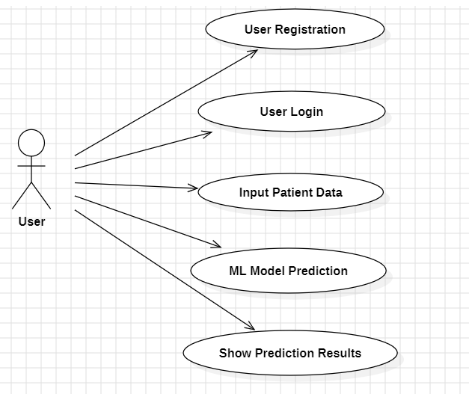
Use Case Diagram

Slide 5
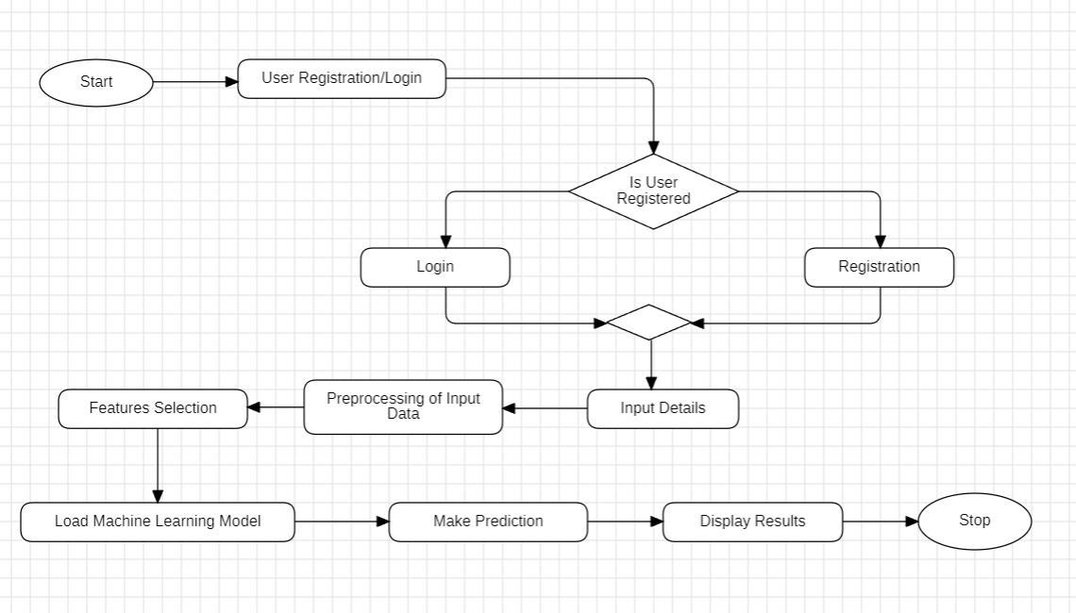
Flow Chart

Slide 6
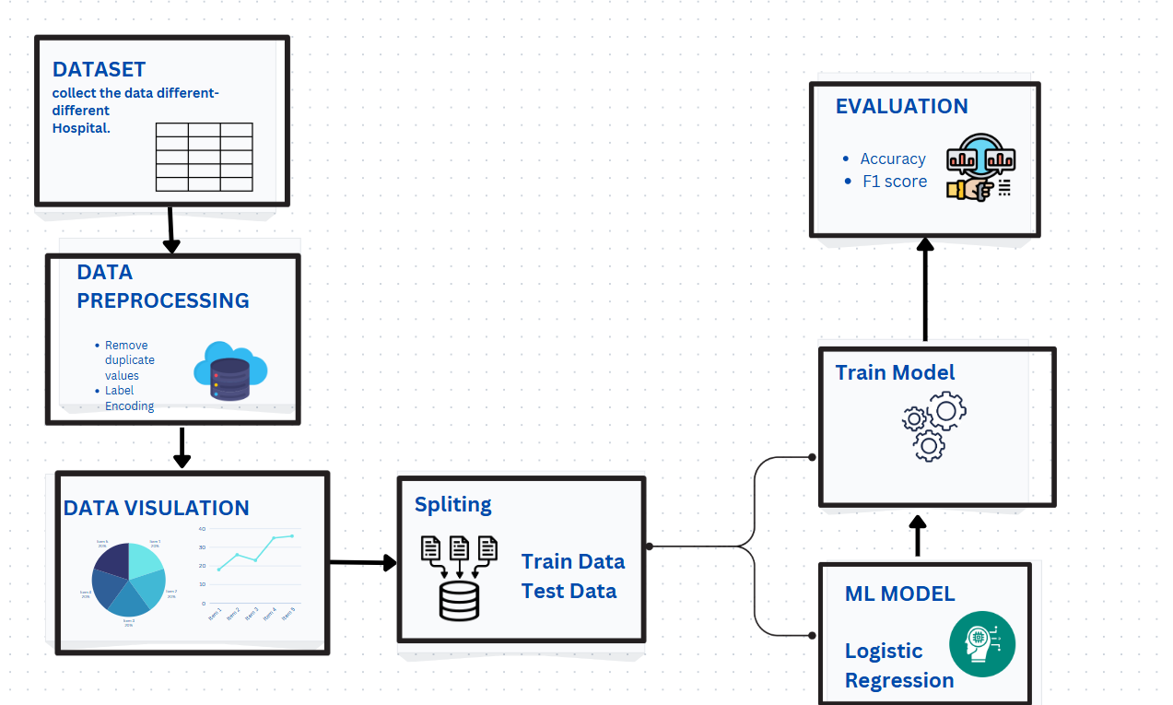
ML Model

Slide 7

Abstract
Breast cancer is a serious health concern, and early detection is crucial for successful treatment.
The main aim is to improve how we detect breast cancer early or find better treatments for it.
3. The website provides a user- friendly platform for users to
access the prediction tool.

Slide 8







Technology
4

Slide 9
Requirements
Functional: User registration (register,login) register data store in database . It should train machine learning models (e.g., Logistic Regression) and predict whether the cancer is benign or malignant.
Non Functional:
The system should provide
accurate predictions with at
least 90% accuracy.
It must ensure fast prediction,
particularly if handling
sensitive medical information.
5

Slide 10

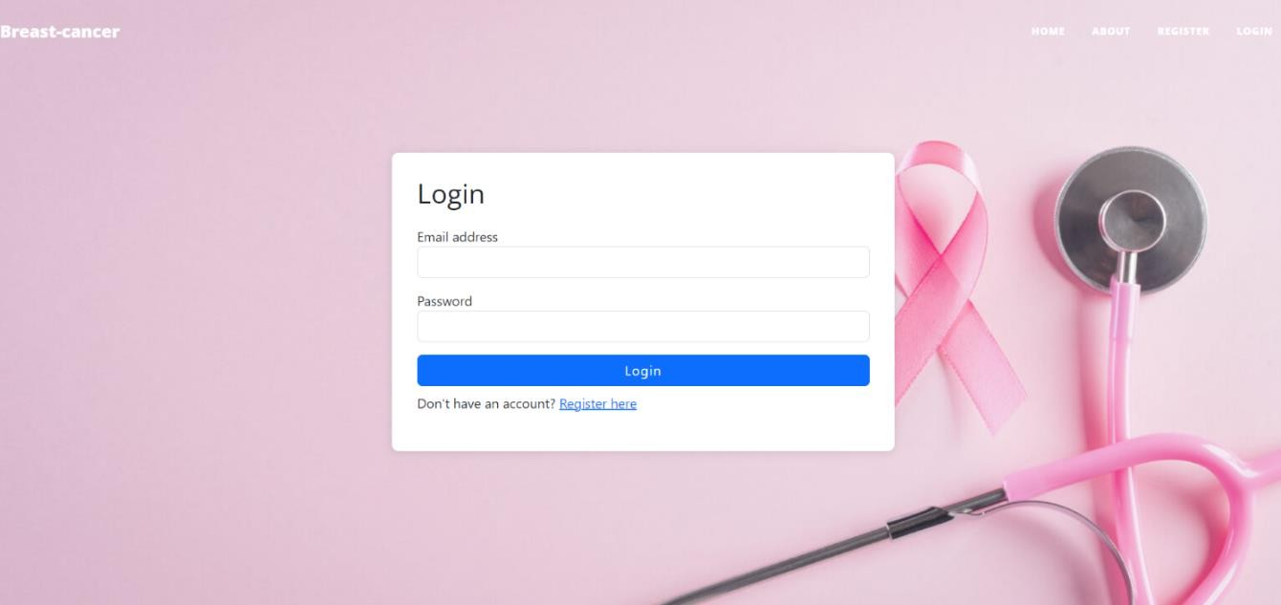
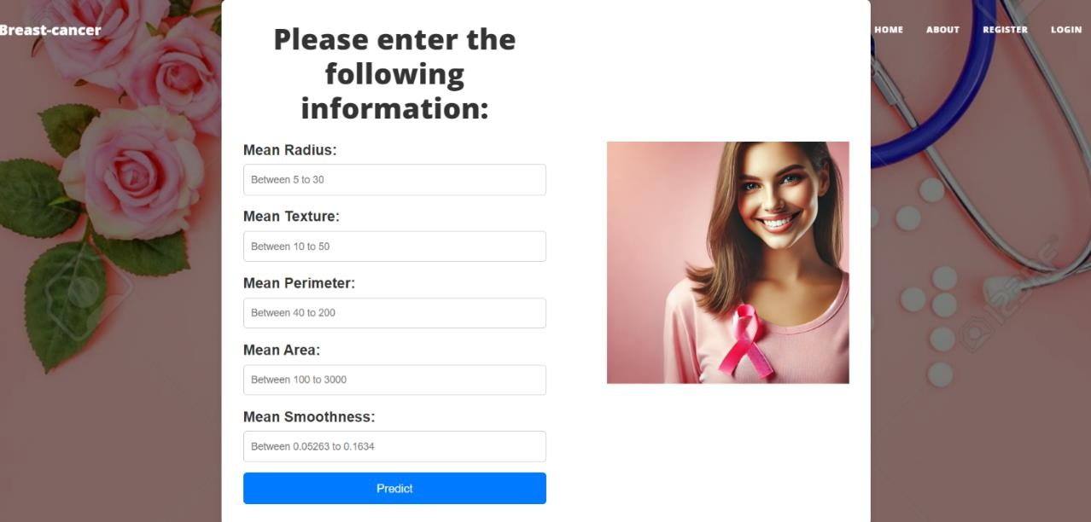
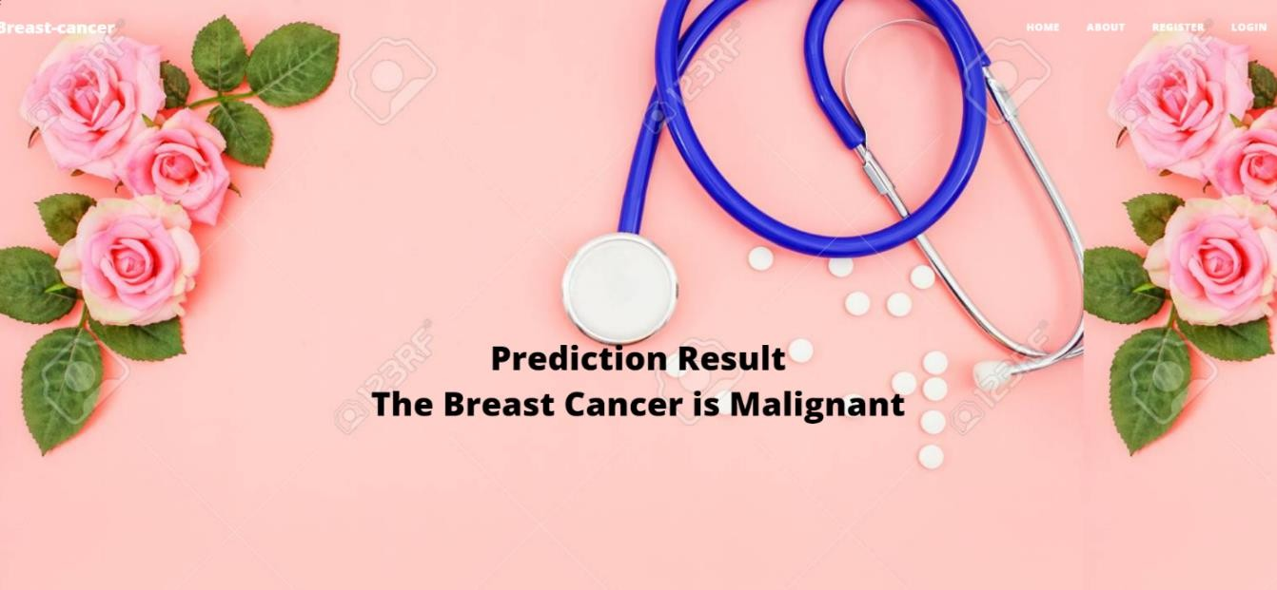
Frontend Screenshots
6

Slide 11
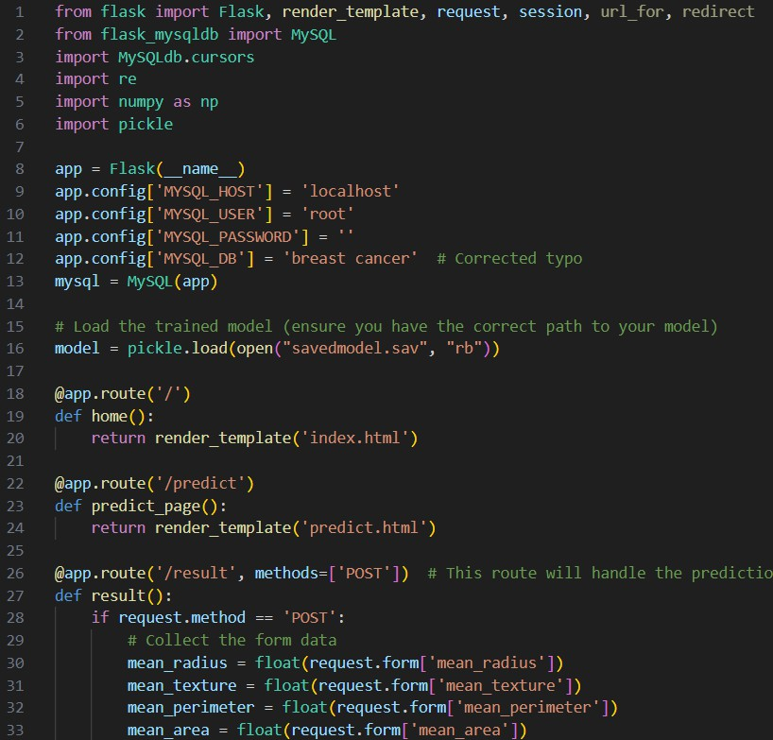
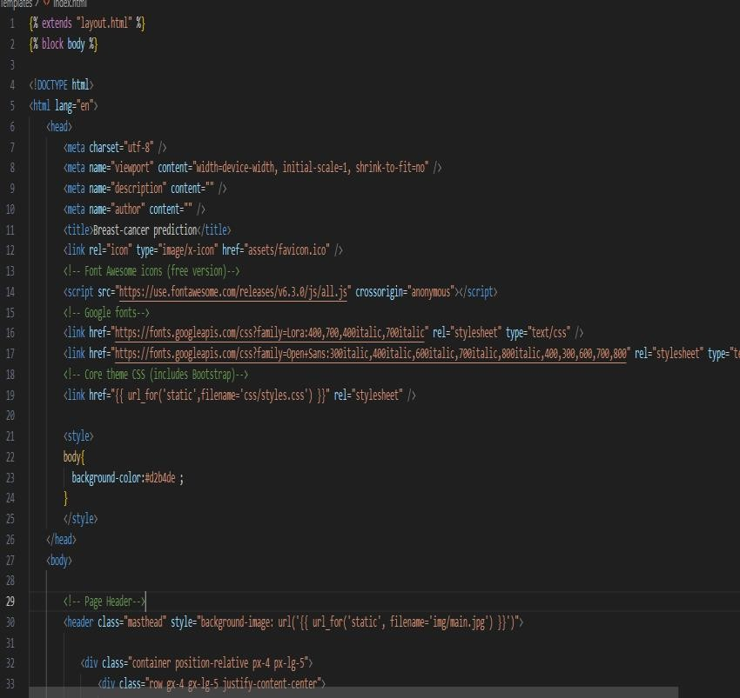
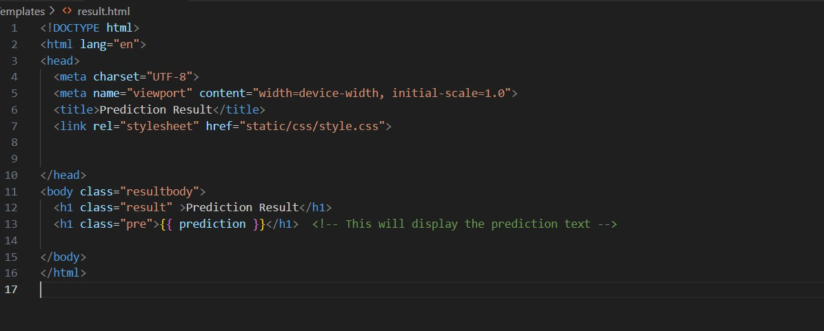
Backend Screenshots
7

Slide 12

9

