Slide 1



Breast Cancer Prediction System
1

Slide 2


The project focuses on developing a machine learning model to predict breast
cancer based on medical data, aiming to assist in early diagnosis. The
approach involves using a dataset like the Wisconsin Breast Cancer Dataset, preprocessing the data (handling missing values, normalization), and selecting important features for prediction. Various models, such as Logistic Regression, Random Forest, or SVM, are trained and evaluated using metrics like accuracy, precision, recall, and ROC-AUC. Model performance is analyzed, and insights into feature importance are drawn. The project can potentially be expanded for real-world application in healthcare diagnostic tools.

Slide 3






Early Detection
2
Machine Learning
Machine learning algorithms are used to analyze large datasets and identify patterns associated with breast cancer risk.
1
Breast cancer is a serious health concern, and early detection is crucial for successful treatment.
3
Web Application
The website provides a user- friendly platform for users to access the prediction tool.

Slide 4








4

Slide 5




Functional
NonFunctional
The system should provide accurate predictions with at least 90% accura
It must ensure data security,
particularly if handling sensitive medical
information.
The system should accept medical data (tumor features) and preprocess it (handling missing values,normalization).
It should train machine learning models (e.g., Logistic Regression, Random Forest) and predict whether the tumor is benign or malignant.
5

Slide 6

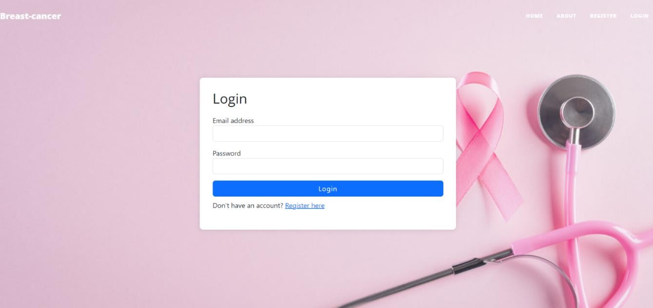
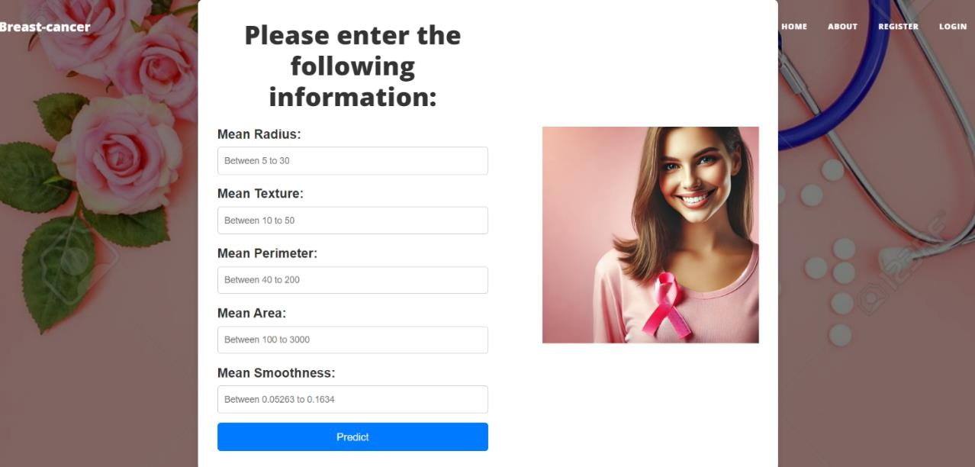

6

Slide 7
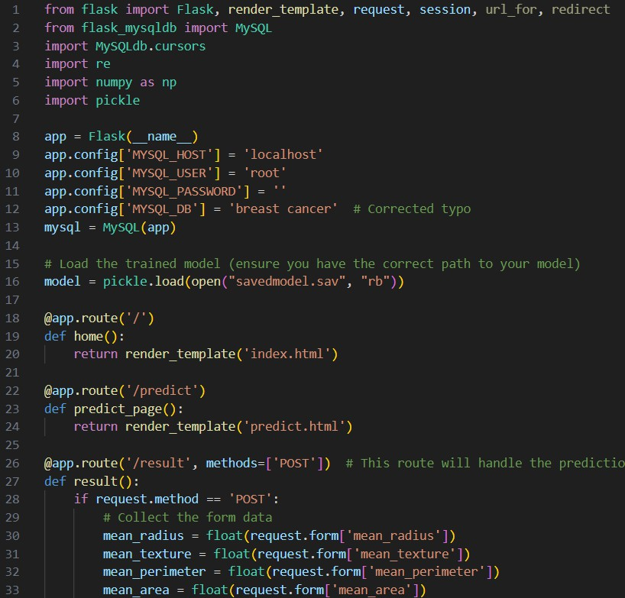
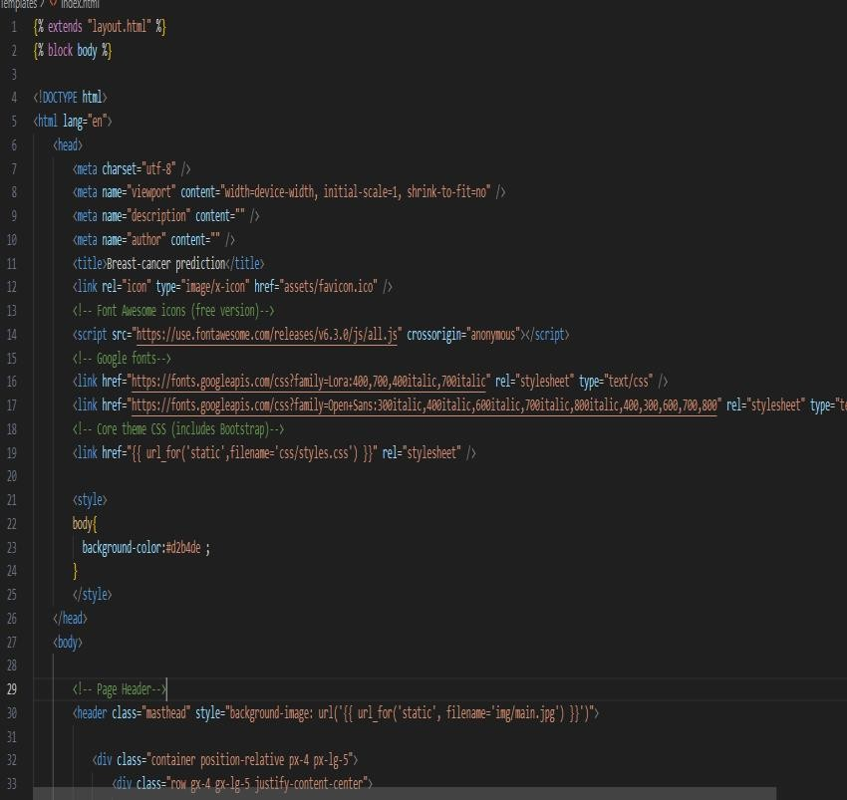
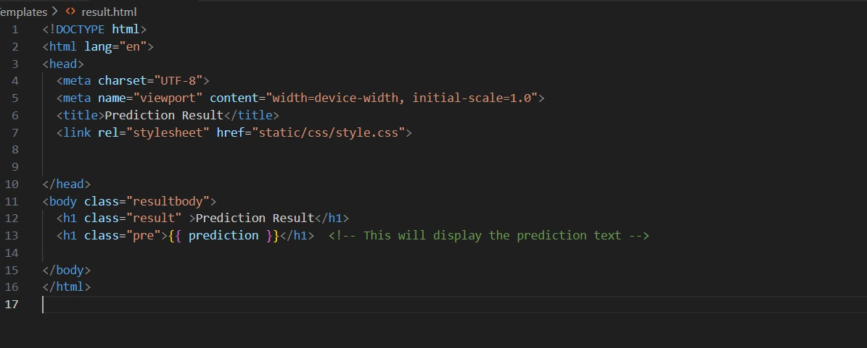
7

Slide 8








SANJANA LODHI (017AS221053) VANDANA YADAVA(017AS221064)
PROF. RUCHI JAIN
8

Slide 9

9

