Slide 1
TIME SERIES ANALYSIS

Slide 2
TIME SERIES ANALYSIS
In this class, we’ll discuss analyzing data that is changing over time.
In most of our previous examples, we didn’t care which data points were collected earlier or later than others.
We made assumptions that the data was not changing over time.
This class will focus on statistics around data that is changing over time and how to measure that change.
Notes:
The idea of looking at data that changes over time
Arima model – specific for time series data

Slide 3
INTRODUCTION
WHAT IS TIME SERIES DATA?

Slide 4
WHAT IS TIME SERIES DATA?
Time series data is any data where the individual data points change over time.
This is fairly common in sales and other business cases where data would likely change according to seasons and trends.
Time series data is also useful for studying social phenomena. For instance, there is statistically more crime in the summer, which is a seasonal trend.
Notes:
There is a time aspect to every single data point
More crime in the summer

Slide 5
WHAT IS TIME SERIES DATA?
Time series analysis is useful in many fields: sales analysis, stock market trends, studying economic phenomena, social science problems, etc.
Typically, we are interested in separating the effects of time into two components:
Trends - significant increases or decreases over time
Seasonality - regularly repeating increases or decreases
Notes:
Typically we’re in terested in trends and seasonality (is there a pattern in the data)

Slide 6
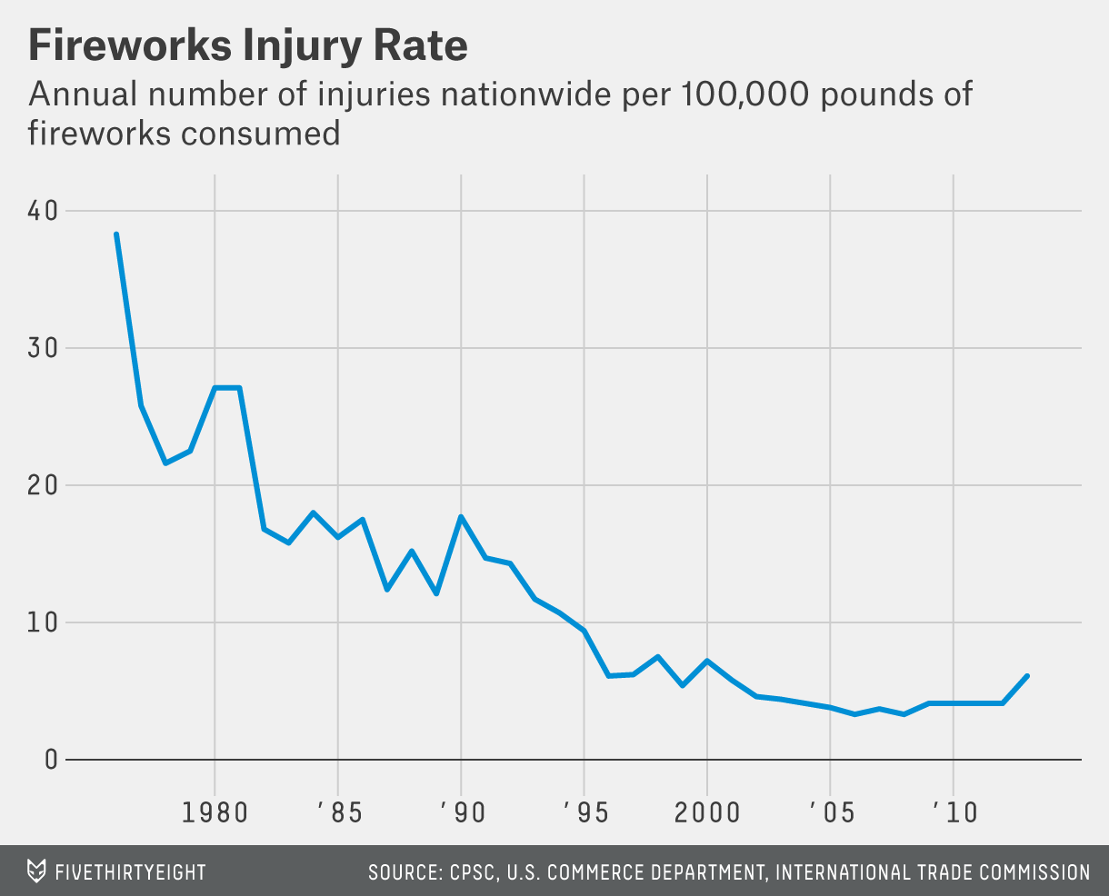
WHAT IS TIME SERIES DATA?
This plot of fireworks injury rates has an overall trend of fewer injuries with no seasonal pattern.
Notes:
Thend downwards

Slide 7
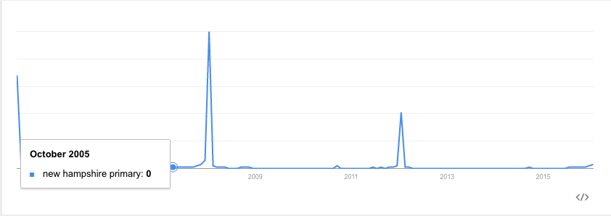
WHAT IS TIME SERIES DATA?
Meanwhile, the number of searches for the New Hampshire Primary has a clear seasonal component - it peaks every four years and on election years.

Slide 8
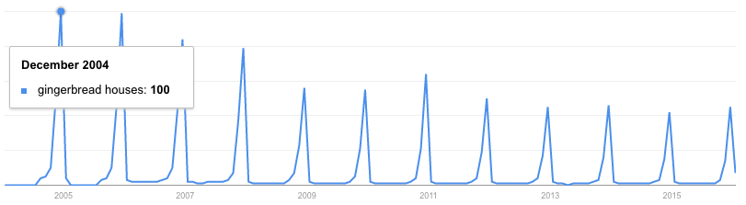
WHAT IS TIME SERIES DATA?
Similarly, searches for ‘gingerbread houses’ spike every year around the holiday season.
These spikes recur on a fixed time-scale, making them seasonal patterns.

Slide 9
WHAT IS TIME SERIES DATA?
These aperiodic patterns are called cycles.
While identifying aperiodic cycles is important, they are often treated differently than seasonal effects. Seasonal effects are useful for their consistency, since prior data is useful as a predictor.
Notes:
Seasonality asks if there is a cycle
Media attention (tv show/olympics) has seasonal trends
Economic growth

Slide 10
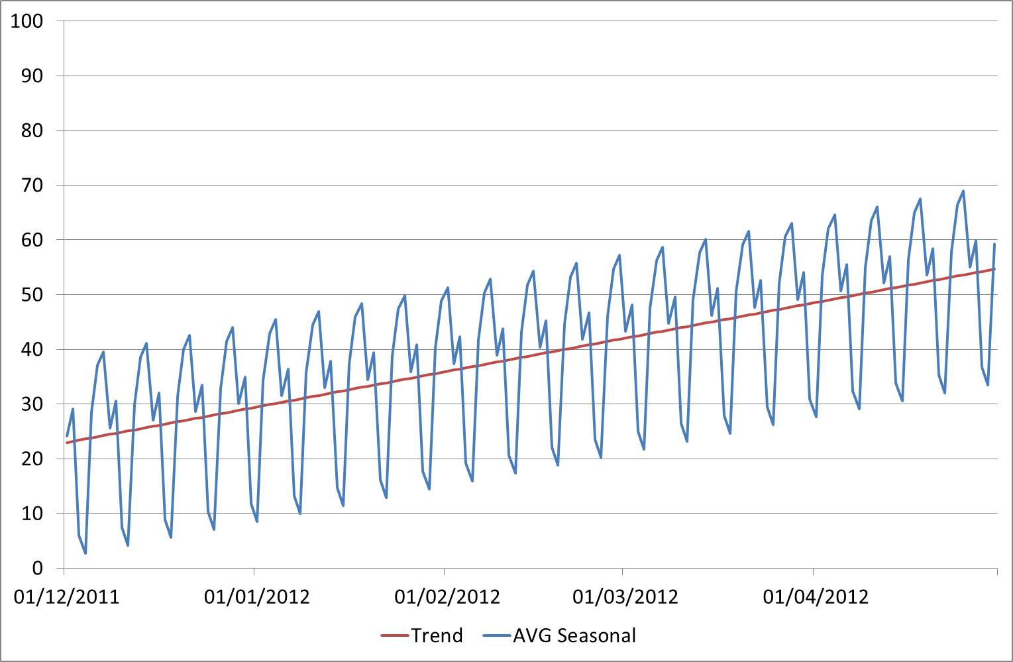
WHAT IS TIME SERIES DATA?
Most often, we’re interested in studying the trend and not the seasonal fluctuations.
Therefore it is important to identify whether we think a change is due to an ongoing trend or seasonal change.
Notes:
Here we have both a trend and a cycle (a pattern)

Slide 11
INTRODUCTION
COMMON ANALYSIS FOR TIME SERIES DATA

Slide 12
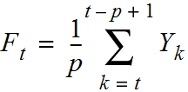
MOVING AVERAGES
A moving average replaces each data point with an average of k consecutive data points in time.
Typically, this is k/2 data points prior to and following a given time point, but it could also be the k preceding points.
These are often referred to as the “rolling” average.
The measure of average could be mean or median.
The formula for the rolling mean is
Notes:
Moving average- avg of data points around a certain point
if everyday we take the total # of tweets for GOT – Tuesday will be avg of the last 7 days, wed will be the avg off the last 7 days as well
Use a # k to see how many points you go back
“going back in time a couple of points, adding up all the points since then and dividing by the number”

Slide 13
PROPERTIES FOR TIME-SERIES PREDICTION
A moving average is an average of p surrounding data points in time.
… to t - p + 1. This includes t, t + 1, t + 2, …, t-p, t-p+1.
Divide by the p surrounding data points
Get the p points from t ...
Notes:
Cant have a moving avg on non time specific data
ROLLING AVG only make sense to smooth out ata that is changing over time

Slide 14
MOVING AVERAGES
A rolling mean would average all values in the window, but can be skewed by outliers (extremely small or large values).
This may be useful if we are looking to identify atypical periods or we want to evaluate these odd periods.
For example, this would be useful if we are trying to identify particularly successful or unsuccessful sales days.
The rolling median would provide the 50 percentile value for the period and would possibly be more representative of a “typical” day.

Slide 15
AUTOCORRELATION
In previous classes, we have been concerned with how two variables are correlated (e.g. height and weight, education and salary).
Autocorrelation is how correlated a variable is with itself. Specifically, how related are variables earlier in time with variables later in time.
Notes:
Autocorrelation looks at both seasonal patterns and trends but is better in seasonal pattersns
corr – meaning that data depending on what the data was before (if strong correlation – that’s a trend)
if you increase the lag (how far in the future you’re looking) and now have a correlation – that implies a seasonal pattern
Moving avgs are good at predicting trends

Slide 16
AUTOCORRELATION
To compute autocorrelation, we fix a “lag” k. This is how many time points earlier we should use to compute the correlation.
A lag of 1 computes how correlated a value is with the prior one. A lag of 10 computes how correlated a value is with one 10 time points earlier.
Notes:
K = lag …how far you’re looking in to the past
Finding the correlation of itself and itself in the past

Slide 17
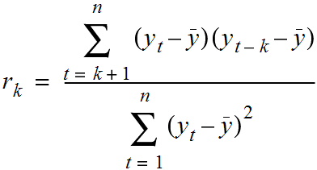
AUTOCORRELATION
The following formula can be used to calculate autocorrelation.

Slide 18
DEMO
EXPLORING ROSSMANN DRUGSTORE SALES DATA

Slide 19
TIME SERIES MODELING

Slide 20
TIME SERIES MODELING
Now let’s advance these techniques to show how to predict or forecast forward from time series data.
With a sequence of values (a time series), we will use the techniques in this class to predict a future value.

Slide 21
TIME SERIES MODELING
There are many times when you may want to use a series of values to predict a future value.
The number of sales in a future month
Anticipated website traffic when buying a server
Financial forecasting
The number of visitors to your store during the holidays

Slide 22
INTRODUCTION
WHAT ARE TIME SERIES MODELS?

Slide 23
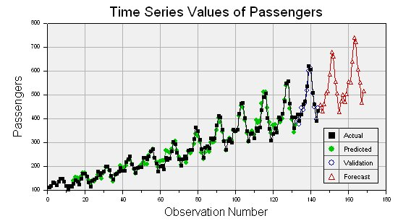
WHAT ARE TIME SERIES MODELS?
Time series models are models that will be used to predict a future value in the time series.
Like other predictive models, we will use prior history to predict the future.
Unlike previous models, we will use the earlier in time outcome variables as inputs for predictions.

Slide 24
WHAT ARE TIME SERIES MODELS?
Like previous modeling exercises, we will have to evaluate the different types of models to ensure we have chosen the best one.
We will want to evaluate on a held-out set or test data to ensure our model performs well on unseen data.

Slide 25
WHAT ARE TIME SERIES MODELS?
Unlike previous modeling exercises, we won’t be able to use standard cross-validation for evaluation.
Since there is a time component to our data, we cannot choose training and test examples at random.
Suppose we did select a random 80% sample of data points for training and a random 20% for testing. What could go wrong?

Slide 26
WHAT ARE TIME SERIES MODELS?
The training dataset would likely contain data from before AND after a test dataset.
This would not be possible in real life (you can’t use future, unseen data points when building your model). Therefore, it’s not a valid test of how our model would perform in practice.

Slide 27
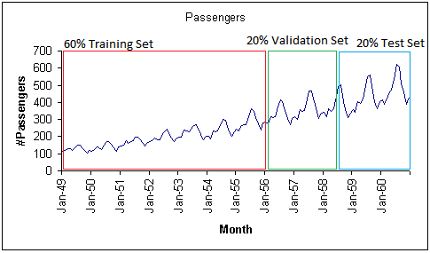
WHAT ARE TIME SERIES MODELS?
Instead, we will exclusively train on values earlier (in time) in our data and test our model on values at the end of the data period.
Notes:
All you have to do is take the training and testing in order
make sure our training data set exists before the testing

Slide 28
PROPERTIES FOR TIME-SERIES PREDICTION
We can use both the moving average and the autocorrelation values to assess how we plan to model our time series.
Typically, for a high quality model, we require some autocorrelation in our data.
We can compute autocorrelation at various lag values to determine how far back in time we need to go.
Notes:
REQUIRE autocorrelation

Slide 29
PROPERTIES FOR TIME-SERIES PREDICTION
Many models make an assumption of stationarity, assuming the mean and variance of our values is the same throughout.
While the values (e.g. of sales) may shift up or down over time, the mean and variance of sales is constant (i.e. there aren’t many dramatic swings up or down).
These assumptions may not represent real world data; we must be aware of that when we are breaking the assumptions of our model.
Notes:
Stationary assumption – no trent (means mean and variance of the model are the same over time)

Slide 30
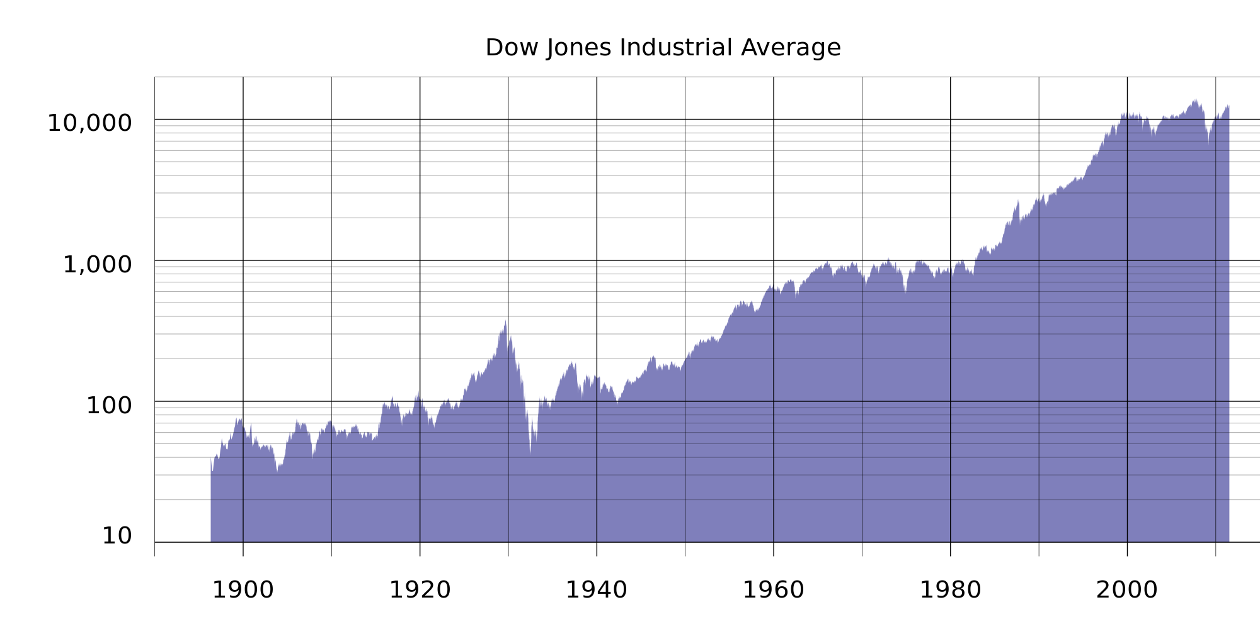
PROPERTIES FOR TIME-SERIES PREDICTION
For example, typical stock or market performance is not stationary. In this plot of Dow Jones performance since 1986, the mean is clearly increasing over time.

Slide 31
PROPERTIES FOR TIME-SERIES PREDICTION
Often, if these assumptions don’t hold, we can alter our data to make them true. Two common methods are detrending and differencing.
Detrending would mean to remove any major trends in our data.
We could do this is many ways, but the simplest is to fit a line to the trend and make a new series that is the difference between the line and the true series.
Notes:
If not stationary (there is a trend) you can either detrend or differencing

Slide 32
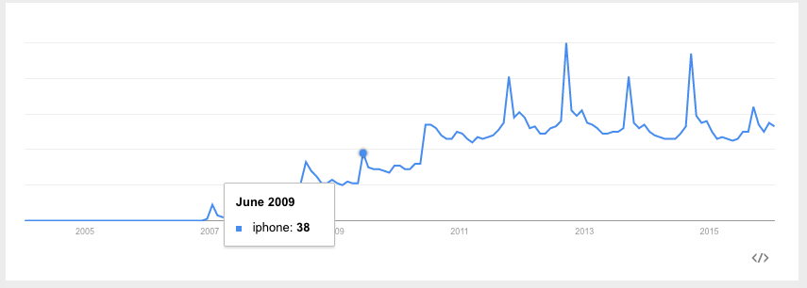
PROPERTIES FOR TIME-SERIES PREDICTION
For example, there is a clear upward (non-stationary) trend in google searches for “iphone”.
If we fit a line to this data first, we can create a new series that is the difference between the true number of searches and the predicted searches.

Slide 33
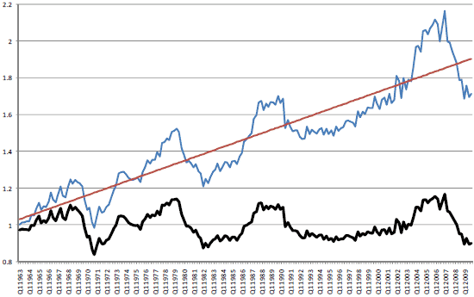
PROPERTIES FOR TIME-SERIES PREDICTION
Below is an example where we look at US housing prices over time. Clearly, there is an upward trend, making the time series non-stationary (ie: the mean house price is increasing).
Notes:
Fit a line and subtract the line from the date
blue – normal data
red – line of best fit
black – blue point minus the red point

Slide 34
PROPERTIES FOR TIME-SERIES PREDICTION
We can fit a line that represents the trend. With our trend line, we can subtract the trend line value from the original value to get the bottom figure.

Slide 35
PROPERTIES FOR TIME-SERIES PREDICTION
The data now has a fixed mean and will be easier to model. This pattern is similar to mean-scaling our features in earlier models with StandardScaler.

Slide 36
PROPERTIES FOR TIME-SERIES PREDICTION
A simpler method is differencing. This is very closely related to the diff function we saw in the last class.
Instead of predicting the series (again our non-stationary series), we can predict the difference between two consecutive values.

Slide 37
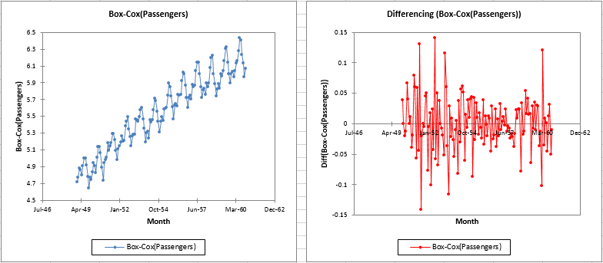
PROPERTIES FOR TIME-SERIES PREDICTION
Notes:
DIFFERENCING – takes the difference between the last paoint and this point
less intepretable – ploting the change as the y value

Slide 38
TIME SERIES MODELS
In the rest of this lesson, we are going to build up to the ARIMA time series model.
This model combines the ideas of differencing and two models we will see.
AR - autoregressive models
MA - moving average models
Notes:
Combination between autoregressive (autocorrelation) and moving avg models

Slide 39
AR MODELS
Autoregressive (AR) models are those that use data from previous time points to predict the next.
This is very similar to previous regression models, except as input, we take the previous outcome.
If we are attempting to predict weekly sales, we use the sales from a previous week as input.
Typically, AR models are notes AR(p) where p indicates the number of previous time points to incorporate, with AR(1) being the most common.

Slide 40
AR MODELS
In an autoregressive model, similar to standard regression, we are learning regression coefficients for each of the p previous values. Therefore, we will learn p coefficients or 𝛃 values.
If we have a time series of sales per week, y_{i}, we can regress each yi from the last p values.
y_{i} = 𝛃₀ + 𝛃₁y_{i-1} + 𝛃₂y_{i-2} + … + 𝛃_{p}y_{i-p} + 𝜺
As with standard regression, our model assumes that each outcome variable is a linear combination of the inputs and a random error term.
Notes:
The input is outputs from the previous dataset
one column – and the predictor is itself
AR(1) – jAR of the last point

Slide 41
AR MODELS
For an AR(1) model, we will learn a single coefficient.
This coefficient, 𝛃, will tell us the relationship between the previous value, Y_{t - 1}, and the next value, Y_{t}.
Y_{t} = 𝛃·Y_{t - 1}
Notes:
Fitting a linear regression where input is sales and the output is sales

Slide 42
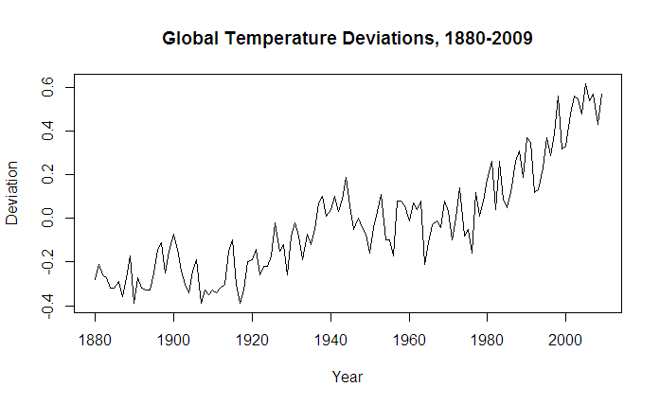
AR MODELS
A value > 1 would indicate a growth over previous values. This would typically represent non-stationary data, since if we compound the increases, the values are continually increasing.
Notes:
A value of b1>1 indicates growth

Slide 43
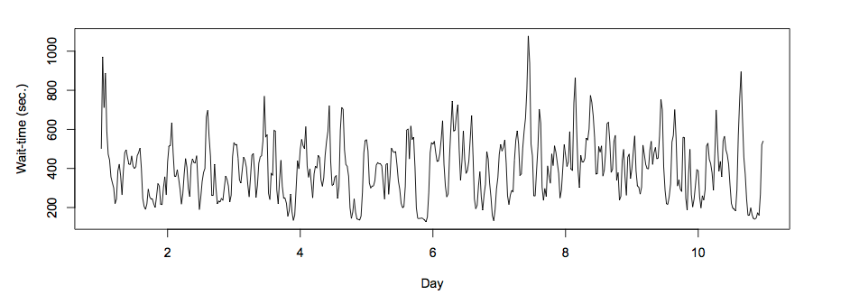
AR MODELS
Values between 1 and -1 represent increasing and decreasing patterns from previous patterns.

Slide 44
AR MODELS
As with other models, interpretation of the model becomes more complex as we add more factors.
Going from AR(1) to AR(2) can add significant multi-collinearity.
Notes:
As you add complexity interpretibility goes down

Slide 45
AR MODELS
Recall that autocorrelation is the correlation of a value with its series lagged behind.
A model with high correlation implies that the data is highly dependent on previous values and an autoregressive model would perform well.
Notes:
AR models are dependent on data that are autocorrelated with itself

Slide 46
AR MODELS
Autoregressive models are useful for learning falls or rises in our series.
This will weight together the last few values to make a future prediction.
Typically, this model type is useful for small-scale trends such as an increase in demand or change in tastes that will gradually increase or decrease the series.

Slide 47
MA MODELS
Moving average (MA) models, as opposed to AR models, do not take the previous outputs (or values) as inputs. They take the previous error terms.
We will attempt to predict the next value based on the overall average and how off our previous predictions were.
Notes:
MA work well when moving avgs have a lot of data

Slide 48
MA MODELS
This model is useful for handling specific or abrupt changes in a system.
AR models slowly incorporate changes in the system by combining previous values; MA models use prior errors to quickly incorporate changes.
This is useful for modeling a sudden occurrence - something going out of stock or a sudden rise in popularity affecting sales.
Notes:
AR models are good at detecting changes from the past but not abrupt canges
AR and MA models are opposites

Slide 49
MA MODELS
As in AR models, we have an order term, q, and we refer to our model as MA(q). The moving average model is dependent on the last q errors.
If we have a time series of sales per week, y_{i}, we can regress each y_{i} from the last q error terms.
y_{i} = mean + 𝛃₁𝜺_{i-1} + 𝛃₂𝜺_{i-2} + … + 𝛃_{q}𝜺_{i-q}
We include the mean of the time series (that’s why it’s called a moving average) as we assume the model takes the mean value of the series and randomly jumps around it.
Notes:
MA – learns by corecting itself every single time
useful in handling specific and abrubt changes in the system (seasonal patern)
slowly incorporate changes in the system by combining previous values
Looks at previous ERROR not the raw numbers from below
Takes in PREVIOUS errors as inputs
trying to learn from its erros

Slide 50
MA MODELS
Of course, we don’t have error terms when we start - where do they come from?
This requires a more complex fitting procedure than we have seen previously.
We need to iteratively fit a model (perhaps with random error terms), compute the errors and then refit, again and again.

Slide 51
MA MODELS
In this model, we learn q coefficients.
In an MA(1) model, we learn one coefficient.
This value indicates the impact of how our previous error term on the next prediction.

Slide 52
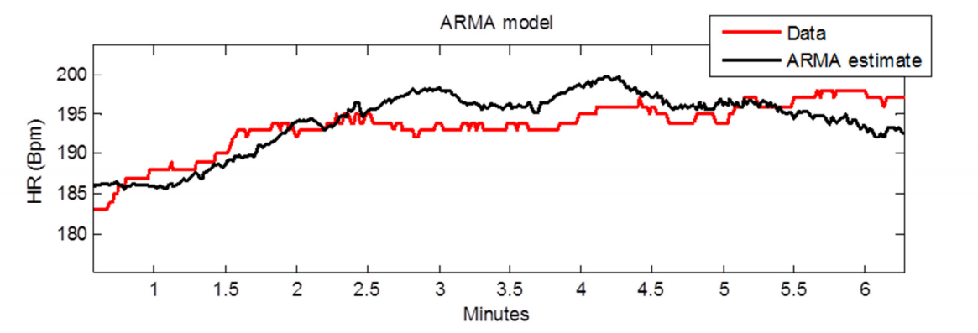
ARMA MODELS
ARMA (pronounced ‘R-mah’) models combine the autoregressive and moving average models.
An ARMA(p,q) model is simply a combination (sum) of an AR(p) model and MA(q) model.
Notes:
ARMA models are a combo or AR and MA

Slide 53
ARMA MODELS
We specify two model settings, p and q, which correspond to combining an AR(p) model with an MA(q) model.
Incorporating both models allows us to mix two types of effects.
AR models slowly incorporate changes in preferences, tastes, and patterns.
Moving average models base their prediction on the prior error, allowing to correct sudden changes based on random events - supply, popularity spikes, etc.
Notes:
P is the lag for autocorrelation
Q is the lag for moving average

Slide 54
ARIMA MODELS
ARIMA (pronounced ‘uh-ri-mah’) is an AutoRegressive Integrated Moving Average model.
In this model, we learn an ARMA(p,q) model to predict the difference of the series (as opposed to the value of the series).
Notes:
ARIMA uses an ARMA to predict the difference in the series (the y(t) – y(t-1))
The differencing removes the trend (the non statianary part)
ARIMA takes into account 3 dif components
AR- predicts seasonal pattersn
I – accountss foroverall trends of data
MA – tries to account for sudden diffences in the

Slide 55
ARIMA MODELS
Recall the pandas diff function. This computes the difference between two consecutive values.
In an ARIMA model, we attempt to predict this difference instead of the actual values.
y_{t} - y_{t-1} = ARIMA(p,q)
This handles the stationarity assumption we wanted for our data. Instead of detrending or differencing manually, the model does this.

Slide 56
ARIMA MODELS
An ARIMA model has three parameters and is specified ARIMA(p, d, q).
p is the order of the autoregressive component
q is the order of the moving average component
d is the degree of differencing.
d was 1 in our prior example. For d=2, our model would be
diff(diff(y)) = (y_{t} - y_{t-l}) - (y_{t-l} - y_{t-2}) = ARIMA(p,q)

Slide 57
ARIMA MODELS
Compared to an ARMA model, ARIMA models do not rely on the underlying series being stationary.
The differencing operation can convert the series to one that is stationary.
Instead of attempting to predict values over time, our new series is the difference in values over time.
Since ARIMA models include differencing, they can be used on a broader set of data without the assumption of a constant mean.
Notes:
ARIMA accounts for everything in the time series

Slide 58
DEMO
TIME SERIES MODELING IN STATSMODELS

Slide 59
TIME SERIES MODELING IN STATSMODELS
To explore time series models, we will continue to use the Rossmann sales data.
This dataset has sales data for every Rossmann store for a 3-year period and indicators for holidays and basic store information.

Slide 60
AR, MA, AND ARMA MODELS IN STATSMODELS
To explore AR, MA, and ARMA models, we will use sm.tsa.ARMA.
Remember, an ARMA model is a combination of autoregressive and moving average models.
We can train an AR model by turning off the MA component (q=0).
from statsmodels.tsa.arima_model import ARMA store1_sales_data = store1_open_data[['Sales']].astype(float) model = ARMA(store1_sales_data, (1, 0)).fit() model.summary()
Notes:
Can detect non stationary data AND detrend the apckage

Slide 61
AR, MA, AND ARMA MODELS IN STATSMODELS
By passing (1, 0) in the second argument, we are fitting an ARMA model with p=1, q=0. This is the same as an AR(1) model.
In this AR(1) model, we learn an intercept (or base sales) value.
Additionally, we learn a coefficient that tells us how to include the latest sales value.
In this case, we add an intercept of ~4700 to 0.68 times the previous month’s sales. Note that the coefficient is not equal to the lag 1 autocorrelation. This implies the data is not stationary.

Slide 62
AR, MA, AND ARMA MODELS IN STATSMODELS
We can learn an AR(2) model, which regresses each sales value on the last two.
model = ARMA(store1_sales_data, (2, 0)).fit() model.summary()
In this case, we learn two coefficients, which tell us the effect of the last two sales values on the current sales.
While this model may perform better, it may be more difficult to interpret.

Slide 63
AR, MA, AND ARMA MODELS IN STATSMODELS
Residuals are the errors of the model or how off our predictions are.
Ideally, we want randomly distributed errors that are small.
If the errors are large, our model does not perform well.
If the errors have a pattern, particularly over time, we may have overlooked something in the model or have periods of time that are different than the rest of the dataset.

Slide 64
AR, MA, AND ARMA MODELS IN STATSMODELS
We can use statsmodels to plot the residuals.
model.resid.plot()
Here we see large spikes at the end of each year, indicating that our model does not account for the holiday spikes.
Our model considers a short period of time, so it does not take into account the longer seasonal pattern.

Slide 65
AR, MA, AND ARMA MODELS IN STATSMODELS
We can also plot the autocorrelations of the residuals. In an ideal world, these would all be near 0 and appear random.
plot_acf(model.resid, lags=50)
This plot shows a problem: the errors are increasing and decreasing every week in a clear pattern.
We may need to expand our model.

Slide 66
ARIMA MODELS IN STATSMODELS
We can user statsmodels to fit ARIMA models. Let’s start by using ARIMA(1, 0, 1) to fit an ARMA(1, 1) model.
from statsmodels.tsa.arima_model import ARIMA model = ARIMA(store1_sales_data, (1, 0, 1)).fit() model.summary()

Slide 67
AR, MA, AND ARMA MODELS IN STATSMODELS
Remember that this is an AR(1) + MA(1) model. The AR coefficient represents dependency on the last value and the MA component represents any spikes independent of the last value.
The coefficients here are 0.69 for the AR component and -0.03 for the MA component.
The AR coefficient is the same as before (decreasing values).
The MA component is fairly small (which we should have expected from the autocorrelation plots).

Slide 68
ARIMA MODELS IN STATSMODELS
We can also fit a true ARIMA model to predict the difference of the series.
model = ARIMA(store1_sales_data, (1, 1, 1)).fit() model.summary()
We can remove the MA component since it does not appear to be useful.
model = ARIMA(store1_sales_data, (1, 1, 0)).fit() model.summary()
We now have an AR(1) model on the differenced series with a coefficient of -0.18.

Slide 69
ARIMA MODELS IN STATSMODELS
With our models, we can also plot our predictions against the true series using the plot_predict function.
We can compare the last 50 days of true values against our predictions.
model.plot_predict(0, 50)
The function takes two arguments, the start and end index of the dataframe to plot. Here, we are plotting the last 50 values.

Slide 70
ARIMA MODELS IN STATSMODELS
To plot earlier values with our predictions continuing where the true values stop, we can do the following.
import matplotlib.pyplot as plt fig, ax = plt.subplots() ax = store1_sales_data['2014'].plot(ax=ax) fig = model.plot_predict(0, 200, ax=ax, plot_insample=False)
This plots true values in 2014 and our predictions 200 days out from 2014.

Slide 71
ARIMA MODELS IN STATSMODELS
The two previous problems remain:
Large errors around the holiday period
Errors with high autocorrelation

Slide 72
ARIMA MODELS IN STATSMODELS
Increasing p increases the dependency on previous values further (longer lag). But our autocorrelation plots show this isn’t necessary past a certain point.
Increasing q increases the likelihood of an unexpected jump at a handful of points. The autocorrelation plots show this doesn’t help past a certain point.
Increasing d increases differencing, but d=1 moves our data towards stationarity (other than a few points). d=2 would imply an exponential trend which we don’t have here.

Slide 73
ARIMA MODELS IN STATSMODELS
There are variants of ARIMA that will better handle the seasonal aspect of our data. This is referred to as Seasonal ARIMA.
These models fit two ARIMA models, one on the current frequency (daily in our example) and another on the seasonal frequency (maybe monthly or yearly patterns).
Additionally, issues with seasonality could be handled by preprocessing tricks such as detrending.

Slide 74
INDEPENDENT PRACTICE
WALMART SALES DATA

Slide 75

ACTIVITY: WALMART SALES DATA
DIRECTIONS (50 minutes)
EXERCISE
We will analyze the weekly sales data from Walmart over a two year period from 2010 to 2012. The data is separated by store and department, but we will focus on analyzing one store for simplicity.
To read in the data
import pandas as pd import numpy as np %matplotlib inline data = pd.read_csv('lessons/lesson-16/assets/data/train.csv') data.set_index('Date', inplace=True) data.head()

Slide 76
ACTIVITY: WALMART SALES DATA
DIRECTIONS
EXERCISE
Complete the following tasks:
Filter the dataframe to Store 1 sales and aggregate over departments to compute the total sales per store.
Plot the rolling_mean for Weekly_Sales. What general trends do you observe?
Compute the 1, 2, 52 autocorrelations for Weekly_Sales and/or create an autocorrelation plot.
What does the autocorrelation plot say about the type of model you want to build?

Slide 77
ACTIVITY: WALMART SALES DATA
DIRECTIONS
EXERCISE
Split the weekly sales data in a training and test set - using 75% of the data for training.
Create an AR(1) model on the training data and compute the mean absolute error of the predictions.
Plot the residuals - where are their significant errors?
Compute and AR(2) model and an ARMA(2, 2) model - does this improve your mean absolute error on the held out set?
Finally, compute an ARIMA model to improve your prediction error - iterate on the p, q, and parameters comparing the model's performance..

Slide 78
CONCLUSION
TOPIC REVIEW

Slide 79
CONCLUSION
Time-series models use previous values to predict future values, also known as forecasting.
AR and MA model are simple models on previous values or previous errors respectively.
ARMA combines these two types of models to account for both gradual shifts (due to AR models) and abrupt changes (MA models).

Slide 80
CONCLUSION
ARIMA models train ARMA models on differenced data to account for non-stationary data.
Note that none of these models may perform well for data that has more random variation.
For example, for something like iphone sales (or searches) which may be sporadic, with short periods of increases, these models may not work well.

