Slide 1
DATA SCIENCE Mid-course Review

Slide 2
Data Science vs Machine Learning

Slide 3
Data Science
The art of extracting knowledge from data
Could be a visualization
Could be a statistical hypothesis test

Slide 4
Machine LEarning
Algorithms that are self-correcting and self taught
Machine Learning is a part of data science

Slide 5
Supervised vs Unsupervised Learning

Slide 6
Supervised Learning
What is the point?
How do we evaluate it?

Slide 7
unSupervised Learning
What is the point?
How do we evaluate it?

Slide 8
Regression vs Classification

Slide 9
Regression vs. classification
Regression is predicting a continuous variable
Classification is predicting a categorical variable
That’s it!

Slide 10
Cross Validation

Slide 11
Why do we do Cross Validation?

Slide 12
To prevent overfitting!!

Slide 13
in any dataset we have the signal and the noise. A great model is only capturing the signal while an overfit model is also trying to predict the noise
It’s like bringing a very powerful microphone into a recording studio that hears the band playing AS WELL AS the background noise in the room. We really only want the band.
Bonus question: why do you think R squared is a bad metric to detect overfitting?
Over-complicating models (too many unnecessary predictors) is a great way to overfit a model.
Use a combination of cross validation and EDA to prevent overfitting

Slide 14
Bias vs Variance

Slide 15
Bias is the measure of how off the model is (residuals)
Low bias models tend to have low training error
High bias models tend to have high training error
Variance is a measure of how random sampling affects our models
Low variance models tend to be more “Stable” on random samples
High variance models tend to be less “Stable” on random samples (less reliable in the wild)

Slide 16
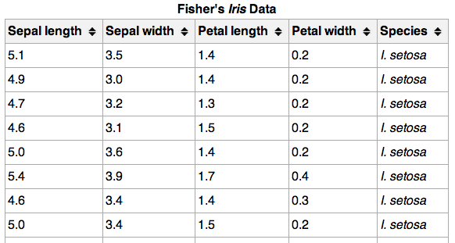
Data
}
These are called ______
{
{
This is called _____
These are called _____

