Slide 1
DATA SCIENCE naive bayes classification and roc/auc curves

Slide 2
I. probability and Bayes’ Theorem iI. Naïve Bayes classification iii. ROC AUC curves
agenda

Slide 3
I. probability And Bayes’ Theorem
DATA SCIENCE

Slide 4
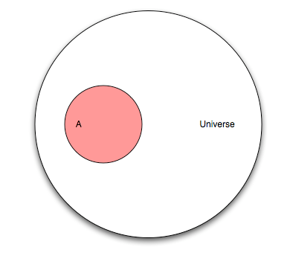
Probability
Let’s pretend you are flipping a coin. This diagram represents the “universe” of all possible outcomes, also known as events. This universe is known as the sample space.
Q: What are the mutually exclusive events that make up the sample space for a coin flip?

Slide 5
Probability
Let’s pretend you are flipping a coin. This diagram represents the “universe” of all possible outcomes, also known as events. This universe is known as the sample space.
Q: What are the mutually exclusive events that make up the sample space for a coin flip?
A: Heads and tails

Slide 6
Probability
Let’s now pretend that our universe involves a research study on humans. Event “A” is people in that study who have cancer.
Q: If our study has 100 people and “A” has 25 people, what is the probability of A?
Q: What is the max probability of any event?

Slide 7
Probability
Let’s now pretend that our universe involves a research study on humans. Event “A” is people in that study who have cancer.
Q: If our study has 100 people and “A” has 25 people, what is the probability of A?
A: P(A) = 25/100
Q: What is the max probability of any event?
A: 1

Slide 8
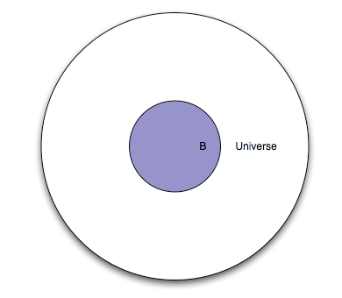
Probability
This represents the same set of people, except everyone in the study is given a test. Event “B” is everyone in the study for whom the test is positive.
Q: What portion of the diagram represents the subset of people with a negative test?
A: The white area between the smaller circle and the larger circle.
Notes:
Complement of an event is the opposite

Slide 9
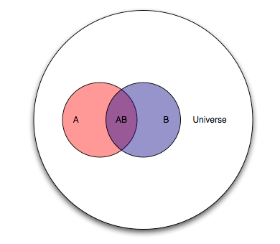
Probability
Because “A” and “B” are events from the same study, we can show them together.
Q: How would you describe the “cancer status” and “test status” of people in each area of the diagram?

Slide 10
Probability
Because “A” and “B” are events from the same study, we can show them together.
Q: How would you describe the “cancer status” and “test status” of people in each area of the diagram?
A: Pink: cancer, negative test
Purple: cancer, positive test
Blue: no cancer, positive test
White: no cancer, negative test

Slide 11
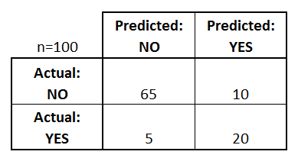
Probability
The purple section is known as the intersection of A and B, denoted as P(AB).
Thinking of this test as a classifier for predicting cancer, draw the confusion matrix.
10
20
5

Slide 12
Probability
Q: Let’s pick an arbitrary person from this study. If you were told their test result was positive, what is the probability they actually have cancer?
10
20
5
Notes:
Sensitivity = p(positive test given that you have cancer)
given that you have cancer, how correct is the test
Specificity = p(negative given that you don’t have cancer)
given that you don’t have cancer how often does the test tell you you don’t
But people only really care about the true positive rate though (prob that you have cancer given that the test is positive)

Slide 13
Probability
Q: Let’s pick an arbitrary person from this study. If you were told their test result was positive, what is the probability they actually have cancer?
A: 20/30
This is the conditional probability of A given B, denoted as P(A|B).
P(A|B) = P(AB) / P(B) = (20/100) / (30/100)
10
20
5

Slide 14
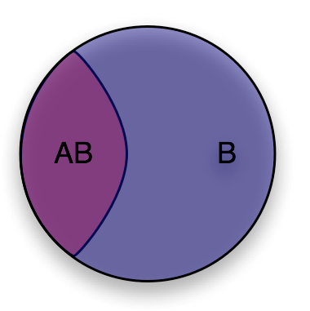
Probability
You can think of conditional probability as “changing the relevant universe.” P(A|B) is a way of saying “Given that my entire universe is now B, what is the probability of A?”
This is also known as transforming the sample space.

Slide 15
Probability
10
20
Q: Let’s pick another arbitrary person from this study. If you were told they have cancer, what is the probability they had a positive test result?
5

Slide 16
Probability
10
20
Q: Let’s pick another arbitrary person from this study. If you were told they have cancer, what is the probability they had a positive test result?
A: P(B|A) = P(AB) / P(A) = 20/25
5
Notes:
Sensitivity – is easier to find out

Slide 17
Bayes’ theorem
Deriving Bayes’ theorem:
We know:
P(A|B) = P(AB) / P(B) and P(B|A) = P(AB) / P(A)
Thus:
P(AB) = P(A|B) * P(B) = P(B|A) * P(A)
Rearrange to get Bayes’ theorem:
P(A|B) = P(B|A) * P(A) / P(B)

Slide 18
Suppose that you are worried that you might have a rare disease. You decide to get tested, and suppose that the testing methods for this disease are correct 99 percent of the time (in other words, if you have the disease, it shows that you do with 99 percent probability, and if you don't have the disease, it shows that you do not with 99 percent probability). Suppose this disease is actually quite rare, occurring randomly in the general population in only one of every 10,000 people.
If your test results come back positive, what are your chances that you actually have the disease?
Bayes Theorem Example
Suppose you might have a rare life-threatening disease and so you get tested. The disease’s test is 99% sensitive and 99% specific (if you have it, the test is correct 99% of the time and same if you don’t have it). This disease occurs in 1 in every 10,000 people.
Q. Your test is positive. What is the probability that you have the disease?

Slide 19
Suppose that you are worried that you might have a rare disease. You decide to get tested, and suppose that the testing methods for this disease are correct 99 percent of the time (in other words, if you have the disease, it shows that you do with 99 percent probability, and if you don't have the disease, it shows that you do not with 99 percent probability). Suppose this disease is actually quite rare, occurring randomly in the general population in only one of every 10,000 people.
If your test results come back positive, what are your chances that you actually have the disease?
Bayes Theorem Example
Q. Your test is positive. What is the probability that you have the disease?
A. 1%

Slide 20
Suppose that you are worried that you might have a rare disease. You decide to get tested, and suppose that the testing methods for this disease are correct 99 percent of the time (in other words, if you have the disease, it shows that you do with 99 percent probability, and if you don't have the disease, it shows that you do not with 99 percent probability). Suppose this disease is actually quite rare, occurring randomly in the general population in only one of every 10,000 people.
If your test results come back positive, what are your chances that you actually have the disease?
Bayes Theorem Example
Q. Your test is positive. What is the probability that you have the disease?
A. 1%
Let A be the event that you have the disease
B be the event that your test was positive
P(B|A) = .99 (sensitivity)
P(B| not A) = .01(1 - sensitivity) this is our false positive

Slide 21
Suppose that you are worried that you might have a rare disease. You decide to get tested, and suppose that the testing methods for this disease are correct 99 percent of the time (in other words, if you have the disease, it shows that you do with 99 percent probability, and if you don't have the disease, it shows that you do not with 99 percent probability). Suppose this disease is actually quite rare, occurring randomly in the general population in only one of every 10,000 people.
If your test results come back positive, what are your chances that you actually have the disease?
Bayes Theorem Example
Q. Your test is positive. What is the probability that you have the disease?
A. 1%
Let A be the event that you have the disease
B be the event that your test was positive
P(B|A) = .99 (sensitivity)
P(B| not A) = .01(1 - sensitivity) this is our false positive
P(B) = P(the test was positive) = P(B | A) * P(A) OR P(B | not A) * P(not A)
P(B) = .99 * .0001 + .01 * .9999
= .010098
P(A|B) = P(B|A)P(A) / P(B)
= .99 * .0001 / .010098 = 0.00980
Bayes Theorem:
Notes:
Prob of having the disease if you have a pos test --- is less tha 1%. Even with the .99 sensitivity and specificity it’s so low because the disease is so rare

Slide 22
II. Naïve bayes classification
DATA SCIENCE
Notes:
A machine learning model based on baye’s theorem
Topid for today – how we use data to update our beliefs
Naïve Bayes is particularly good for TEXT – letters e and s are very common – we know the distribution of e and s
#in general things that follow a distribution tend to work well with naïve bayes
#ELECTIONS follow a distributions and we have the priors
#weather - what will you do today
Also good b/c sometimes the prob that are hard to get in practive are not hard to get in bayes

Slide 23
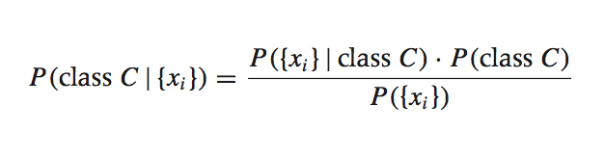
Bayesian inference
Suppose we have a dataset with features x₁, …, x_{n} and a class label C. What can we say about classification using Bayes’ theorem?
Bayes’ theorem can help us to determine the probability of a record belonging to a class, given the data we observe.
source: Data Analysis with Open Source Tools, by Philipp K. Janert. O’Reilly Media, 2011.
Notes:
Chance of *something happening, given this happened
P© given these features,

Slide 24
Bayesian inference
This term is the prior probability of C. It represents the probability of a record belonging to class C before the data is taken into account.

Slide 25
Bayesian inference
This term is the likelihood function. It represents the joint probability of observing features {x_{i}} given that that record belongs to class C.

Slide 26
Bayesian inference
This term is the normalization constant. It doesn’t depend on C, and is generally ignored.
Notes:
It usually is ignored b/c it is the only number that does not depend on C (our class function)
here it means for e.g the prob of a RANDOM email in the world containing the word “viagra”

Slide 27
Bayesian inference
This term is the posterior probability of C. It represents the probability of a record belonging to class C after the data is taken into account.
The idea of Bayesian inference, then, is to update our beliefs about the distribution of C using the data (“evidence”) at our disposal.
Notes:
The probability of the posterior probability is updated with each new observation
A and B change to being “belonging to a class” and “data”

Slide 28
Naïve bayes classification
Q: What piece of the puzzle we’ve seen so far looks like it could intractably difficult in practice?

Slide 29
Naïve bayes classification
Q: What piece of the puzzle we’ve seen so far looks like it could intractably difficult in practice?
A: Estimating the full likelihood function.
P({x_{i}}|C) = P({x₁, x₂, …, x_{n}})|C)
Observing this exactly would require us to have enough data for every possible combination of features to make a reasonable estimate.

Slide 30
Naïve bayes classification
Q: So what can we do about it?
A: Make a simplifying assumption. In particular, we assume that the features x_{i} are conditionally independent from each other:
P({x_{i}}|C) = P({x₁, x₂, …, x_{n}}|C) ≈ P(x₁|C) * P(x₂|C) * … * P(x_{n}|C)
This “naïve” assumption simplifies the likelihood function to make it tractable.

Slide 31
Naïve bayes classification
In summary, the training phase of the model involves computing the likelihood function, which is the conditional probability of each feature given each class.
counts the unique words and finds the prob of each email with the word is spam
The prediction phase of the model involves computing the posterior probability of each class given the observed features, and choosing the class with the highest probability.
Notes:
Receiver operating characteristic – area under the curve
#good at binary classifications
#GREAT when classes are imbalanced
#GREAT for comparing across models
#gives you a good description of which model to choose

Slide 32
Iii. ROC AUC curves
DATA SCIENCE

Slide 33
ROC Curve / AUC
Every email is assigned a “spamminess” score by our classification algorithm. To actually make our predictions, we choose a numeric cutoff for classifying as spam.
An ROC Curve will help us to visualize how well our classifier is doing without having to choose a cutoff!
Email Number | Score | True Label
5 | 0.99 | Spam
8 | 0.82 | Spam
2 | 0.60 | Spam
1 | 0.60 | Ham
7 | 0.48 | Spam
3 | 0.22 | Ham
4 | 0.10 | Ham
6 | 0.02 | Ham

Slide 34
ROC CURVE / AUC
The ROC plots the True Positive Rate (TRP) on the y-axis against the False Positive Rate (FPR) on the x-axis.
TPR: When actual value is spam, how often is prediction correct?
FPR: When actual value is ham, how often is prediction wrong?
Email Number | Score | True Label
5 | 0.99 | Spam
8 | 0.82 | Spam
2 | 0.60 | Spam
1 | 0.60 | Ham
7 | 0.48 | Spam
3 | 0.22 | Ham
4 | 0.10 | Ham
6 | 0.02 | Ham

Slide 35
ROC Curve / AUC
TPR: When actual value is spam, how often is prediction correct?
FPR: When actual value is ham, how often is prediction wrong?
Email Number | Score | True Label
5 | 0.99 | Spam
8 | 0.82 | Spam
2 | 0.60 | Spam
1 | 0.60 | Ham
7 | 0.48 | Spam
3 | 0.22 | Ham
4 | 0.10 | Ham
6 | 0.02 | Ham
Cutoff | TPR (y) | FPR (x) | Cutoff | TPR (y) | FPR (x)
0 |  |  | 0.50
0.05 |  |  | 0.65
0.15 |  |  | 0.85
0.25 |  |  | 1

Slide 36
ROC Curve / AUC
TPR: When actual value is spam, how often is prediction correct?
FPR: When actual value is ham, how often is prediction wrong?
Email Number | Score | True Label
5 | 0.99 | Spam
8 | 0.82 | Spam
2 | 0.60 | Spam
1 | 0.60 | Ham
7 | 0.48 | Spam
3 | 0.22 | Ham
4 | 0.10 | Ham
6 | 0.02 | Ham
Cutoff | TPR (y) | FPR (x) | Cutoff | TPR (y) | FPR (x)
0 | 1 | 1 | 0.50 | 0.75 | 0.25
0.05 | 1 | 0.75 | 0.65 | 0.5 | 0
0.15 | 1 | 0.5 | 0.85 | 0.25 | 0
0.25 | 1 | 0.25 | 1 | 0 | 0

Slide 37
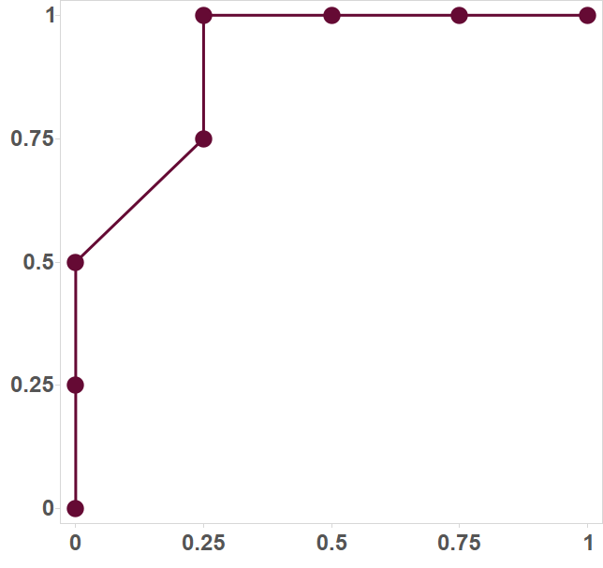
ROC CURVE / AUC
ROC Curve
Email Number | Score | True Label
5 | 0.99 | Spam
8 | 0.82 | Spam
2 | 0.60 | Spam
1 | 0.60 | Ham
7 | 0.48 | Spam
3 | 0.22 | Ham
4 | 0.10 | Ham
6 | 0.02 | Ham
TPR
FPR

