Slide 1
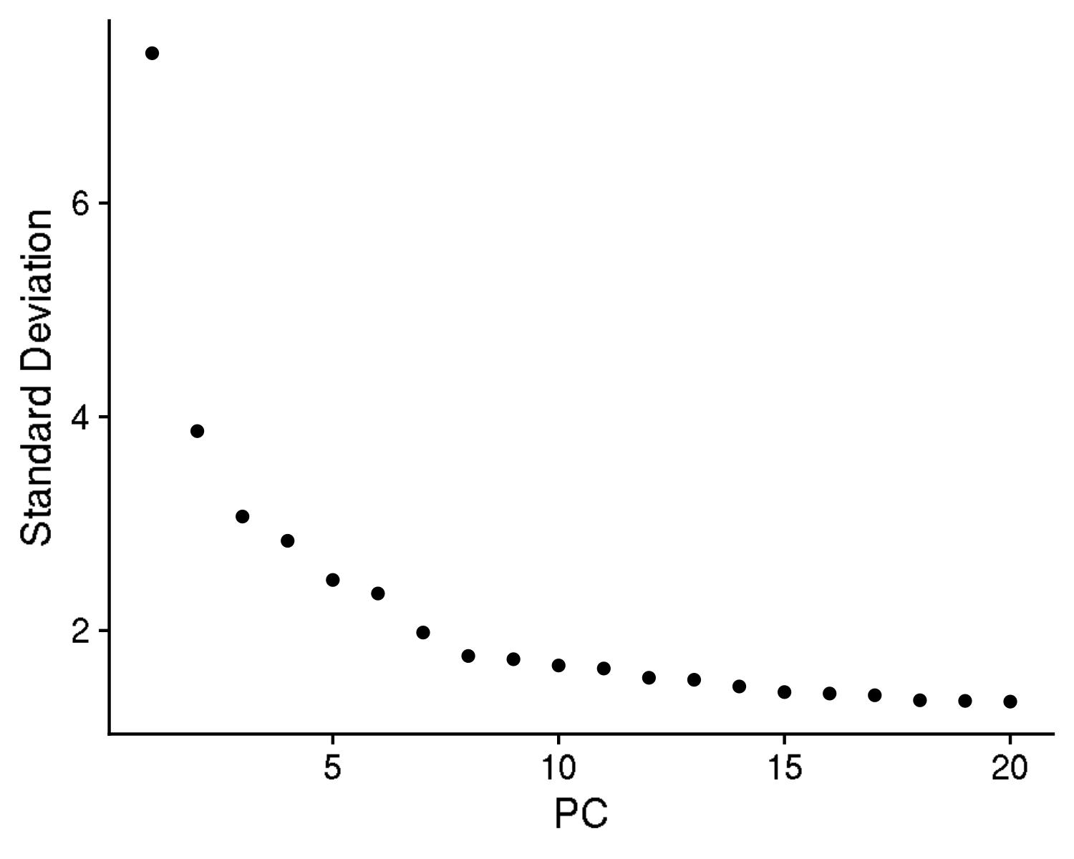
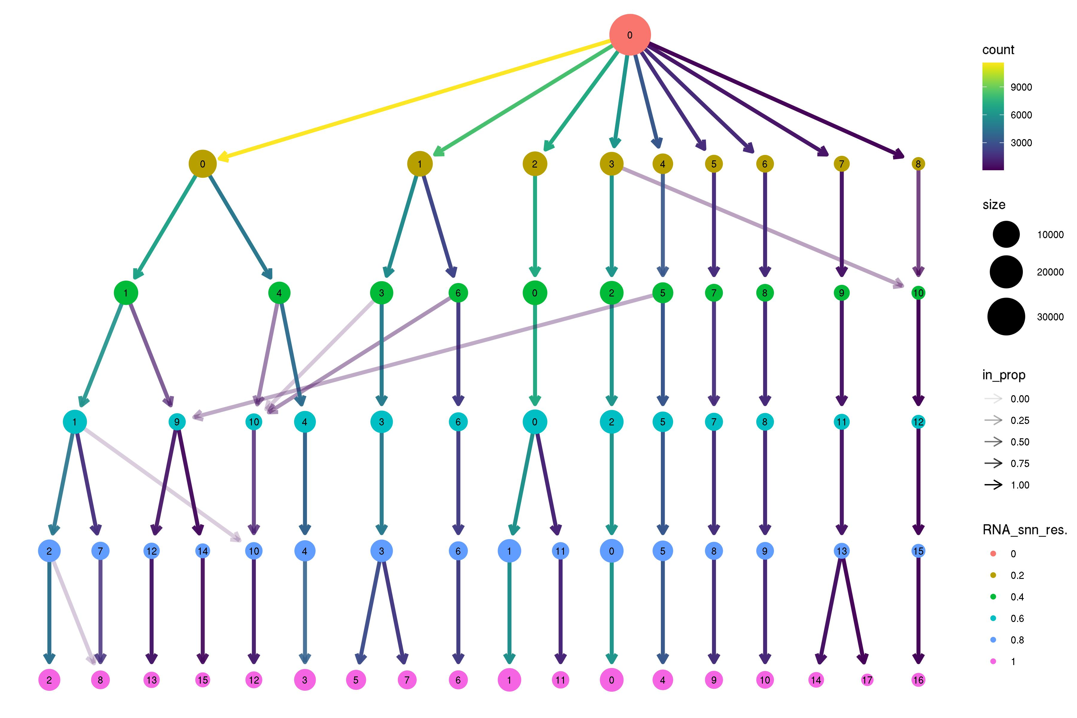
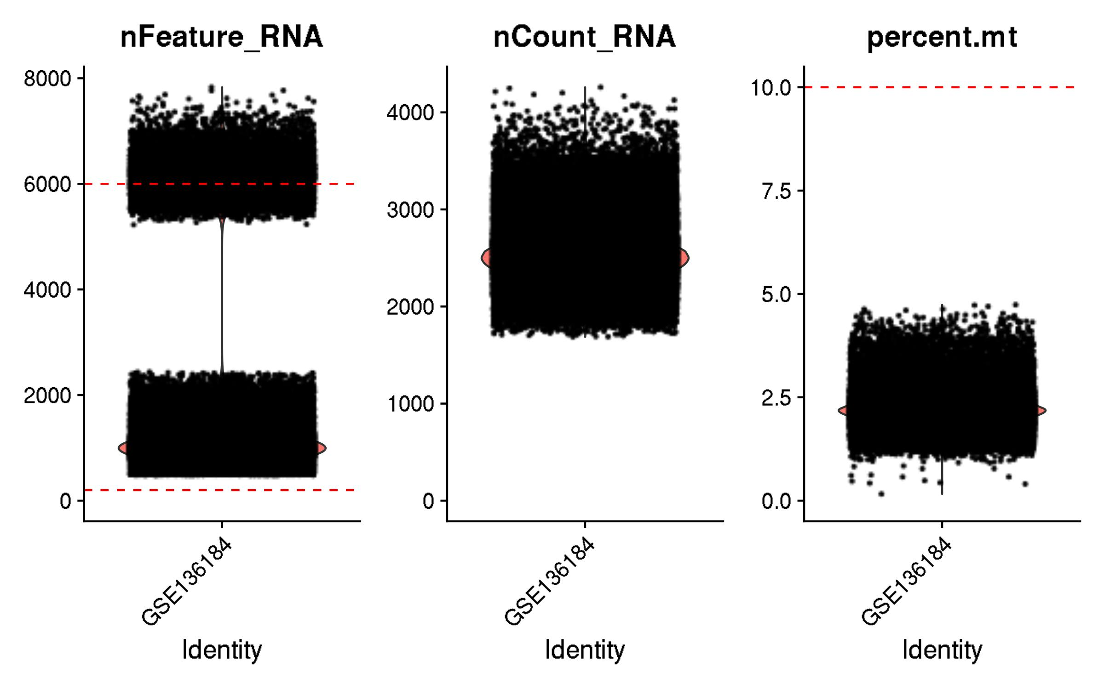
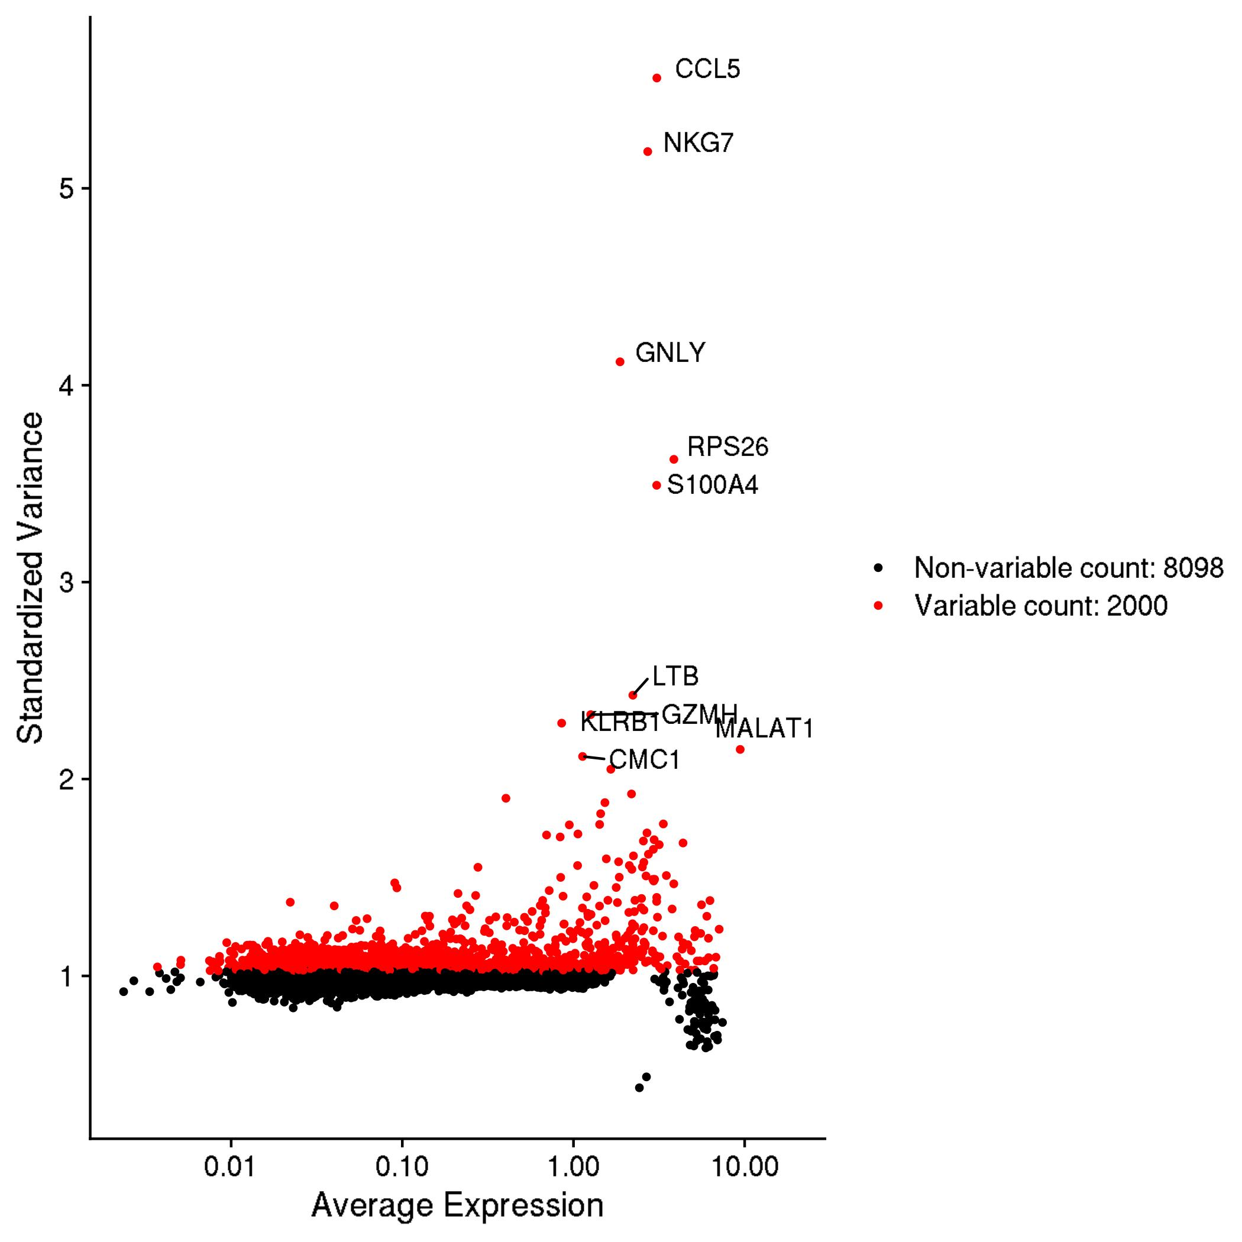
GSE136184: CD8+ T cells across 9 decades of life
Inspection and quality control

Slide 2
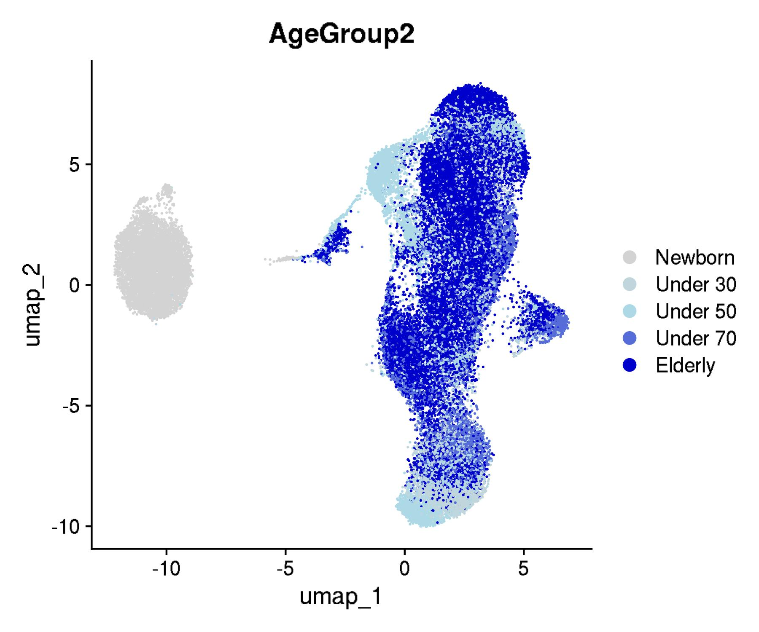
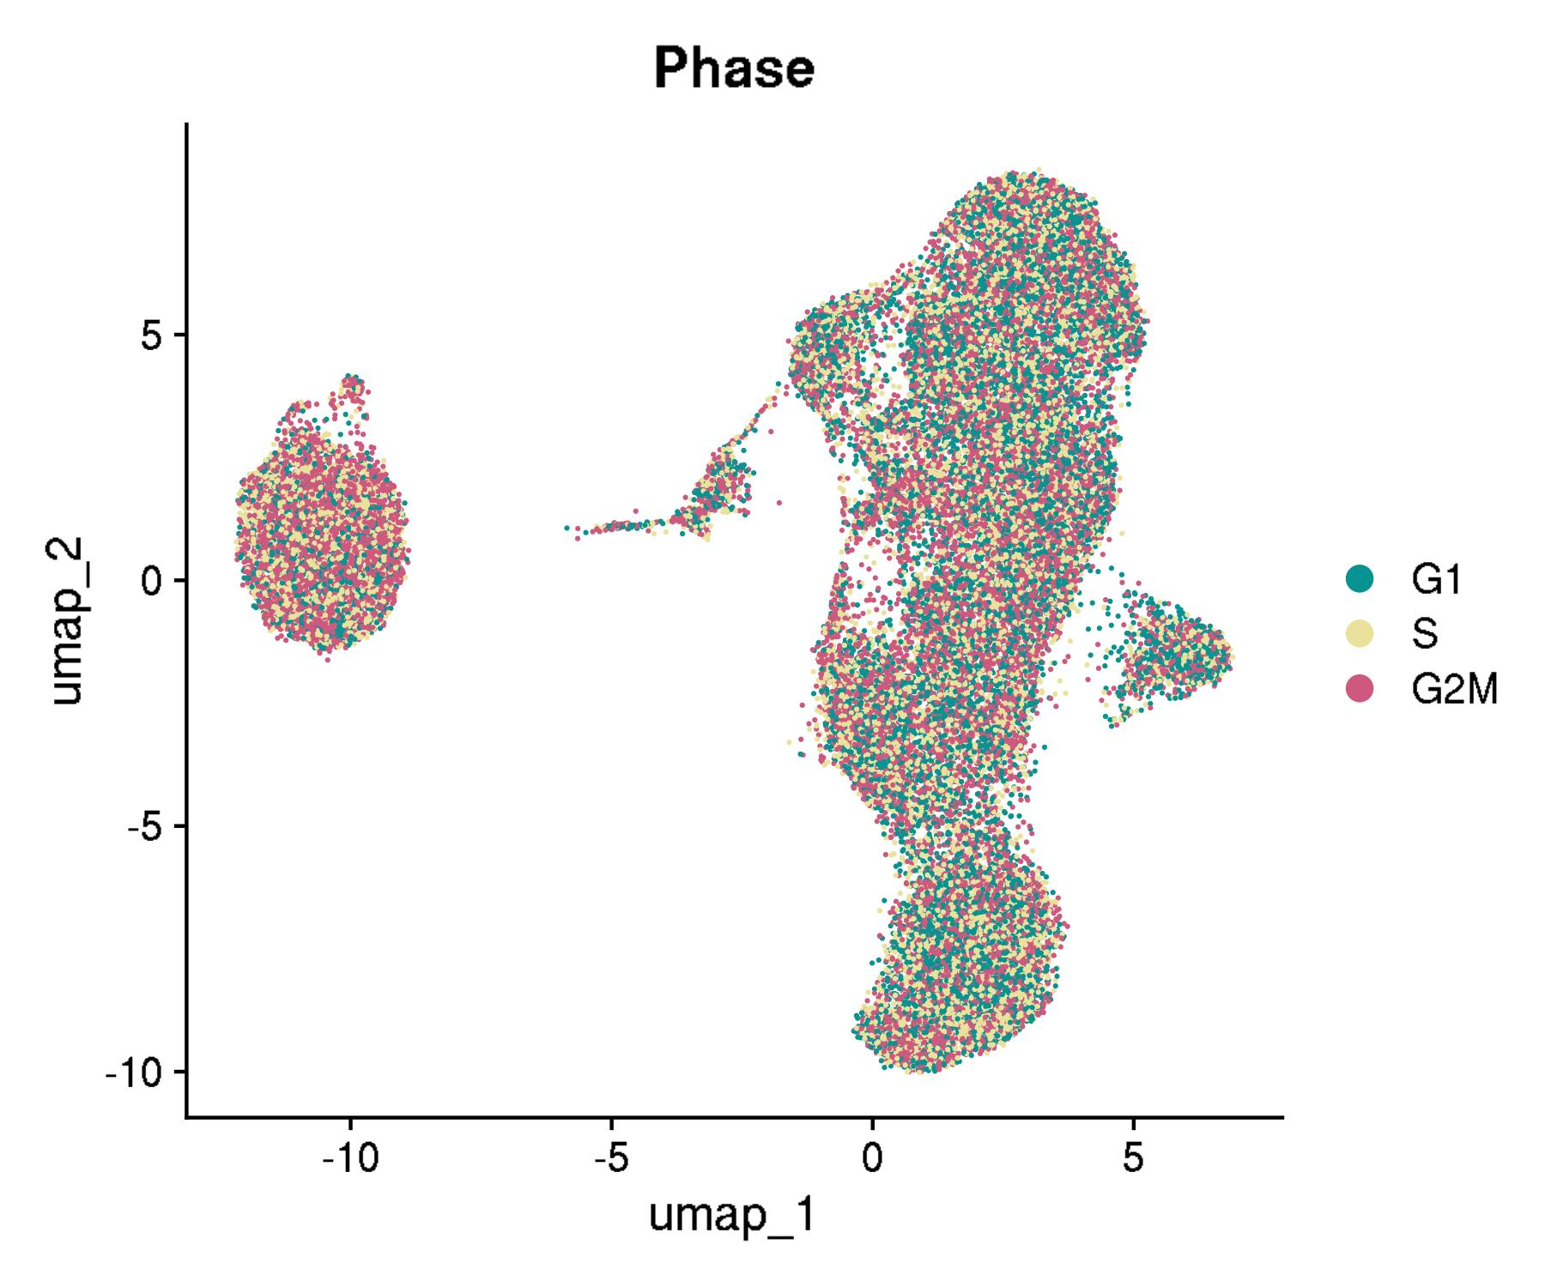
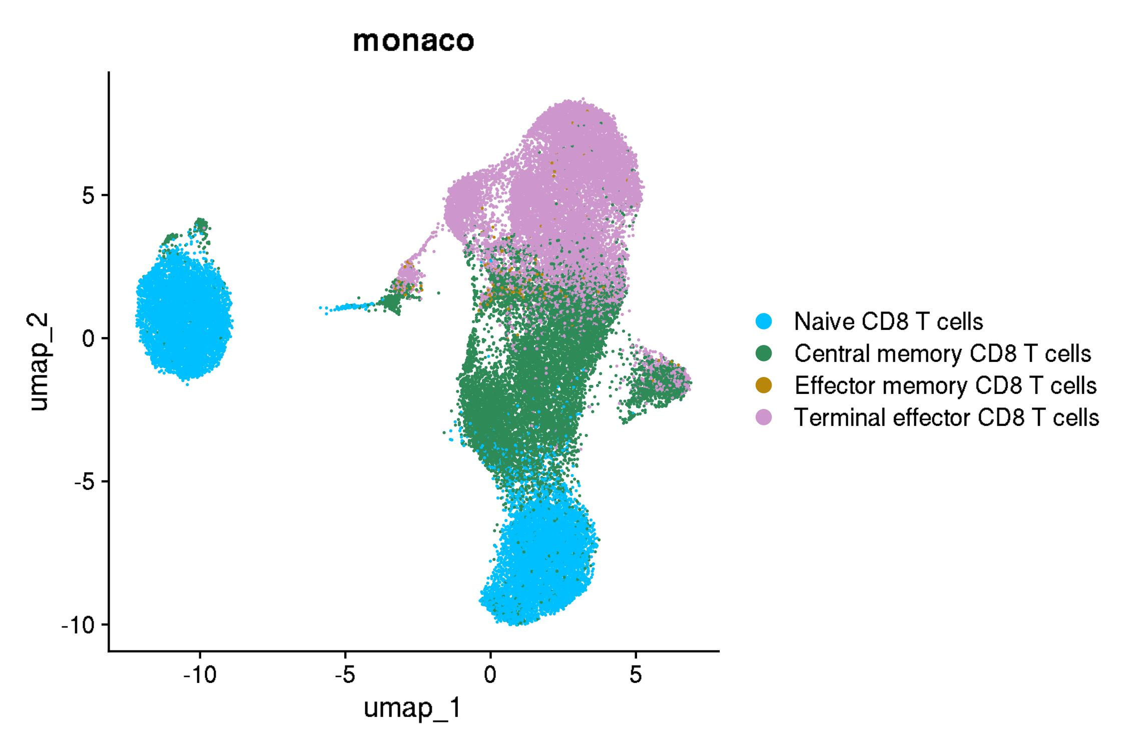
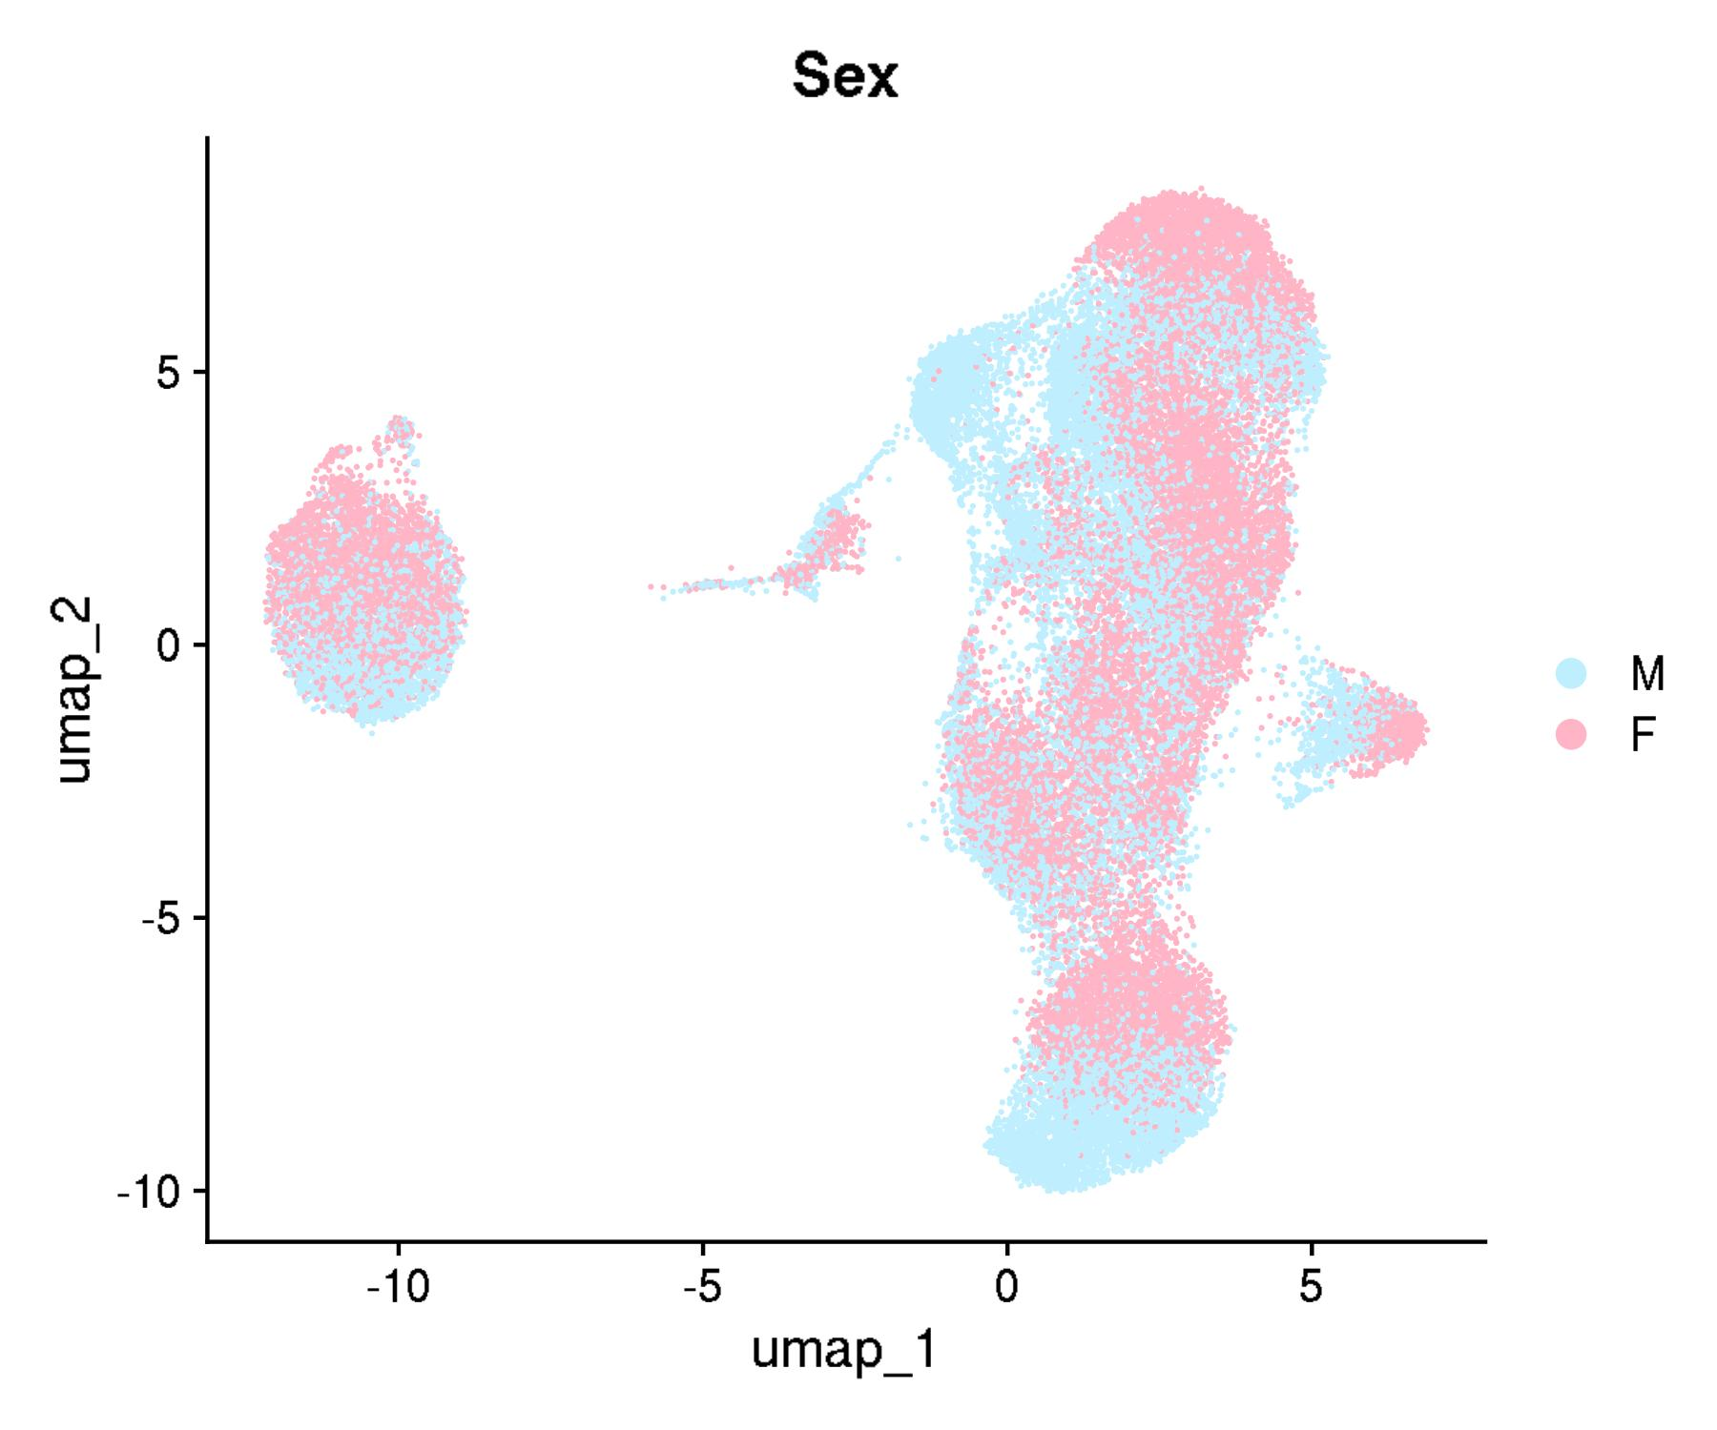
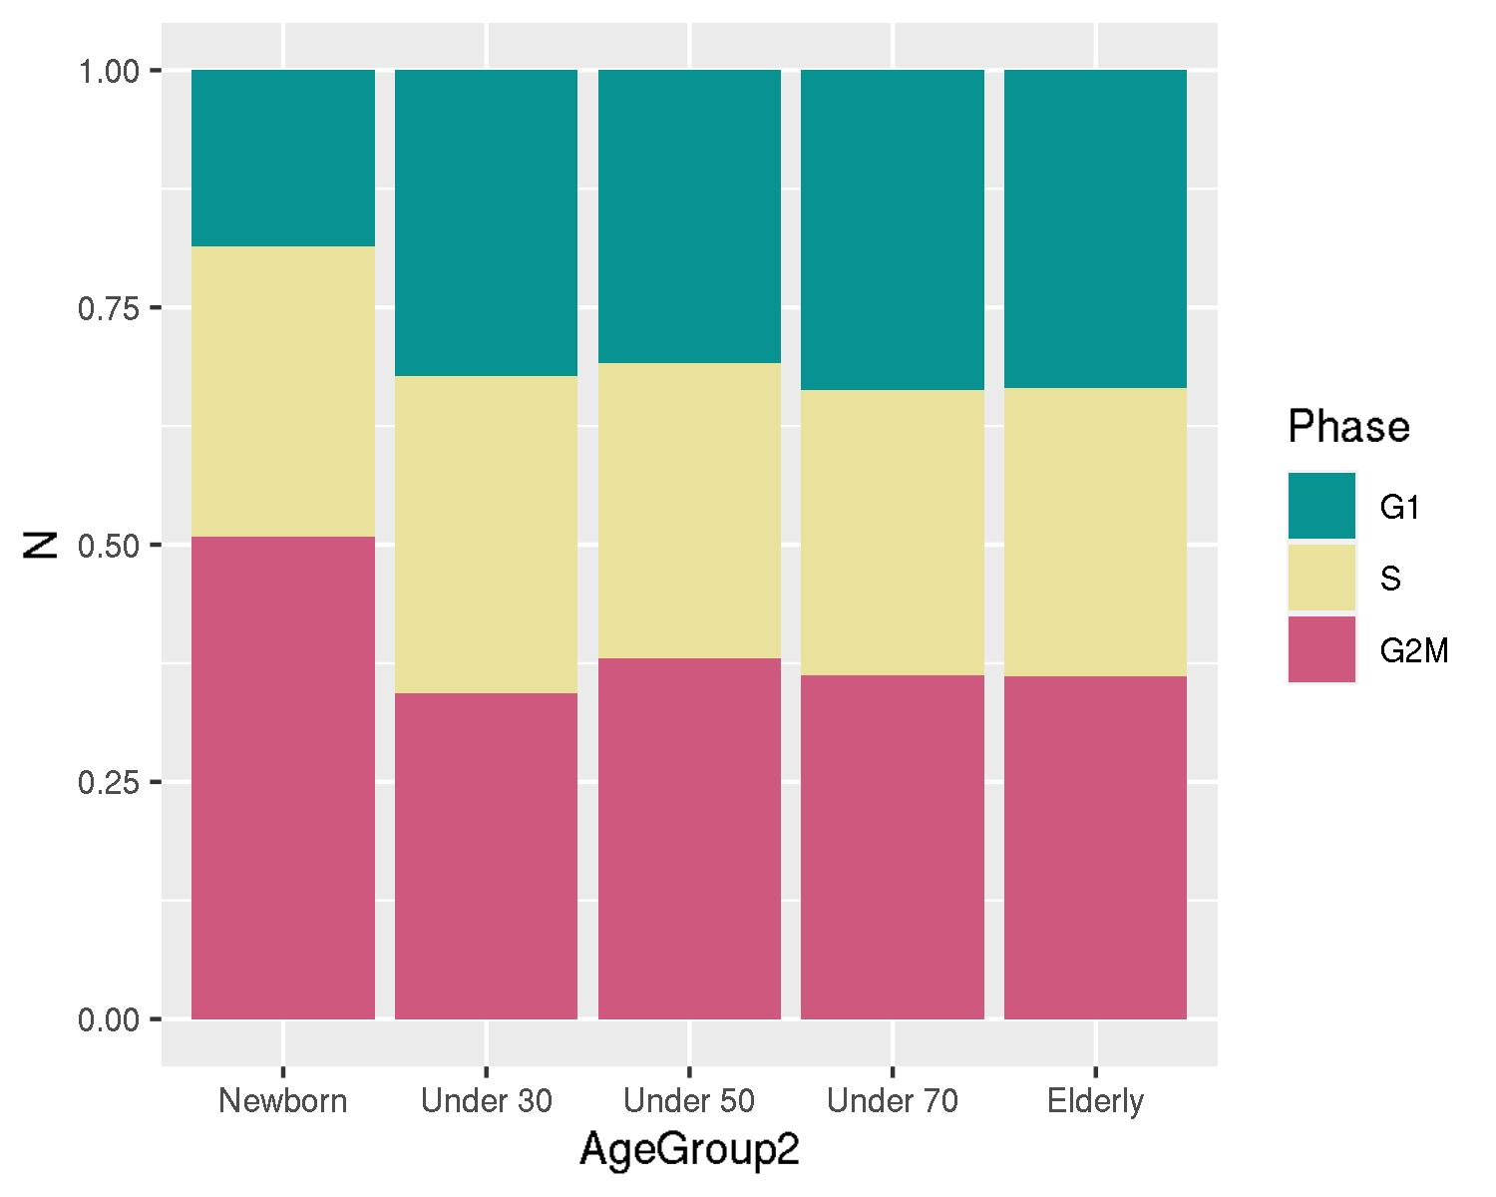
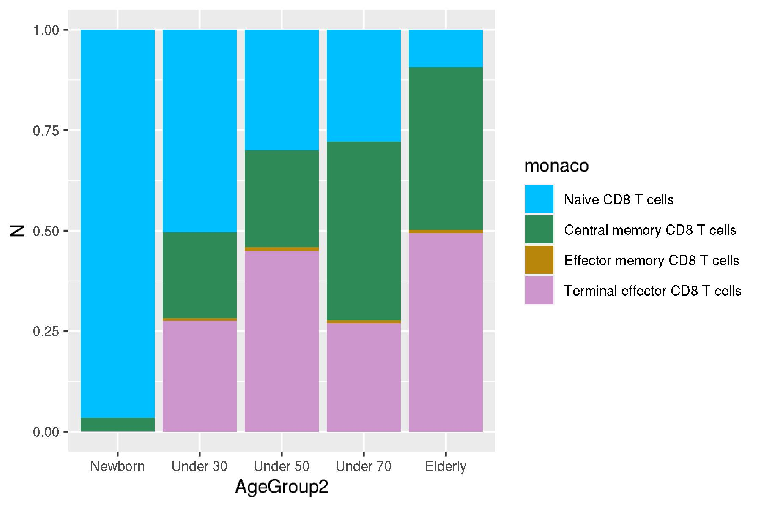
GSE136184: CD8+ T cells across 9 decades of life
UMAPs for cell annotations

Slide 3
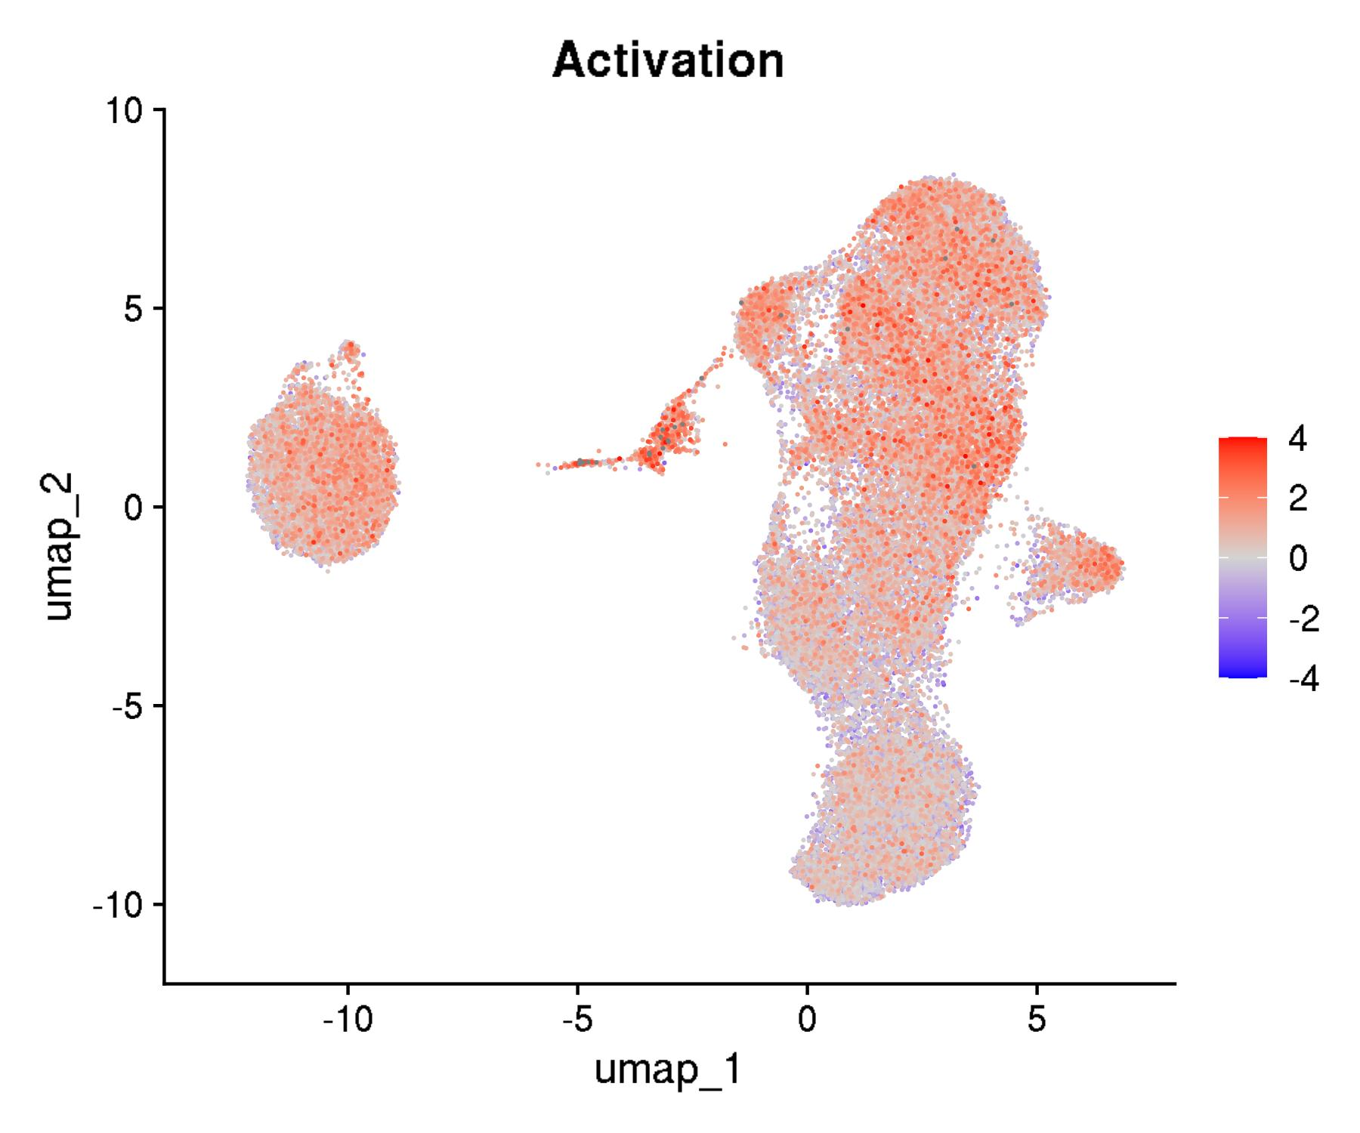



GSE136184: CD8+ T cells across 9 decades of life
UMAPs for cell states

Slide 4
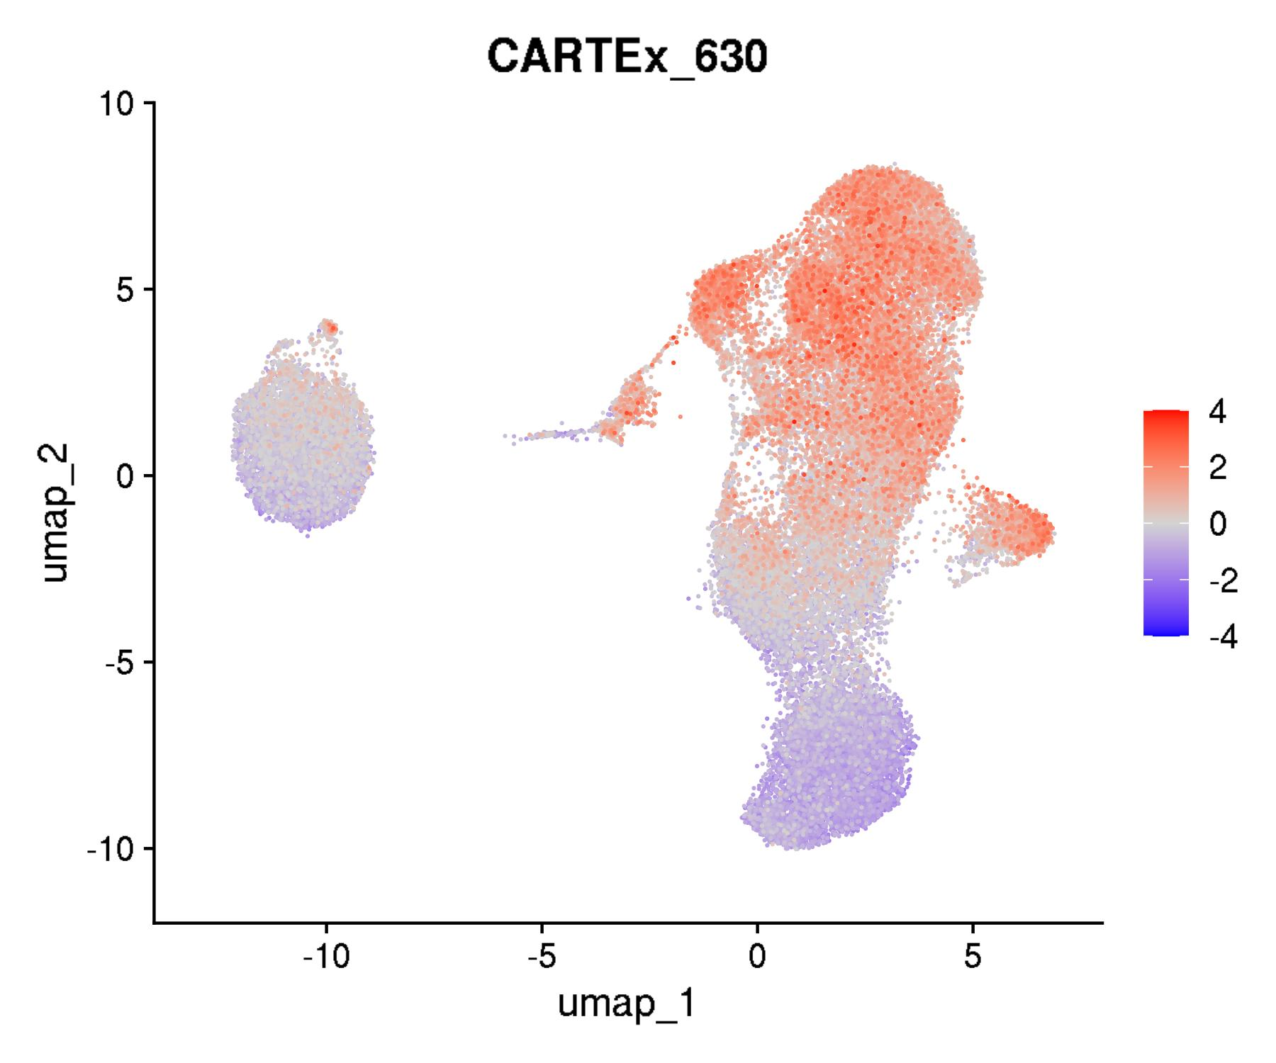
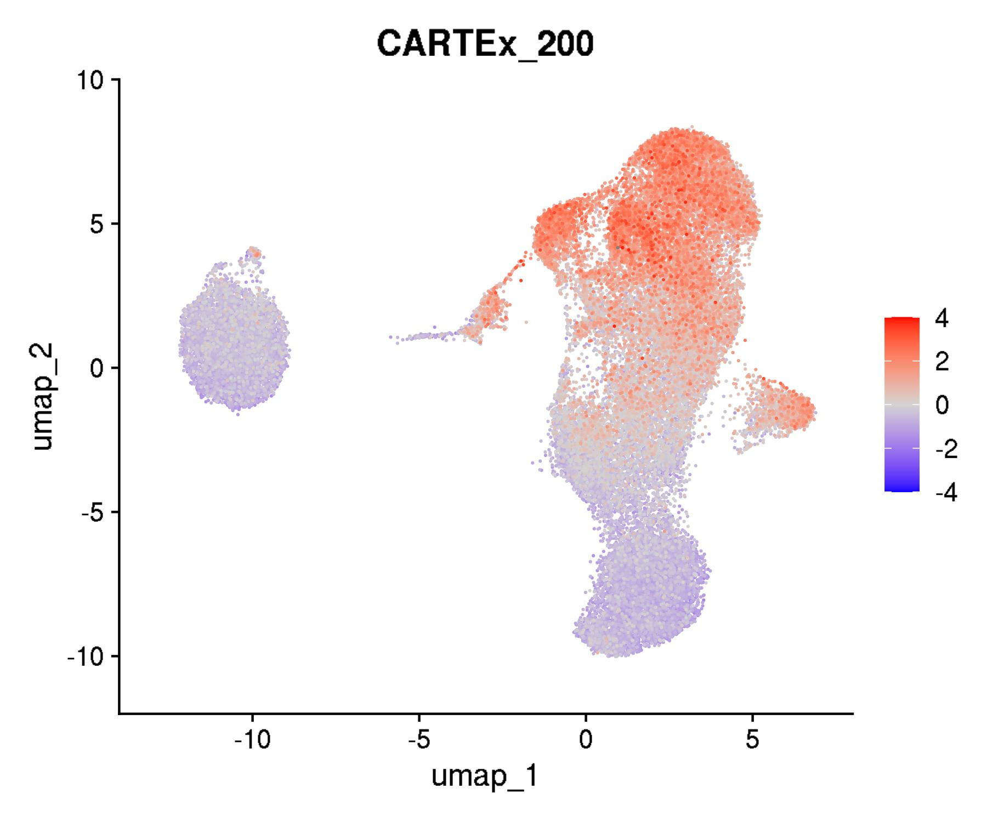
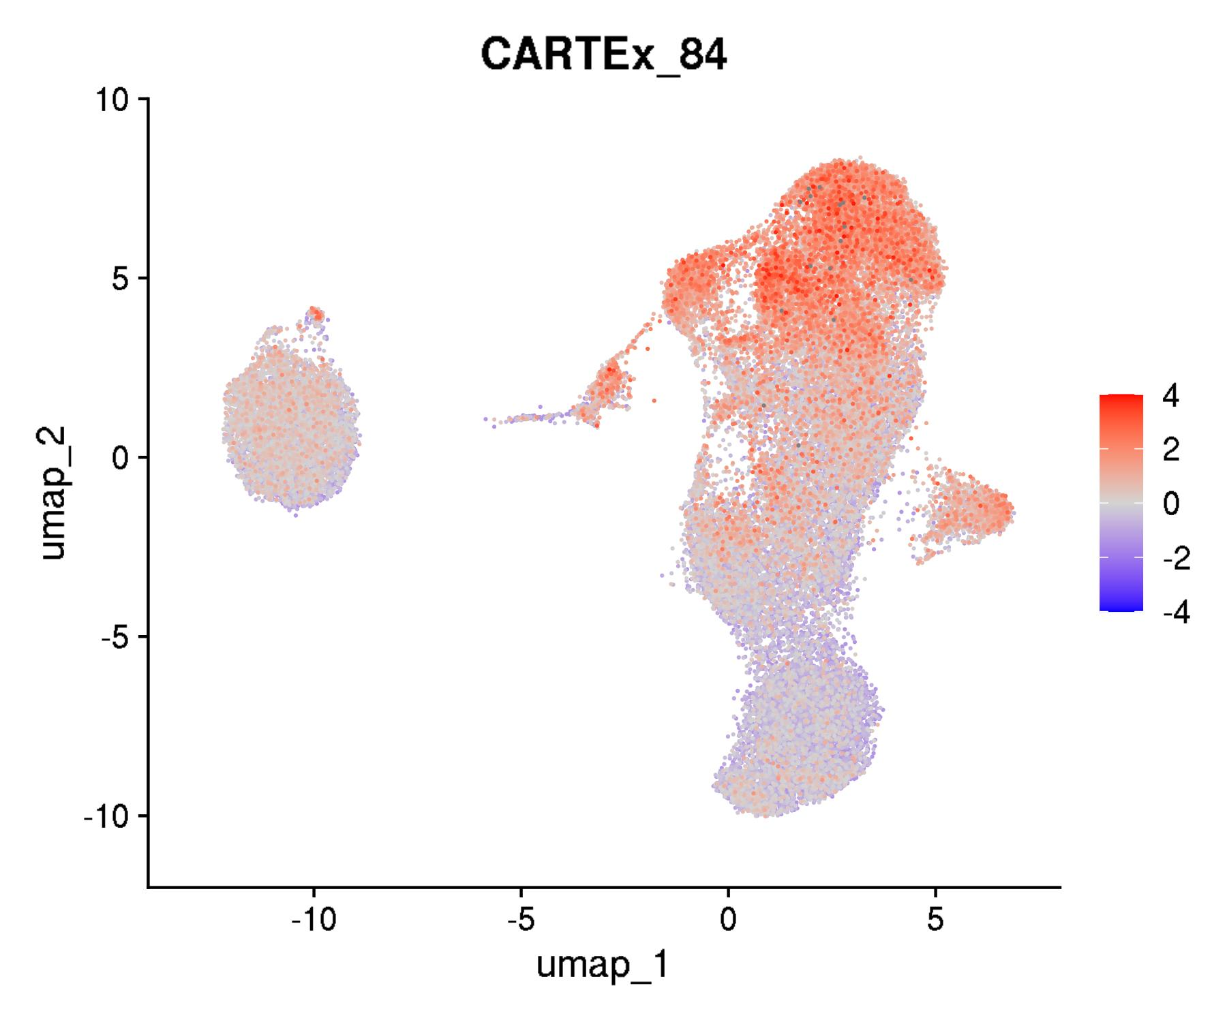
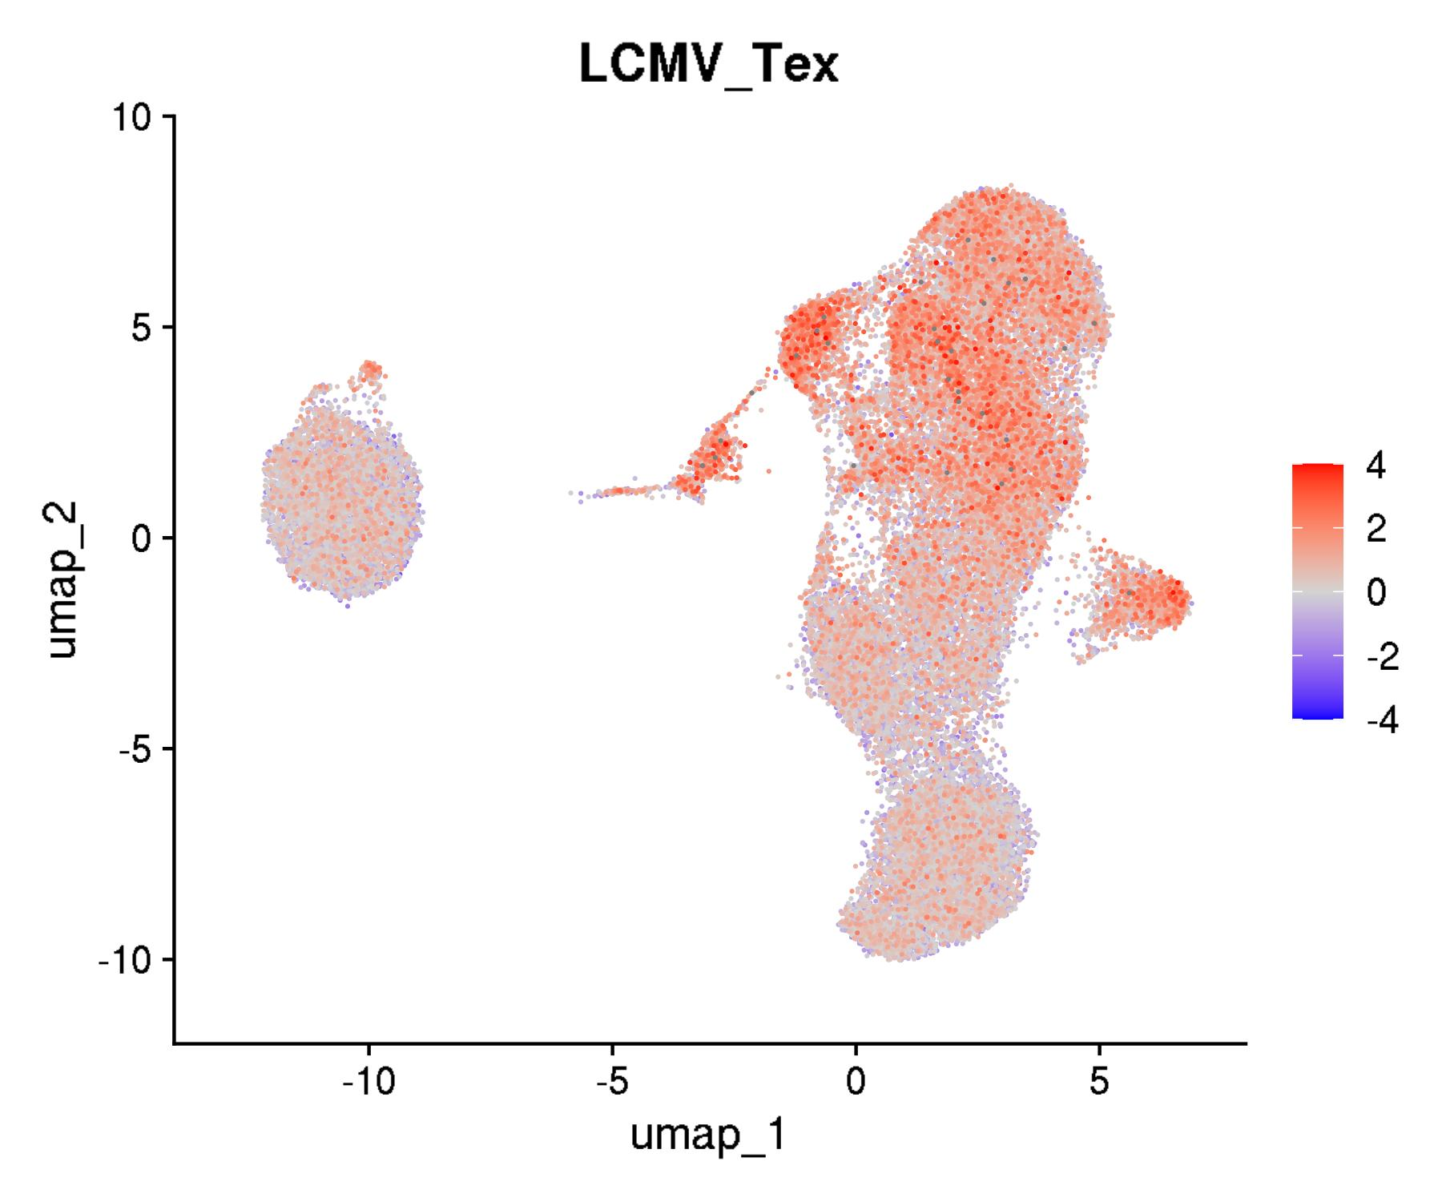
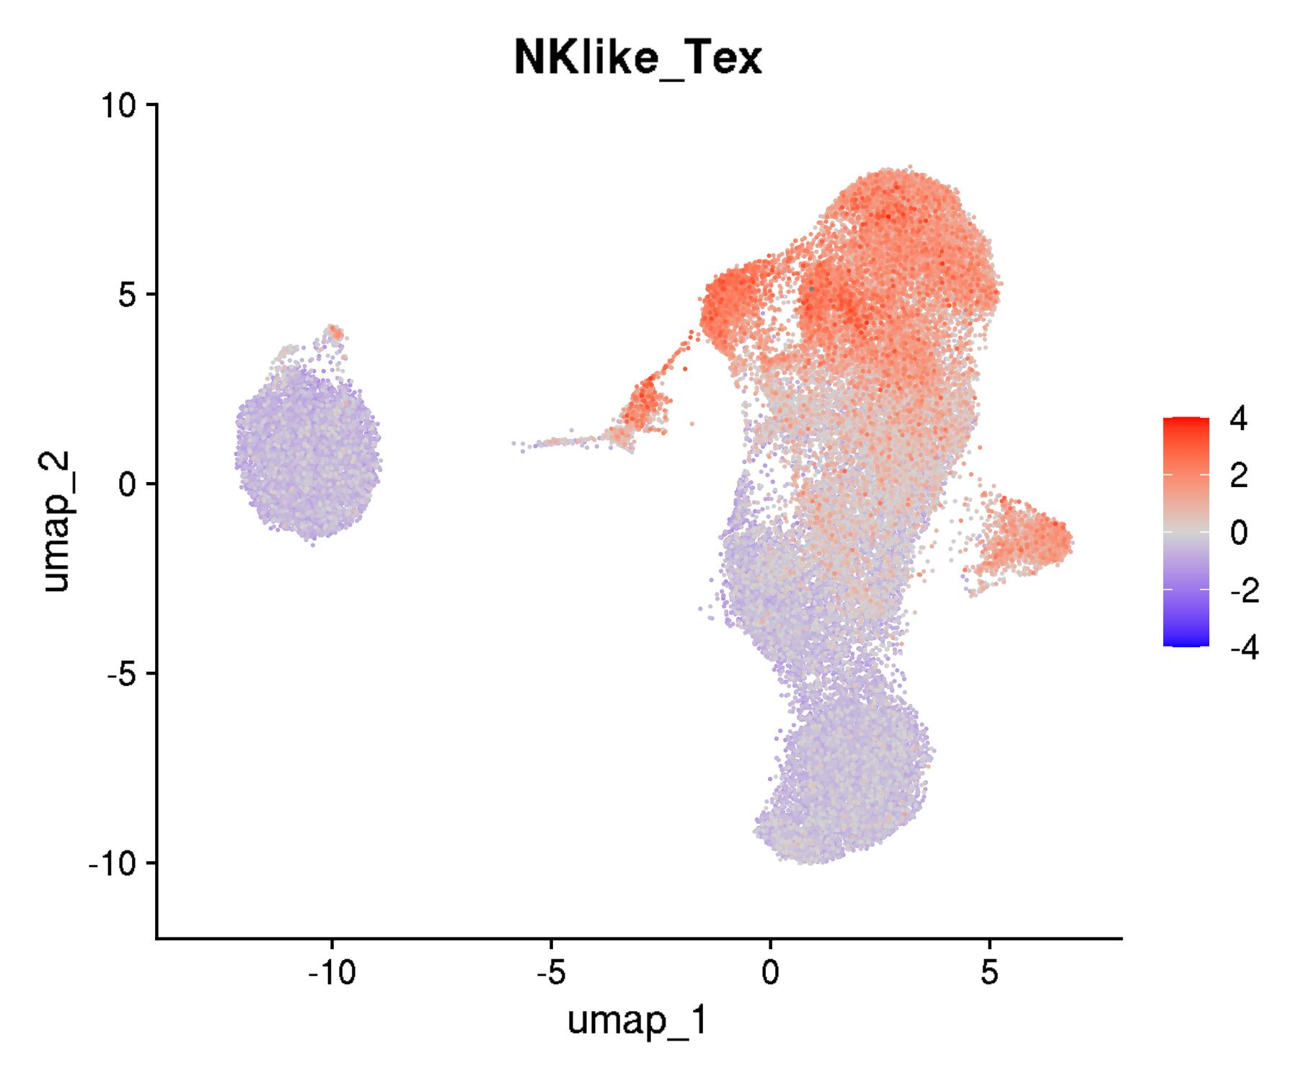

GSE136184: CD8+ T cells across 9 decades of life
UMAPs for exhaustion scores

Slide 5
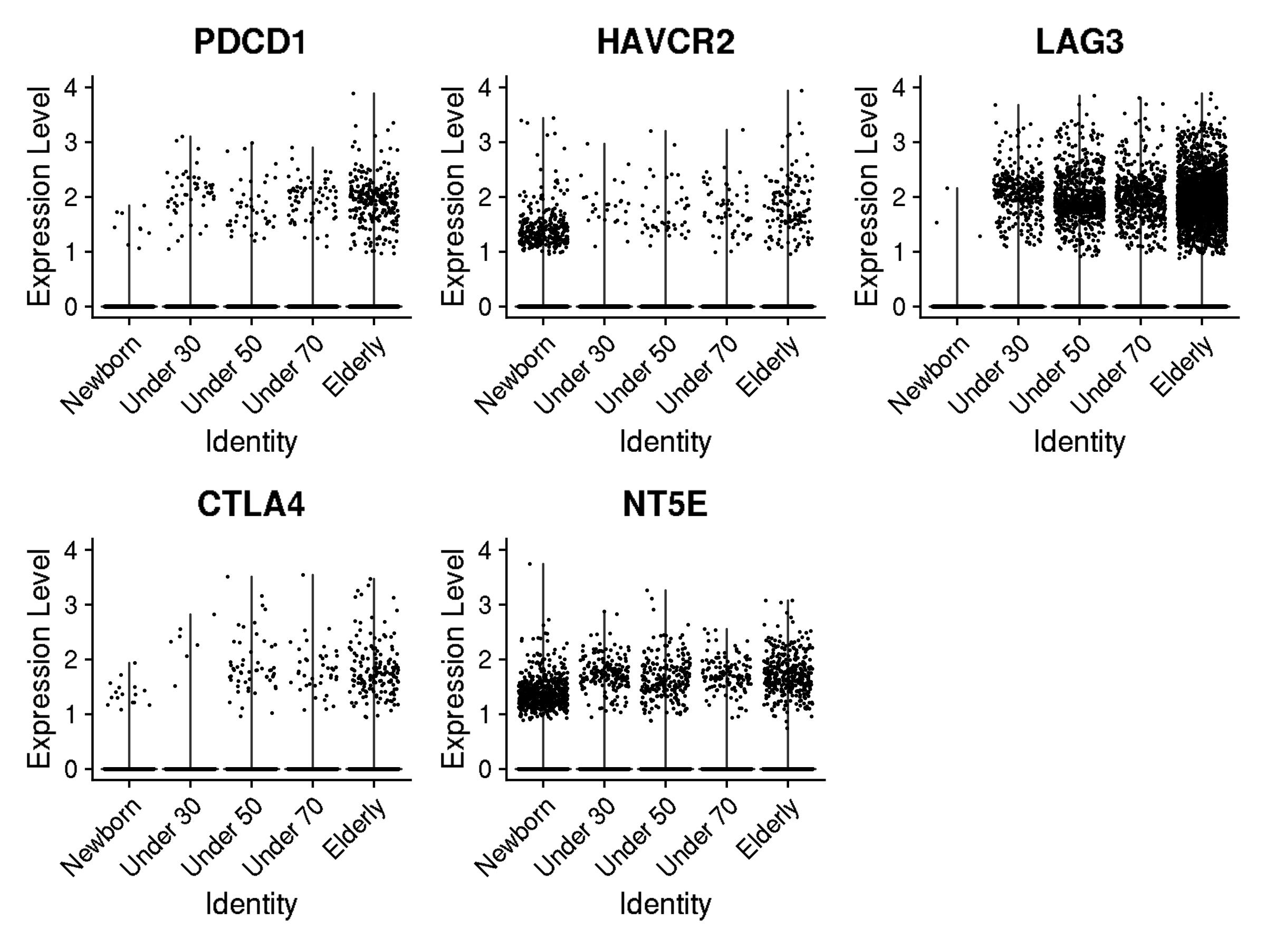
GSE136184: CD8+ T cells across 9 decades of life
Violin plots for canonical exhaustion markers
Gene and corresponding protein
PDCD1 encodes PD-1
HAVCR2 encodes TIM-3
LAG3 encodes LAG-3
CTLA4 encodes CTLA-4
NT5E encodes CD73

Slide 6
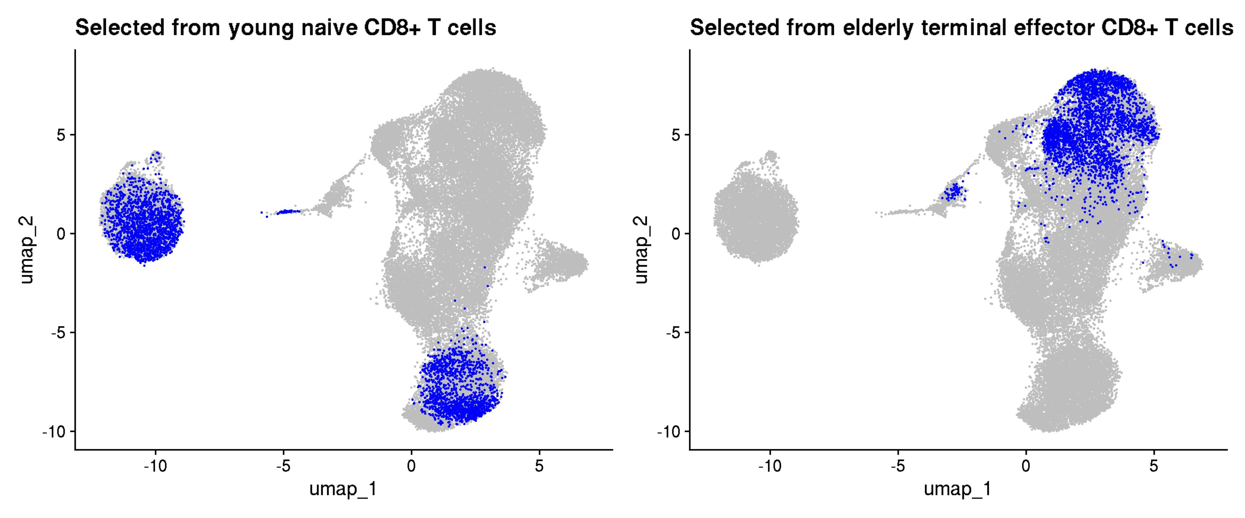
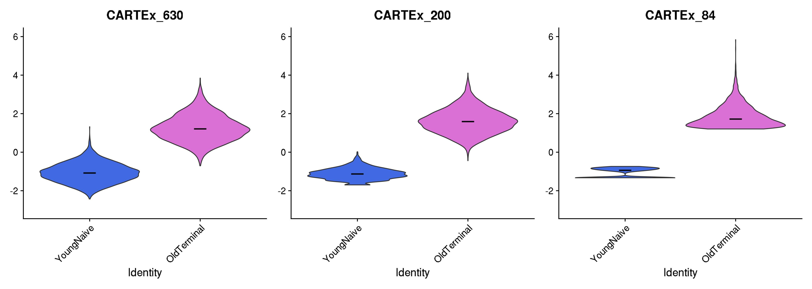
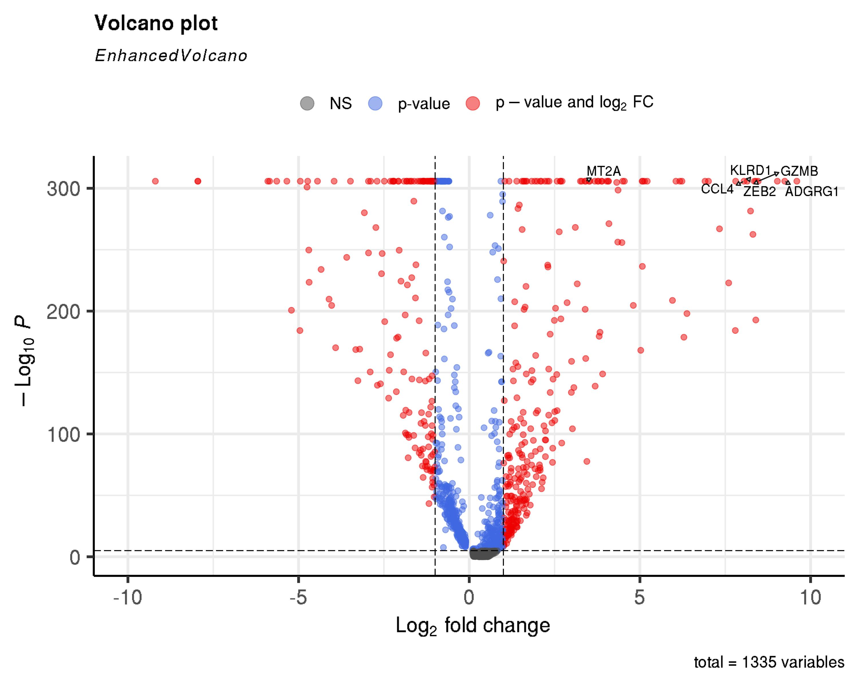
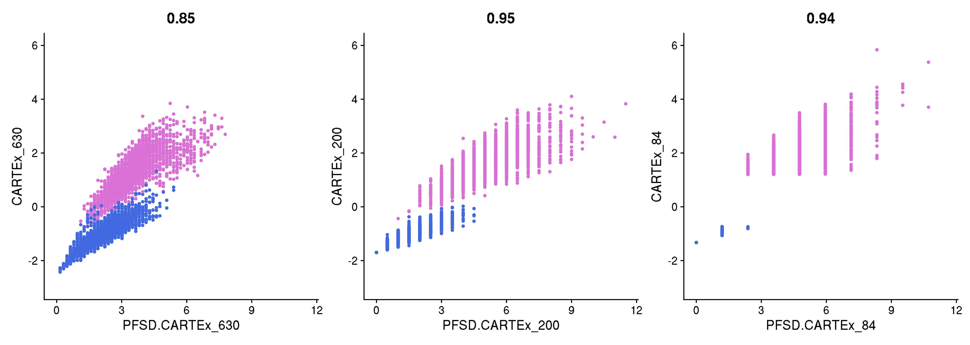
GSE136184: CD8+ T cells across 9 decades of life
Extraction of young naive T cells and old terminal effector T cells

