Slide 1
AUTOMATING LINUX SYSTEM

Slide 2
Nội dung
Applying Practical Automation
Using script for automating admin on multi system
Distributing Login Scripts
Tasks setup new system
Creating a Custom Configuration Approach

Slide 3
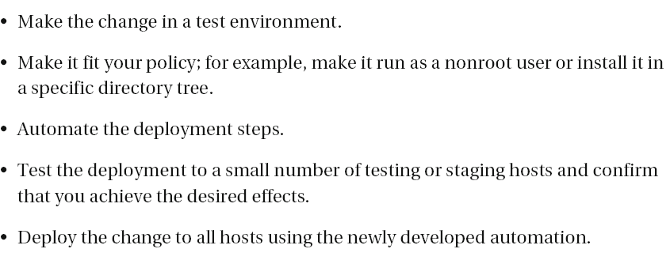
overview of automated change development process

Slide 4
Example Automation
illustrate important points about creating automated procedures
Steps
  set of manual steps frequently performed at most sites
  Turn it into an automated procedure

Slide 5
Scripting a Working Procedure
Scenario
  SA needs to create user accounts regularly
  create a directory on a central Network File System (NFS) server
  send off a welcome e-mail

Slide 6
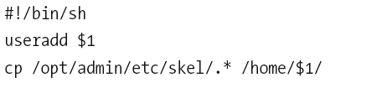
begin automation process
take all commands and put them into a shell script

Slide 7
Distribution script
another SA cannot use it easily
Need addition
  Usage syntax
  Test correct host
  If account is created ?
  Create e-mail with content

Slide 8
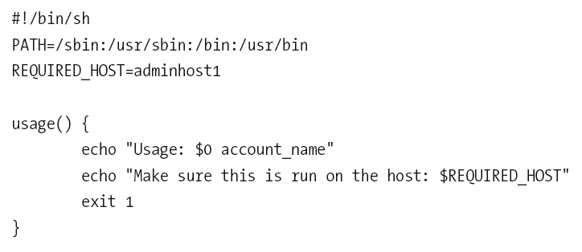
Script ver 2

Slide 9
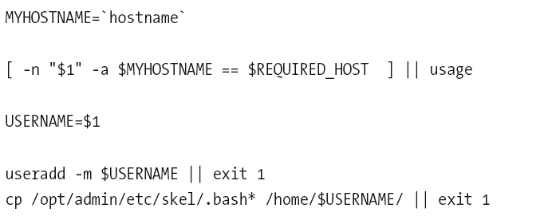

Slide 10
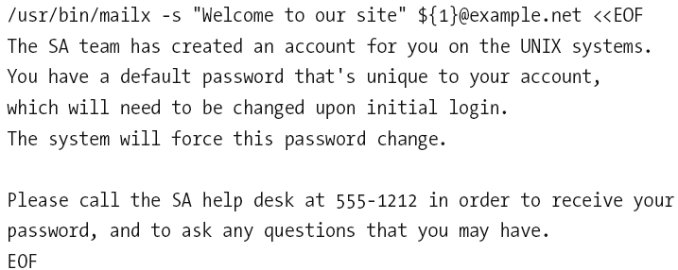

Slide 11
Turning Script into a Robust Automation
some improved error messages,
rollback step.

Slide 12
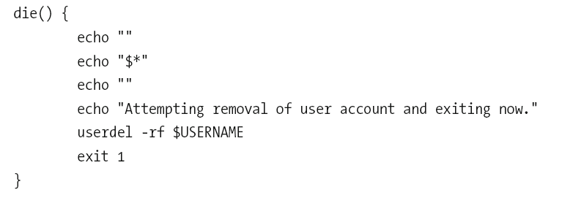

Slide 13
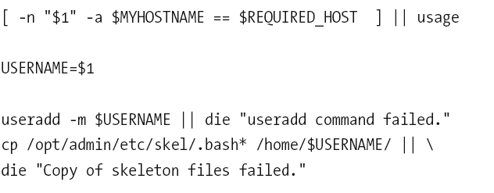

Slide 14
Using script for multi system
Create Commands That Affect Multiple Systems
  Simple Multi-SSH
    simple shell script that executes specified command on every machine listed in configuration file
  Group-Based Multi-SSH

Slide 15
SSH review
Remote connect into another PC
Authentication
  Password
  Certificate

Slide 16
Certificate authentication
Generating Key Pair
Specifying Authorized Keys
private key alone allows to access account

Slide 17
Generating Key Pair
On client PC
Ssh-keygen -t rsa -b 2048
→ Generating public/private key
In ~/.ssh/
  Private key: id_rsa
  Public key: id_rsa.pub

Slide 18
Specifying Authorized Keys
Put public into authorized file (on remote PC)
Cp ~/.ssh/id_rsa.pub ~/.ssh/authorized_keys

Slide 19
private key alone allows to access account
Modify file /etc/ssh/sshd_config
Change
  PasswordAuthentication: yes → no

Slide 20
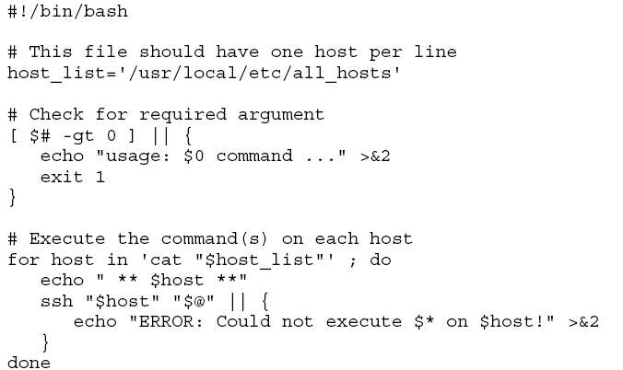
Simple Multi-SSH

Slide 21
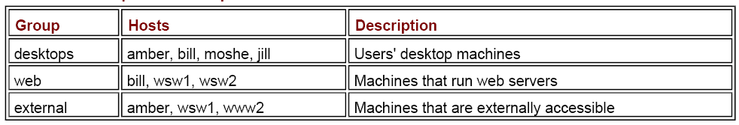
Group-Based Multi-SSH
run a command on a certain subset of machines
  instead of being forced to run it on every machine in every circumstance

Slide 22
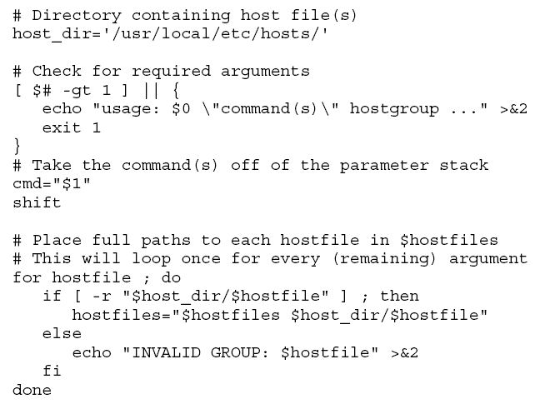

Slide 23
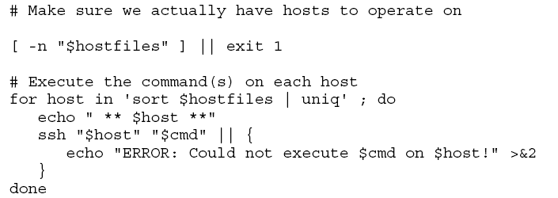

Slide 24
Copying Files
copy 1(more) local files, recursively, to a given directory on multiple PC.
1st arg
  (list)local file
2nd arg
  destination directory.
  Following file(s) & destination directory is 1(more) group names.

Slide 25
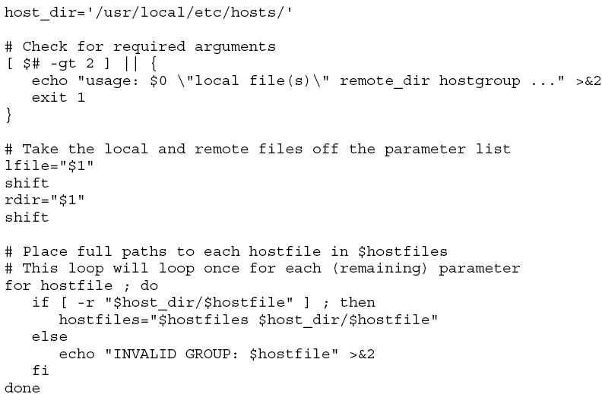

Slide 26
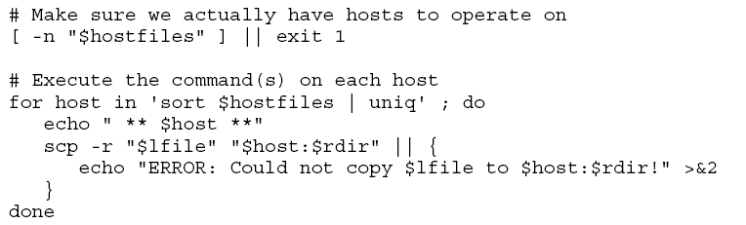

Slide 27
Distributing Login Scripts
Creating a Central Configuration File
Creating Distribution Script

Slide 28
Startup Scripts
determining & controlling a user’s environment
Stored under user’s home dir.
contain a series of commands to be executed when a user logs in
.bashrc file
Default file
  /etc/skel directory

Slide 29
Other Scripts
.xinitrc
  script overrides default script
  when you log into X Window .
.Xdefaults
  contains defaults
  can specify for X Window apps

Slide 30
Create a Central Configuration File
configuration file uses 1 line per account
Each line contains one entry in following format: user@host

Slide 31
Example
kirk@kaybee.org
root@kaybee.org
kirk@desktop.work.com
root@desktop.work.com
root@www1.work.com
root@www2.work.com
amber@sca.org

Slide 32
Sharing root Account
root account is shared among several users --> login scripts execute when log in to root account
Removes need to modify root's home directory at all.
alias su="su -c 'bash –rcfile ~$USER/.bashrc'"

Slide 33
Creating Distribution Script
assume
  same authorized_keys file on each host
first
  set up SSH authorized_keys file in remote account
Remaining
  scp is used to transfer any remaining files

Slide 34
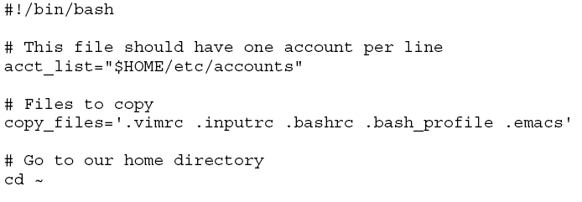
Script

Slide 35
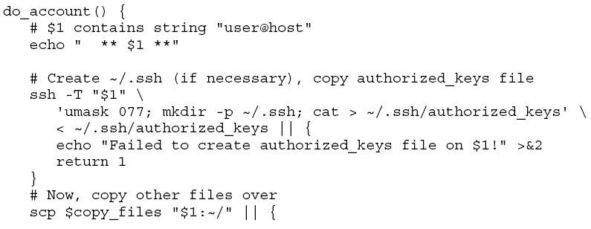

Slide 36
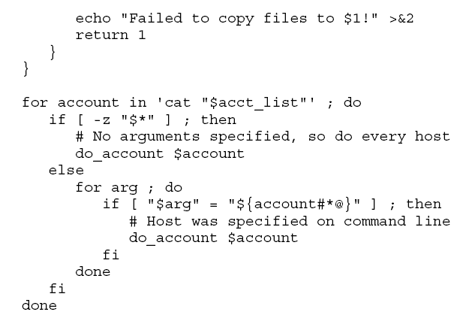

Slide 37
Tasks setup new system
Locking
Allocating an IP address
Adding new host to system lists
Configuring Dynamic Host Configuration Protocol (DHCP) server
Configuring Domain Name System (DNS)
Updating /etc/hosts file

Slide 38
Lock
prevent 1(more) person (or process) from doing same thing at once
Task
  lockfile
  prevent having 2 sessions of program running at same time
  2 try to add a new system at same time

Slide 39
simple locking system
prevent a program from being run multiple times simultaneously on same system
can be added to top of script
sure script only exists on system.

Slide 40
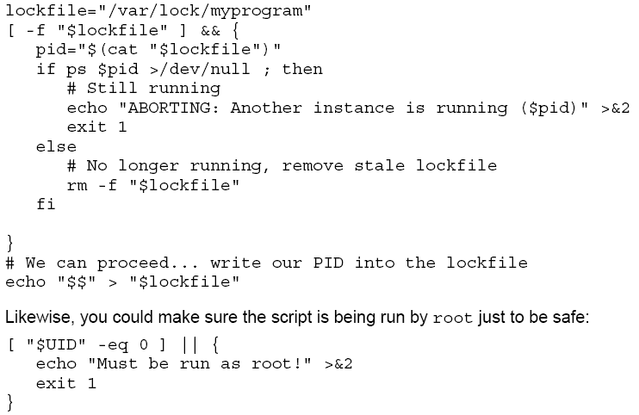
Locking Script

Slide 41
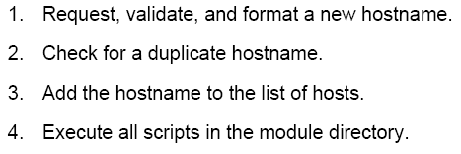
Base Pre-Installation Script

Slide 42
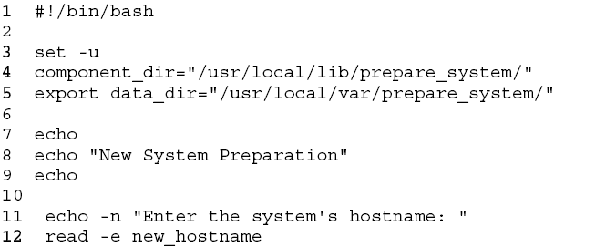
Script

Slide 43
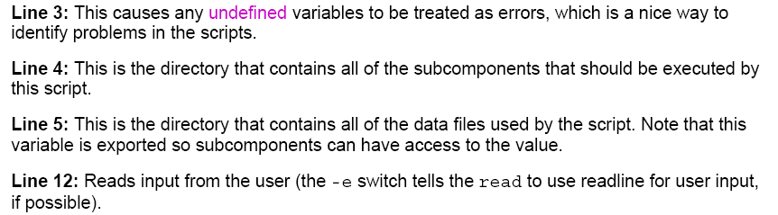
Comment

Slide 44
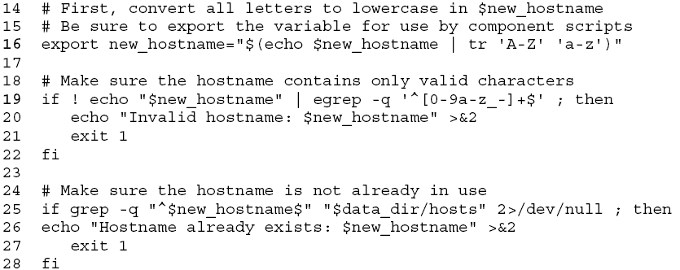

Slide 45
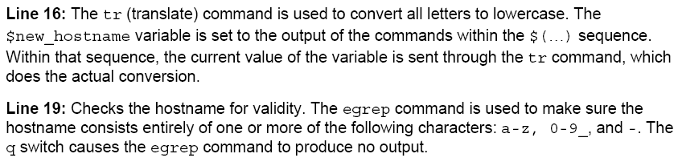

Slide 46
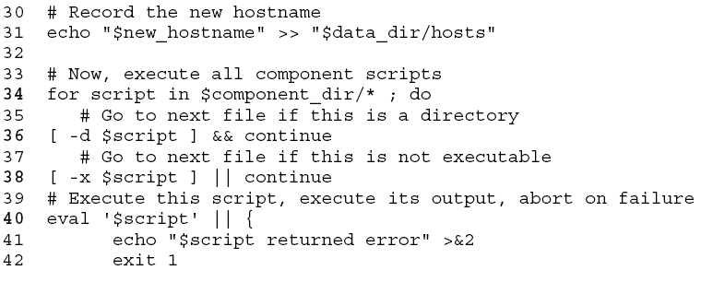

Slide 47
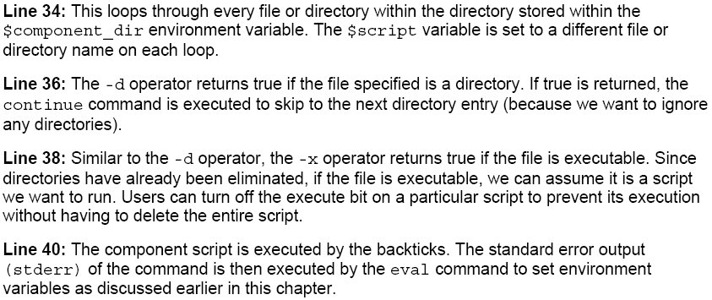

Slide 48
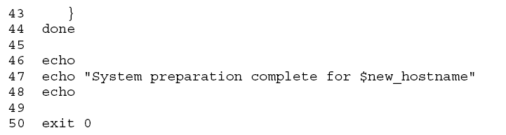

Slide 49
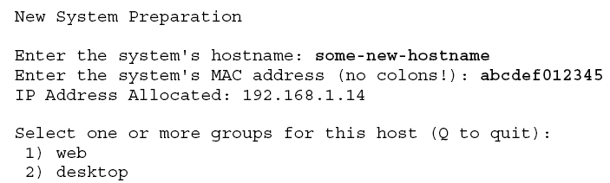
sample run of program

Slide 50
Pre-Installation Component Scripts
used to perform real setup tasks
Each script
  Has 2 environment variables $data_dir and $new_hostname
    be set by base script
  interact with user
    limit output on stdout to commands that should be executed by base script
    Output:string [true or false]

Slide 51
Pre-Installation Component Scripts
Assumption
  all operations should be performed on machine on which specific service is running

Slide 52
Example
DHCP & DNS changes are made locally
  changes would usually need to be made on other machines
→script can simply be split into 2 parts
  1 part can be placed on another system
  local script execute remote script via SSH
    perform any operations that must be performed remotely

Slide 53
Example – Other solution
create shared files among systems
check to see if configuration file has changed.
→ service can be restarted or reloaded if need

Slide 54
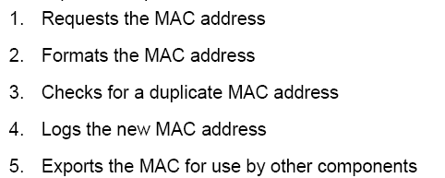
Requesting MAC Address

Slide 55
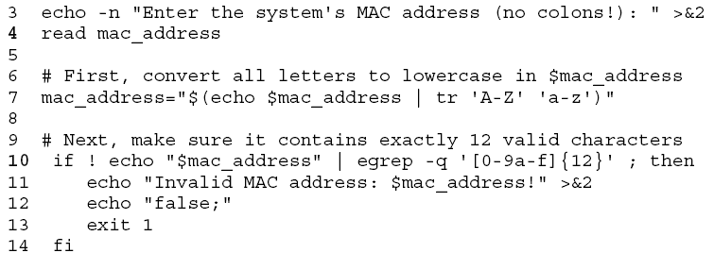
00getmac.sh

Slide 56
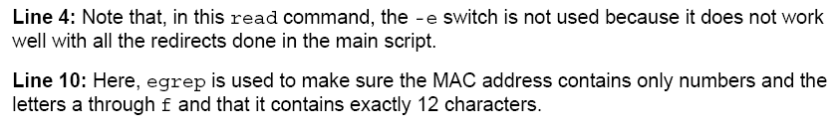

Slide 57
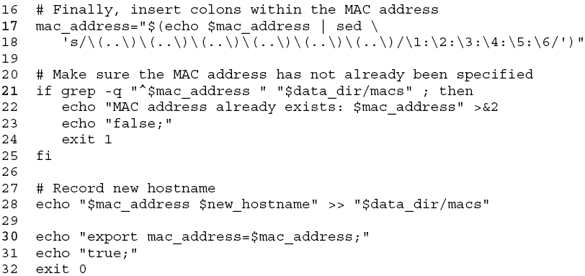

Slide 58
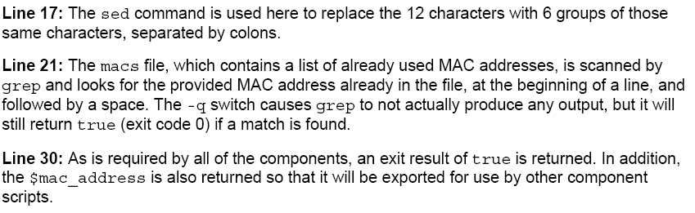

Slide 59
Allocating an IP
allocates an IP address for the new machine.
address has been allocated, it is removed from list of available IPs.
available file (in data directory) contains 1 available IP address per line

Slide 60
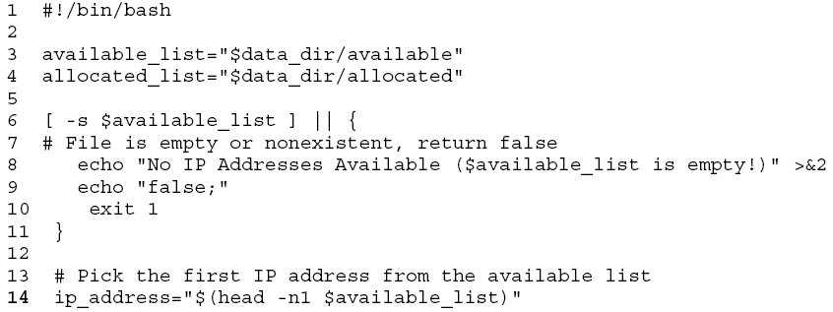

Slide 61
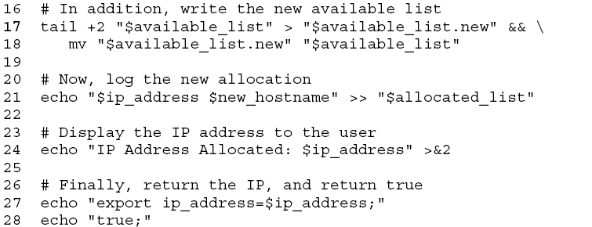

Slide 62
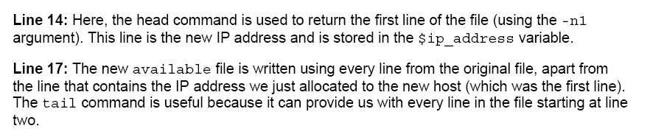

Slide 63
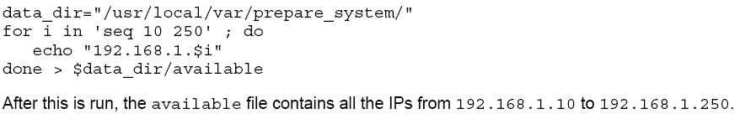
running on command line

Slide 64
Classifying System
lets user place new host in 1(more) groups
Each group contain systems with something in common

Slide 65
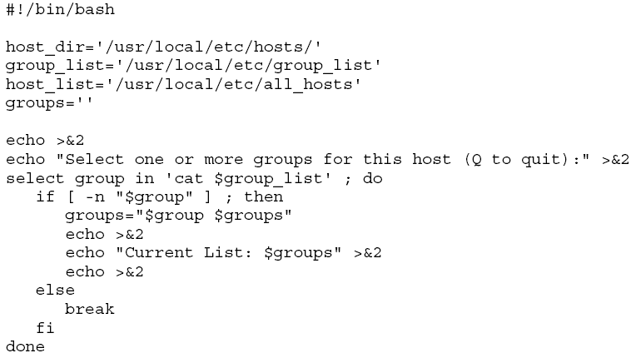

Slide 66
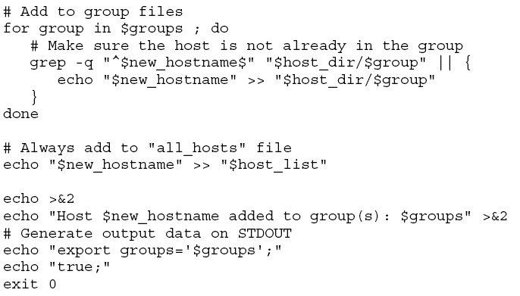

Slide 67
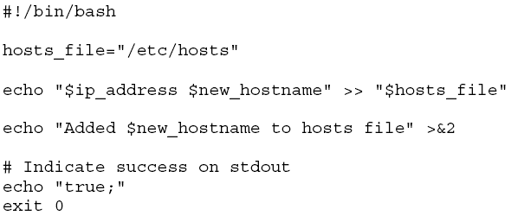
Adding to /etc/hosts File

Slide 68
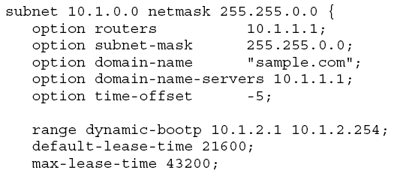
Configuring a DHCP Server

Slide 69
Edit config file DHCP
Using Perl script

Slide 70
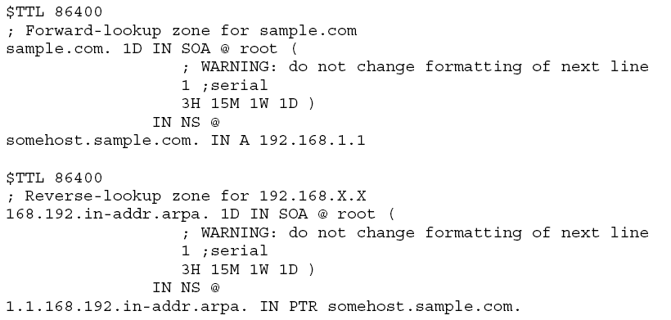
Updating DNS Configuration

Slide 71
Example: change
script
  updates serial numbers in these zone files
  adds appropriate entry to end of each file

Slide 72
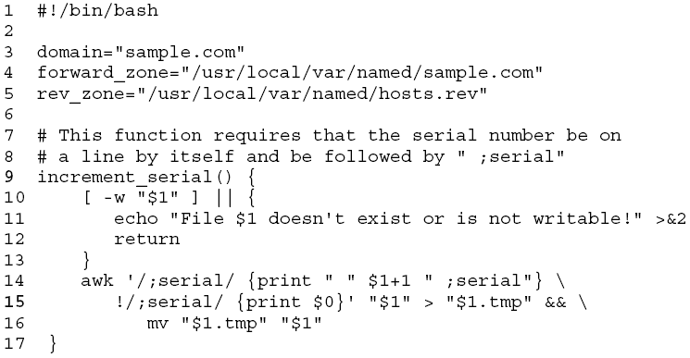

Slide 73
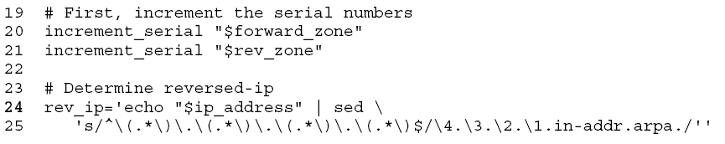

Slide 74
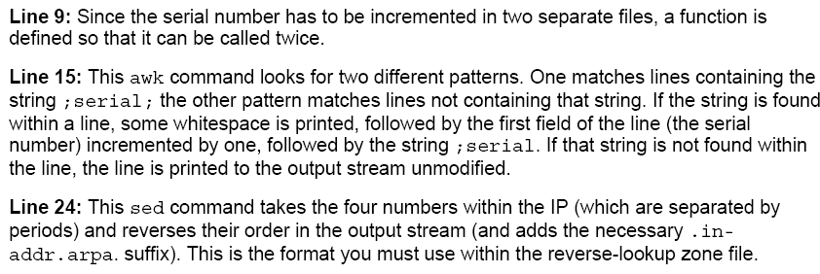

Slide 75
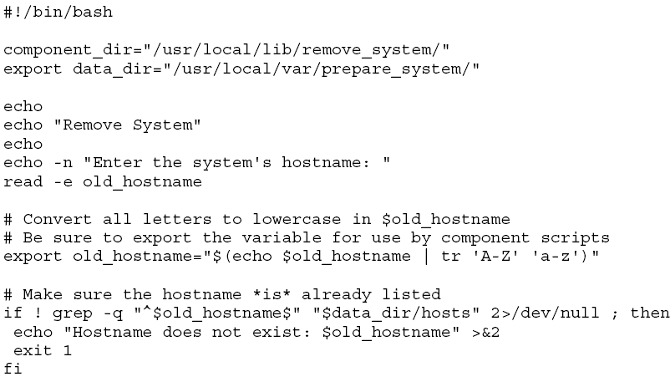
Removing Machines

Slide 76
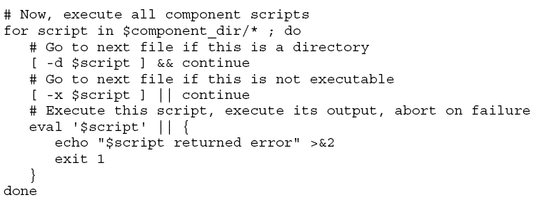

Slide 77
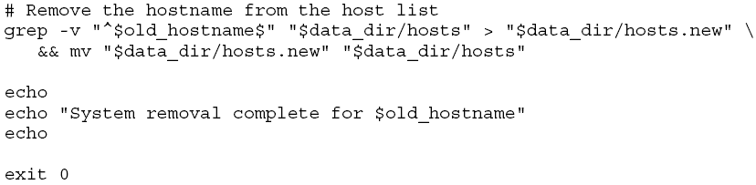

Slide 78
Removing MAC Addresses
Find hostname
set $mac_address environment variable that can be used by other removal component scripts.
removes that line from file.
sed command used in script

Slide 79
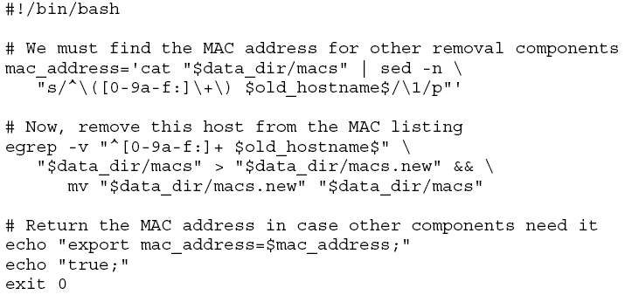

Slide 80
Reclaiming IP
finds IP assigned to hostname
removes record
returns IP address for future use

Slide 81
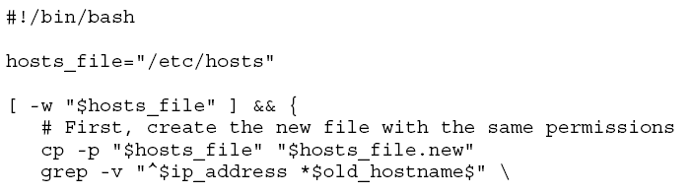
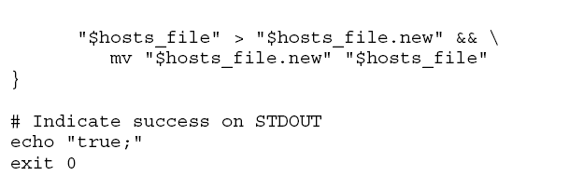
Modifying Hosts File

Slide 82
Remotely Config New System
Enabling Remote Access
Transferring Data
Configuring System

Slide 83
Transferring Data
use SCP or RCP to transfer files to that system
example
  use AutoRPM to install RPMs on each system from a central server.

Slide 84
files need be transferred to each new system
initial_setup.sh
  script performs the initial setup of the new system.
ssh_public_key
  public key that needs to be placed in ~root/.ssh/authorized_keys
autorpm-2.9-1.noarch.rpm
  AutoRPM program
sysadmin_crontab
  crontab file that needs to become the sysadmin user's crontab

Slide 85
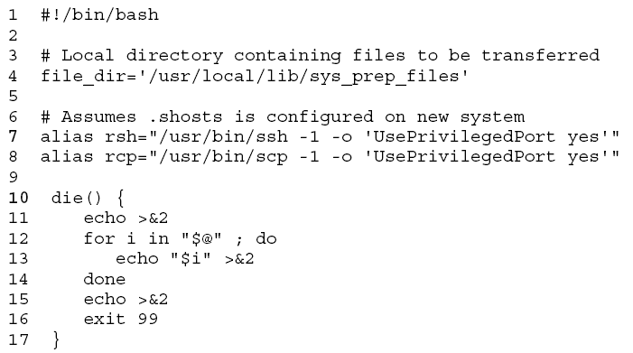

Slide 86


Slide 87


Slide 88


Slide 89


Slide 90

Configuring System

Slide 91


Slide 92


Slide 93
Creating a Custom Configuration Approach
Defining Files & Directory Structure
Defining Configuration Logic
Presenting Configuration Script
Exploring Example Configuration File Creation

Slide 94

/usr/local/etc/ directory

Slide 95

conf/ Directory
contains any number of configuration settings

Slide 96

files/ Directory
exact file you want on proper hosts
placed on each host unmodified except for certain metadata that is removed from file

Slide 97
templates/ Directory
processed for possible substitution of various settings from configuration files
separates templates from regular files
  IP_ADDRESS="${IP_ADDRESS}" SUBNET="${SUBNET}"

Slide 98

Defining Configuration Logic

Slide 99


Slide 100
Presenting Configuration Script
divided into two scripts
  config_all_systems
    executes configure_system script for each system and summarizes results
  configure_system script
    actual configuration on any one system

Slide 101

config_all_systems Script

Slide 102


Slide 103

configure_system Functions

Slide 104

do_template Function

Slide 105

push_file Function

Slide 106


Slide 107


Slide 108

configure_system Script

Slide 109


Slide 110


Slide 111


Slide 112


Slide 113


Slide 114

Exploring Example Configuration File Creation
/etc/resolv.conf File

Slide 115


