Slide 1



Hyungyu Lee
Copyright (C) Data Science & AI Laboratory, Seoul National University. This material is for educational uses only. Some contents are based on the material provided by other paper/book authors and may be copyrighted by them. Written by Hyungyu Lee <rucy74@snu.ac.kr> , September, 2019.

Slide 2
Assignment Objectives
Part 1: Data Curation
Practice loading and preprocessing of data using the notMNIST dataset
Implement a simple machine learning code using sklearn library
Part 2: Implementing Neural Networks from Scratch
Understand the deep learning models
Implement a simple deep learning model
Part 3: Neural Networks with TensorFlow
Understand the roles of hyperparameter
Practice TensorFlow code implementing deep learning models

Slide 3

notMNIST dataset
Consist of characters rendered in a variety of fonts on a 28x28 image
10 classes, with letters A-J
Training set: notMNIST_large (uncleaned, 500k instances)
Test set: notMNIST_small (hand-cleaned, about 19k instances)

Slide 4
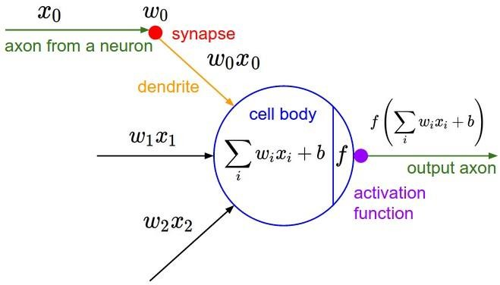
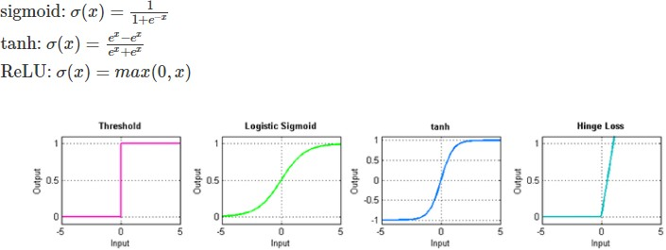
Training a Neural Network
Artificial Neuron
Activation Functions

Slide 5
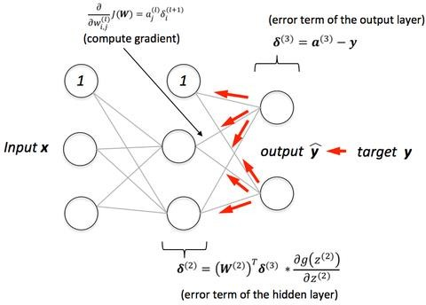
Training a Neural Network
BackPropagation
Correct parameter weights by calculating the derivatives of the cost function w.r.t. each parameter of the NN.
Optimized with (mini-batch, stochastic) gradient descent

Slide 6
Hyperparameters
Hyperparameters
Learning rate
Mini-batch size
Number of training iterations
Momentum
Weight initialization
– …
Choosing a set of optimal hyperparameters
Difficult
Relies on experiences

Slide 7
How to install assignment files
Assignment files
Utils/ (image file included for exaplanation)
data/ (empty)
Assignment1-1_Data_Curation.ipynb
Assignment1-2_NN_from_scratch.ipynb
Assignment1-3_NN_with_TF.ipynb
CollectSubmission.sh
Install assignment files
tar zxvf assignment1.tar.gz (decompress tar gz file)
sudo chmod 755 CollectSubmission.sh (get permission of script file)
Open the notebooks on your browser and get started

Slide 8
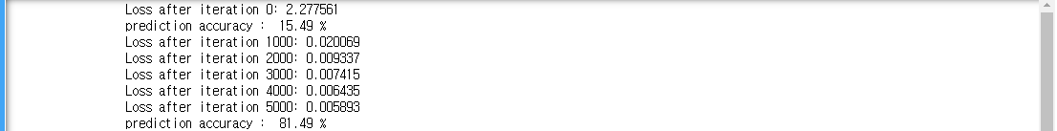
Output Examples
Assignment1-1_Data_Curationdata
Assignment1-2_NN_from_scratch
Assignment1-3_NN_with_TF

Slide 9
Important Notes
Team project (2 people 1 team)
Due: 10/7 23:59
PLEASE read the notes on the notebooks carefully
Google first before mailing TAs
Submitting your work
DO NOT clear the final outputs
After you are done all three parts
$ ./CollectSubmission.sh team_#
Upload the team_#.tar.gz on ETL
You may upload once per team using any account
TA email: deeplearning.snu@gmail.com

