Slide 1
Assignment 2
Saehyung Lee
Copyright © Data Science Laboratory, Seoul National University. This material is for educational uses only. Some contents are based on the material provided by other paper/book authors and may be copyrighted by them.

Slide 2
Assignment Objectives
Part 1: Implementing CNN
To understand CNN architecture before using the TensorFlow
Implement forward / backward passes for (1) convolution layer and (2) max pooling layer
Part 2: Training CNN
Learn how to define, train, and evaluate CNNs with TensorFlow
Explore various hyperparameters to design a better CNN model
Part 3: Visualizing CNN
Learn how to visualize and interpret a trained CNN model
Implement the codes for generating (1) image-specific class saliency maps, (2) class representative images, and (3) adversarial examples

Slide 3
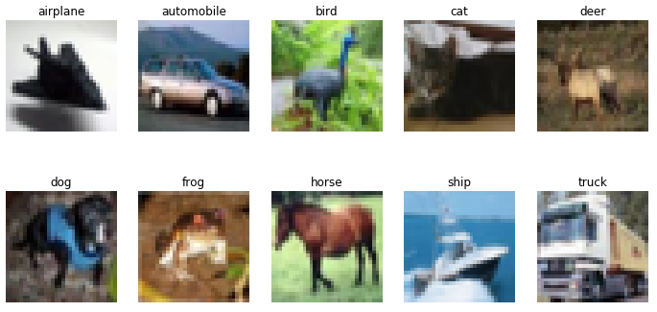
CIFAR10 Dataset
Consists of 32x32x3 color images in 10 classes
Training set: 40k instances *Model training
Validation set: 10k instances *Model evaluation and selection
Test set: 10k instances *Final model testing

Slide 4
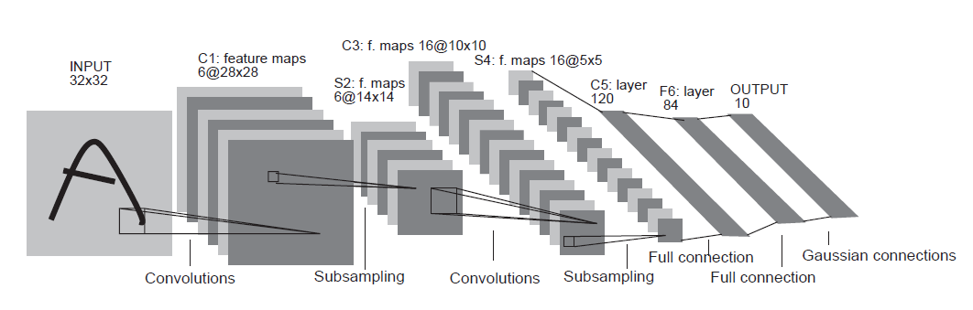

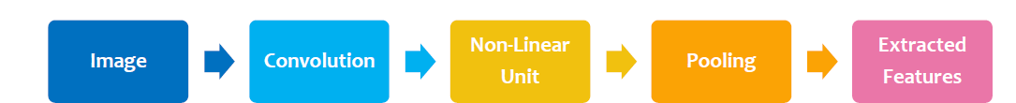
Convolutional Neural Networks (CNNs)
Simply neural networks that use convolution in their layers
Three key ideas behind CNN
Local connectivity
Invariance to location
Invariance to local transition
Convolution layer
Pooling layer

Slide 5
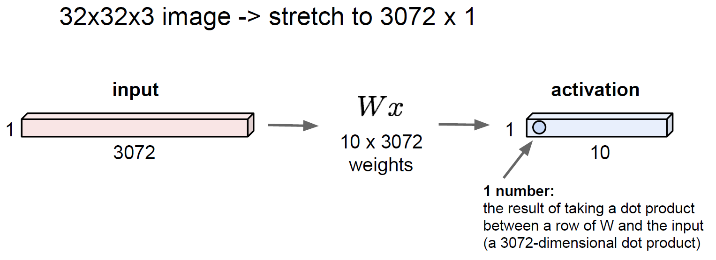
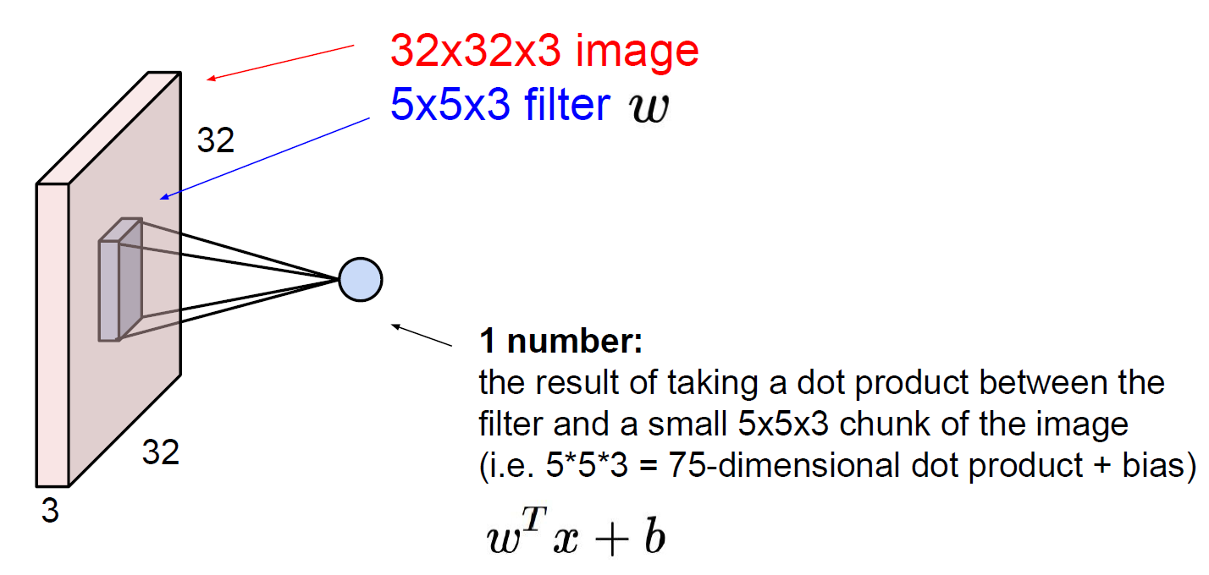
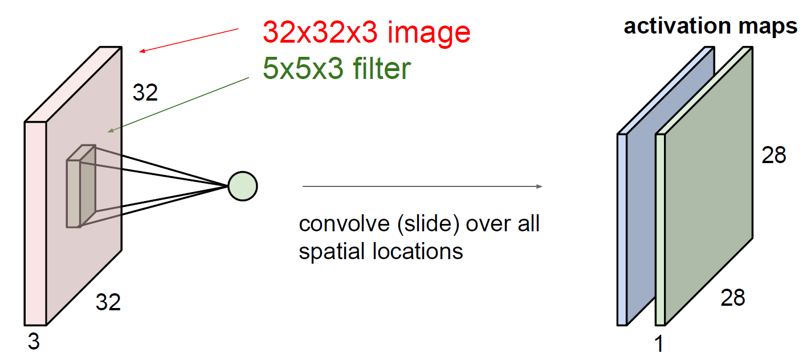
Fully Connected Layer and Convolution Layer
Fully connected layer
Convolution layer

Slide 6
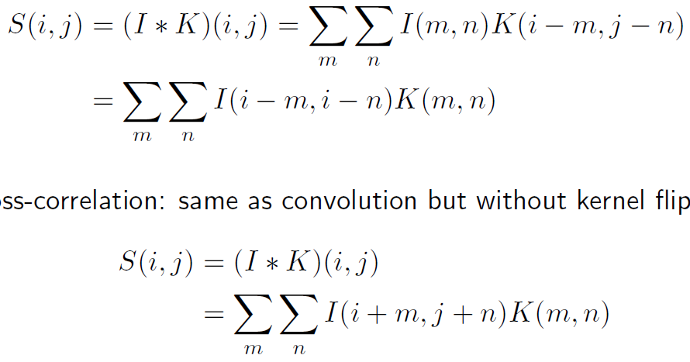
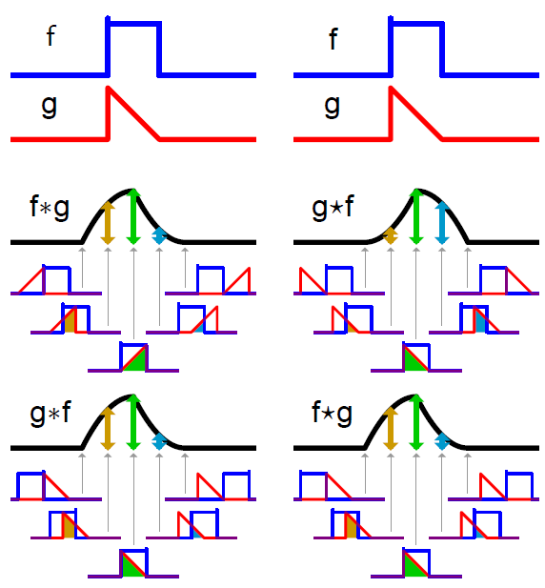
Convolution and Cross-correlation
Convolution
Many NN libraries implement cross-correlation but call it convolution (without kernel flipping)
Cross-correlation

Slide 7
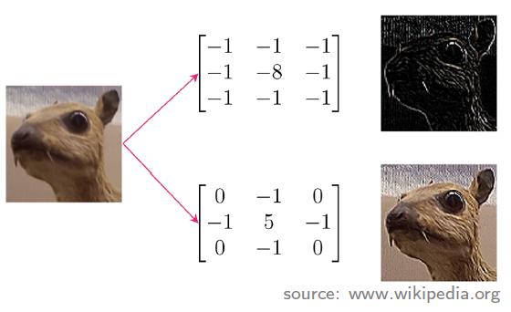
Convolution Layer
Input is convolved with a set of filters, giving feature maps (without kernel flipping)
Filter (aka kernel or convolution matrix)
Different filters extract different features (e.g. edges)
Filter weights: trained with data
Weight sharing & local connectivity

Slide 8
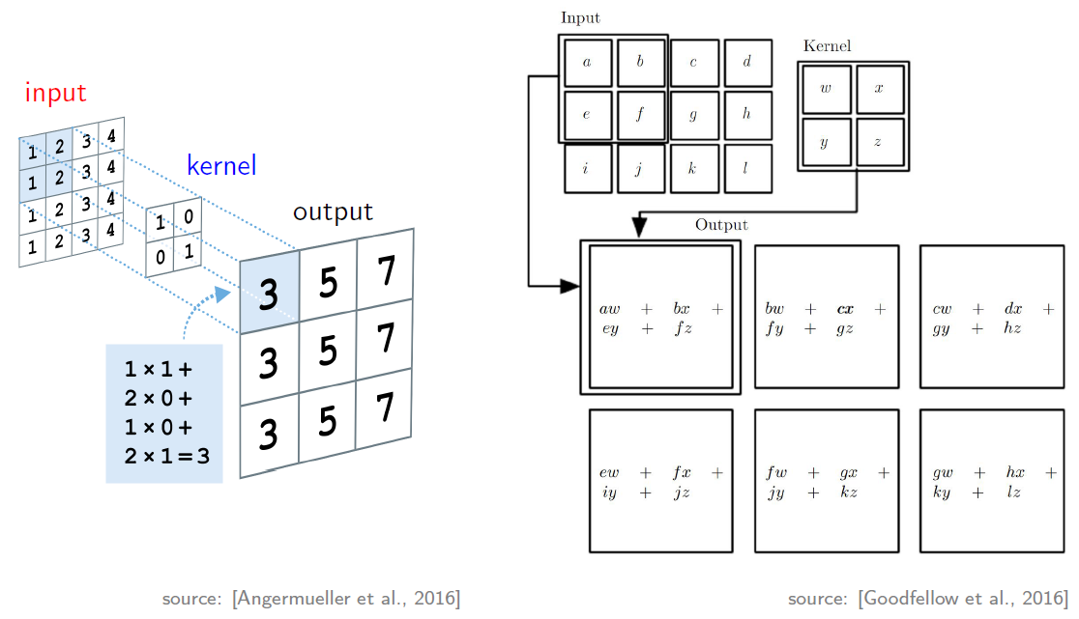
Convolution Example

Slide 9
Convolution with Stride
The number of pixels between adjacent receptive fields = down-sampling the output of full convolution function
7x7 input
3x3 filter with stride 1
➔ 5x5 output
7x7 input
3x3 filter with stride 2
➔ 3x3 output

Slide 10
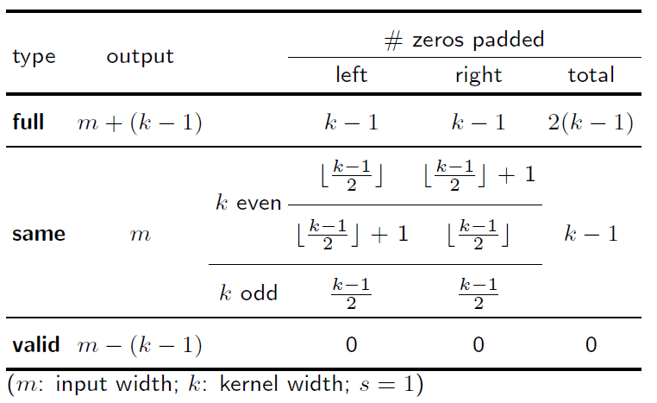
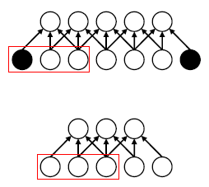
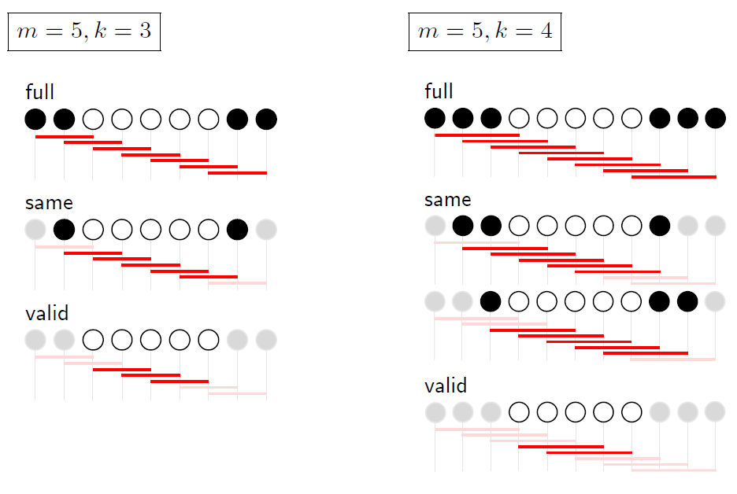
Zero-padding
Implicitly zero-pad input to make it wider
Examples

Slide 11
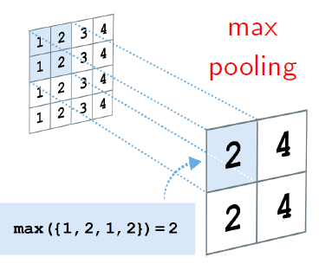
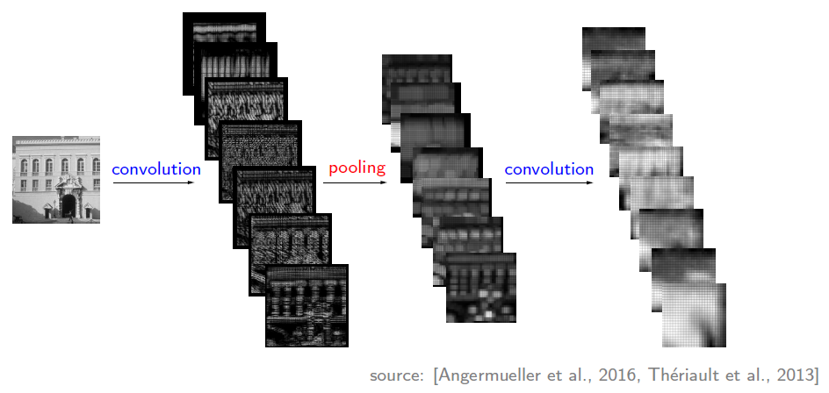
Pooling Layer
Nonlinear down-sampling
Aggregates statistics of local features (with max or average operation)
Reduced variance: provides invariance to local transformations

Slide 12
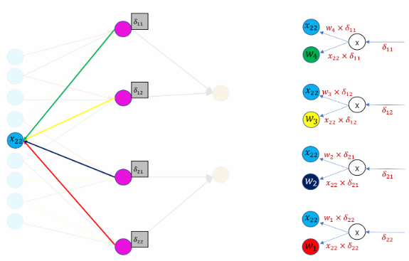
CNN Backpropagation - dW
source: https://becominghuman.ai/back-propagation-in-convolutional-neural-networks-intuition-and-code-714ef1c38199
source: https://ratsgo.github.io/deep%20learning/2017/04/05/CNNbackprop/

Slide 13
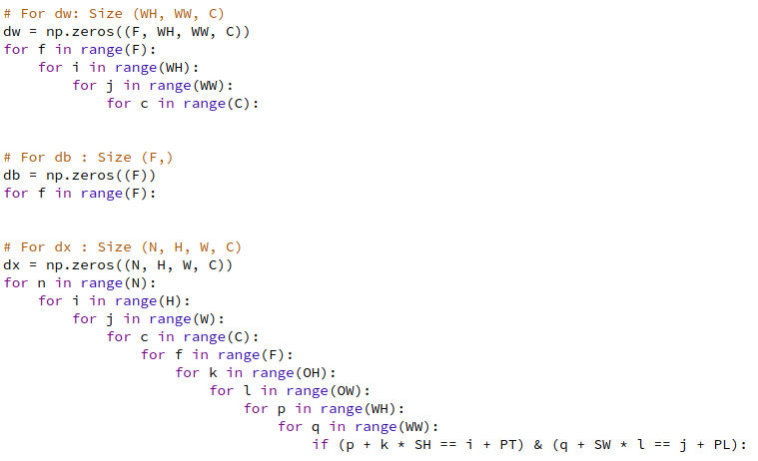
CNN Backpropagation

Slide 14
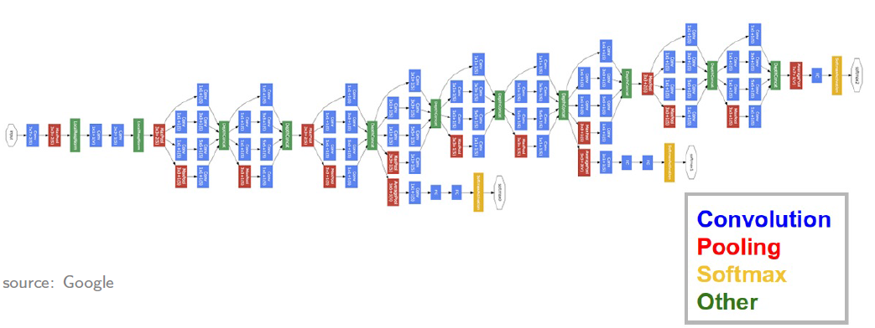
Inception model (a.k.a GoogLeNet)
Deeper network with computational efficiency
ImageNet Large Scale Visual Recognition Competition (ILSVRC) 2014 winner (6.7% top 5 error)
22 layers with 5 million parameters (12x less than AlexNet *ILSVRC 2012 winner)
Efficient “Inception” module

Slide 15
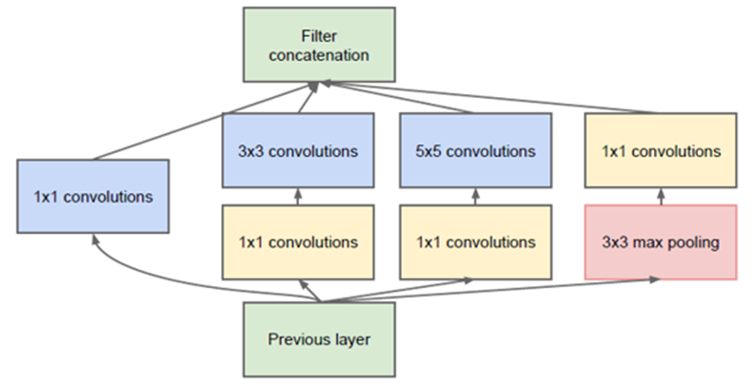
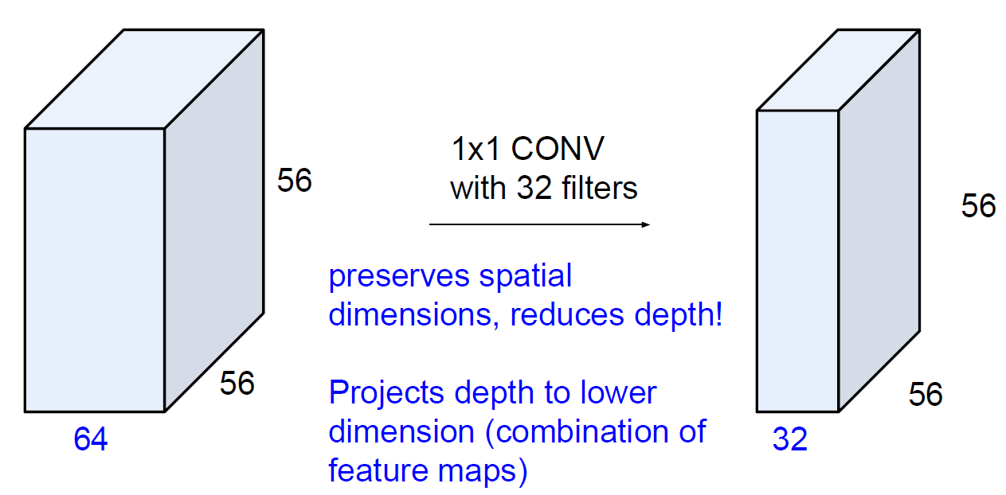
Inception module
Local network topology composing the Inception model
Apply parallel filter operations on the input from previous layer
Multiple filter sizes for convolution (1x1, 3x3, 5x5)
1x1 convolution for dimensionality reduction
Inception module
1x1 convolution

Slide 16
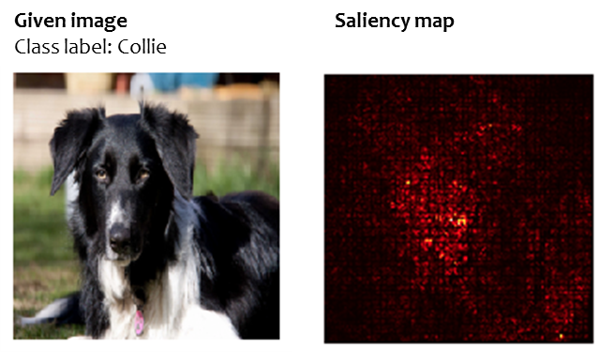
Image-specific class saliency maps
How to tell which pixels matter for classification?
Visualize the degree to which each pixel affects the classification
Compute gradient of unnormalized class score with respect to image pixels, take absolute value and max over RGB channels

Slide 17
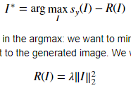
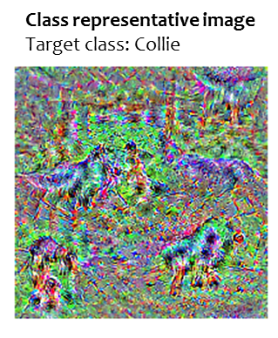
Class representative images
Generate an image I* that achieves a high score for the class y
Starting with a random noise, perform gradient ascent on a target class
L2 regularization and periodic Gaussian blur regularization

Slide 18
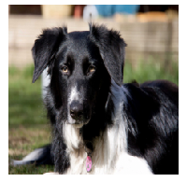
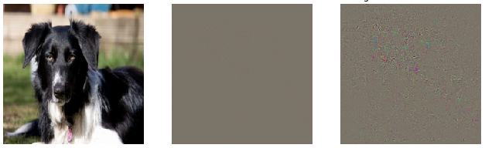
Adversarial examples
Make the CNN model to miss-classify a given image into a target class
Starting with a given image (cf. random noise), perform gradient ascent over the image to maximize the target class score
Stop when the network classifies the image as the target class
L2 regularization to normalize the gradients
Given image
Class label: Collie
Adversarial example
Target class: Tarantula
Difference
Magnified difference (10x)

Slide 19
How To Install Assignment Files
Assignment files
Utils/*
Assignment2-1_Implementing_CNN.ipynb
Assignment2-2_Training_CNN.ipynb
Assignment2-3_Visualizing_CNN.ipynb
CollectSubmission.sh
Install assignment files
tar zxvf assignment2.tar.gz
sudo chmod 755 CollectSubmission.sh
jupyter notebook
Open the notebooks on your browser and get started

Slide 20
Submitting your work
Submitting your work
DO NOT clear the final outputs
After you are done all three parts
$ ./CollectSubmission.sh team_#
Upload the team_#.tar.gz on ETL
Your team_# is in the excel file, http://etl.snu.ac.kr/mod/ubboard/article.php?id=724723&bwid=1535905

Slide 21
Important Notes
DUE : 10/28/2019, We do not accept late submissions!
PLEASE read the notes on the notebooks carefully
Google first before mailing TAs
TA email: deeplearning.snu@gmail.com

